Slide 1
ICCP COMMISSION III
Self-Heating WG
2018 ROUND ROBIN EXERCISE Thermally altered coals
Convenors:
Dr. Jolanta Kus Dr. Magdalena Misz-Kennan
Dr. Deolinda Flores
Geochemistry of Oil and Coal (B 1.5)
Federal Institute for Geosciences and Natural Resources
Stilleweg 2
D-30655 Hannover
Germany
e-mail: J.Kus@bgr.de

Slide 2
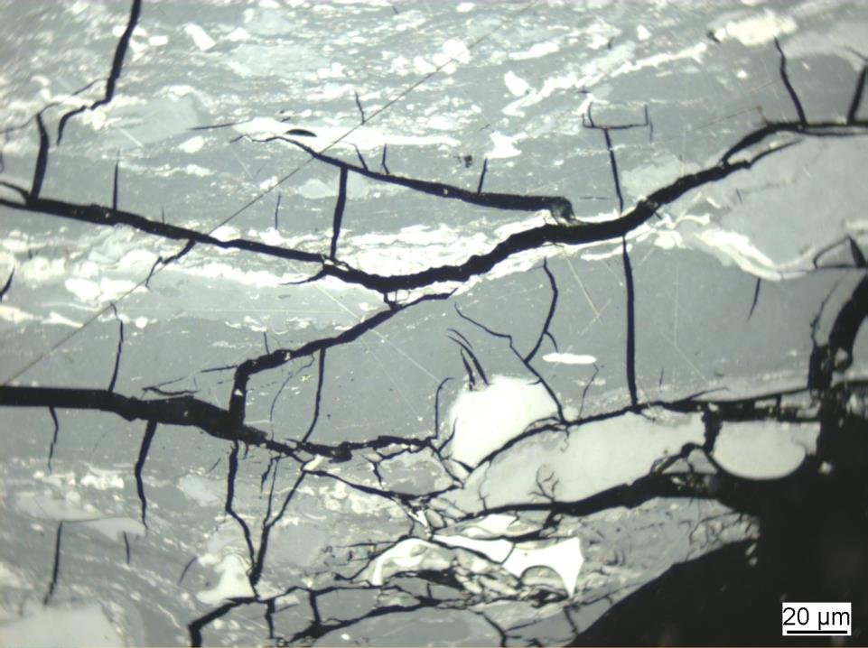
Photo 1.0
Vitrinite reflectance: 0.96% VRr; NA% VRmax
Reflectance values below 0.90% VRr and above 0.98 VRr are considered to
be oxidatively and thermally altered.

Slide 3
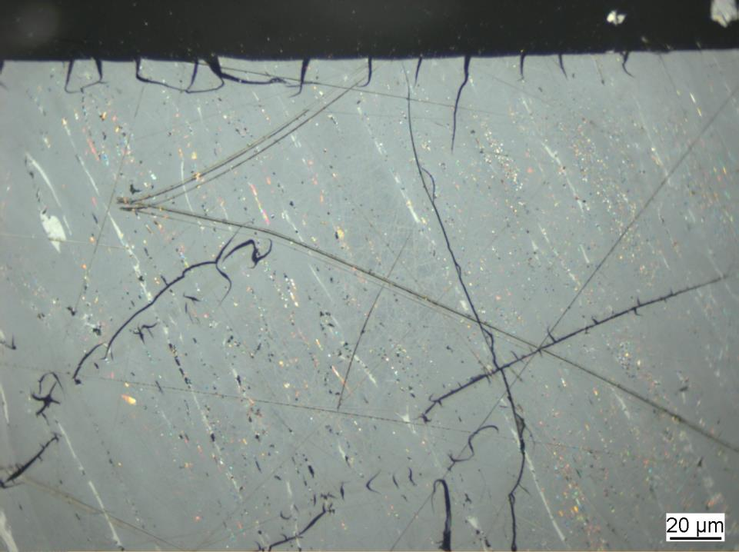
Photo 2.0
Vitrinite reflectance: 0.96% VRr; NA% VRmax
Reflectance values below 0.90% VRr and above 0.98 VRr are considered to
be oxidatively and thermally altered.

Slide 4
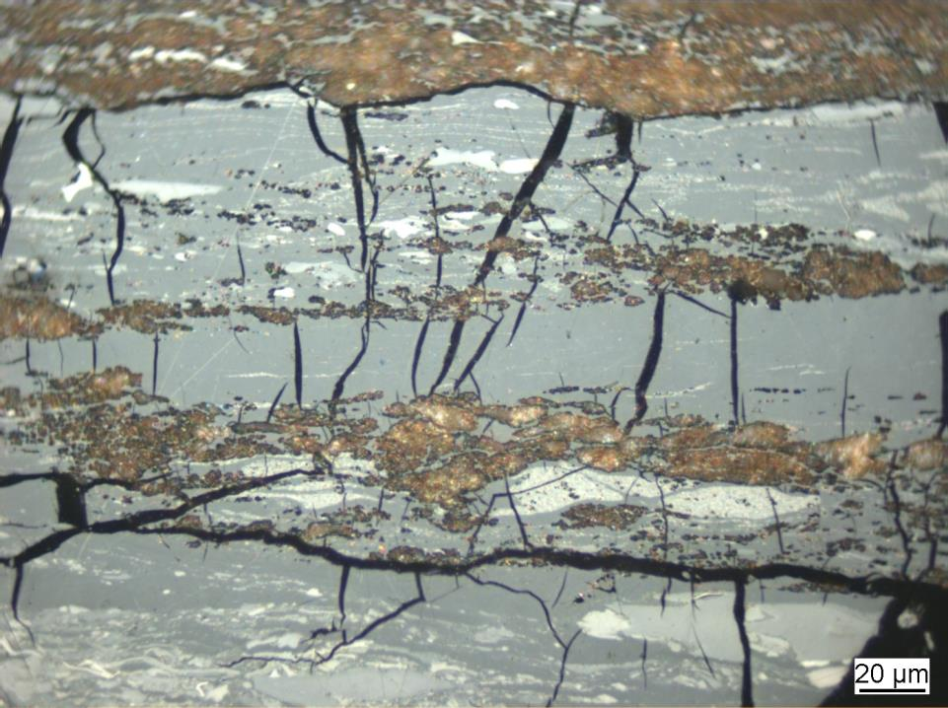
Photo 3.0
Vitrinite reflectance: 0.96% VRr; NA% VRmax
Reflectance values below 0.90% VRr and above 0.98 VRr are considered to
be oxidatively and thermally altered.

Slide 5
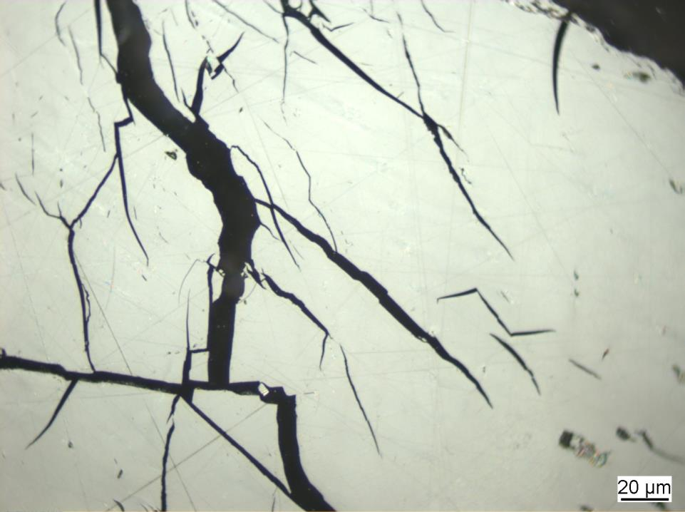
Photo 4.0
Vitrinite reflectance: 1.53% VRr; NA% VRmax
Reflectance values below 0.90% VRr and above 0.98 VRr are considered to
be oxidatively and thermally altered.

Slide 6
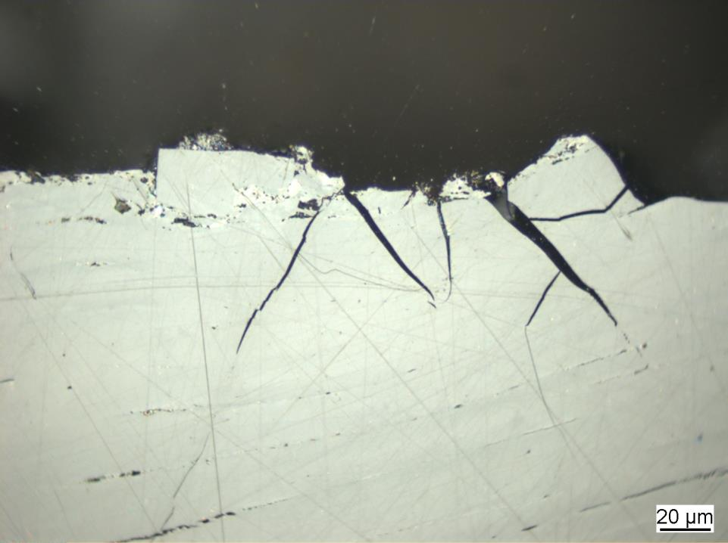
Photo 5.0
Vitrinite reflectance: 1.53% VRr; NA% VRmax
Reflectance values below 0.90% VRr and above 0.98 VRr are considered to
be oxidatively and thermally altered.

Slide 7
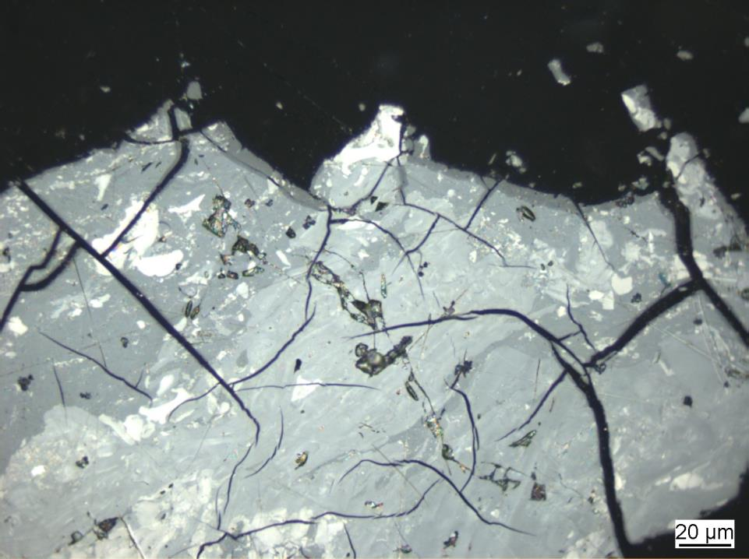
Photo 6.0
Vitrinite reflectance: 0.94% VRr; NA% VRmax
Reflectance values below 0.90% VRr and above 0.98 VRr are considered to
be oxidatively and thermally altered.

Slide 8
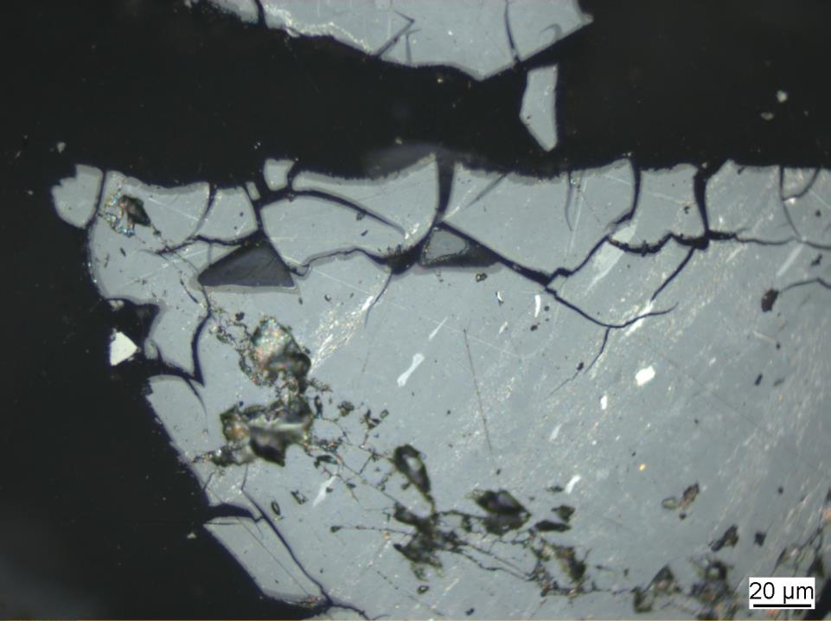
Photo 7.0
Vitrinite reflectance: 0.94% VRr; NA% VRmax
Reflectance values below 0.90% VRr and above 0.98 VRr are considered to
be oxidatively and thermally altered.

Slide 9
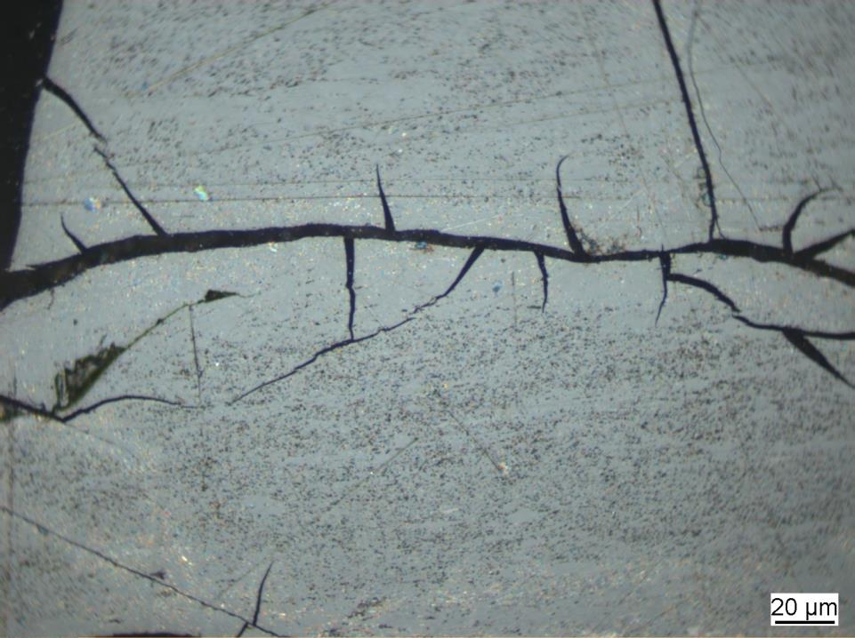
Photo 8.0
Vitrinite reflectance: 1.28% VRr; NA% VRmax
Reflectance values below 0.90% VRr and above 0.98 VRr are considered to
be oxidatively and thermally altered.

Slide 10
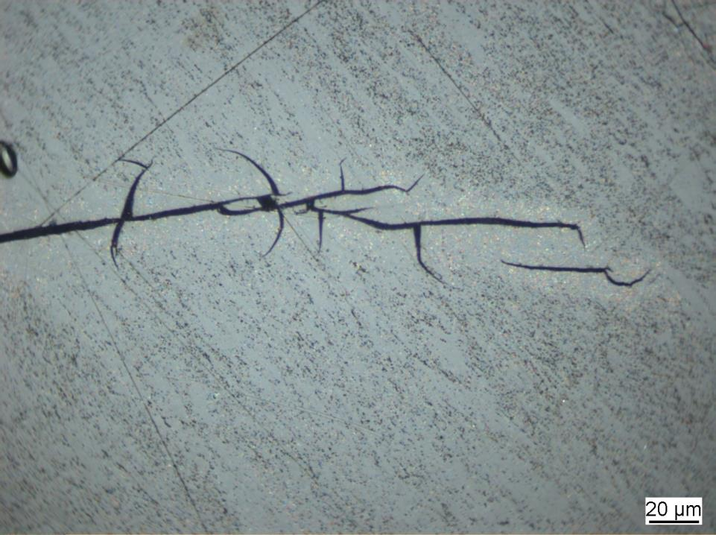
Photo 9.0
Vitrinite reflectance: 1.28% VRr; NA% VRmax
Reflectance values below 0.90% VRr and above 0.98 VRr are considered to
be oxidatively and thermally altered.

Slide 11
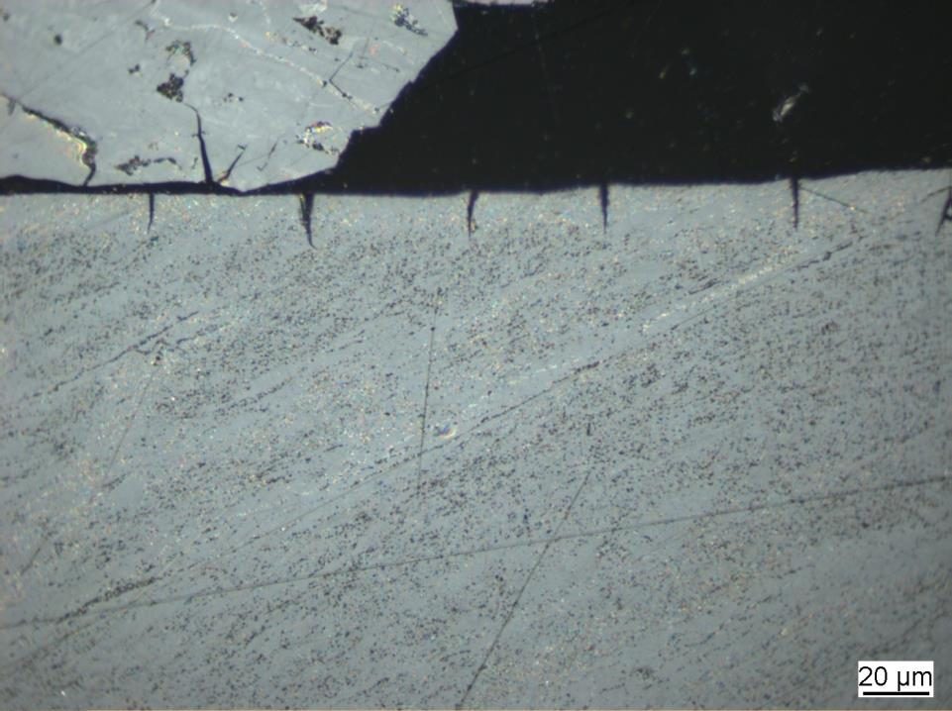
Photo 10.0
Vitrinite reflectance: 1.28% VRr; NA% VRmax
Reflectance values below 0.90% VRr and above 0.98 VRr are considered to
be oxidatively and thermally altered.

Slide 12
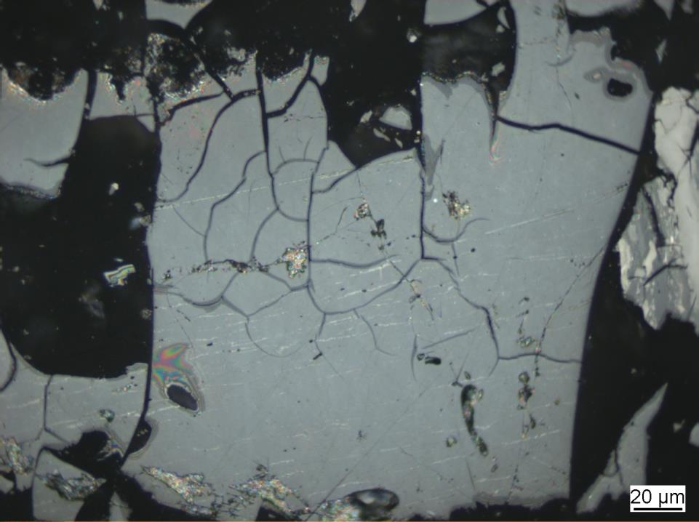
Photo 11.0
Vitrinite reflectance: 0.92% VRr; NA% VRmax
Reflectance values below 0.90% VRr and above 0.98 VRr are considered to
be oxidatively and thermally altered.

Slide 13
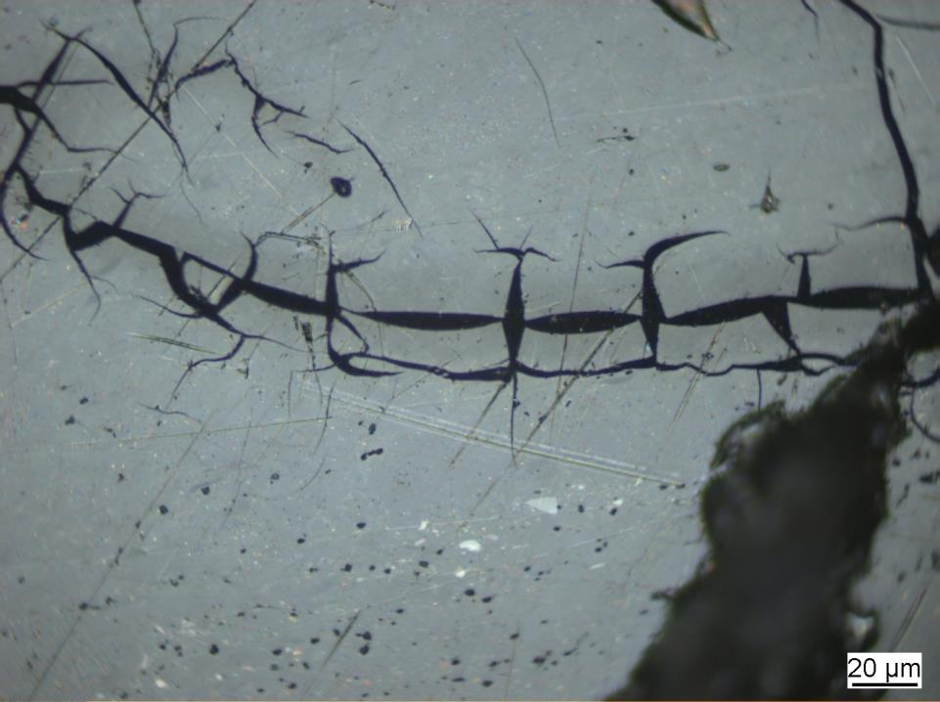
Photo 12.0
Vitrinite reflectance: 0.92% VRr; NA% VRmax
Reflectance values below 0.90% VRr and above 0.98 VRr are considered to
be oxidatively and thermally altered.

Slide 14
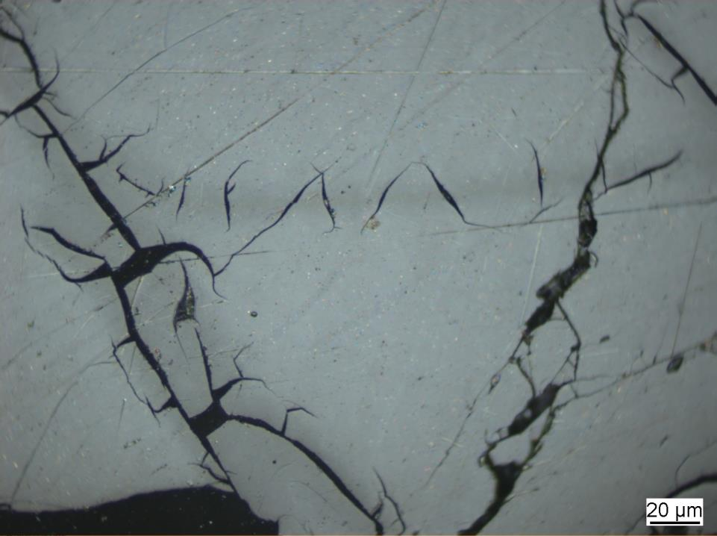
Photo 13.0
Vitrinite reflectance: 0.92% VRr; NA% VRmax
Reflectance values below 0.90% VRr and above 0.98 VRr are considered to
be oxidatively and thermally altered.

Slide 15
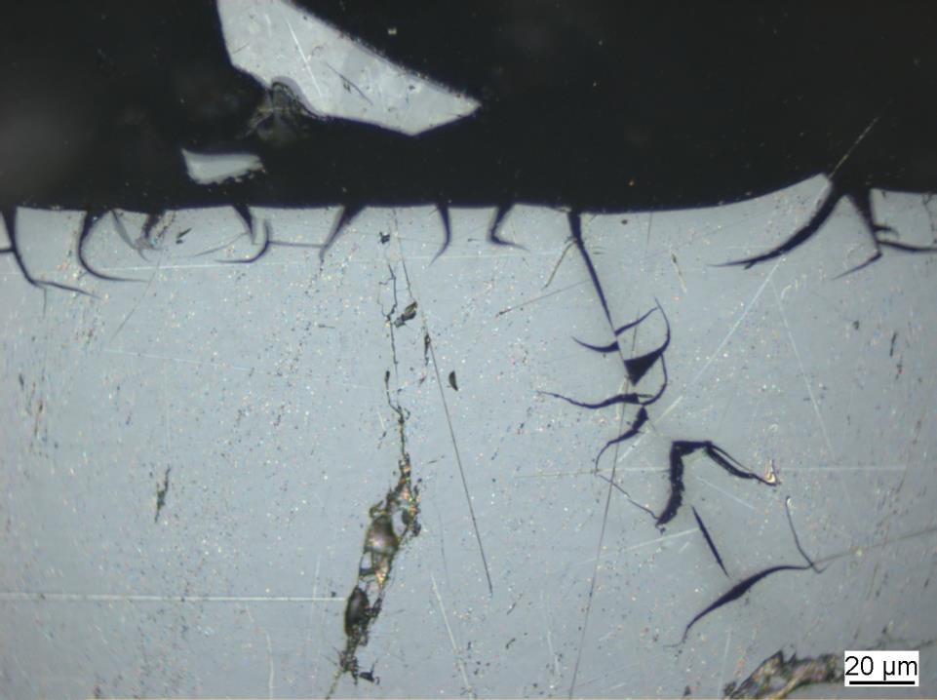
Photo 14.0
Vitrinite reflectance: 0.93% VRr; NA% VRmax
Reflectance values below 0.90% VRr and above 0.98 VRr are considered to
be oxidatively and thermally altered.

Slide 16
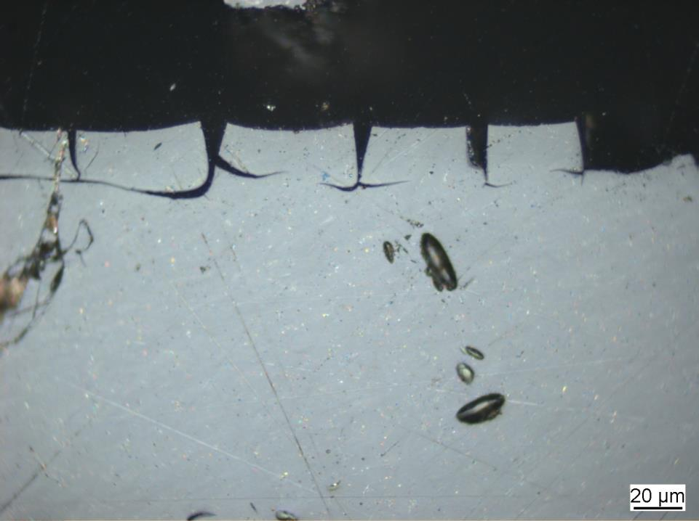
Photo 15.0
Vitrinite reflectance: 0.93% VRr; NA% VRmax
Reflectance values below 0.90% VRr and above 0.98 VRr are considered to
be oxidatively and thermally altered.

Slide 17
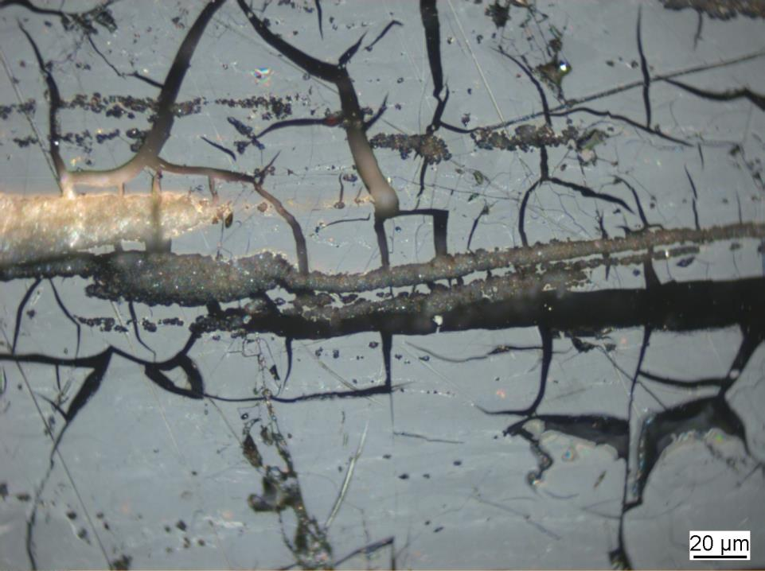
Photo 16.0
Vitrinite reflectance: 0.96% VRr; NA% VRmax
Reflectance values below 0.90% VRr and above 0.98 VRr are considered to
be oxidatively and thermally altered.

Slide 18
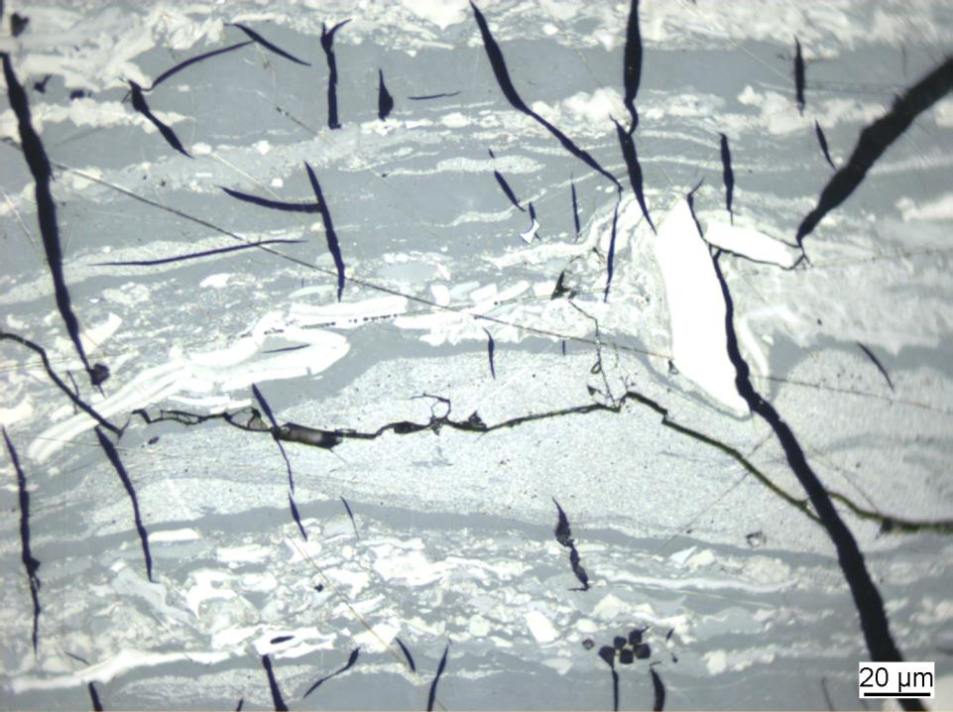
Photo 17.0
Vitrinite reflectance: 1.01% VRr; NA% VRmax
Reflectance values below 0.90% VRr and above 0.98 VRr are considered to
be oxidatively and thermally altered.

Slide 19
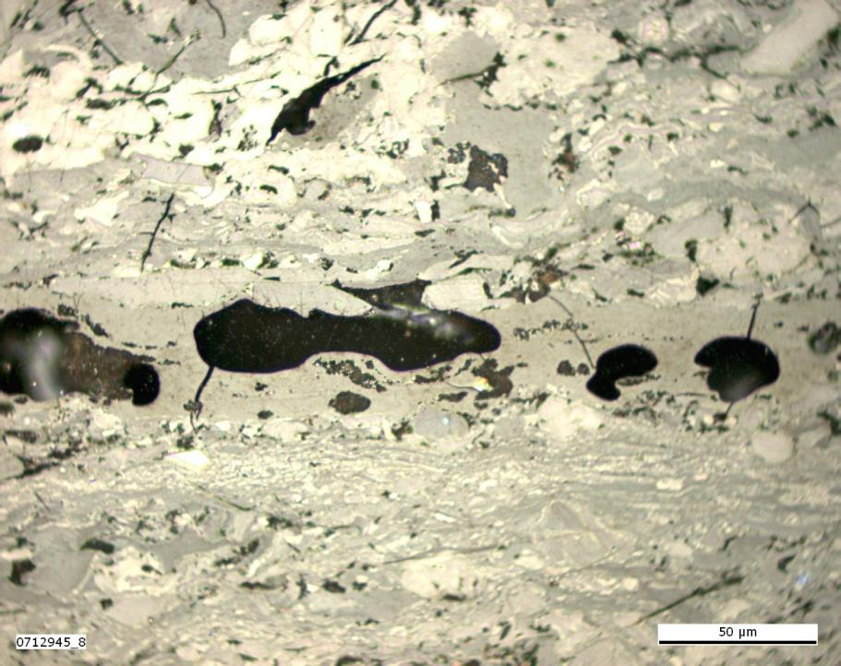
Photo 18.0
Vitrinite reflectance: 1.30% VRr; 1.43% VRmax
Reflectance values below 0.90% VRr and above 0.98 VRr are considered to
be oxidatively and thermally altered.

Slide 20
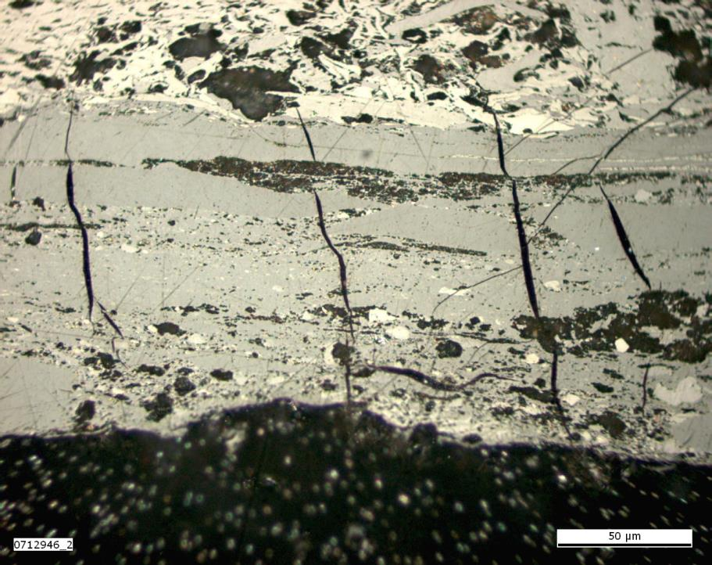
Photo 19.0
Vitrinite reflectance: 1.39% VRr; 1.49% VRmax
Reflectance values below 0.90% VRr and above 0.98 VRr are considered to
be oxidatively and thermally altered.

Slide 21
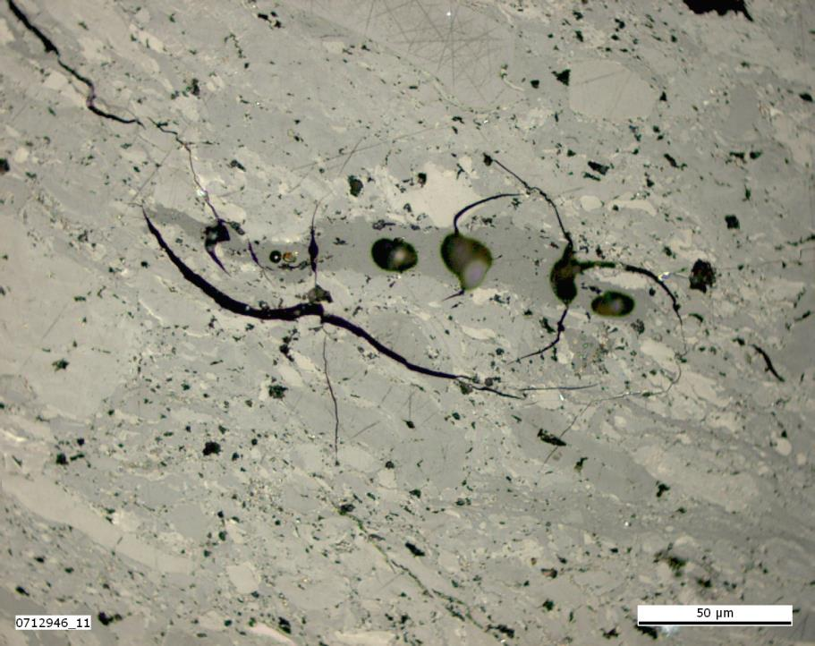
Photo 20.0
Vitrinite reflectance: 1.39% VRr; 1.49% VRmax
Reflectance values below 0.90% VRr and above 0.98 VRr are considered to
be oxidatively and thermally altered.

Slide 22
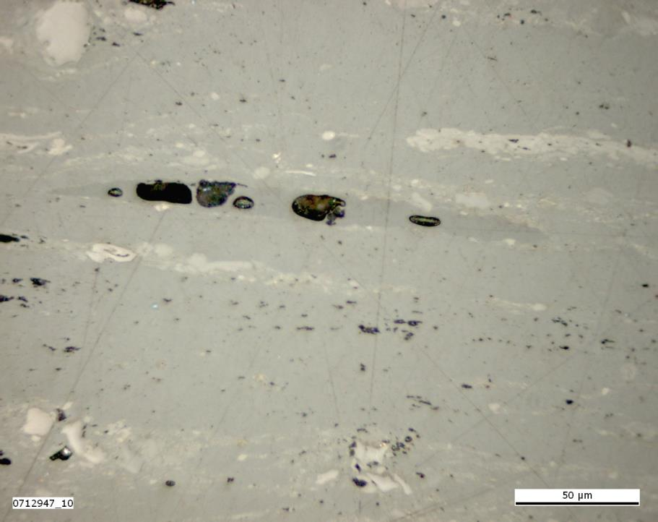
Photo 21.0
Vitrinite reflectance: 1.49% VRr; 1.58% VRmax
Reflectance values below 0.90% VRr and above 0.98 VRr are considered to
be oxidatively and thermally altered.

Slide 23
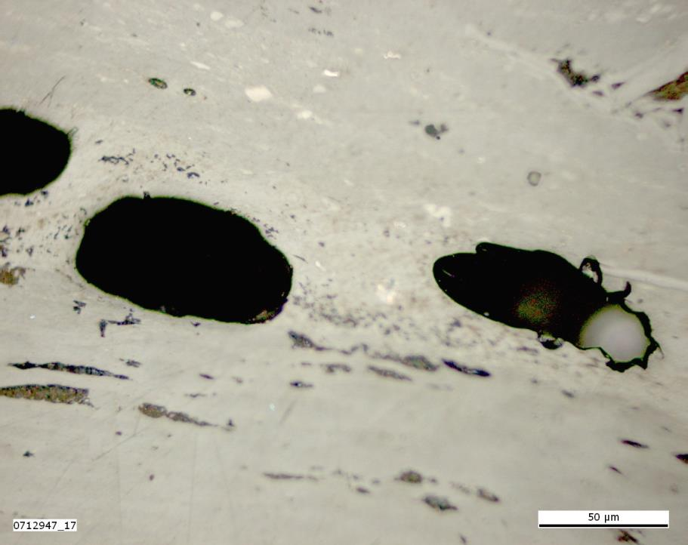
Photo 22.0
Vitrinite reflectance: 1.49% VRr; 1.58% VRmax
Reflectance values below 0.90% VRr and above 0.98 VRr are considered to
be oxidatively and thermally altered.

Slide 24
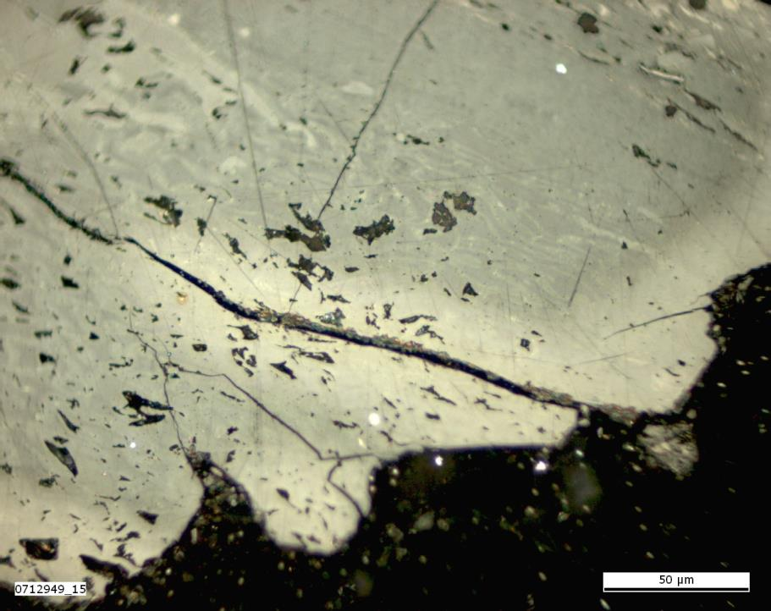
Photo 23.0
Vitrinite reflectance: 0.93% VRr; 1.05% VRmax
Reflectance values below 0.90% VRr and above 0.98 VRr are considered to
be oxidatively and thermally altered.

Slide 25
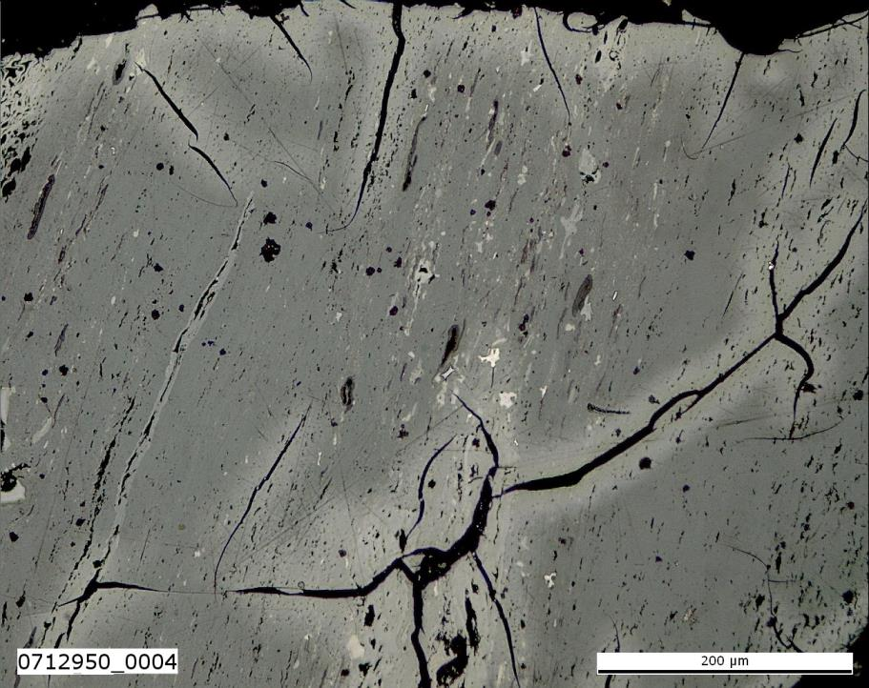
Photo 24.0
Vitrinite reflectance: 0.92% VRr; 1.01% VRmax
Reflectance values below 0.90% VRr and above 0.98 VRr are considered to
be oxidatively and thermally altered.

Slide 26
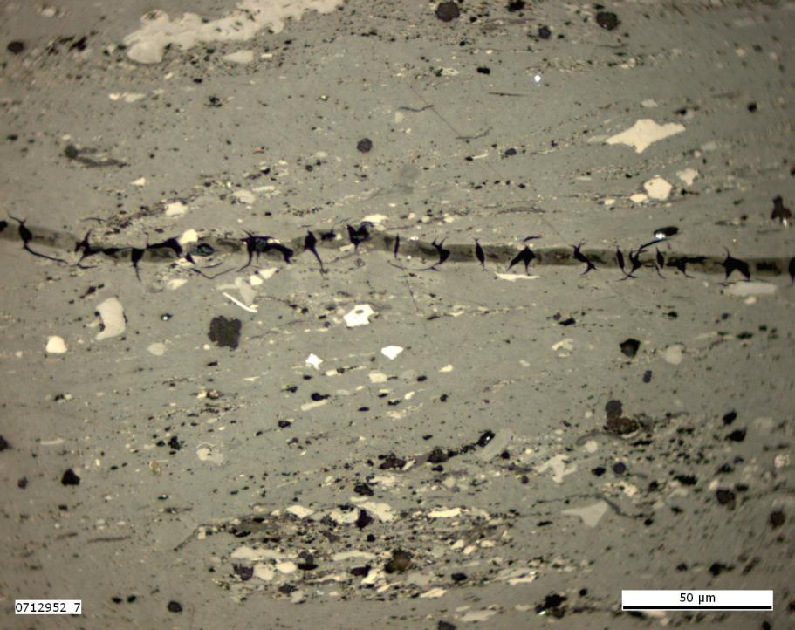
Photo 25.0
Vitrinite reflectance: 0.92% VRr; 1.01% VRmax
Reflectance values below 0.90% VRr and above 0.98 VRr are considered to
be oxidatively and thermally altered.

Slide 27
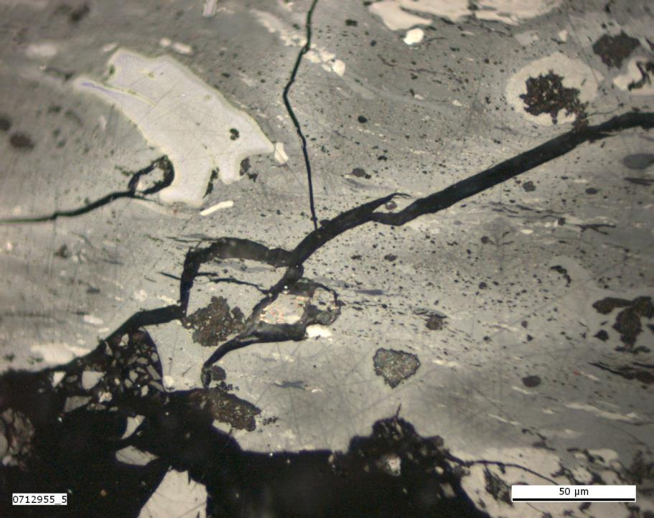
Photo 26.0
Vitrinite reflectance: 0.92% VRr; 0.99% VRmax
Reflectance values below 0.90% VRr and above 0.98 VRr are considered to
be oxidatively and thermally altered.

Slide 28
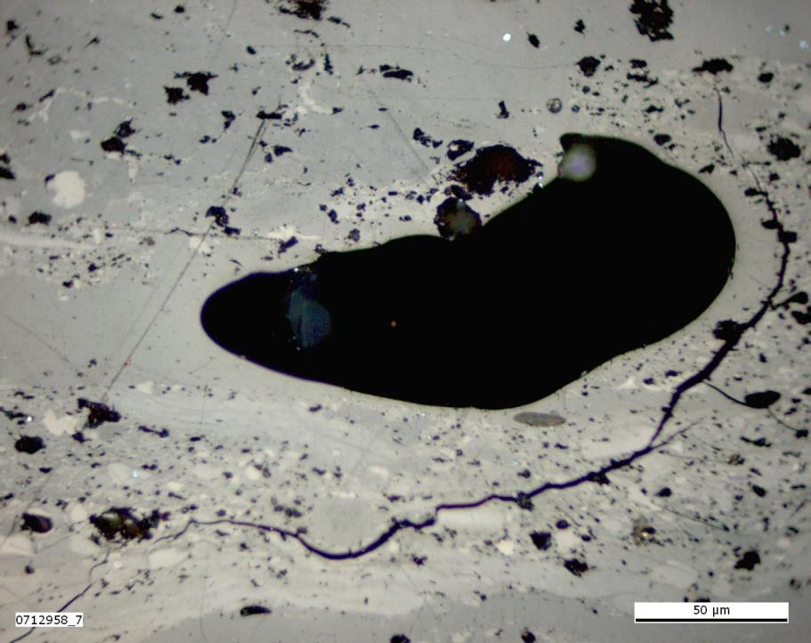
Photo 27.0
Vitrinite reflectance: 1.13% VRr; 1.20% VRmax
Reflectance values below 0.90% VRr and above 0.98 VRr are considered to
be oxidatively and thermally altered.

Slide 29
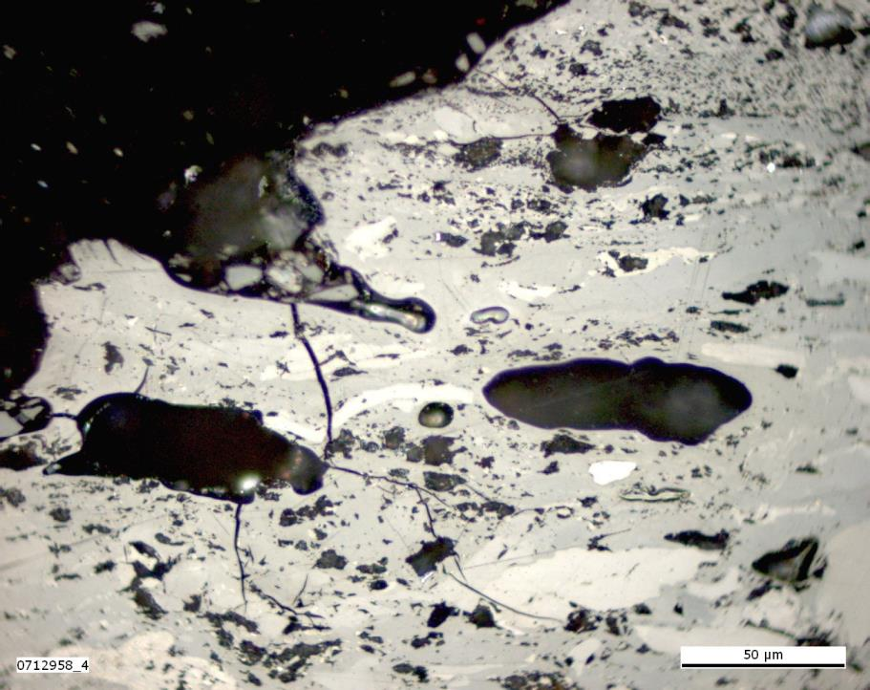
Photo 28.0
Vitrinite reflectance: 1.13% VRr; 1.20% VRmax
Reflectance values below 0.90% VRr and above 0.98 VRr are considered to
be oxidatively and thermally altered.

Slide 30
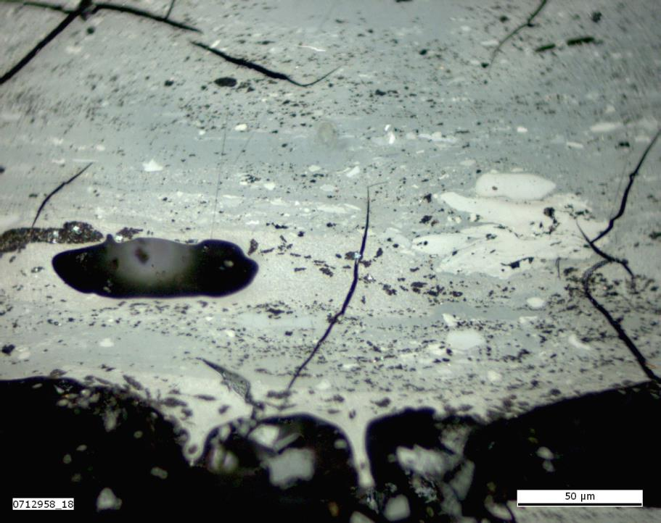
Photo 29.0
Vitrinite reflectance: 1.13% VRr; 1.20% VRmax
Reflectance values below 0.90% VRr and above 0.98 VRr are considered to
be oxidatively and thermally altered.

Slide 31
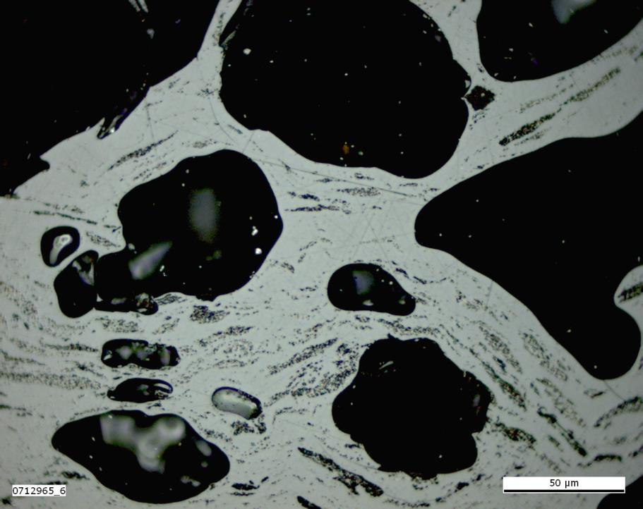
Photo 30.0
Vitrinite reflectance: 4.40% VRr; 2.93% VRmax
Reflectance values below 0.90% VRr and above 0.98 VRr are considered to
be oxidatively and thermally altered.

Slide 32
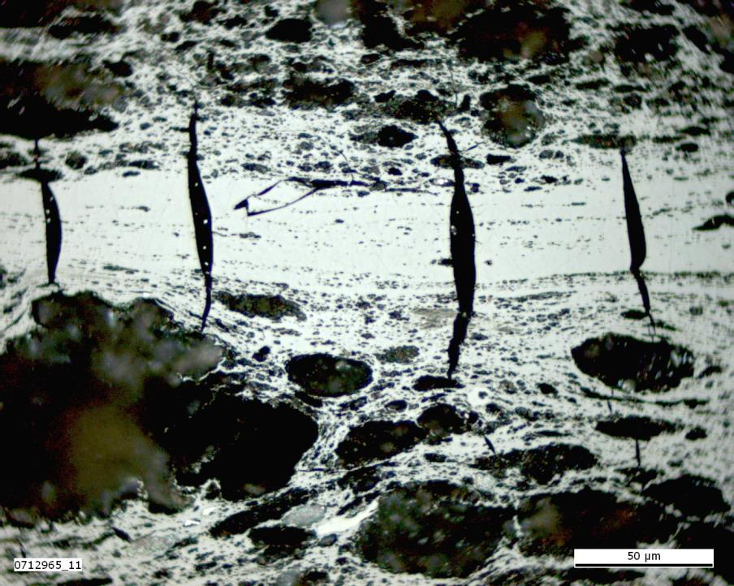
Photo 31.0
Vitrinite reflectance: 4.40% VRr; 2.93% VRmax
Reflectance values below 0.90% VRr and above 0.98 VRr are considered to
be oxidatively and thermally altered.

Slide 33
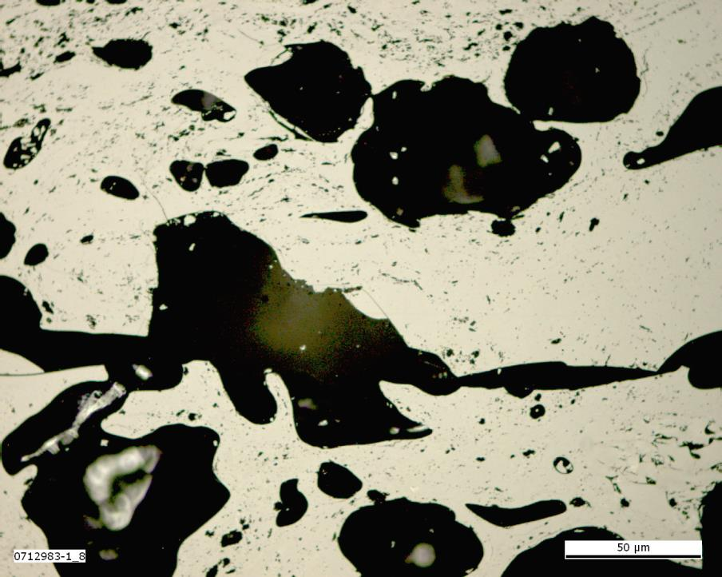
Photo 32.0
Vitrinite reflectance: 5.16% VRr; 5.32% VRmax
Reflectance values below 0.90% VRr and above 0.98 VRr are considered to
be oxidatively and thermally altered.

Slide 34
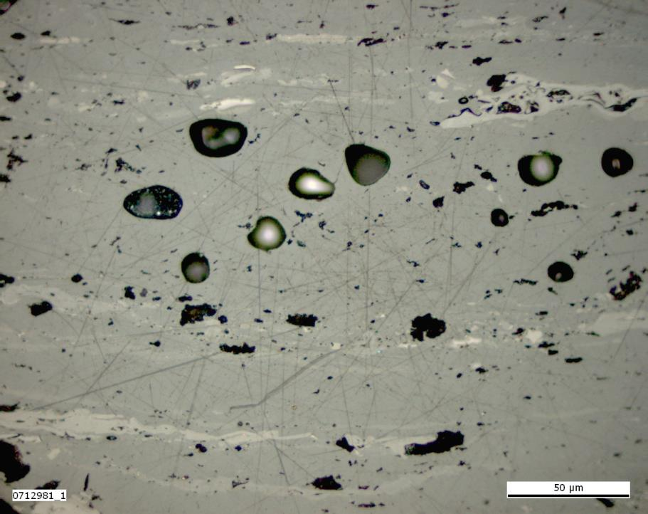
Photo 33.0
Vitrinite reflectance: 1.60% VRr; 1.71% VRmax
Reflectance values below 0.90% VRr and above 0.98 VRr are considered to
be oxidatively and thermally altered.

Slide 35
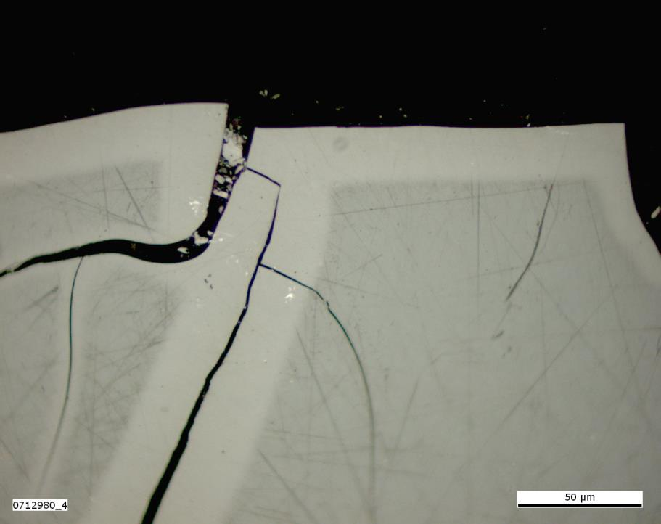
Photo 34.0
Vitrinite reflectance: 1.60% VRr; 1.72% VRmax
Reflectance values below 0.90% VRr and above 0.98 VRr are considered to
be oxidatively and thermally altered.

Slide 36
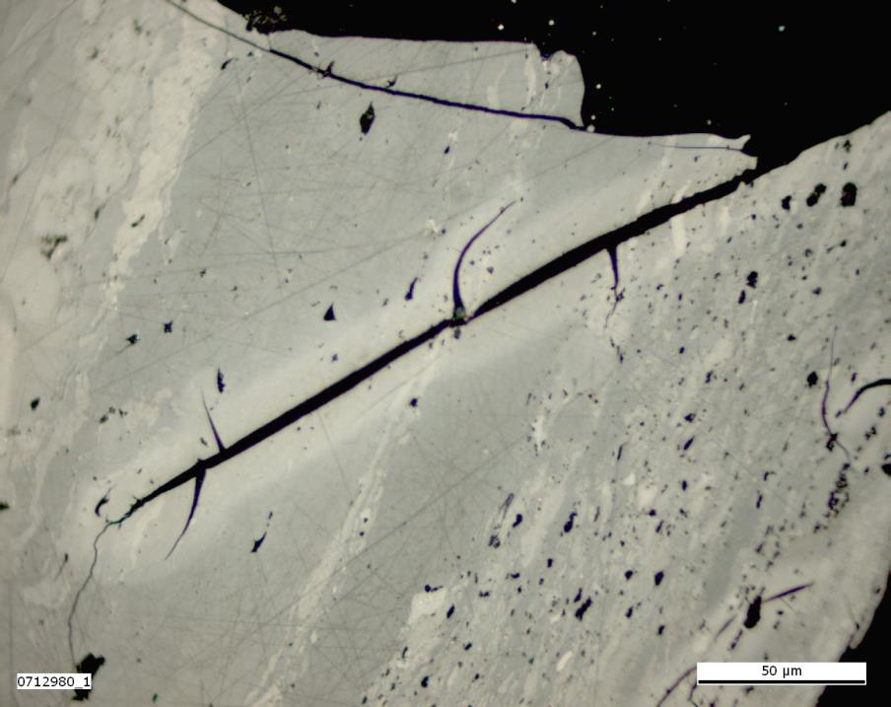
Photo 35.0
Vitrinite reflectance: 1.60% VRr; 1.72% VRmax
Reflectance values below 0.90% VRr and above 0.98 VRr are considered to
be oxidatively and thermally altered.

Slide 37
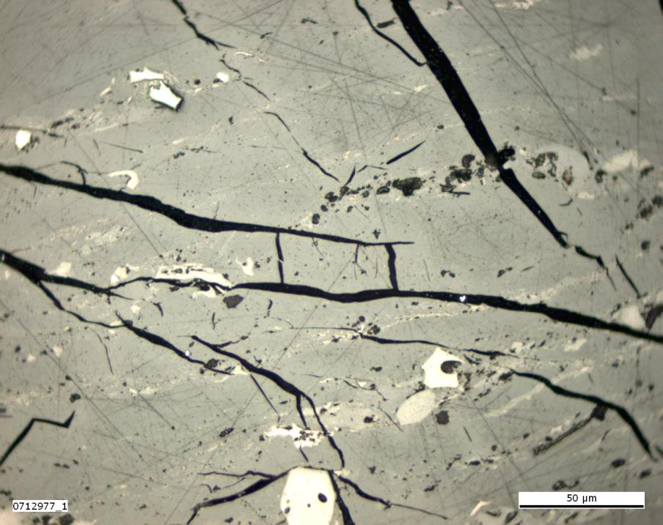
Photo 36.0
Vitrinite reflectance: 1.62% VRr; 1.72% VRmax
Reflectance values below 0.90% VRr and above 0.98 VRr are considered to
be oxidatively and thermally altered.

Slide 38
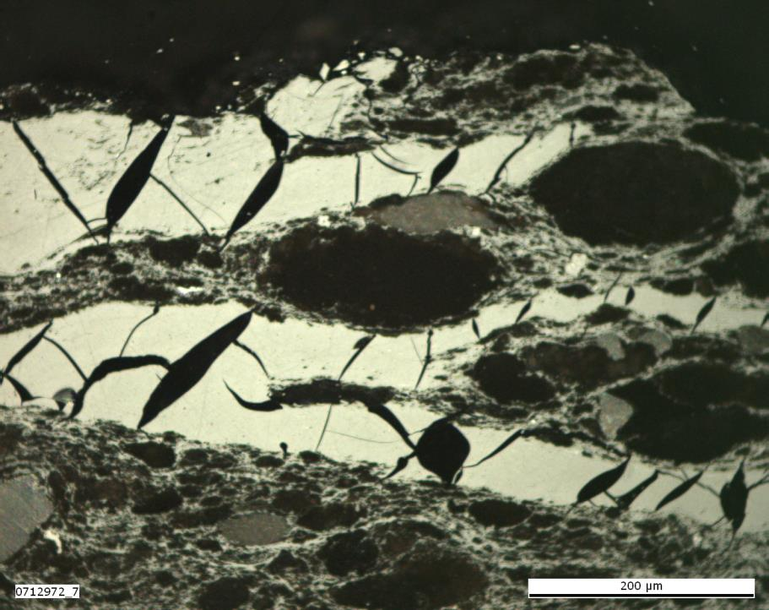
Photo 37.0
Vitrinite reflectance: 1.80% VRr; 1.96% VRmax
Reflectance values below 0.90% VRr and above 0.98 VRr are considered to
be oxidatively and thermally altered.

Slide 39
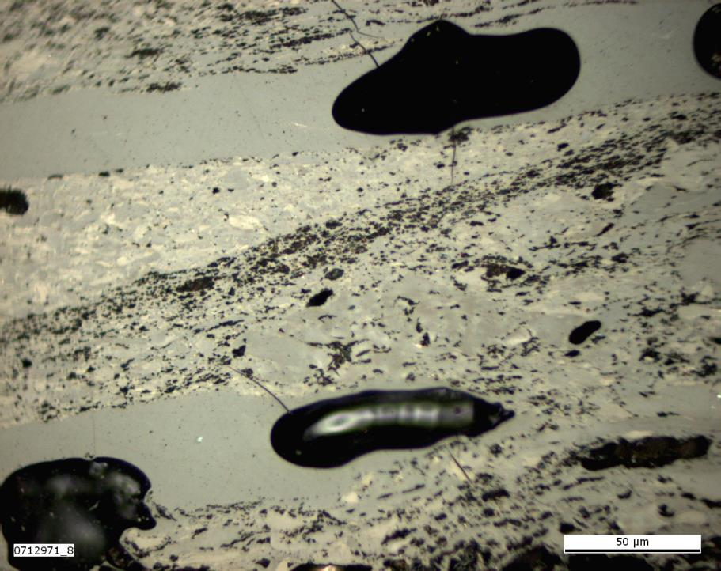
Photo 38.0
Vitrinite reflectance: 2.01% VRr; 2.09% VRmax
Reflectance values below 0.90% VRr and above 0.98 VRr are considered to
be oxidatively and thermally altered.

Slide 40
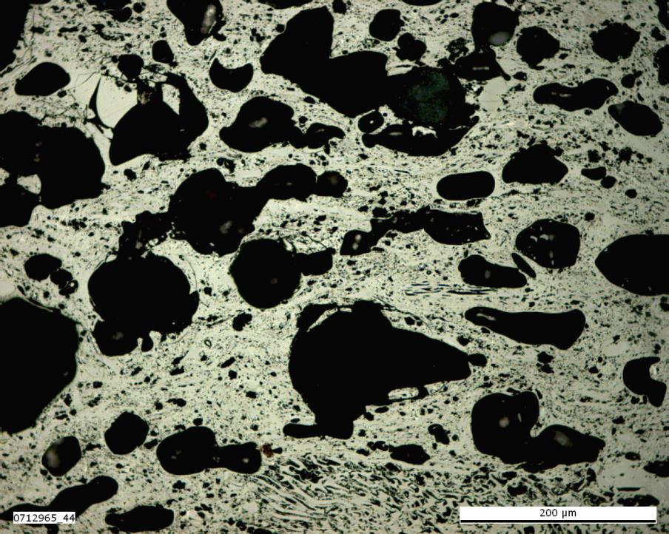
Photo 39.0
Vitrinite reflectance: 4.40% VRr; 2.93% VRmax
Reflectance values below 0.90% VRr and above 0.98 VRr are considered to
be oxidatively and thermally altered.

Slide 41
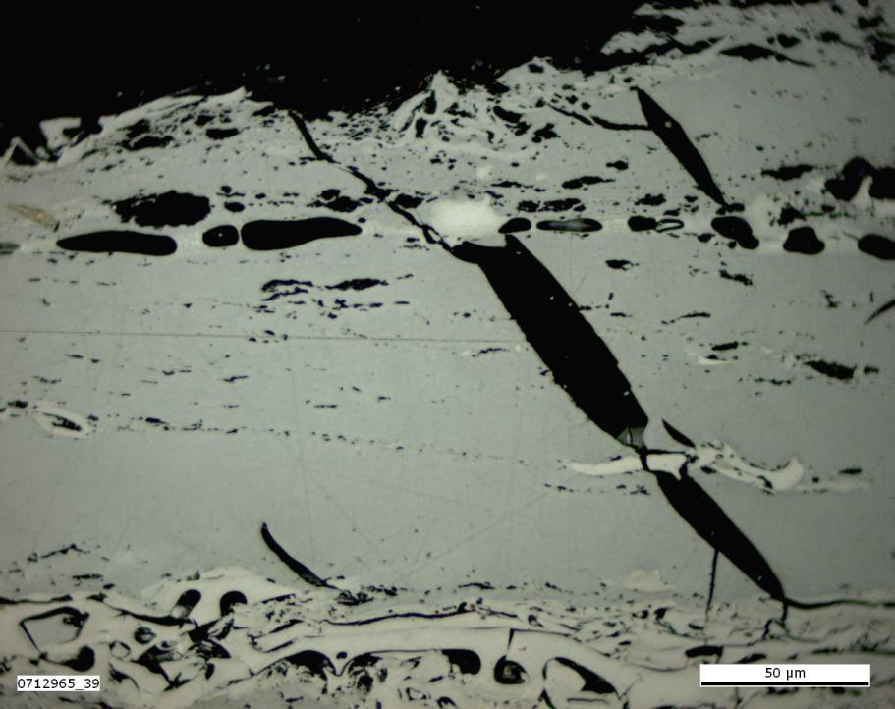
Photo 40.0
Vitrinite reflectance: 4.40% VRr; 2.93% VRmax
Reflectance values below 0.90% VRr and above 0.98 VRr are considered to
be oxidatively and thermally altered.

Slide 42
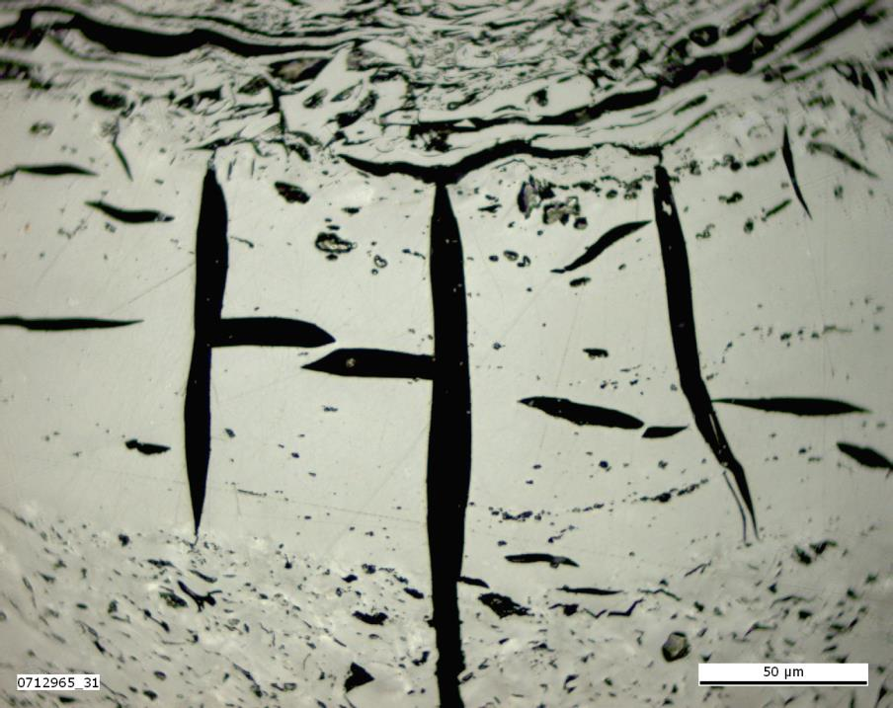
Photo 41.0
Vitrinite reflectance: 4.40% VRr; 2.93% VRmax
Reflectance values below 0.90% VRr and above 0.98 VRr are considered to
be oxidatively and thermally altered.

Slide 43
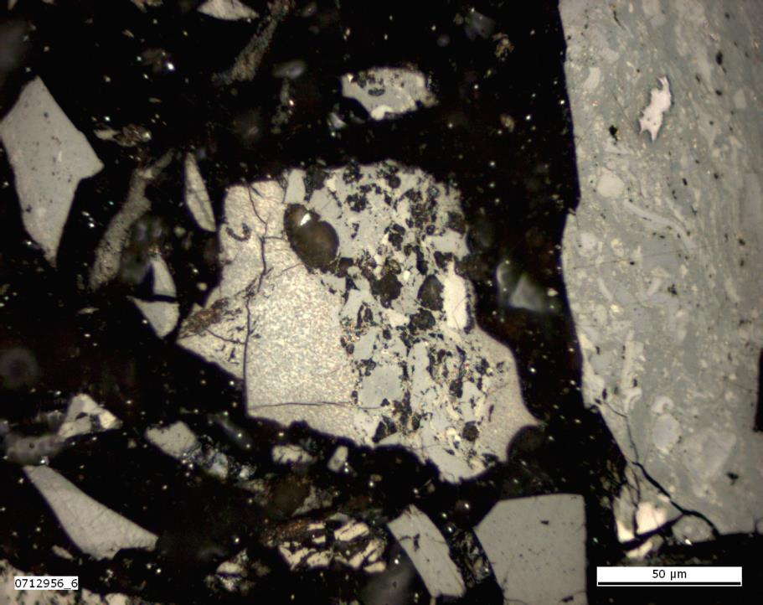
Photo 42.0
Vitrinite reflectance: 1.40% VRr; 1.48% VRmax
Reflectance values below 0.90% VRr and above 0.98 VRr are considered to
be oxidatively and thermally altered.

Slide 44
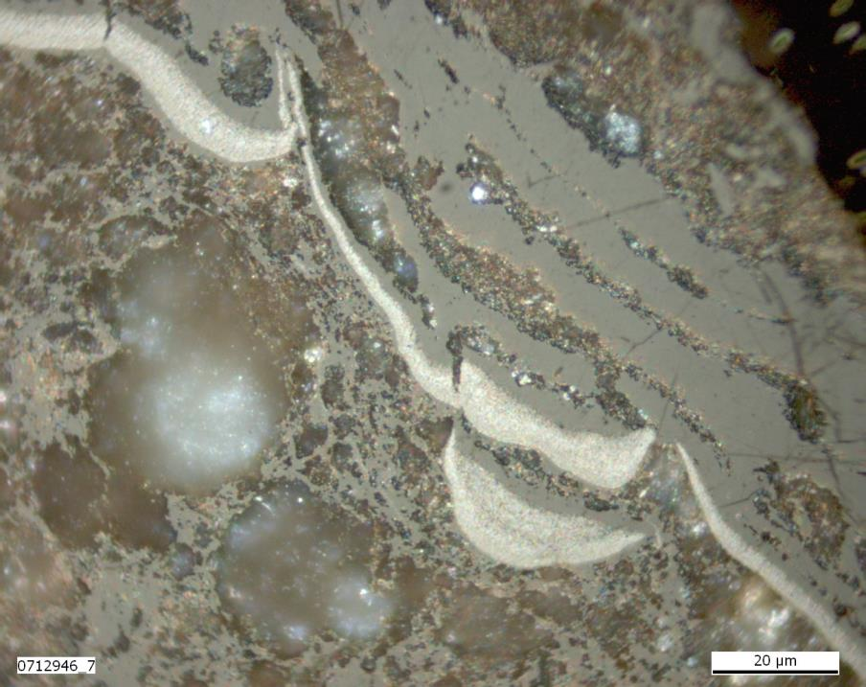
Photo 43.0
Vitrinite reflectance: 1.40% VRr; 1.48% VRmax
Reflectance values below 0.90% VRr and above 0.98 VRr are considered to
be oxidatively and thermally altered.

Slide 45
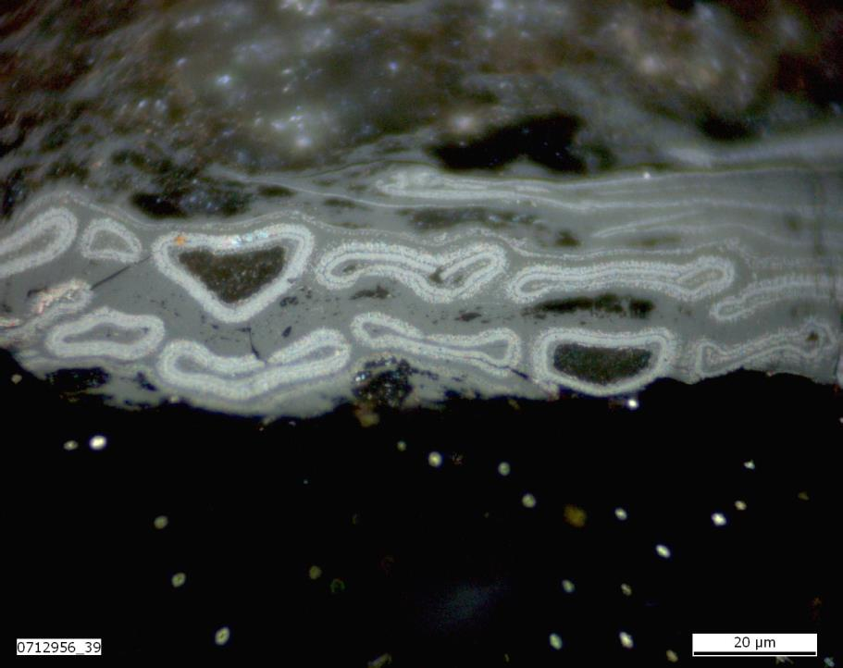
Photo 44.0
Vitrinite reflectance: 1.40% VRr; 1.48% VRmax
Reflectance values below 0.90% VRr and above 0.98 VRr are considered to
be oxidatively and thermally altered.

Slide 46
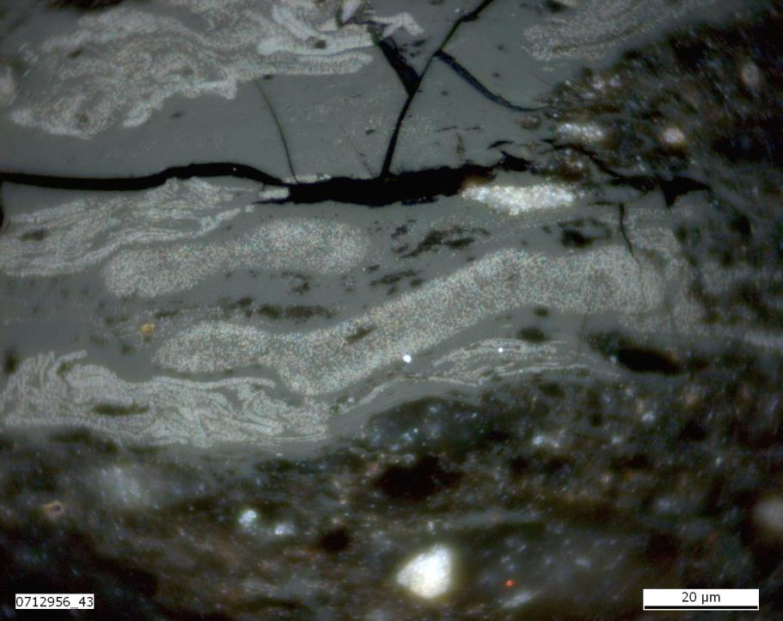
Photo 45.0
Vitrinite reflectance: 1.40% VRr; 1.48% VRmax
Reflectance values below 0.90% VRr and above 0.98 VRr are considered to
be oxidatively and thermally altered.

Slide 47
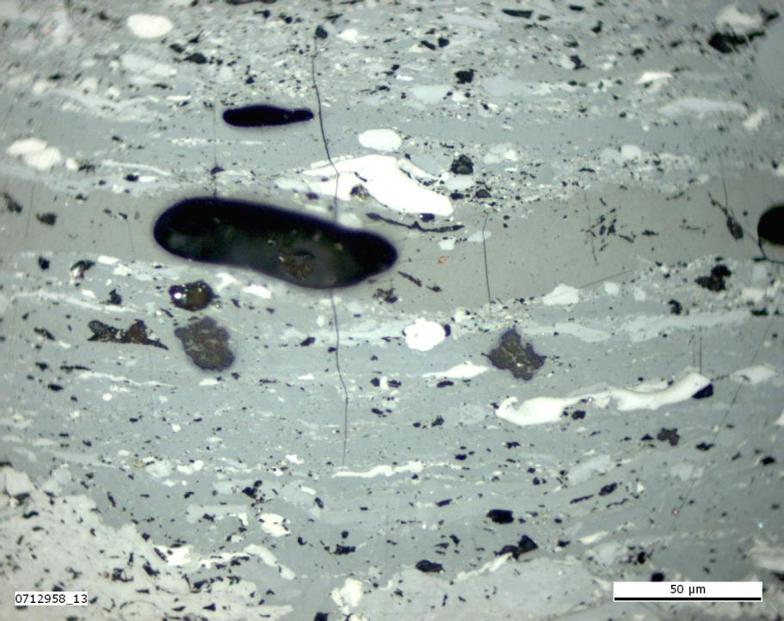
Photo 46.0
Vitrinite reflectance: 1.13% VRr; 1.20% VRmax
Reflectance values below 0.90% VRr and above 0.98 VRr are considered to
be oxidatively and thermally altered.

Slide 48
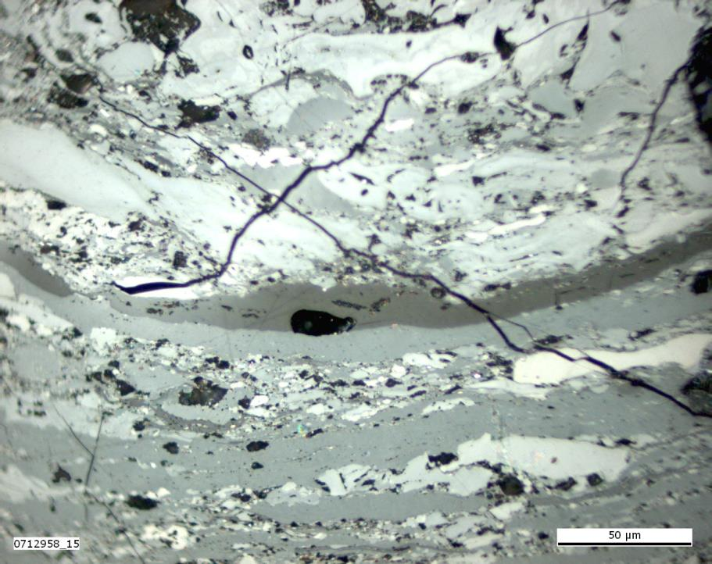
Photo 47.0
Vitrinite reflectance: 1.13% VRr; 1.20% VRmax
Reflectance values below 0.90% VRr and above 0.98 VRr are considered to
be oxidatively and thermally altered.

Slide 49
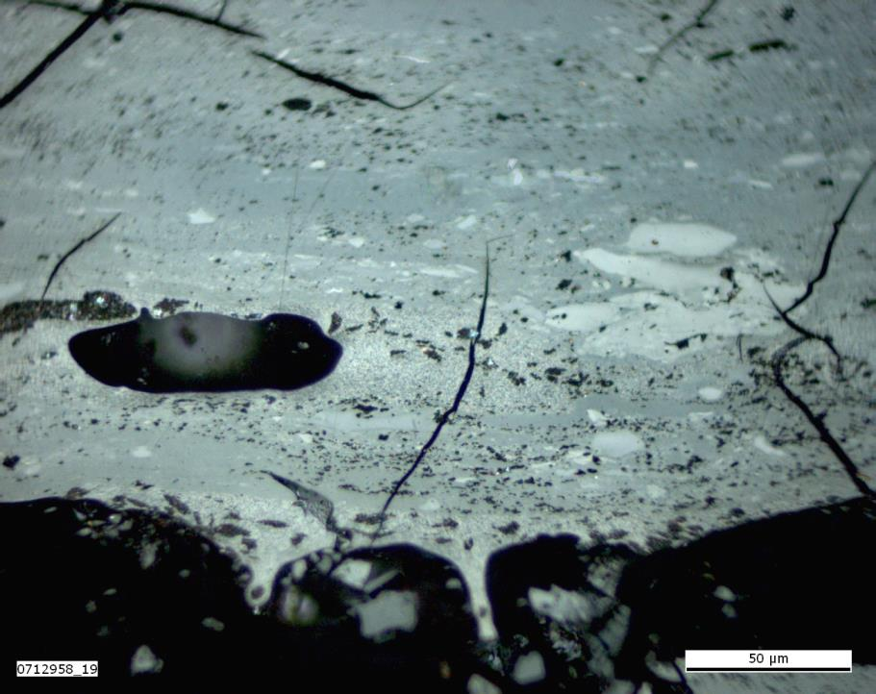
Photo 48.0
Vitrinite reflectance: 1.13% VRr; 1.20% VRmax
Reflectance values below 0.90% VRr and above 0.98 VRr are considered to
be oxidatively and thermally altered.

Slide 50
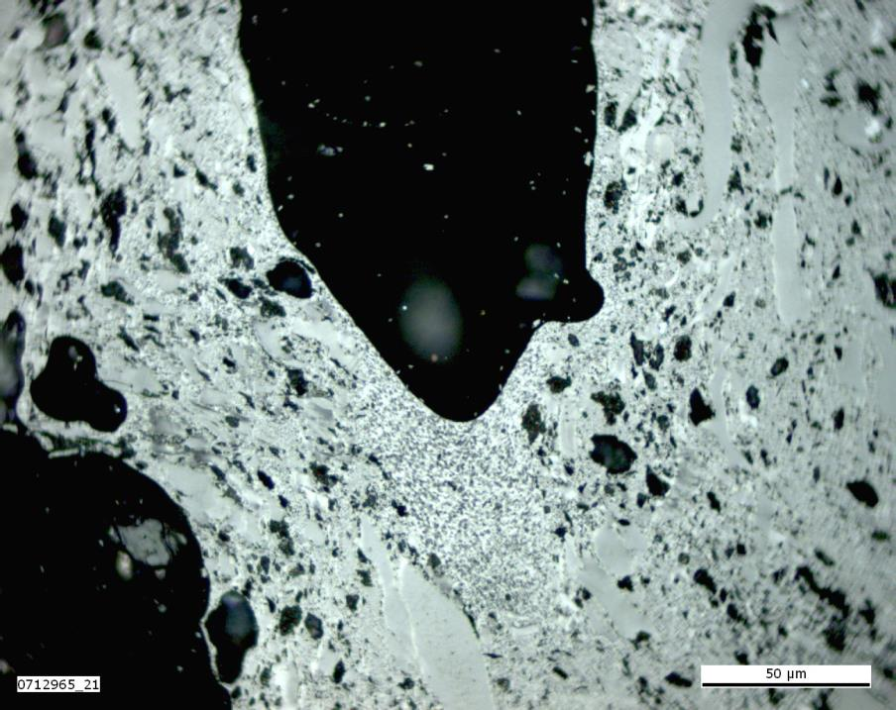
Photo 49.0
Vitrinite reflectance: 4.40% VRr; 2.93% VRmax
Reflectance values below 0.90% VRr and above 0.98 VRr are considered to
be oxidatively and thermally altered.

Slide 51
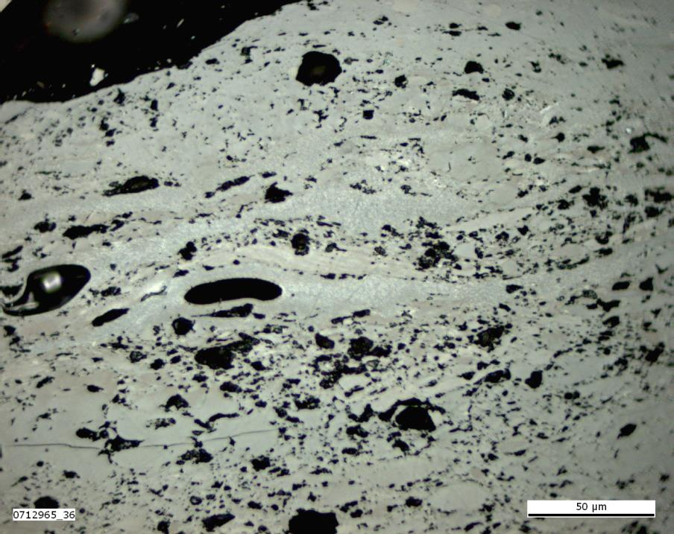
Photo 50.0
Vitrinite reflectance: 4.40% VRr; 2.93% VRmax
Reflectance values below 0.90% VRr and above 0.98 VRr are considered to
be oxidatively and thermally altered.

Slide 52
Photo 51.0
Vitrinite reflectance: 4.40% VRr; 2.93% VRmax
Reflectance values below 0.90% VRr and above 0.98 VRr are considered to
be oxidatively and thermally altered.

Slide 53
Photo 52.0
Vitrinite reflectance: 4.40% VRr; 2.93% VRmax
Reflectance values below 0.90% VRr and above 0.98 VRr are considered to
be oxidatively and thermally altered.

Slide 54
Photo 53.0
Vitrinite reflectance: 4.40% VRr; 2.93% VRmax
Reflectance values below 0.90% VRr and above 0.98 VRr are considered to
be oxidatively and thermally altered.

Slide 55
Photo 54.0
Vitrinite reflectance: 4.40% VRr; 2.93% VRmax
Reflectance values below 0.90% VRr and above 0.98 VRr are considered to
be oxidatively and thermally altered.

Slide 56
Photo 55.0
Vitrinite reflectance: 0.82% VRr; NA% VRmax
Reflectance values below 0.90% VRr and above 0.98 VRr are considered to
be oxidatively and thermally altered.

Slide 57
Photo 56.0
Vitrinite reflectance: 0.82% VRr; NA% VRmax
Reflectance values below 0.90% VRr and above 0.98 VRr are considered to
be oxidatively and thermally altered.

Slide 58
Photo 57.0
Vitrinite reflectance: 1.63% VRr; 1.66% VRmax
Reflectance values below 0.90% VRr and above 0.98 VRr are considered to
be oxidatively and thermally altered.

Slide 59
Photo 58.0
Vitrinite reflectance: 2.01% VRr; 2.09% VRmax
Reflectance values below 0.90% VRr and above 0.98 VRr are considered to
be oxidatively and thermally altered.

Slide 60
Photo 59.1
Vitrinite reflectance: 1.93% VRr; 2.00% VRmax
Reflectance values below 0.90% VRr and above 0.98 VRr are considered to
be oxidatively and thermally altered.

Slide 61
Photo 59.2
Vitrinite reflectance: 1.93% VRr; 2.00% VRmax
Reflectance values below 0.90% VRr and above 0.98 VRr are considered to
be oxidatively and thermally altered.

Slide 62
Photo 60.1
Vitrinite reflectance: 1.93% VRr; 2.00% VRmax
Reflectance values below 0.90% VRr and above 0.98 VRr are considered to
be oxidatively and thermally altered.

Slide 63
Photo 60.2
Vitrinite reflectance: 1.93% VRr; 2.00% VRmax
Reflectance values below 0.90% VRr and above 0.98 VRr are considered to
be oxidatively and thermally altered.

