Slide 1
ORGANIZED BY
ICCP
Department of Geology University of Patras

Slide 2
ATHENS
Patras

Slide 3
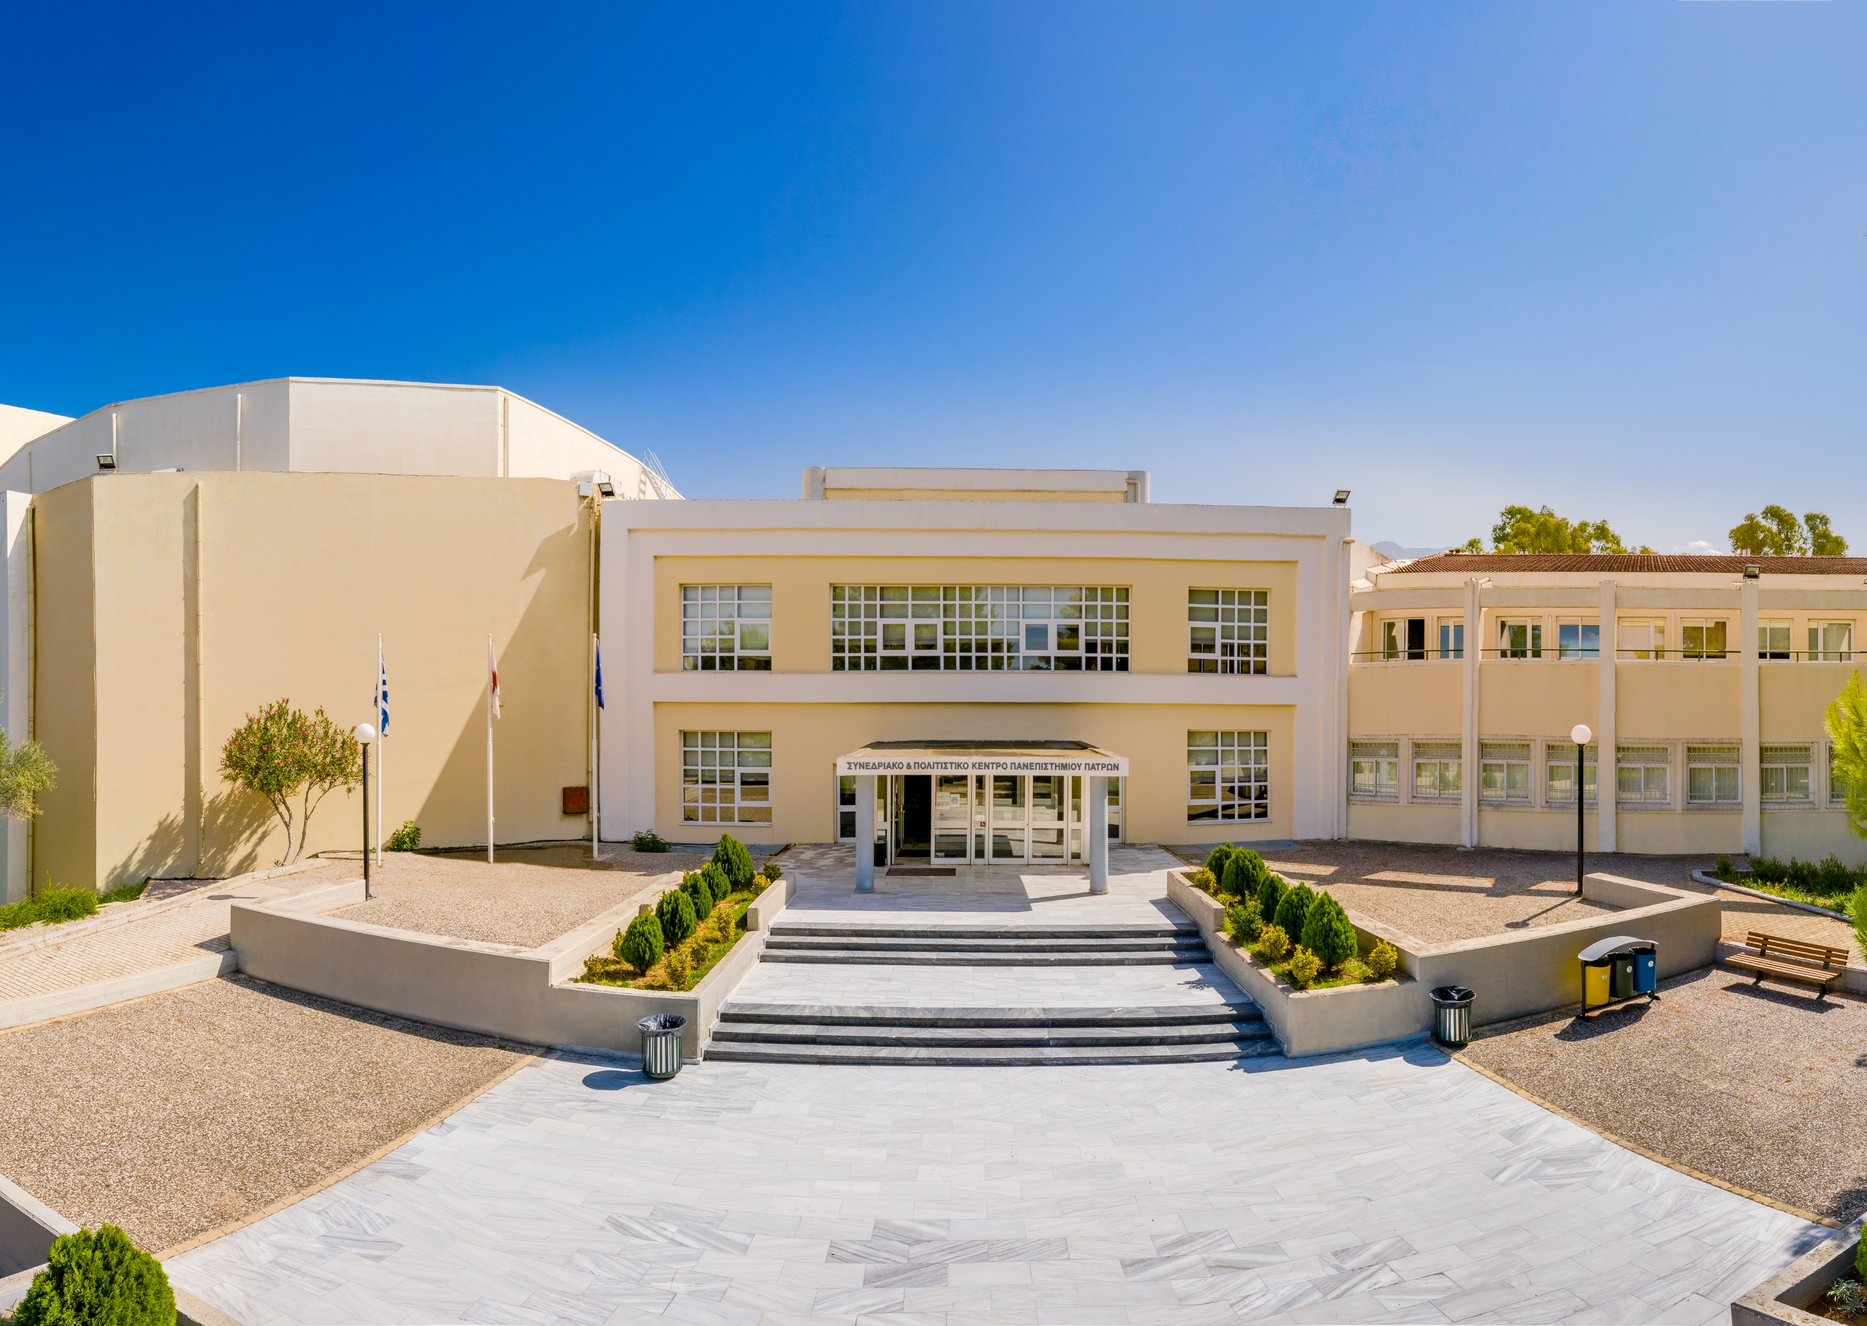
Venue
Conference & Cultural Center of the University of Patras
A seminar room, 30 seats
A second office-room
Coffee-beaks and Lunch on site.

Slide 4
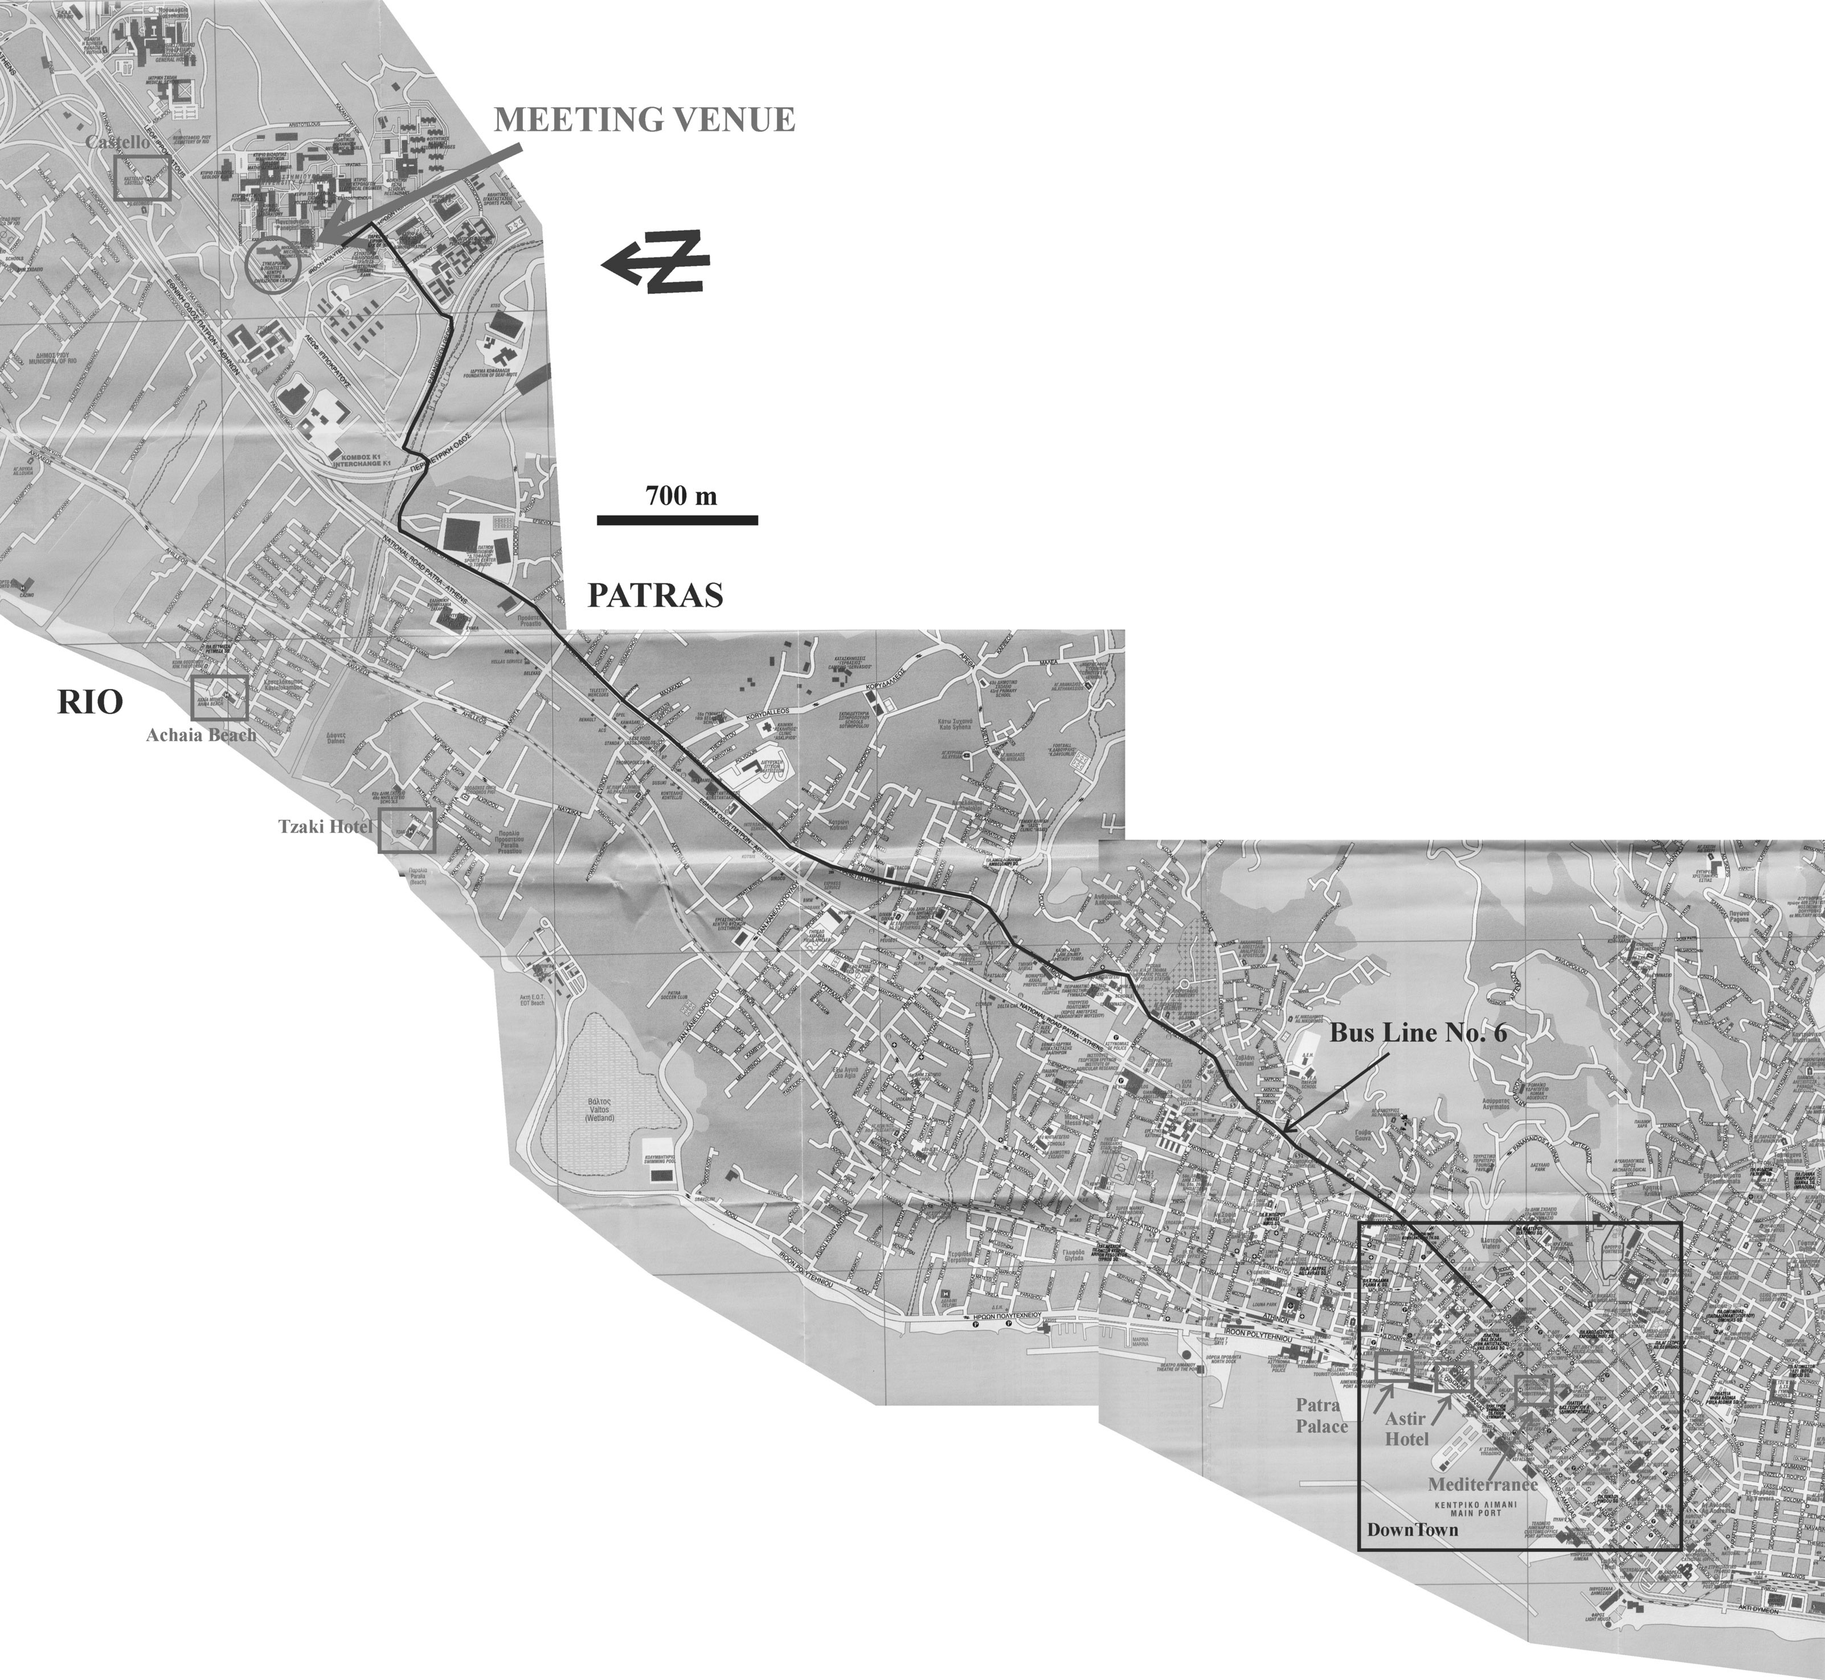
Travelling to venue
By bus: From the city of Patras to the University, every 15 min. The trip lasts ca. 25 min. from Patras downtown and 5 min. walking from the city of Rio.
By taxi: From Patras to the C.C.C. the trip lasts 15 min. and costs ca. 10 Euro.

Slide 5
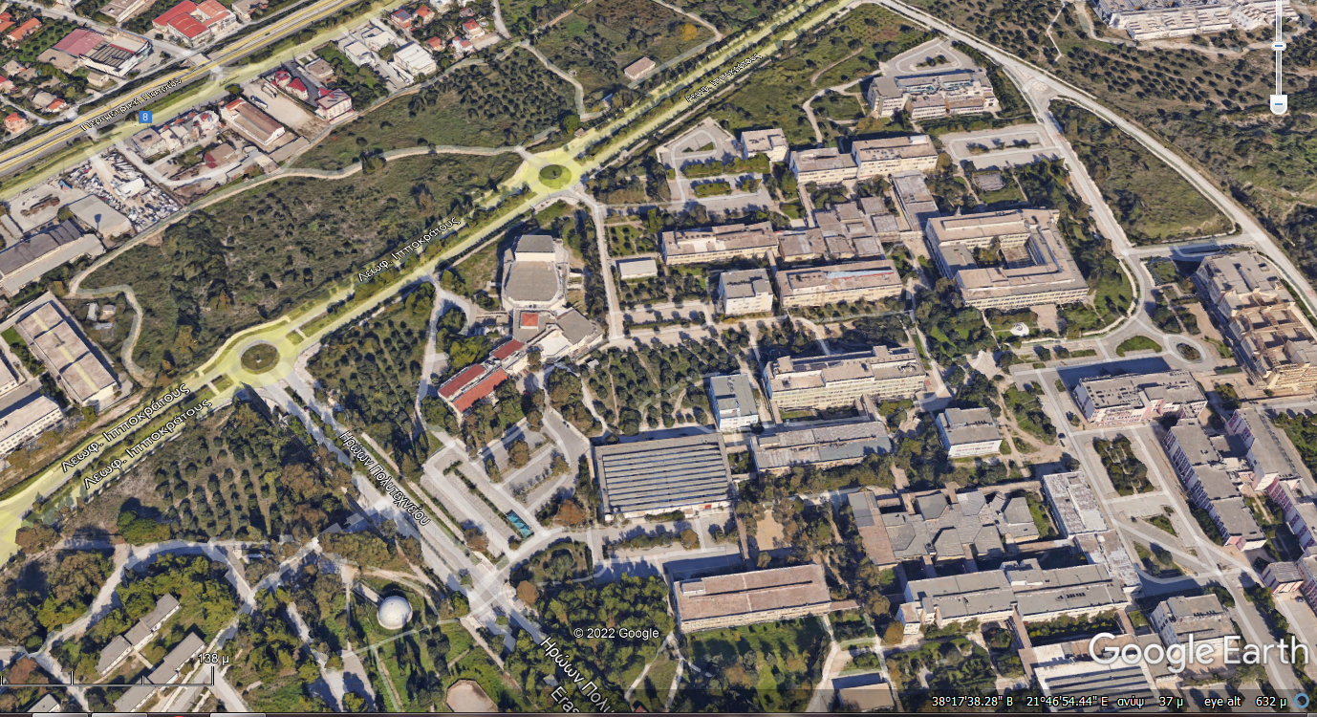
Bus stop
Conference Center
Bus stop
Car parking

Slide 6
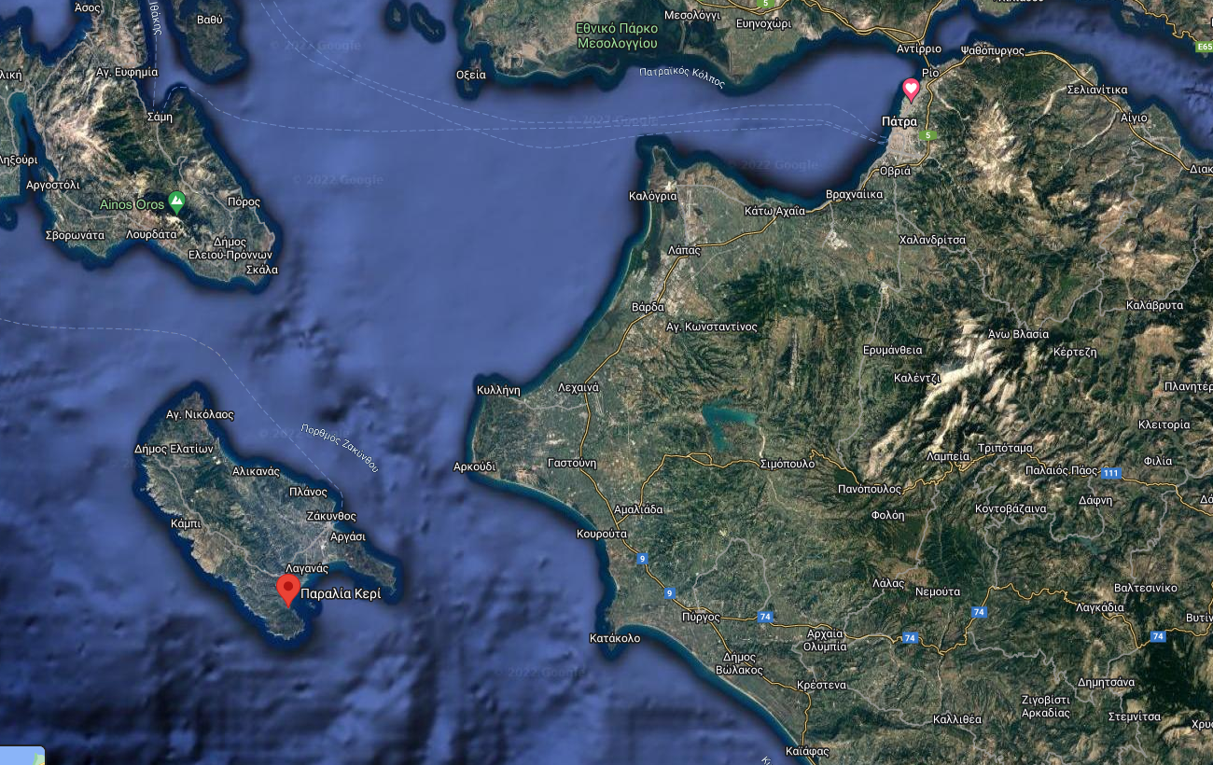
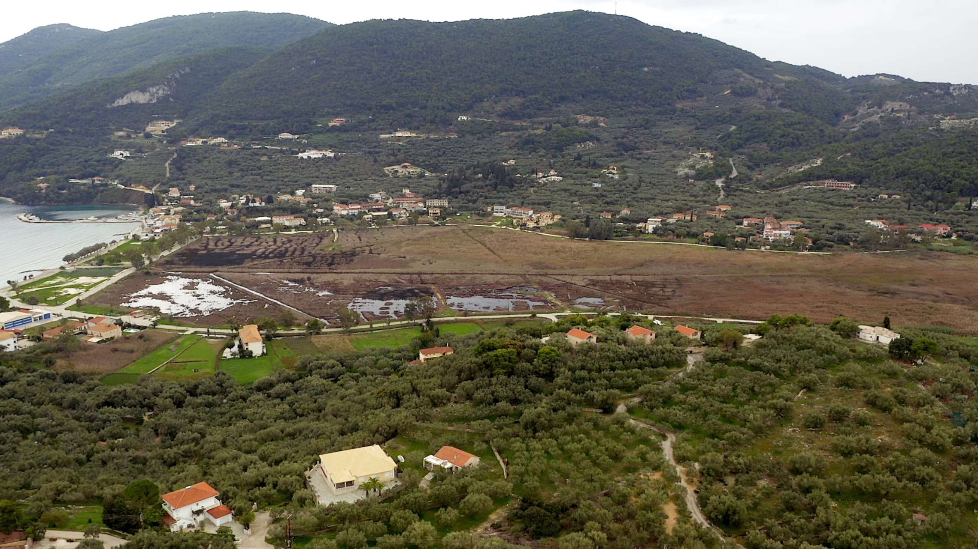
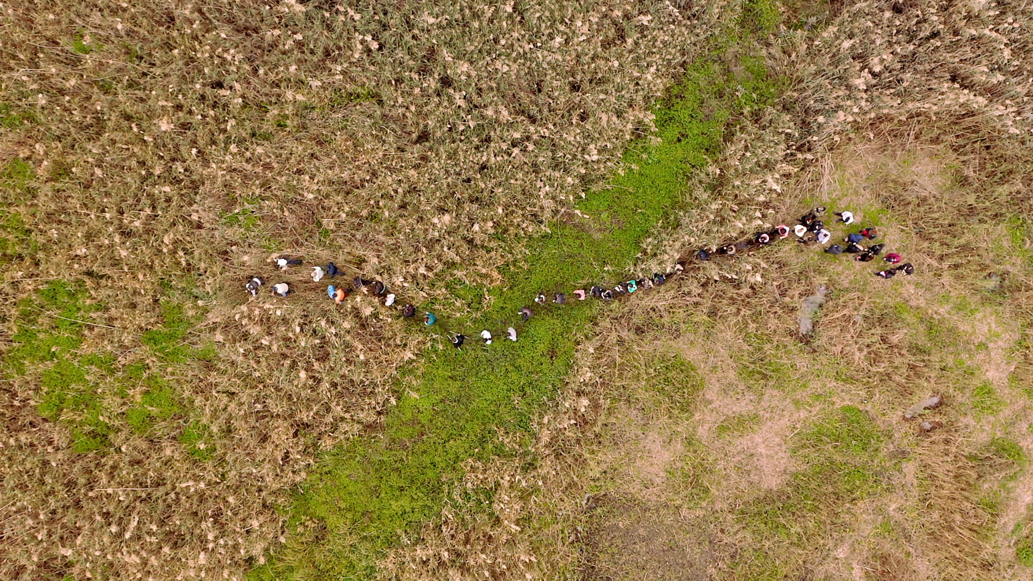
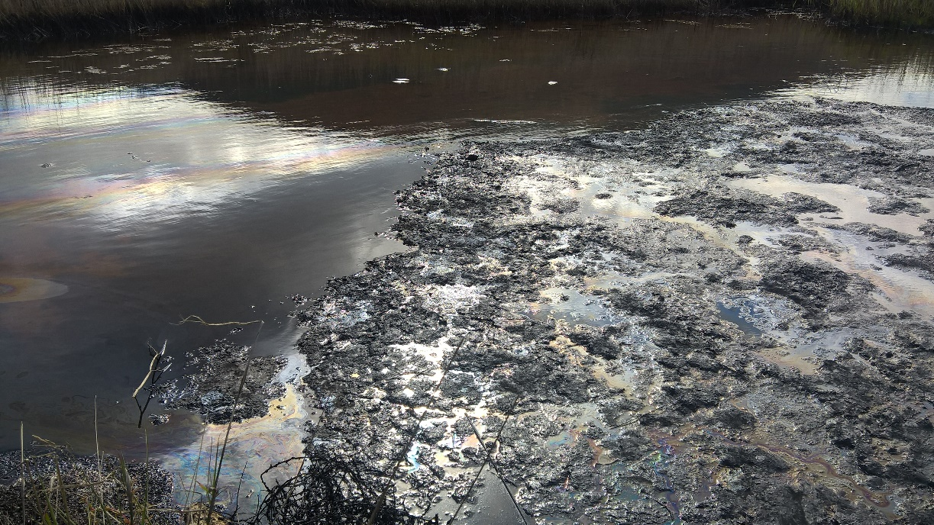
14th ICCP Training Course – General Organic Petrology Patras, October Friday 28th September, 2022
Geological Field Trips –Keri Mire on Zakynthos island

