Slide 1
Dispersed organic matter in sedimentary rocks WG
ICCP Commission II
Joint 74th ICCP and 39th TSOP Meeting, Patras, Greece, 2023
Convenors: Jolanta Kus, Paul C. Hackley, Paula Alexandra Gonçalves
Notes:
U.S. Geological Survey, Reston, Virginia, USA

Slide 2
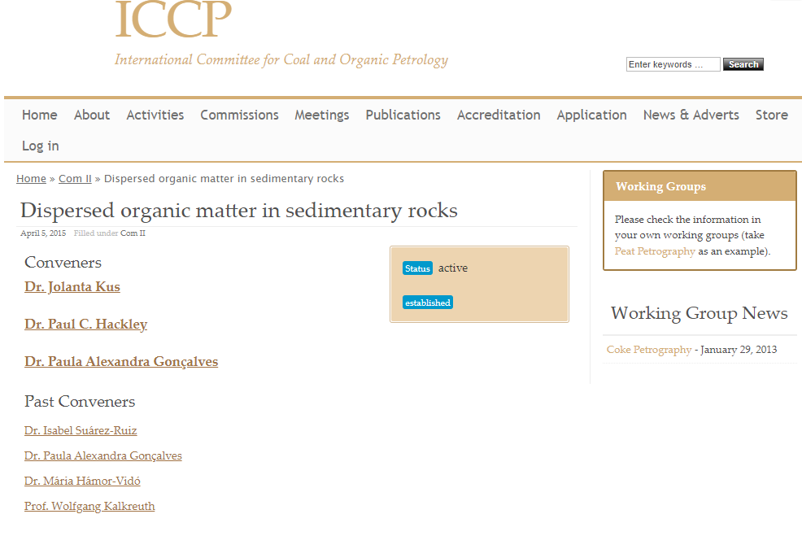
Dispersed organic matter in sedimentary rocks WG Objective
to provide: a review paper on application studies of DOM in geological context.
to be entitled: “Applications of dispersed organic matter petrology in the 21st century: a review”.
to be submitted: at IJCG with previous communication with Prof. Deolinda Flores and prior to internal reviews and approvals
at ICCP, BGR, USGS.
Dispersed organic matter in sedimentary rocks WG – Joint 74th ICCP and 39th TSOP Meeting, Patras, 2023
Notes:
Fibered light sources of a given specification depending on the bulb type, wavelength, output mode and measurement type (Absorbance, Fluorescence, Reflectance, Transmission or Calibration and with options for UV, Visible
Tungsten HalogenHL-2000 – red
Deuterium Tungsten HalogenDH-2000-BAL – blue

Slide 3
Dispersed organic matter in sedimentary rocks WG Activities
2022 & 2023
Zoom Call Meetings: (15.12.2022; 23.02.2023; 28.04.2023; 02.06.2023 & 04.09.2023).
Preparations: of text body, figures, and tables.
Publication: of call in 85 ICCP Newsletter 2023 (April; p. 16) to ICCP Members for submission of related publications (authored and co-authored).
ICCP News No. 85, 2023
Dispersed organic matter in sedimentary rocks WG – Joint 74th ICCP and 39th TSOP Meeting, Patras, 2023

Slide 4
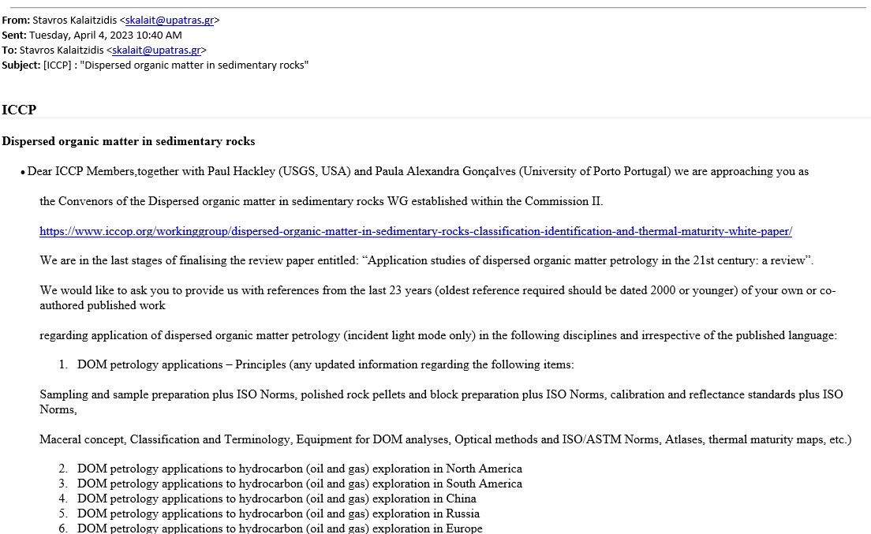
Dispersed organic matter in sedimentary rocks WG Activities
2022 & 2023
Circulation: of a call on the 04.04.2023 to ICCP Members in form of an e-mail sent by Stavros Kalaitzidis asking for submission of related publications (authored and co-authored).
Dispersed organic matter in sedimentary rocks WG – Joint 74th ICCP and 39th TSOP Meeting, Patras, 2023

Slide 5
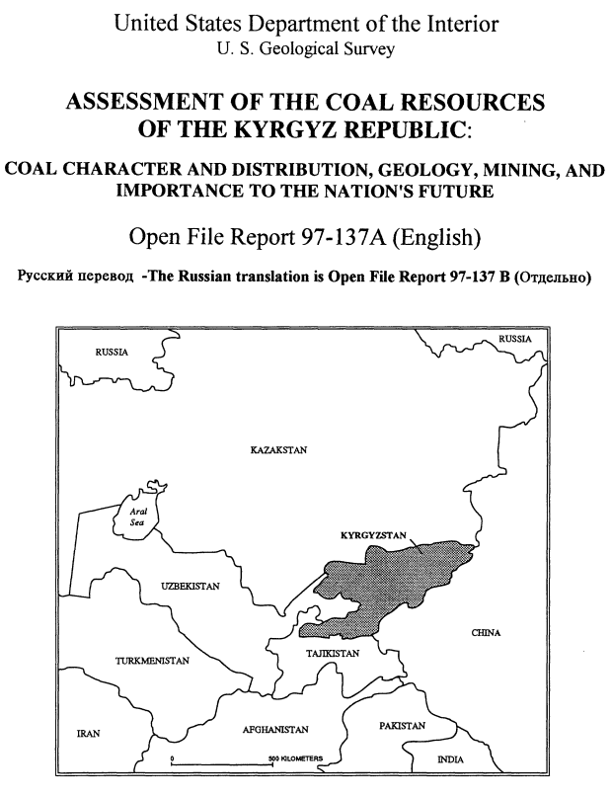
Dispersed organic matter in sedimentary rocks WG Activities
2022 & 2023
Replies from: Neely Bostick. Paul established a contact in order to supply any Russian study material that was translated into English. Paul did find a publication, which he had worked on:
“Assessment of the coal resources of the Kyrgyz Republic; coal character and distribution, geology, mining, and importance to the nation's future”
Open-File Report 97-137-A
By: Edwin R. Landis, N. H. Bostick, H.J. Gluskoter, C.D. Harrison, D.W. Huber, and E. A. Johnson
https://doi.org/10.3133/ofr97137A
Dispersed organic matter in sedimentary rocks WG – Joint 74th ICCP and 39th TSOP Meeting, Patras, 2023

Slide 6
Dispersed organic matter in sedimentary rocks WG Activities
2022 & 2023
Replies from: Peter Sobolev. Jolanta established a contact to check the GOST standards:
GOST 17070-2014. 2015. Coal. Terms and definitions. (ISO 1213-2:1992). Inter-State Council on Standardization, Metrology and Certification (ISC), Moscow, 19 p.
GOST 10742-71. Lignite, hard coal, anthracite, oil shale and coal briquettes. Sampling methods and preparation of samples for laboratory tests. (ISO 1988: 1975), State Committee of Standards of the Council of Ministers of the USSR. Moscow, 19 p.
GOST Р 55659-2013. Methods for the petrographic analysis of coals. Part 5. (ISO7404-5:2009) Method of determining microscopically the reflectance of vitrinite. Inter-State Council on Standardization, Metrology and Certification (ISC), Moscow, 19 p.
Dispersed organic matter in sedimentary rocks WG – Joint 74th ICCP and 39th TSOP Meeting, Patras, 2023

Slide 7
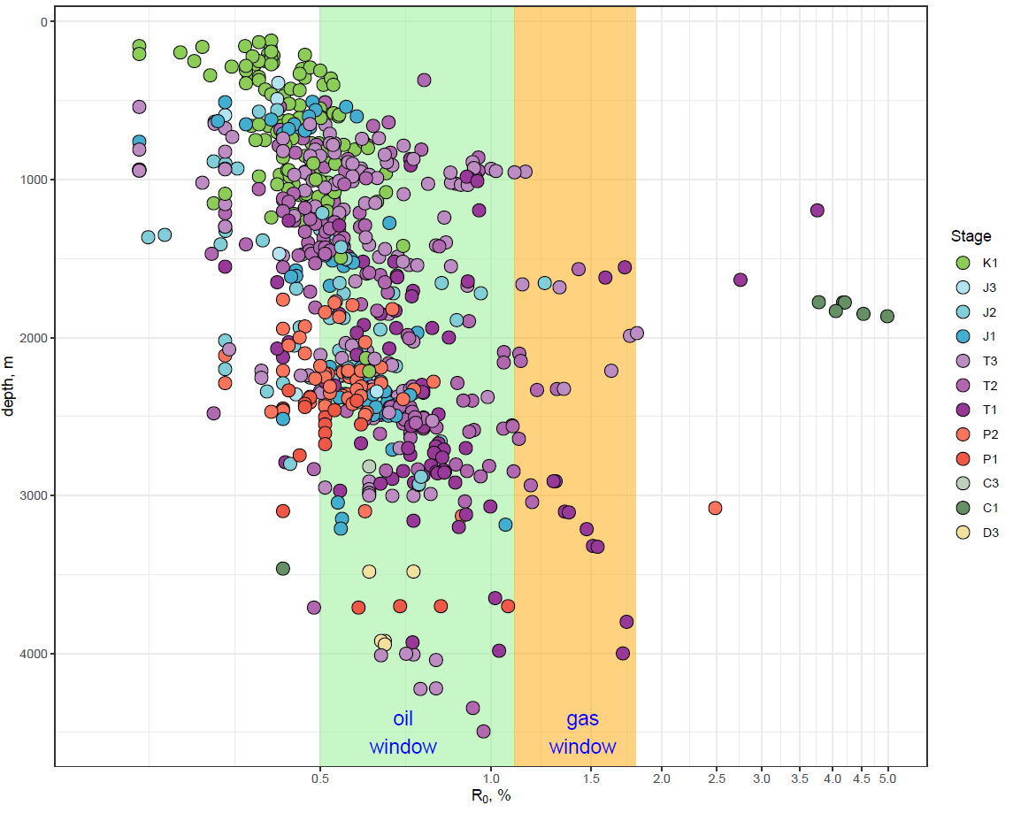
Dispersed organic matter in sedimentary rocks WG Activities
2022 & 2023
Replies from: Peter Sobolev. Jolanta established a contact for plots of VR vs depth for the Russian Barents Sea=Murmanskoye More.
Dispersed organic matter in sedimentary rocks WG – Joint 74th ICCP and 39th TSOP Meeting, Patras, 2023

Slide 8
Dispersed organic matter in sedimentary rocks WG Activities
2022 & 2023
Replies from: Aleksander Kostić (Serbia), Atul K. Varma (India), George Siavalas (The Netherlands), Georgeta Predeanu (Romania), Henrik Petersen (Denmark), Luo Qingyong (China), Ralf Littke (Germany), and Stavros Kalaitzidis (Greece).
Details of gold open access articles at IJCG:
Article Publishing Charge for this journal amounts to USD 4.270,00 excluding taxes.
Articles are freely available to both subscribers and the wider public with permitted reuse.
Request: to ICCP to financially cover for the publication charges of the gold open access of both manuscripts.
Dispersed organic matter in sedimentary rocks WG – Joint 74th ICCP and 39th TSOP Meeting, Patras, 2023

Slide 9
Dispersed organic matter in sedimentary rocks WG Activities
2022 & 2023
Details of gold open access articles at IJCG:
User rights:
Creative Commons Attribution (CC BY). Allows users to: distribute and copy the article; create extracts, abstracts, and other revised versions, adaptations or derivative works of or from an article (such as a translation); include in a collective work (such as an anthology); and text or data mine the article. These uses are permitted even for commercial purposes, provided the user: gives appropriate credit to the author(s) (with a link to the formal publication through the relevant DOI); includes a link to the license; indicates if changes were made; and does not represent the author(s) as endorsing the adaptation of the article or modify the article in such a way as to damage the authors' honor or reputation. | Creative Commons Attribution-NonCommercial-NoDerivs (CC BY-NC-ND). Allows users to: distribute and copy the article; and include in a collective work (such as an anthology). These uses are permitted only for non-commercial purposes, and provided the user: gives appropriate credit to the author(s) (with a link to the formal publication through the relevant DOI); provides a link to the license; and does not alter or modify the article.
Dispersed organic matter in sedimentary rocks WG – Joint 74th ICCP and 39th TSOP Meeting, Patras, 2023

Slide 10
Dispersed organic matter in sedimentary rocks WG Activities
2023
Decision to extract the Chapter 2 : “Dispersed Organic Matter in Organic Petrology” and to prepare a stand-alone review manuscript:
entitled: “The petrology of dispersed organic matter in sedimentary rocks: review and update” (Manuscript 1)
authored by: Paula A. Gonçalves, Jolanta Kus, Paul C. Hackley, Ángeles G. Borrego, Maria Hámor-Vidó, Wolfgang Kalkreuth, João G. Mendonça Filho, Henryk I. Petersen, Walter Pickel†, Martin J. Reinhardt†, Isabel Suárez-Ruiz
Decision to keep the remaining chapters and to prepare a stand-alone review manuscript:
entitled: “Applications of dispersed organic matter petrology in the 21st century: a review” (Manuscript 2)
authored by: Jolanta Kus, Paul C. Hackley, Paula A. Gonçalves
Dispersed organic matter in sedimentary rocks WG – Joint 74th ICCP and 39th TSOP Meeting, Patras, 2023
Notes:
Manuscript 1 - reference publication on disperesd organic matter

Slide 11
Dispersed organic matter in sedimentary rocks WG Activities
“Applications of dispersed organic matter petrology in the 21st century: a review” (Manuscript 2)
Contents
Introduction
Petroleum exploration (Europe, Russia, China, Africa, South America, North America)
Geothermal exploration
Disposal and management of radioactive waste
Paleoclimate
Geobiology
Environmental impact
Archaeology
Conclusions
Dispersed organic matter in sedimentary rocks WG – Joint 74th ICCP and 39th TSOP Meeting, Patras, 2023

Slide 12
Dispersed organic matter in sedimentary rocks WG Activities
“Applications of dispersed organic matter petrology in the 21st century: a review” (Manuscript 2)
Chaper: Petroleum exploration
Petroleum exploration (Europe, Russia, China, Africa, South America, North America):
conventional vs. unconventional,
basin-associated vs. country-associated approach,
sea-associated vs. sector-associated approach,
Russian concept of catagenesis substages: protocatagenesis (PK1-PK3), mesocatagenesis (MK1-MK5), and apocatagenesis (AK1-AK4),
Russian maceral terminology and classification: Ginzburg (1991), GOST 17070-2014, GОSТ 55659-2013, GOST 9414.1-94; reflectance standard: GOST 12113-94,
Petrological Atlas of Fossil Organic Matter of Russia authored by Petrov et al. (2006).
Dispersed organic matter in sedimentary rocks WG – Joint 74th ICCP and 39th TSOP Meeting, Patras, 2023

Slide 13
Dispersed organic matter in sedimentary rocks WG Activities
“Applications of dispersed organic matter petrology in the 21st century: a review” (Manuscript 2)
Chaper: Petroleum exploration
Petroleum exploration (Europe, Russia, China, Africa, South America, North America):
papers with inadequate or insufficient literacy related to qualitative and quantitative methodology in DOM were removed from the list of publications,
nomenclature and empirical equasions were kept in reference to the reviewed publication,
multi-region and generic studies,
methodological studies.
Dispersed organic matter in sedimentary rocks WG – Joint 74th ICCP and 39th TSOP Meeting, Patras, 2023

Slide 14
Dispersed organic matter in sedimentary rocks WG Activities
“Applications of dispersed organic matter petrology in the 21st century: a review” (Manuscript 2)
Review
Review at ICCP: It is intended to be reviewed by Commission II.
from 01.-30.11.2023 - November
circulate among active reviewers within Commission II
Revison: December
Review at BGR: till January
Review at USGS: till February
Dispersed organic matter in sedimentary rocks WG – Joint 74th ICCP and 39th TSOP Meeting, Patras, 2023

Slide 15
Dispersed organic matter in sedimentary rocks WG Activities
“Applications of dispersed organic matter petrology in the 21st century: a review” (Manuscript 2)
Submission
Submission: February - March 2024
Contact with IJCG Editors-in-Chief: Prof. Deolinda Flores
Dispersed organic matter in sedimentary rocks WG – Joint 74th ICCP and 39th TSOP Meeting, Patras, 2023

Slide 16
Dispersed organic matter in sedimentary rocks WG Activities
“The petrology of dispersed organic matter in sedimentary rocks: review and update”
(Manuscript 1)
Review
Review at ICCP: It is intended to be reviewed by Commission II.
from 01.-30.11.2023 – November
circulate among active reviewers within Commission II
Revison: December
Review at USGS: till January
Submission: February - March 2024
Contact with IJCG Editors-in-Chief: Prof. Deolinda Flores
Dispersed organic matter in sedimentary rocks WG – Joint 74th ICCP and 39th TSOP Meeting, Patras, 2023

Slide 17
Thank you very much for your attention!
Correction Function for Spectral Fluorescence Measurements WG – Joint 74th ICCP and 39th TSOP Meeting, Patras, 2023

Slide 18
Impressum
Herausgeber:
Bundesanstalt für Geowissenschaften und Rohstoffe
Stilleweg 2
30655 Hannover
Contact:
Dr. Jolanta Kus
Jolanta.Kus@bgr.de
Joint 74th ICCP and 39th TSOP Meeting, Patras, Greece, 2023
ICCP Commission II
Dispersed organic matter in sedimentary rocks WG
Stand: August 2023
Correction Function for Spectral Fluorescence Measurements WG – Joint 74th ICCP and 39th TSOP Meeting, Patras, 2023

