Slide 1


Standardisation of Fluorescence Measurements WG
ICCP Commission II
76th ICCP Meeting, Beijing, China, 2025
Present Conveners: Dr. Jolanta Kus, Dr. Paul C. Hackley
Former Conveners: Dr. Maria Ángeles Gómez Borrego, Carla Araujo,
Dr. Joalice O. Mendonça, Richard Orban
Notes:
Institute of Carbon Science and Technology (INCAR-CSIC) at the Spanish National Research Council

Slide 2
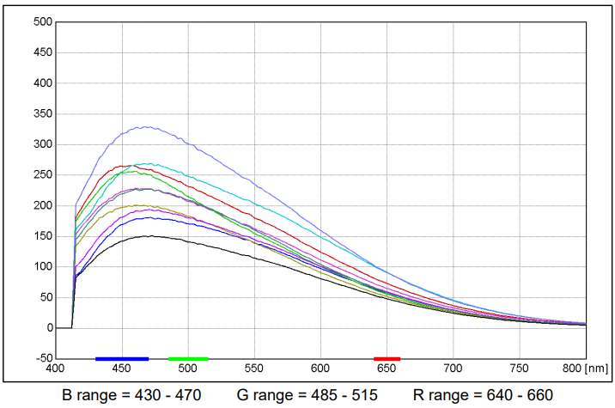
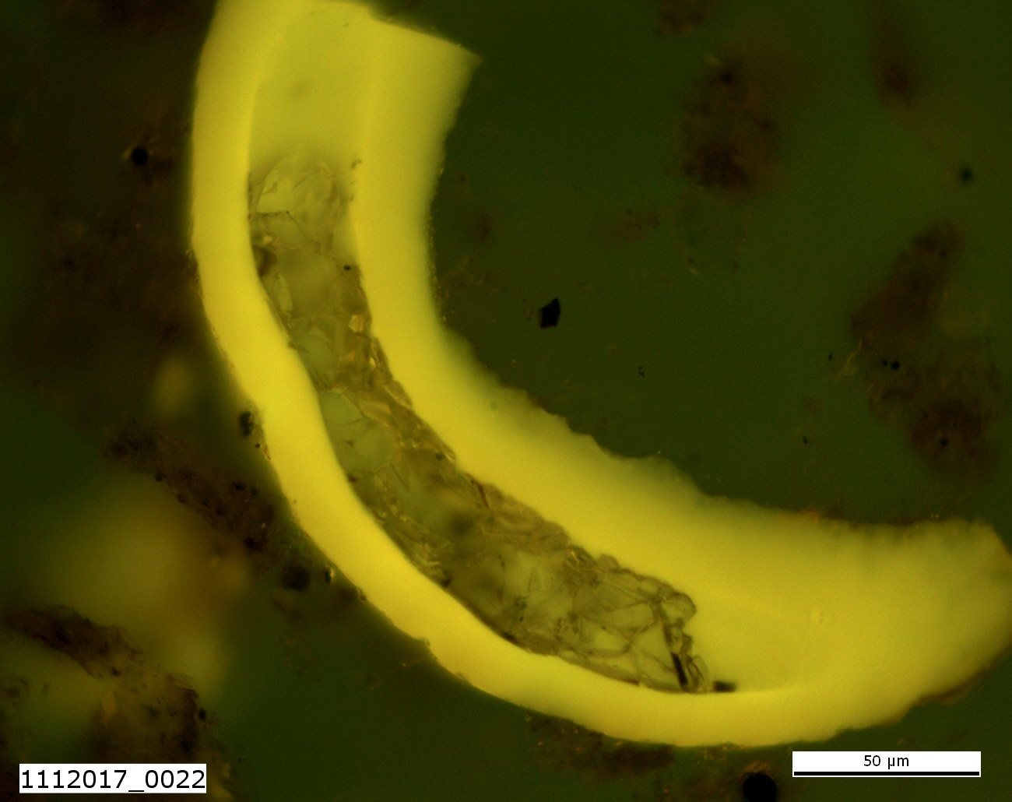
Standardisation of Fluorescence Measurements WG
In 2025, the former Correction Function WG changed its name to:
Standardization of Fluorescence Measurements WG.
Objective:
to standardize spectral fluorescence measurements of sedimentary organic matter in rocks.
Methodology
Calibration device(s)
https://www.iccop.org/workinggroup/standardization-of-fluorescence-measurement-wg/
Sample: Paul Hackley (USGS)
Kentucky, Huron Mb., Ohio Shale Formation,
Upper Devonian (Famennian)
Standardisation of Fluorescence Measurements WG – 76th ICCP Meeting, Beijing, China, 2025
Notes:
Fibered light sources of a given specification depending on the bulb type, wavelength, output mode and measurement type (Absorbance, Fluorescence, Reflectance, Transmission or Calibration and with options for UV, Visible
Tungsten HalogenHL-2000 – red
Deuterium Tungsten HalogenDH-2000-BAL – blue

Slide 3
Standardisation of Fluorescence Measurements WG
Brief outline:
Fluorescence microscopy has been applied to the petrology of sedimentary organic matter since 1936 (Schochardt, 1936; cited in Taylor et al., 1998, p. 407).
The measurement of spectral fluorescence by recording the emission spectrum between 400–750 nm has grown steadily in importance since the 1970s (e.g., Jacob, 1965; van Gijzel, 1967, 1975, 1981; Ottenjann et al., 1975; Ting and Lo, 1975; Alpern, 1976; Teichmüller and Ottenjann, 1977; Ottenjann, 1980; Teichmüller, 1982, 1984).
Spectral fluorescence parameters [e.g., λmax; red to green ratio (Q)] can be used to determine thermal maturity in dispersed organic matter (e.g., Pradier et al., 1988, 1991; Stasiuk, 1994; Thompson-Rizer and Woods, 1987).
Araujo et al. (1998, 2014) conducted two interlaboratory exercises organized within ICCP Thermal Indices Working Group with the purpose of improving the reproducibility and comparability of spectral fluorescence measurements with calibrated ICCP lamp source sensu Baranger et al. (1991).
Standardisation of Fluorescence Measurements WG – 76th ICCP Meeting, Beijing, China, 2025

Slide 4
Standardisation of Fluorescence Measurements WG
2025 Activities:
Preparation and conduction of 2025 preliminary test in conjunction with BAM (The Federal Institute for Materials Research and Testing, Berlin, Germany).
Well-designed methodology of spectral fluorescence measurements:
(e.g., warm-up time; distance to the objective; type of objective, magnification, and numerical aperture; background correction; dark current correction, filters set, etc.).
Hardware:
1. ICCP lamp source 2B
2. Glass-based Multi-emitter Fluorescence Standard (ME Slide) of BAM (Dr. U. Resch-Gengner (BAM) kindly offered to supply us with the reference material ME Slide of BAM-F012).
3. Polished resin block 1 prepared by LAOP (Das Labor für Angewandte Organische Petrologie, eng.: The Laboratory for Applied Organic Petrology), Tübingen, Germany.
Standardisation of Fluorescence Measurements WG – 76th ICCP Meeting, Beijing, China, 2025

Slide 5
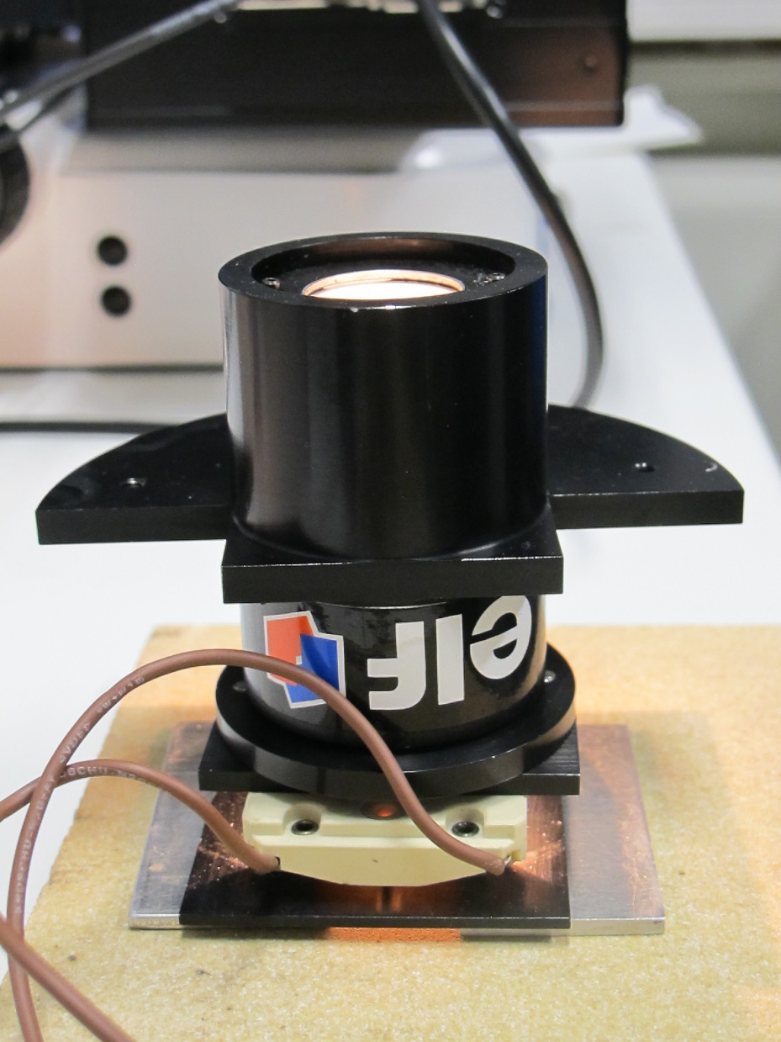
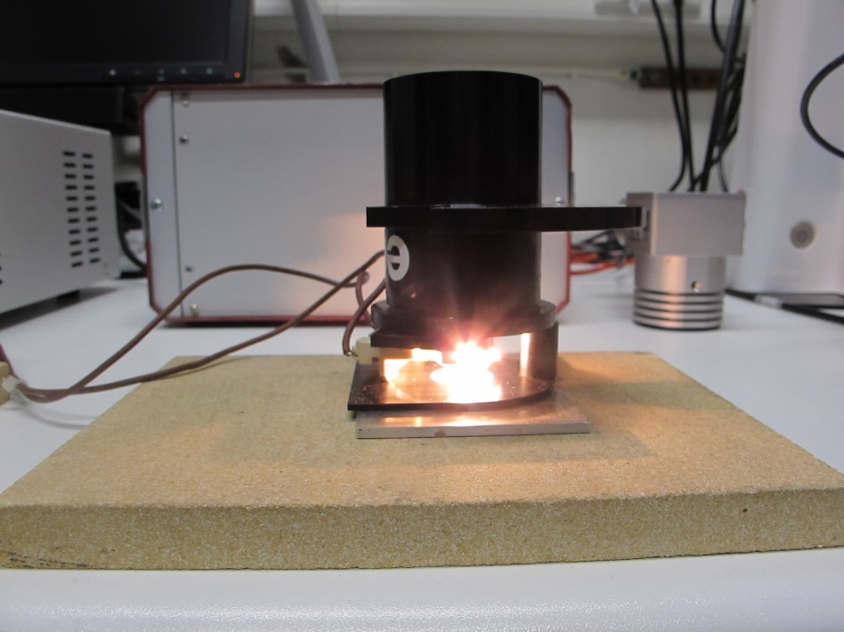
Standardisation of Fluorescence Measurements WG
Calibration standards
ICCP lamp source (e.g., lamp 2B, 3, 5) – Old lamp source
Quartz-iodine lamps acquired from Laboratoire National d‘Essais
(National Testing Laboratory). Laboratoire National d‘Essais is today
Laboratoire National de Métrologie et d‘Essais (National Laboratory
of Metrology and Testing). https://www.lne.fr/fr
Spectral correction for the
entire emission spectrum
using relative correction function.
Standardisation of Fluorescence Measurements WG – 76th ICCP Meeting, Beijing, China, 2025
Notes:
Quartz iodine lamps, which incorporated the elemental iodine, were the first commercial halogen lamps being sold.

Slide 6
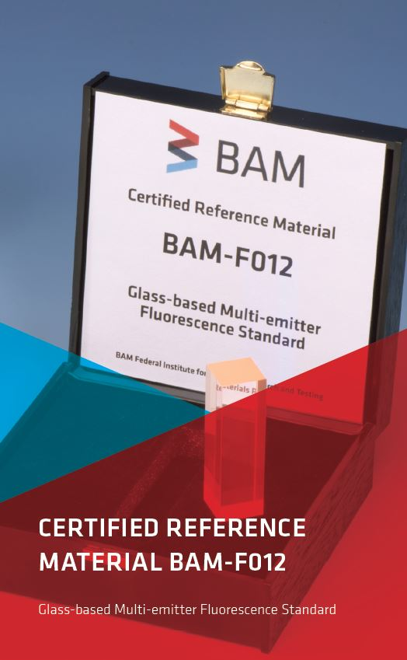
Standardisation of Fluorescence Measurements WG
Calibration standards
Certified reference materials (e.g., BAM-F012) – New reference materials
- Glass-based Multi-emitter Fluorescence Standard (ME Slide).
- Normalized, spectrally corrected emission spectrum of eight bands and
shoulders.
- It is a lanthanum phosphate glass melt doped with the luminescent rare
earth (RE) metal ions: Cerium (III), Terbium (III), and Europium (III).
- Correction of wavelength and emission intensity based on eight emission
peaks.
Standardisation of Fluorescence Measurements WG – 76th ICCP Meeting, Beijing, China, 2025
Notes:
The fluorescence spectrum of the ME glass consists of several relatively sharp emission bands in the wavelength region between 450 nm and 720 nm.
for Instrument Performance Validation (IPV) of fluorescence measurement instruments in terms of wavelength accuracy of the emission channels-

Slide 7
Standardisation of Fluorescence Measurements WG
2025 Activities:
Participants:
BAM (The Federal Institute for Materials Research and Testing, Berlin, Germany)
INCAR (Institute of Carbon Science and Technology, Oviedo, Spain)
USGS (United States Geological Survey, Huston VA, USA)
UFRJ (Universidade Federal do Rio de Janeiro, Rio de Janeiro, Brasil)
AU (Aarhus University, Aarhus, Denmark)
BGR (The Federal Institute for Geosciences and Natural Resources, Hannover, Germany)
Standardisation of Fluorescence Measurements WG – 76th ICCP Meeting, Beijing, China, 2025
Notes:
The Institute of Carbon Science and Technology (INCAR) in Oviedo, Spain, is a research center of the Spanish National Research Council (CSIC) focusing on various aspects of carbon, energy, and materials science, including CO2 capture, biocarbon, and carbonization technologies.

Slide 8
Standardisation of Fluorescence Measurements WG
2025 Activities: 2025 preliminary test results – Absolute intensity of the ICCP Lamp 2B
Measured absolute intensity of the ICCP Lamp 2B in 2025 by BGR and INCAR.
Average of N=10 to N= 14
ZEISS AXIO Imager M2m and Leica DM 4500 P
TEC-5 Spectrometer (spectral range: 200 nm- 980 nm, MCS FLEX CCD 1044 pixel Peltier cooled) and MSP 400 Tidas CCD and monochromator with diffraction grating)
Note: measurements on two different days (D1, D2) and with different objective types as well as spectrometer types.
Standardisation of Fluorescence Measurements WG – 76th ICCP Meeting, Beijing, China, 2025
Notes:
A CCD or Charge Coupled Device is a highly sensitive photon detector or sensor. It is a silicon-based multi-channel array detector builf of an array of linked, or coupled, capacitors. The capacitors are represented by p-doped metal–oxide–semiconductor (MOS) capacitors.
TEC 5 - Compact diode array based spectrometer, UV to extended NIR wavelength ranges . Back-thinned CCDs anre detectors which are back-illuminated. They are characterised by their direct sensitivity to UV light. To reduce dark current, this detector has an integrated Peltier cooling system. The special alloy of the housing completes the excellent thermal properties of the MCS FLEX. The significantly improved thermal stability and low stray light ensure reliable measuring results. The blazed flat-field grating for light dispersion and imaging. The overall configuration results in a spectral pixel resolution of 0.8 nm/ pixel, enabling a spectral resolution of better than 3 nm in accordance with the Rayleigh criterion.

Slide 9
Standardisation of Fluorescence Measurements WG
2025 Activities: 2025 preliminary test results – Relative correction function
Standardisation of Fluorescence Measurements WG – 76th ICCP Meeting, Beijing, China, 2025
Notes:
Relative spectral correction functions adjust raw spectral measurements by accounting for instrument-specific factors like the varying sensitivity of a detector or the spectral shape of a light source.
These functions are determined using a calibrated reference light source and detector and are scaled by the instrument's spectral response. So these produce a spectral shape that is independent of the instrument's characteristics, yielding a more accurate representation of the actual light source
The relative correction functions display again evident differences between both set-ups of microscope brands, types and spectrometer designs. The relative correction functions were most aligned for water objectives, intermediate with oil objectives and were least aligned with dry objectives of INCAR.

Slide 10
Standardisation of Fluorescence Measurements WG
2025 Activities: 2025 preliminary test results – Emission spectrum of BAM-F012
612 nm
BGR Emission spectrum of BAM-F012 at D1 measured at:
ZEISS AXIO Imager M2m (Excitation: 365 nm with 63 xw objective
with Spectrometer: TEC-5 Spectrometer (spectral range: 200 nm- 980 nm, MCS FLEX CCD)
Average of N=10
Note: measurement on day 1 (D1) and emission spectra with two different resolution at 1 nm (uncorrected; black) and 5 nm (corrected; red))
618 nm
590 nm
701 nm
543 nm 548 nm
488 nm
653 nm
Standardisation of Fluorescence Measurements WG – 76th ICCP Meeting, Beijing, China, 2025
Notes:
The normalized emission intensities of eight characteristic bands used for certification of the emission wavelength pattern.

Slide 11
Standardisation of Fluorescence Measurements WG
2025 Activities: 2025 preliminary test results – Emission spectrum of BAM-F012
INCAR Emission spectrum of BAM-F012 at D2 measured at:
Leica DM 4500 P (Excitation: 365 nm with 20 xw objective)
with Spectrometer: MSP 400 Tidas CCD, monochromator with diffraction grating
Average of N=12
Note: measurement on day 2 (D2) and emission spectra with one resolution at 5 nm (uncorrected and corrected).
Standardisation of Fluorescence Measurements WG – 76th ICCP Meeting, Beijing, China, 2025
Notes:
The raw (not normalized) emission intensities of eight characteristic bands used for certification of the emission wavelength pattern.

Slide 12
Standardisation of Fluorescence Measurements WG
2025 Activities: 2025 preliminary test results – Emission spectrum of BAM-F012
BGR (63 xw objective) and BAM data points for the peaks of BAM-F012 overlap.
INCAR (20 xw objective) peaks fit very well, being slightly offsetted, especially in the blue light spectrum.
Note: measurement on day 2 (D2) and emission spectra with one resolution at 5 nm (uncorrected and corrected)
Standardisation of Fluorescence Measurements WG – 76th ICCP Meeting, Beijing, China, 2025

Slide 13
Standardisation of Fluorescence Measurements WG
2025 Activities: 2025 preliminary test results – Emission spectrum of epoxy resin block 1
421 nm
440 nm
Standardisation of Fluorescence Measurements WG – 76th ICCP Meeting, Beijing, China, 2025

Slide 14
Standardisation of Fluorescence Measurements WG
2025 Activities: 2025 preliminary test results – Emission spectrum of epoxy resin block 1
425 nm
460 nm
Standardisation of Fluorescence Measurements WG – 76th ICCP Meeting, Beijing, China, 2025

Slide 15
Standardisation of Fluorescence Measurements WG
2025 Activities: 2025 preliminary test results – Preliminary remarks
The displayed absolute intensity of the ICCP Lamp 2B measured by BGR (63 xw objective) and INCAR (20 xw objective) differs in spectral resolution (1 nm vs 5 nm, respectively) and reflects the overall spectrometer design and fabrication. “The design's resolution capacity vs. sensitivity”.
The relative correction functions display again evident differences between both set-ups of microscope brands, types and spectrometer designs. The relative correction functions were most aligned for water objectives, intermediate with oil objectives and were least aligned with dry objectives of INCAR.
The emission spectra of BAM-F012 under given set-up were well-comparable with BGR and INCAR peaks fitting well with BAM peaks. In the blue light spectrum, the INCAR peaks displayed a slight offset.
The emission spectrum of epoxy resin block 1 yielded differences in the overall signal-to noise ratio, owing possibly to lower sensitivity capacity of the MSP 400 Tidas CCD spectrometer for the given set-up. Nevertheless, the lambda max of both spectra differ by c. 15 nm.
Standardisation of Fluorescence Measurements WG – 76th ICCP Meeting, Beijing, China, 2025

Slide 16
Thank you very much for your attention!
Sample: Paul Hackley (USGS)
E210402-005 NY, Chicago, St. Louis 73-75
Huron Mb., Ohio Shale Formation,
Upper Devonian (Famennian)
Standardisation of Fluorescence Measurements WG – 76th ICCP Meeting, Beijing, China, 2025

Slide 17
Impressum
Herausgeber:
Bundesanstalt für Geowissenschaften und Rohstoffe
Stilleweg 2
30655 Hannover
Contact:
Dr. Jolanta Kus
Jolanta.Kus@bgr.de
75th ICCP Meeting, Oviedo, Spain, 2024
ICCP Commission II
Standardisation of Fluorescence Measurements WG
Stand: September 2025
Standardisation of Fluorescence Measurements WG – 76th ICCP Meeting, Beijing, China, 2025

