Slide 1


COMMISSION II: Geological Applications of Coal and Organic Petrology
Geological Application of Graptolite Reflectance
Conveners:
Sherry (Xiaowei) Zheng¹, Thomas Gentzis²
China University of Petroleum, Beijing, China
Core Laboratories, 6316 Windfern Rd., Houston, TX, USA 77040
18 Sep, 2025 Beijing

Slide 2
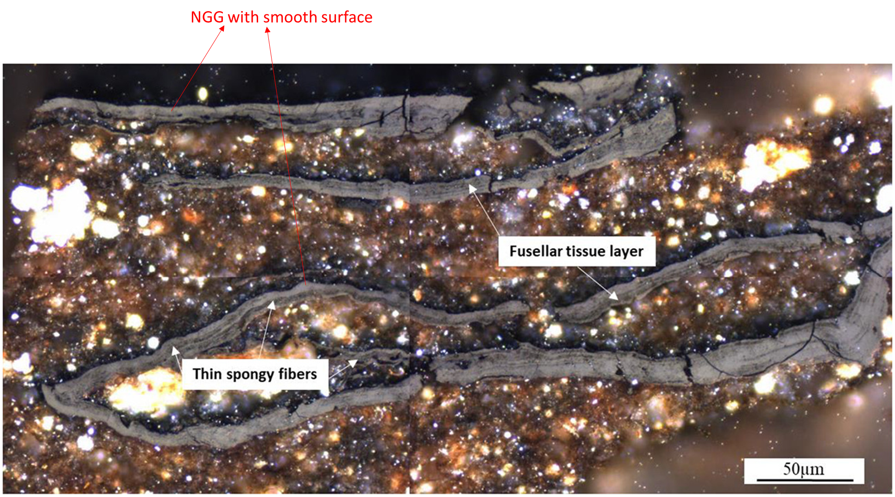
Lower Ordovician (Tremadocian) , Keila, well Core601, western Estonia

Slide 3
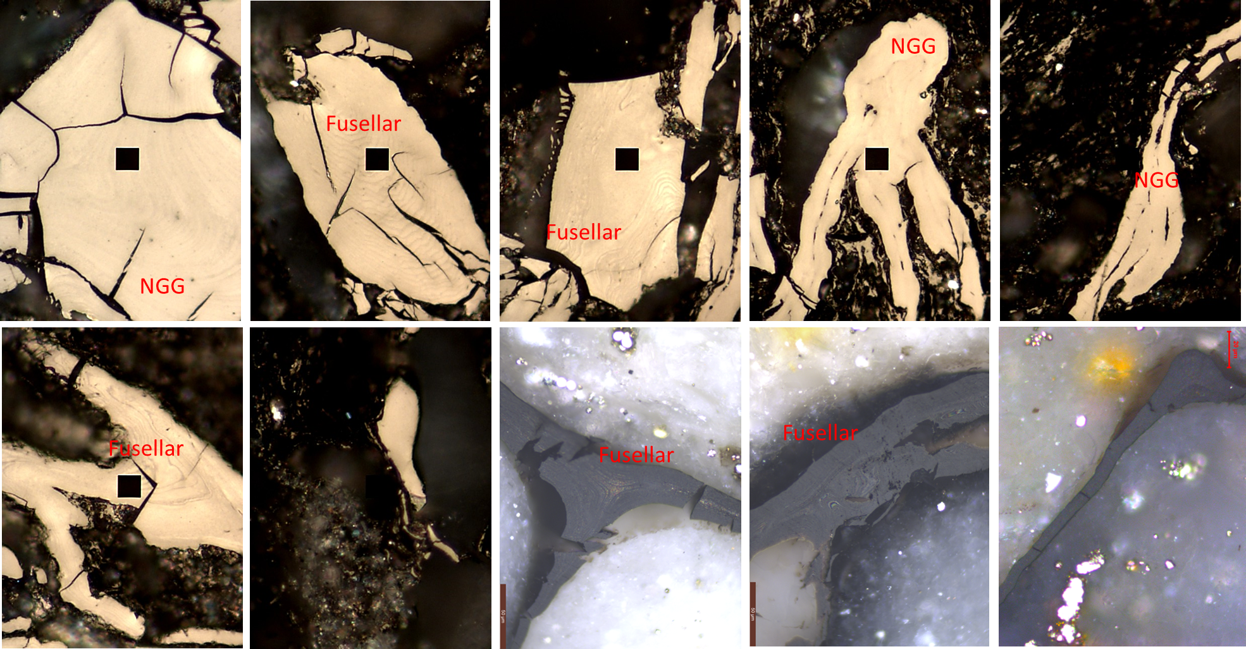
Typical Fusellar

Slide 4
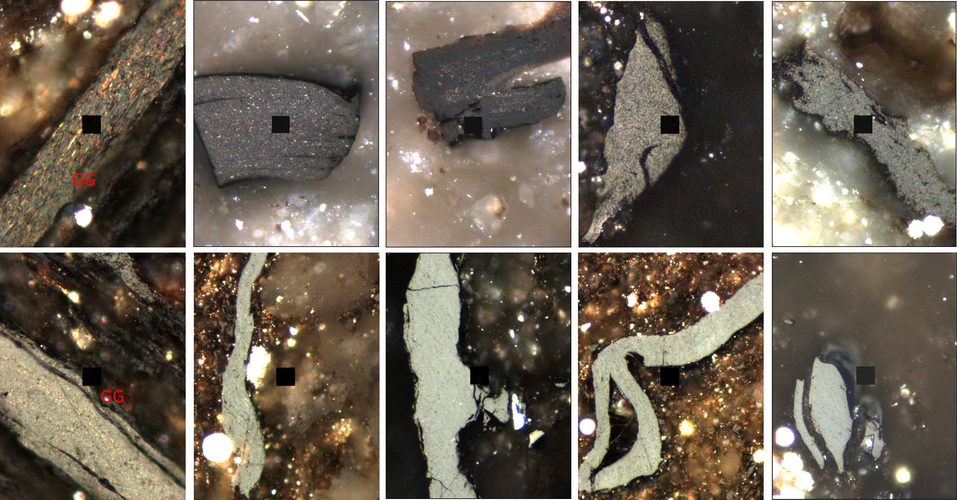

Slide 5
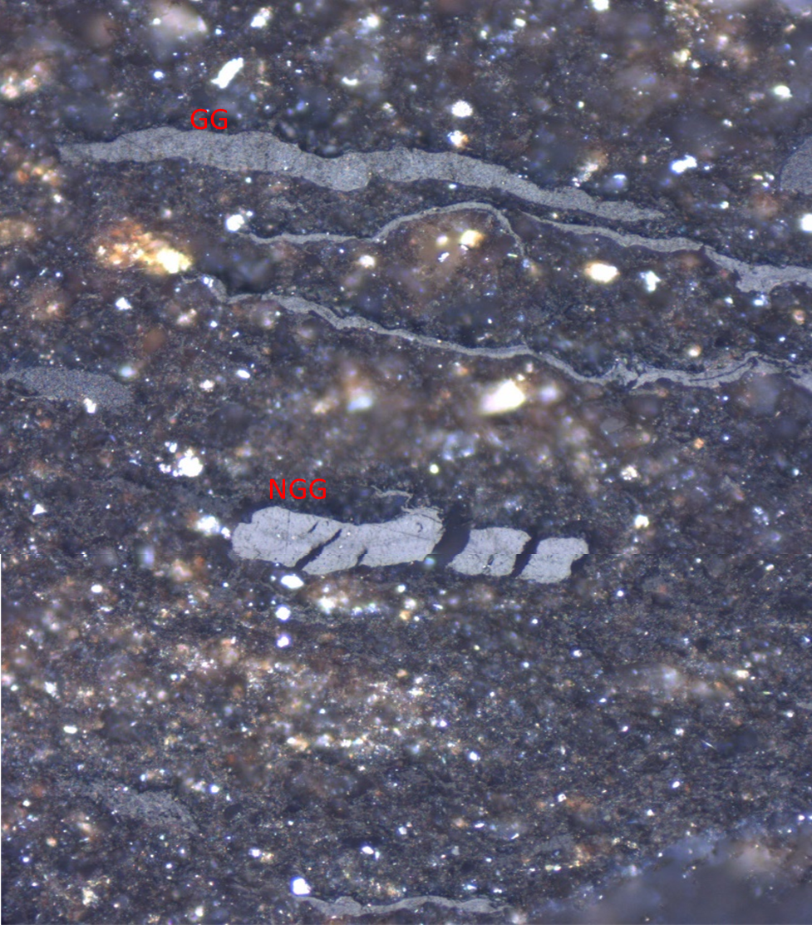
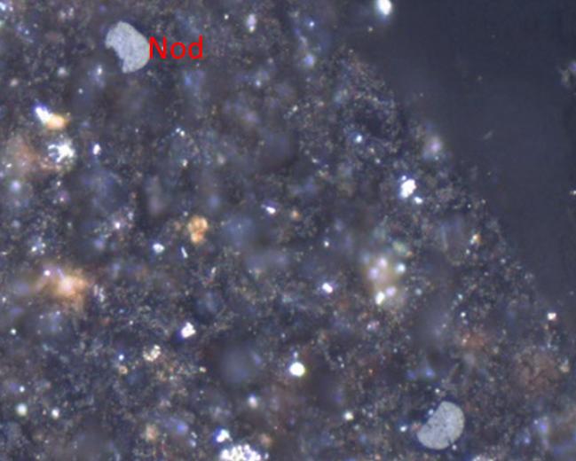
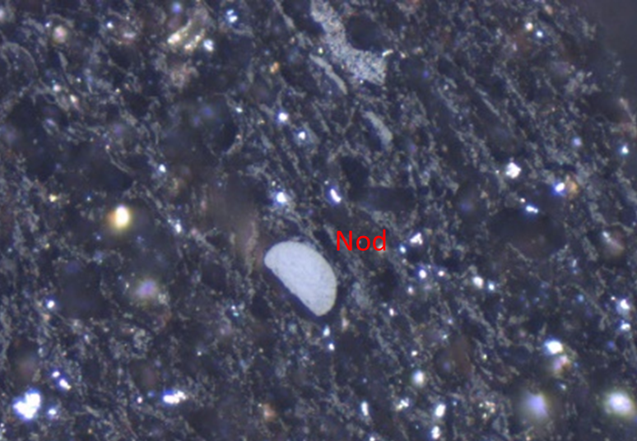
After gold tube hydrous pyrolysis of 300 ℃ for 72 hrs, Lower Ordovician (Tremadocian) , Keila, well Core601, western Estonia

Slide 6
Background and Timeflow
Established
2022 ICCP Meeting, New Delhi
Call
ICCP Newsletter No. 84, Dec 2022
Workgroup Webpage in Commission II, July 2023
Release
2023 ICCP|TSOP Meeting
Participants & Samples preparation
Exercise
Sample delivery (Pick up by person on 2023 ICPP + shipping)
Data collection
Data collect until August, 5
Report on 2024 ICCP
Summary and Update
2025 ICCP

Slide 7
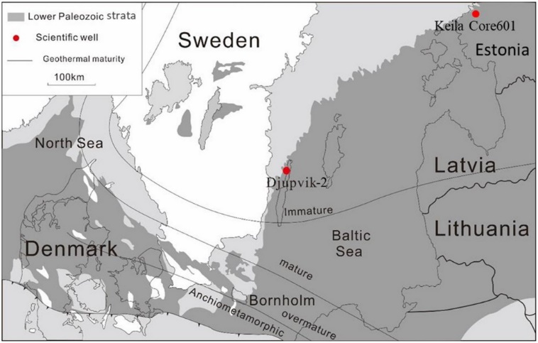
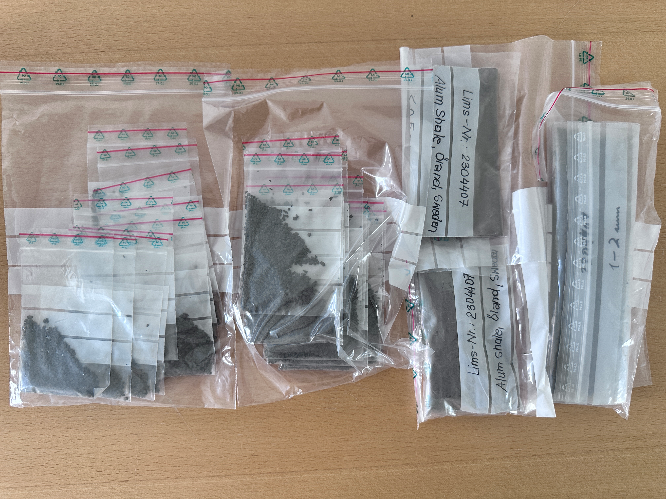

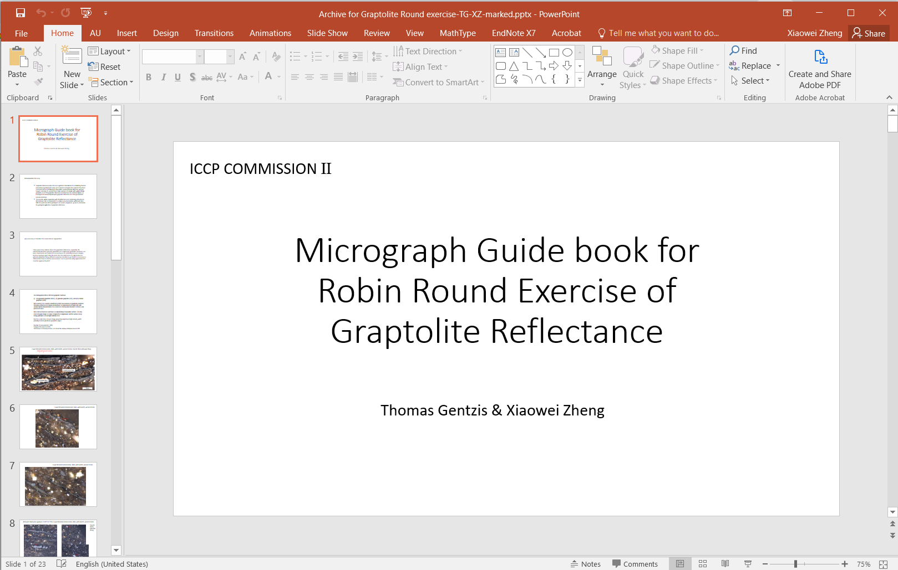
Proposed inter-laboratory studies
Pool for potential inter-lab studies
General round robin exercises on samples with well-identifiable graptolite to measure reflectance values.
Testing the graptolite reflectance anomaly from one sedimentary basin.
Investigate the relationship between graptolite reflectance and other geochemical maturity indicators.
1st Round Exercise
Öland
Work group establishment
Sample set preparation
Robin Round in turn
Data analysis
An Alum shale outcrop sample was collected from Öland, Sweden (56.238˚, 16.405˚)

Slide 8
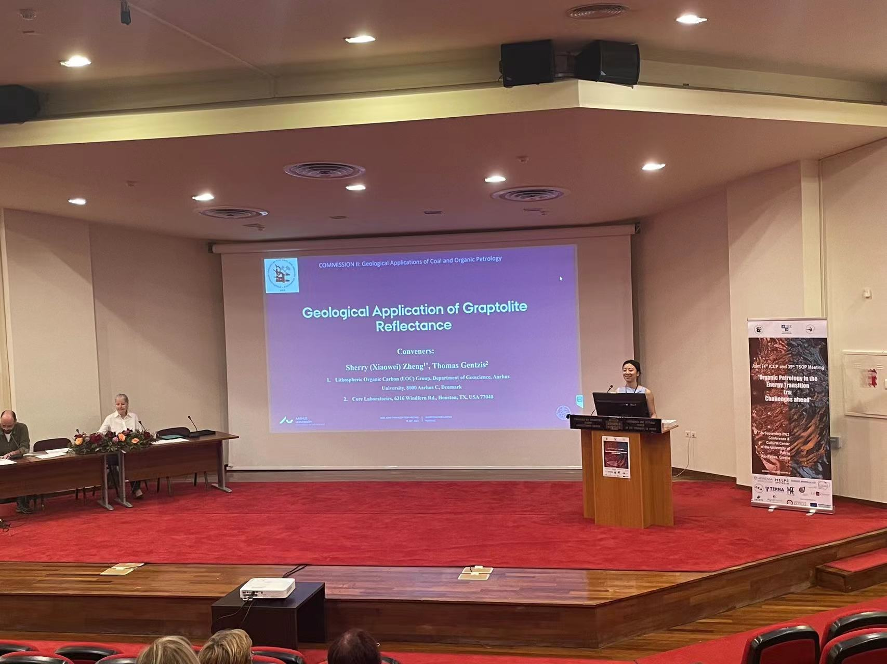
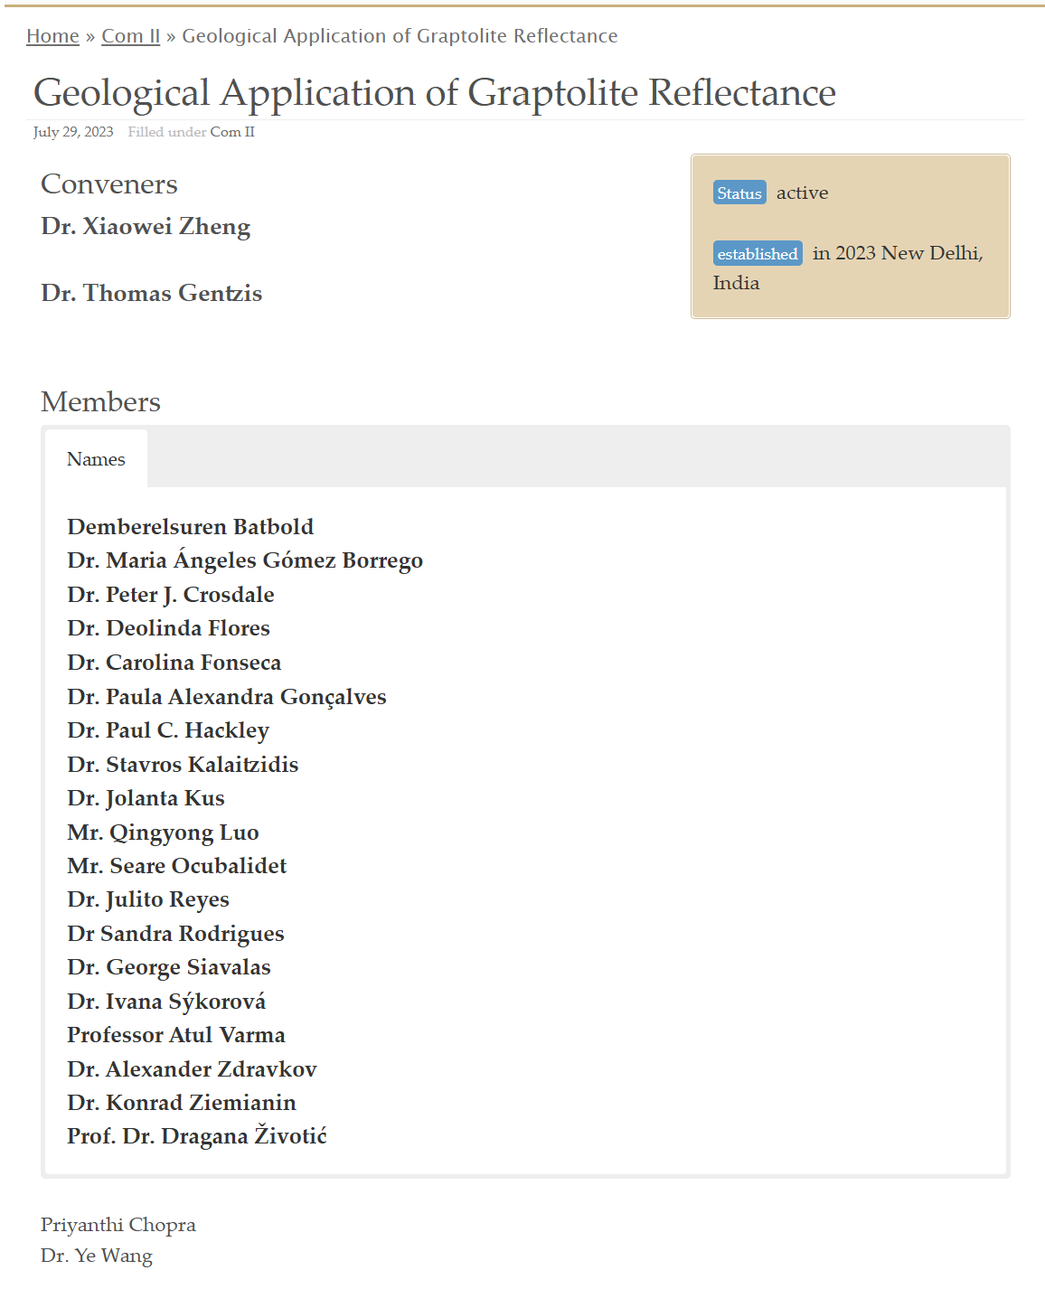
2023 Round Robin Exercise
J.Nedzweckas
Seare Ocubalidet
Greg Lis
2023 ICCP
Currently
2 Conveners
24 Participants
15 Results received

Slide 9
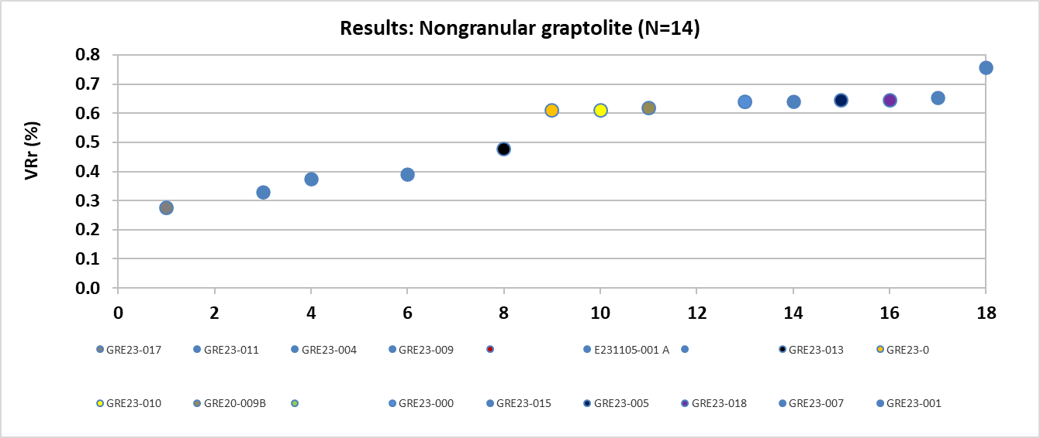
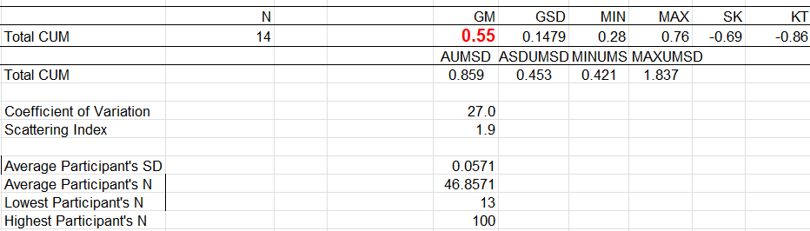
Data analysis—in order

Slide 10
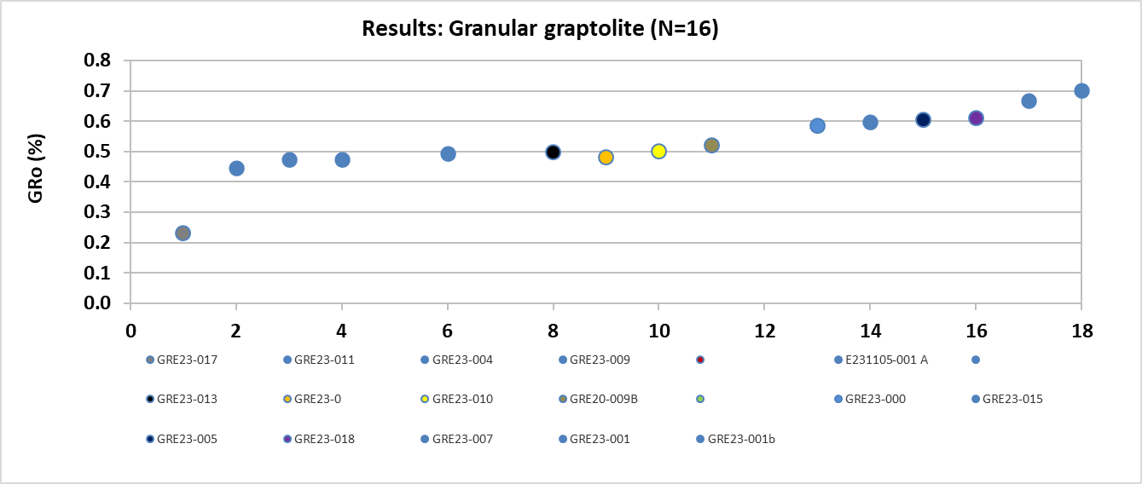
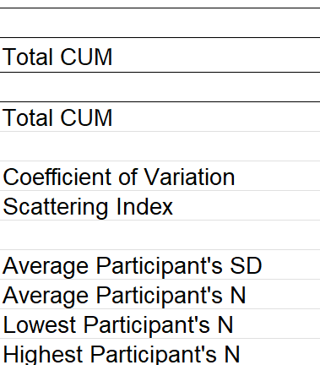
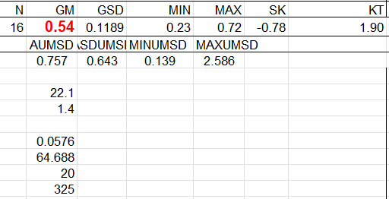
Data analysis—in order

Slide 11
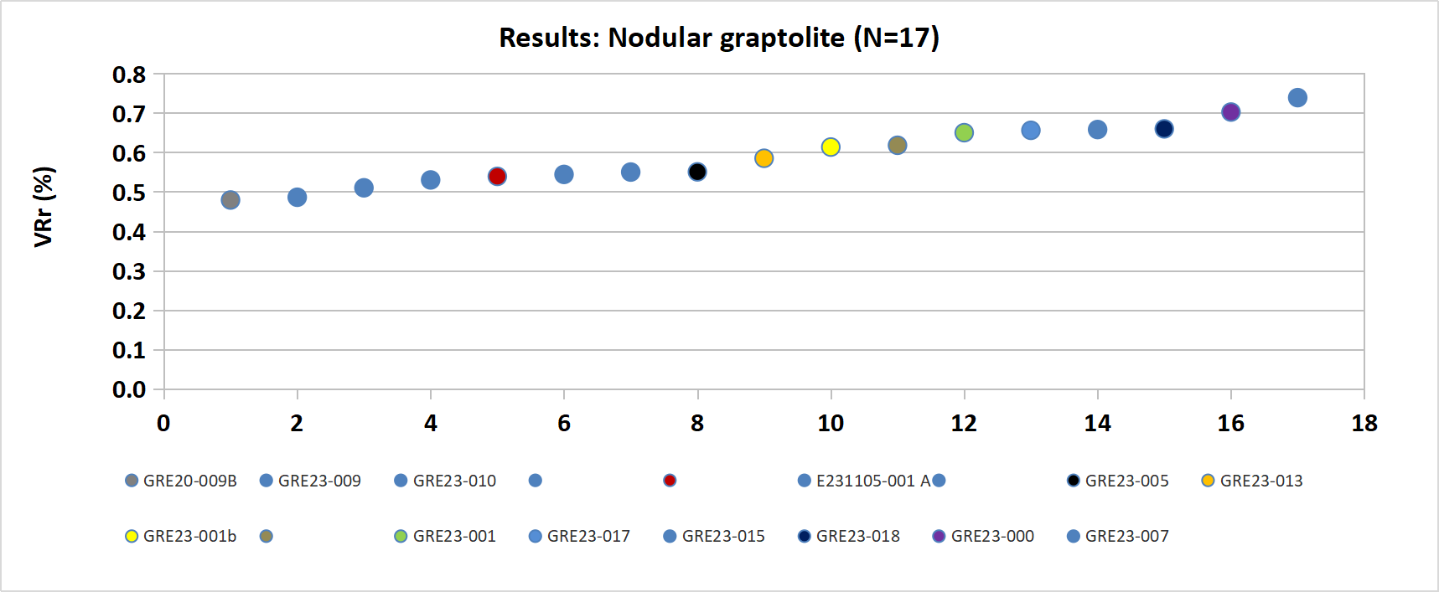
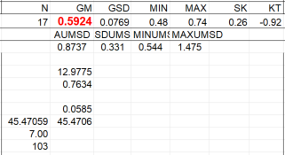
Data analysis—in order

Slide 12
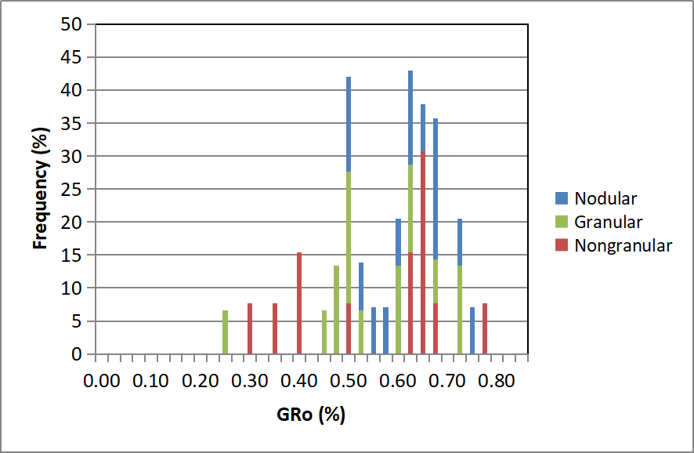
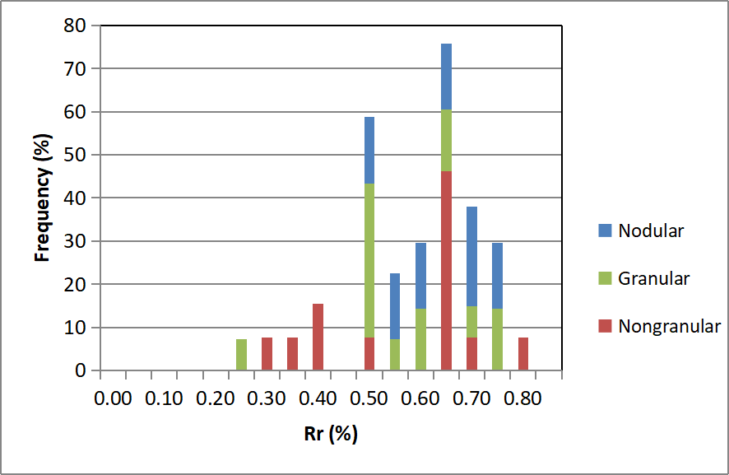
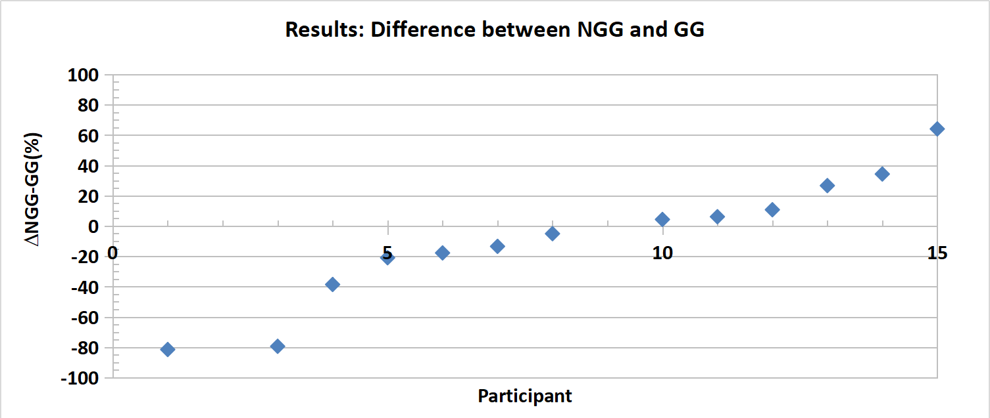
Data analysis—in order
By：0.025
By：0.05

Slide 13
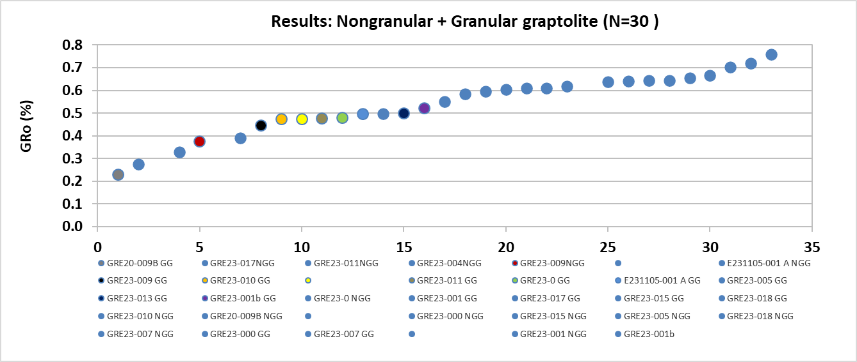
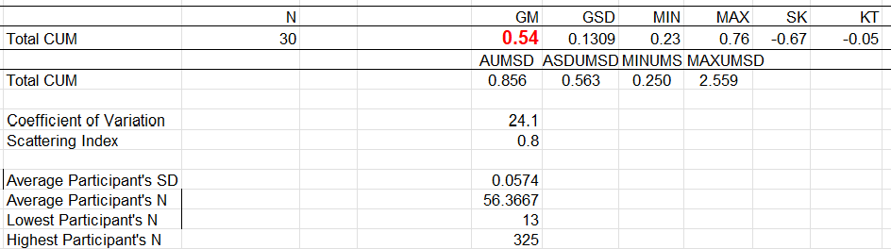
Data analysis—in order

Slide 14
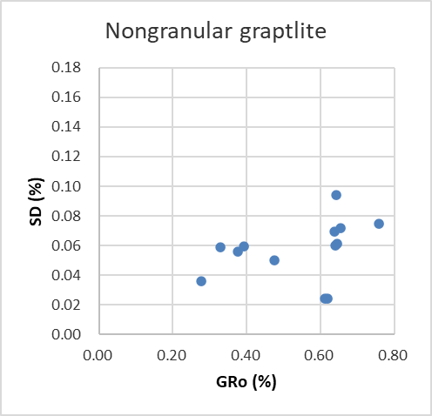
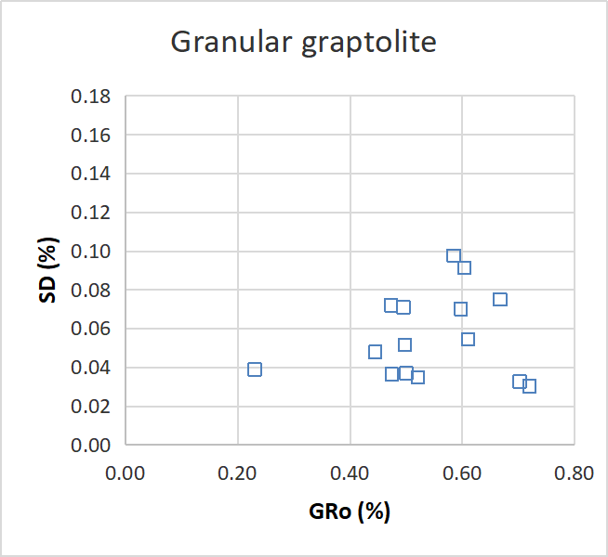
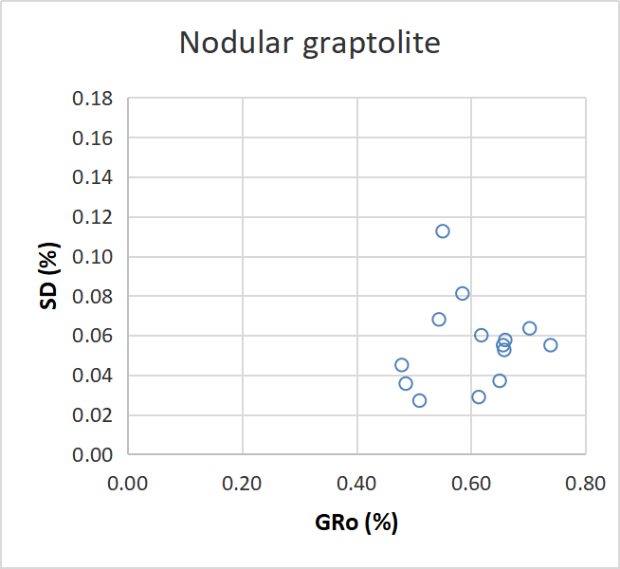
Data analysis—SD vs GRo
Notes:
any tendency or correlation between the Rr % and SD, etc. Once the report is written, it will have to be circulated among the participants with the aim to approve it.

Slide 15
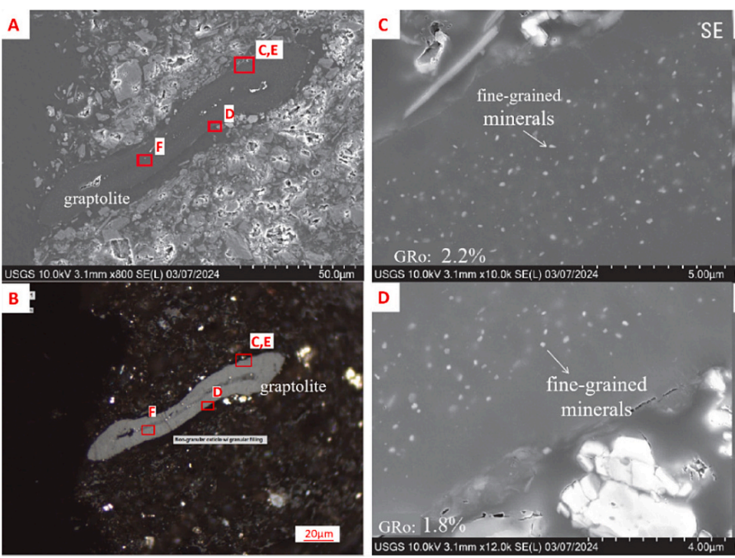
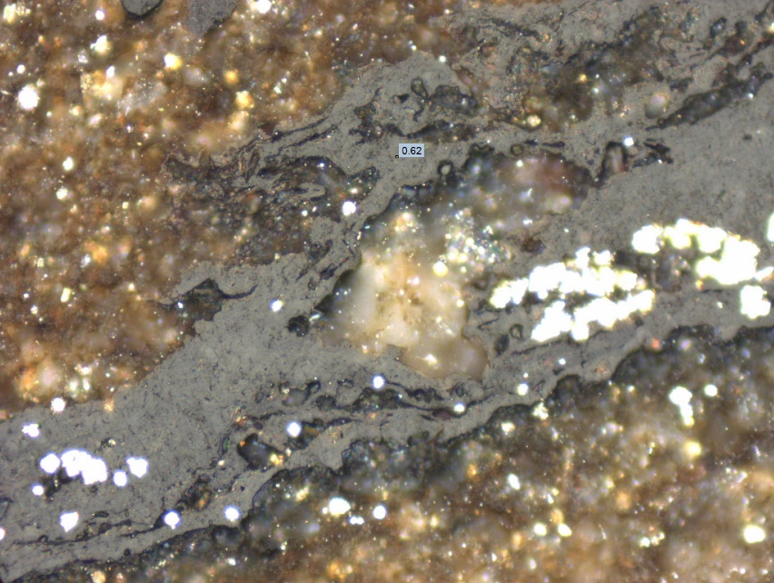
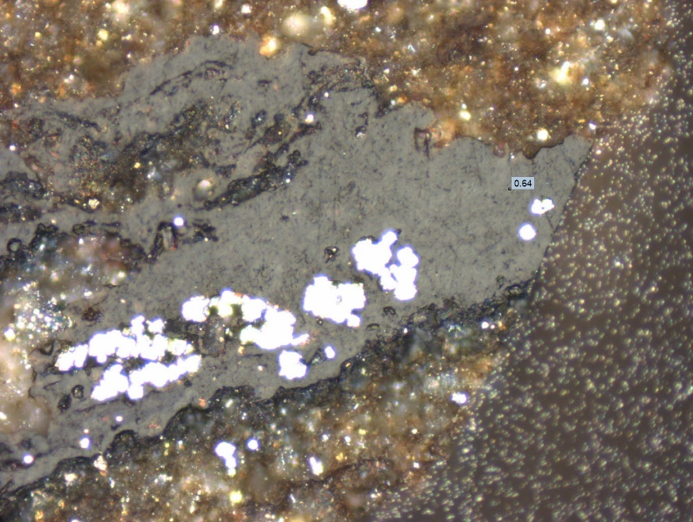
Some remarks from participants
GRE23-015（Peter Crosdale）：
I would like to comment that I had trouble with the smooth category in that there appeared to be a range of continuous morphologies from cleat graptolite to a more bituminite-like substance, all within the same reflectance range and all with variable fluorescence properties.
GRE23-007(Alexander Zdravkov):
GG particles are commonly heavily mineralized or impregnated by solid bitumens …the very fine structure of GG and the significant GRo variations …., there is significant variation of GRo and so the standard deviation is quite high.

Slide 16
Reasons for discrepancy and Special attention
Potential reasons for discrepancy:
Not all of the three types of graptolite can be observed by all participants
Inaccurate categorization between granular and non-granular graptolite
Uneven and wide range of reflectance on single maceral
Mineral inclusion
Special attention during measurement:
Heterogeneous of single maceral (inner low, while outlayer high). Difficult for measurement and classification
Some irregular shape / big chunk maceral
Diagenetic solid bitumen

Slide 17

Conclusion and future work
Future work:
This year-round robin exercise will be conducted on photomicrographs contained within a PowerPoint presentation.
Call also for additional samples with well-preserved graptolite at ca. 0.4-0.7 % GRo.
Conclusion:
There should be better definition and differentiation method of non-granular and granular graptolite

Slide 18
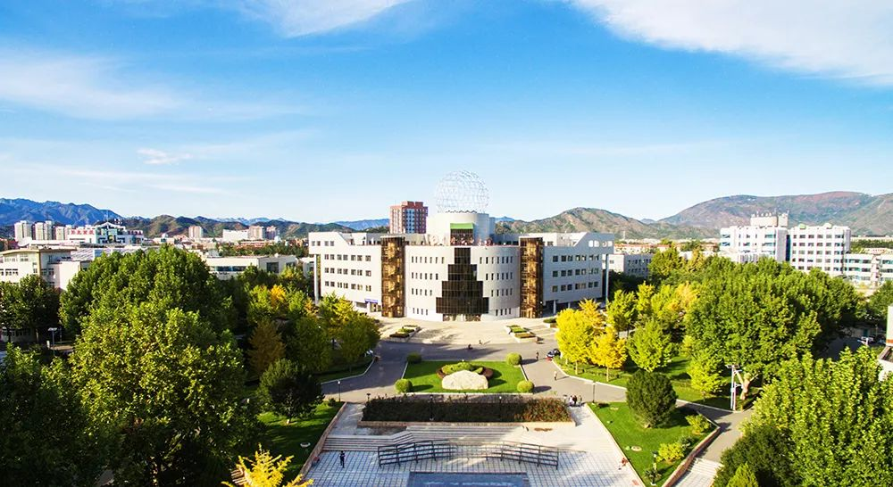
THANKS FOR YOUR TIME!

