Slide 1
Micrograph Guidebook for Round Robin Exercise of Graptolite Reflectance
Xiaowei Zheng & Thomas Gentzis
Joint ICCP-TSOP meeting, Patras, Greece, September 17-24, 2023

Slide 2
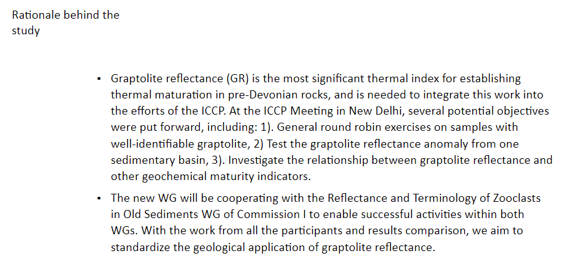

Slide 3
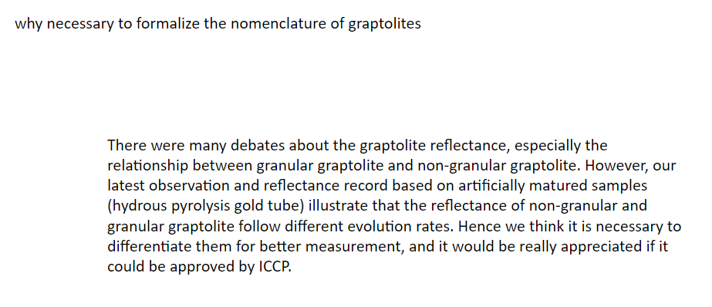

Slide 4
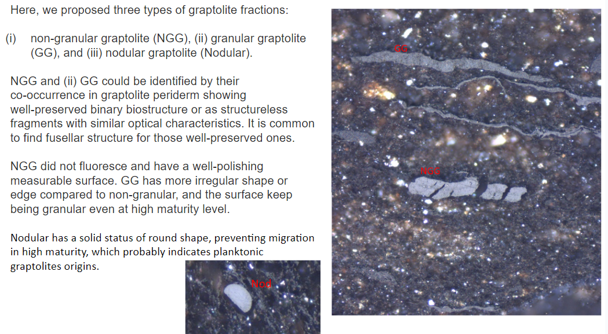

Slide 5
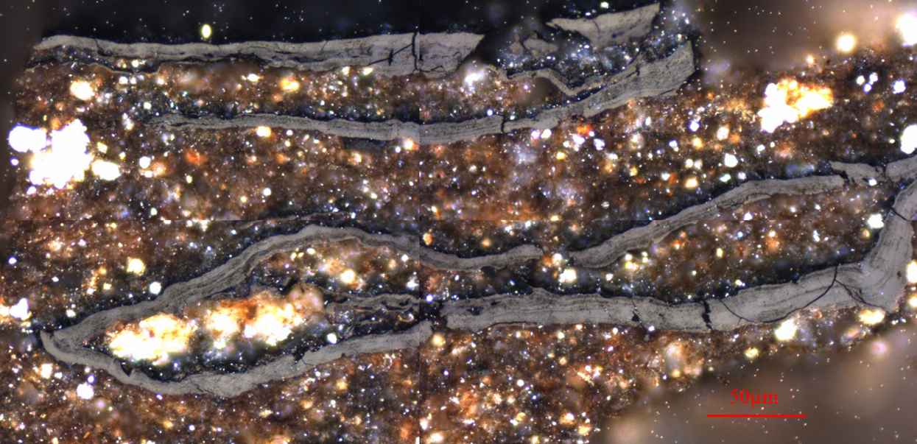
A
B
C

Slide 6
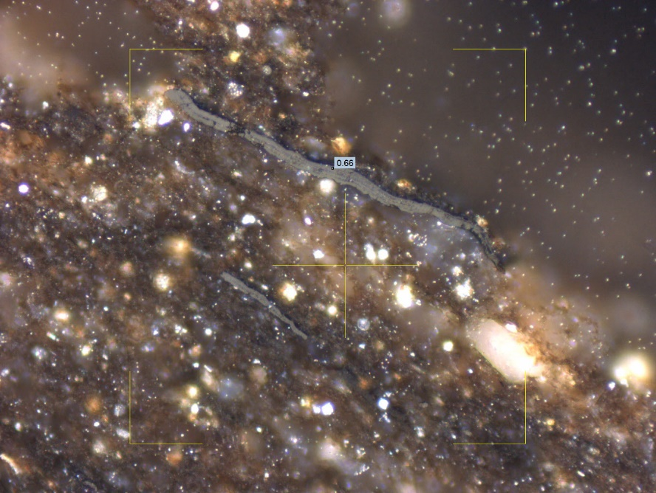
A
B

Slide 7
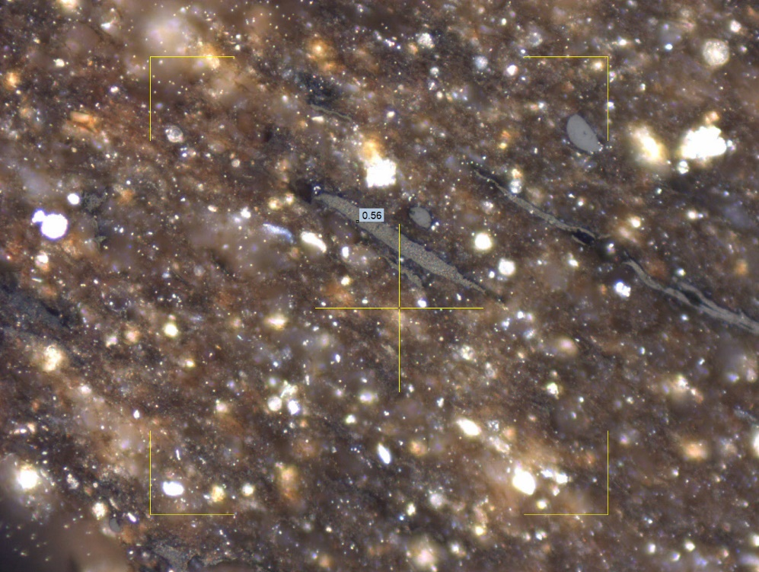
B
A

Slide 8
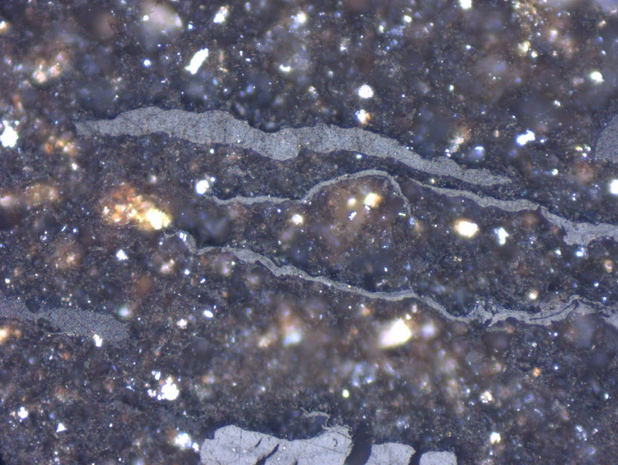
B
A
C

Slide 9
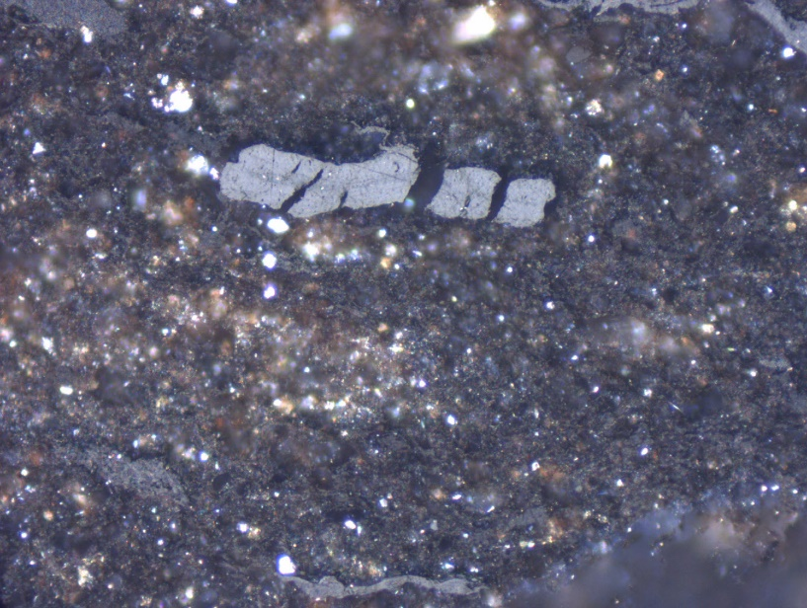

Slide 10
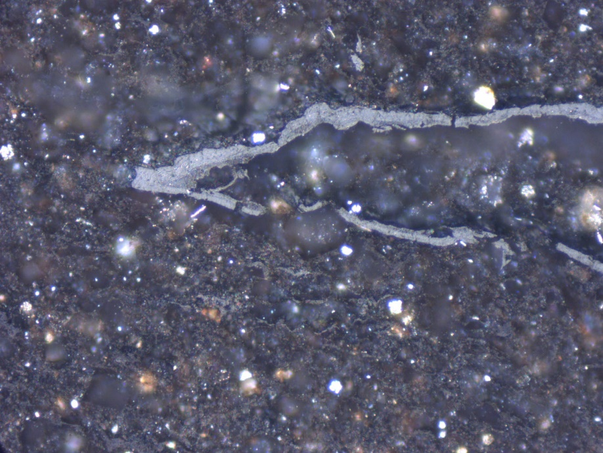
B
A

Slide 11
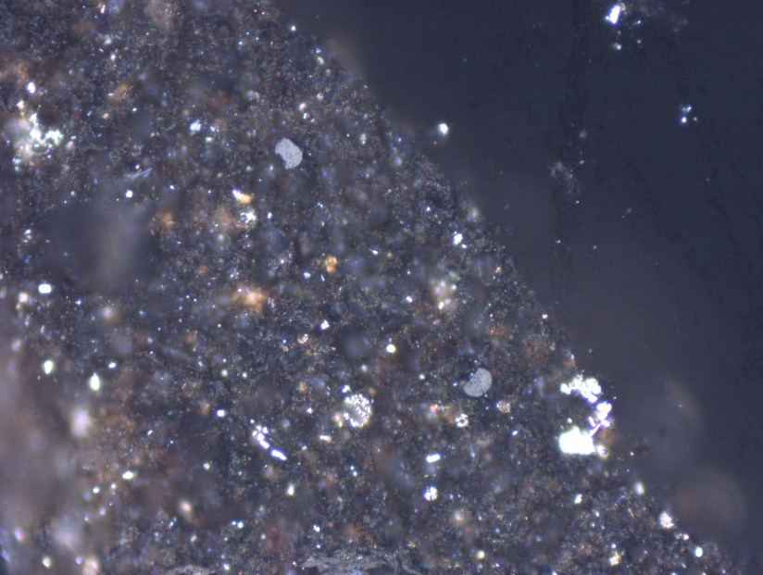

Slide 12
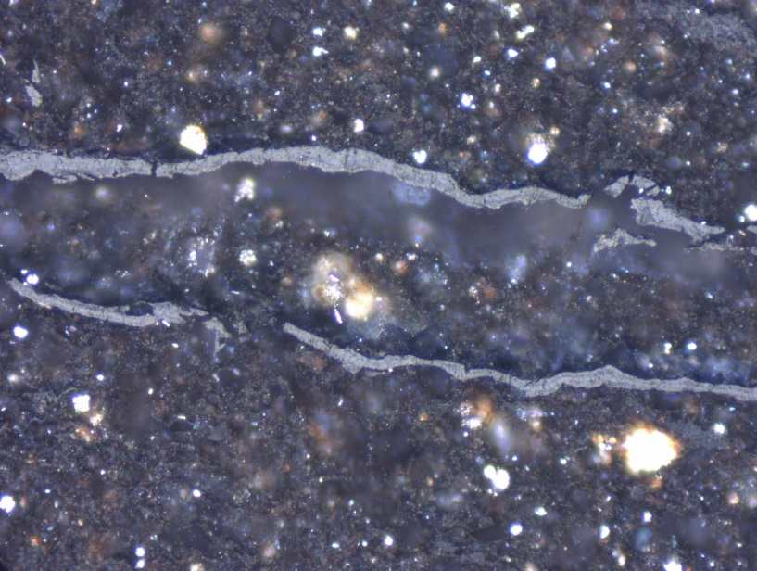

Slide 13
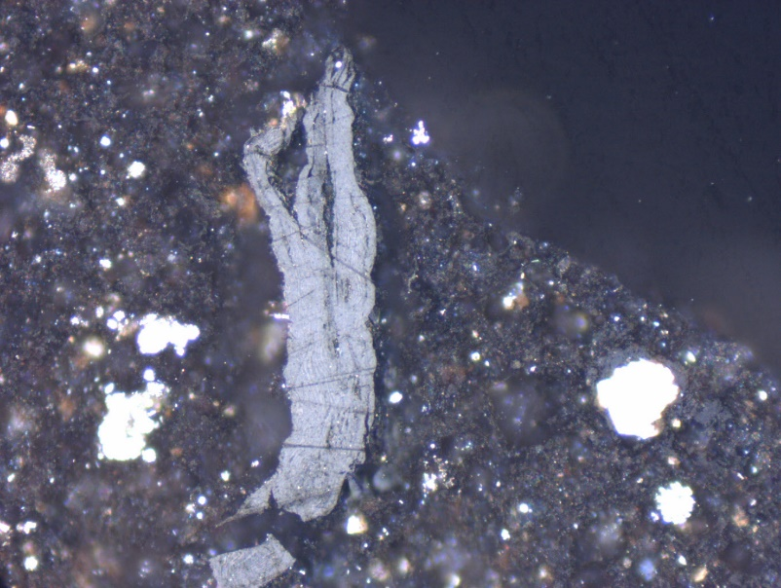
A
B

Slide 14
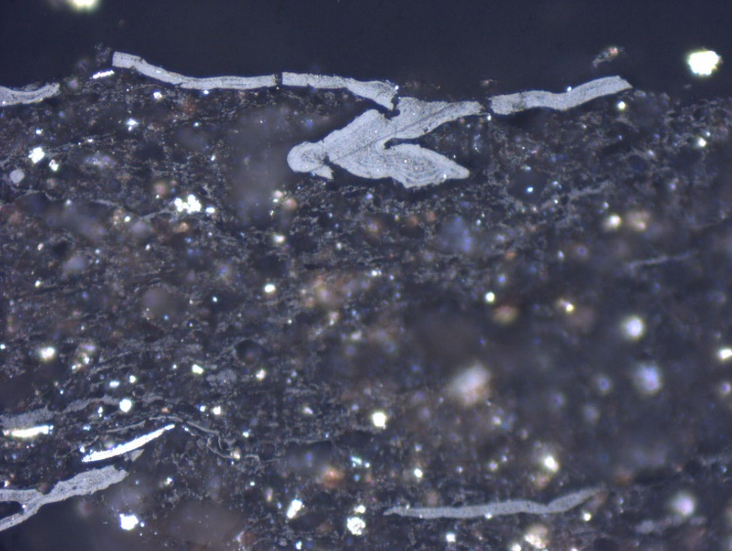
A
B

Slide 15
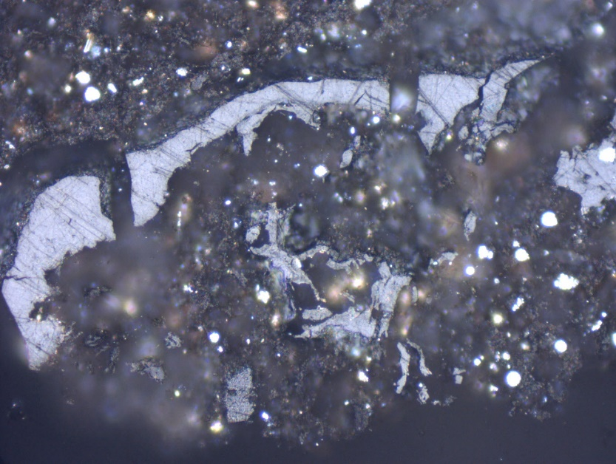
B
A

Slide 16
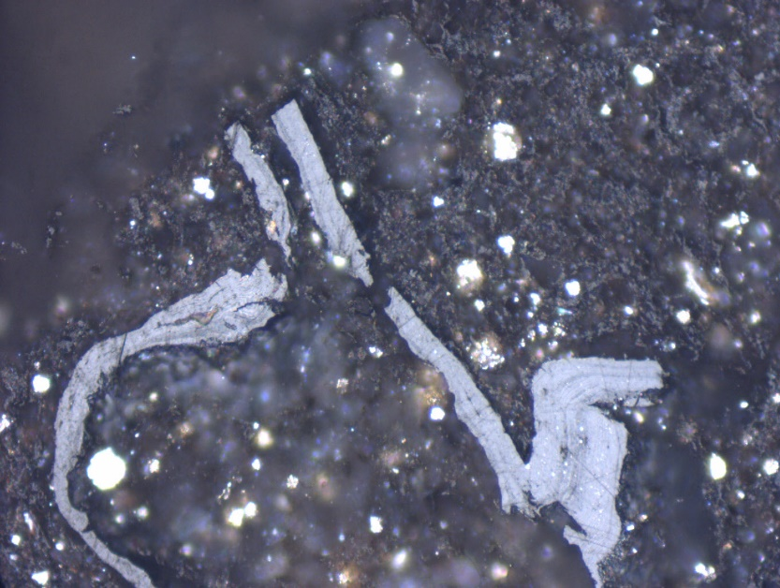
A
C
B

Slide 17
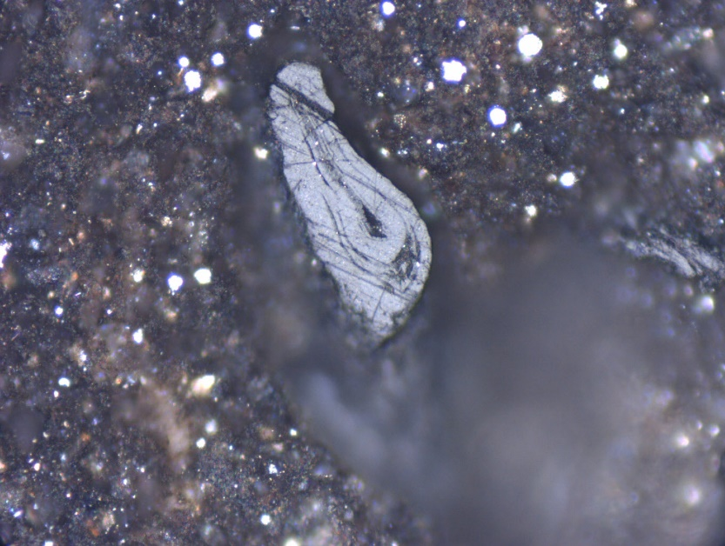
A
B

Slide 18
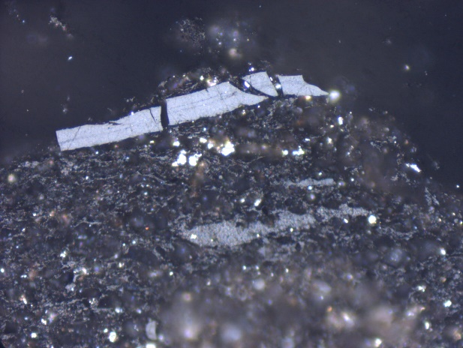
B
A

Slide 19
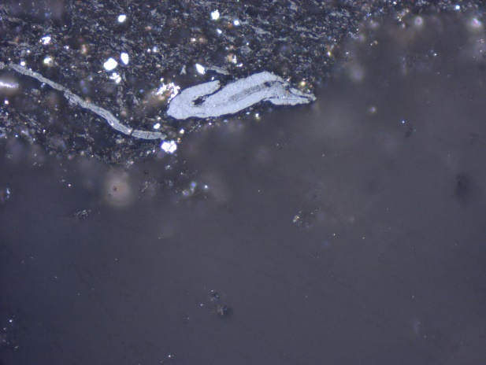

Slide 20
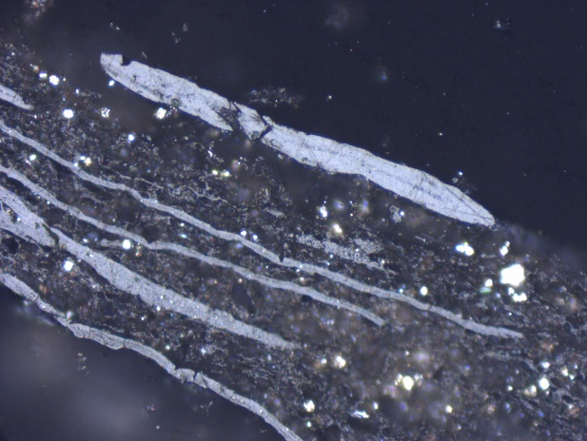
B
C
A

Slide 21
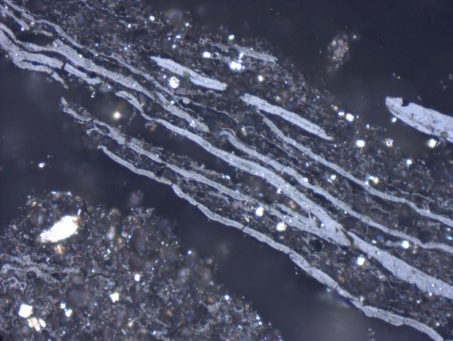
A
B

Slide 22
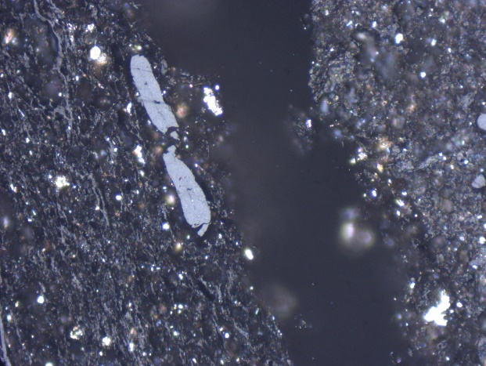

Slide 23
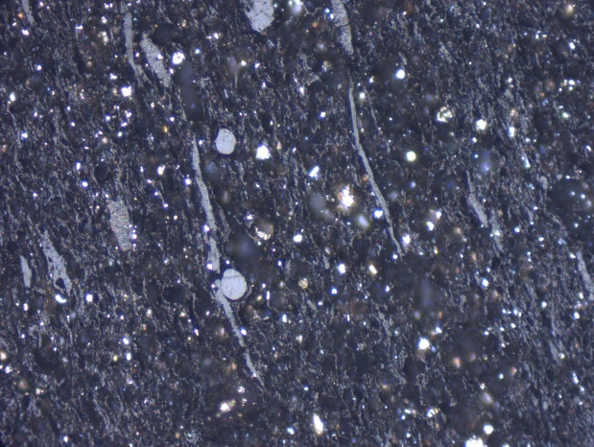

Slide 24
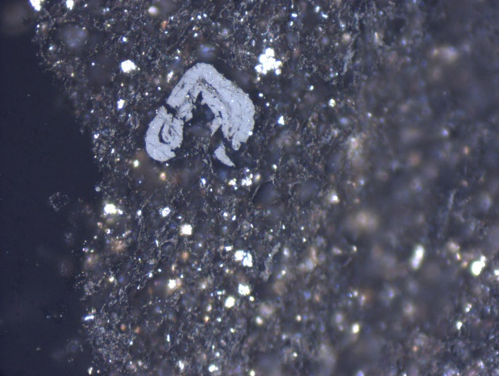

Slide 25
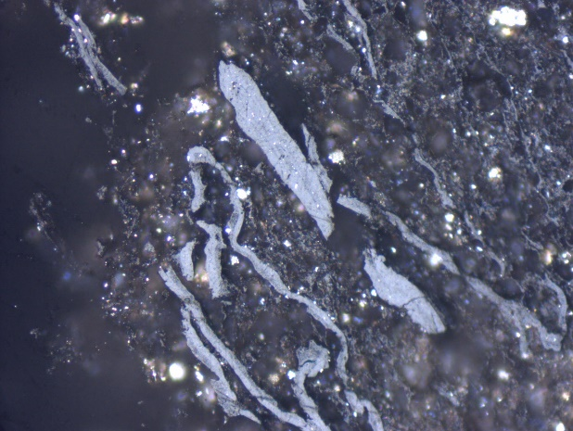
A
B

Slide 26
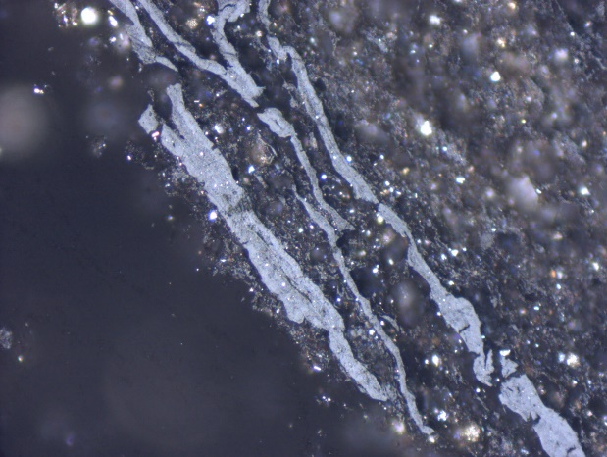

Slide 27
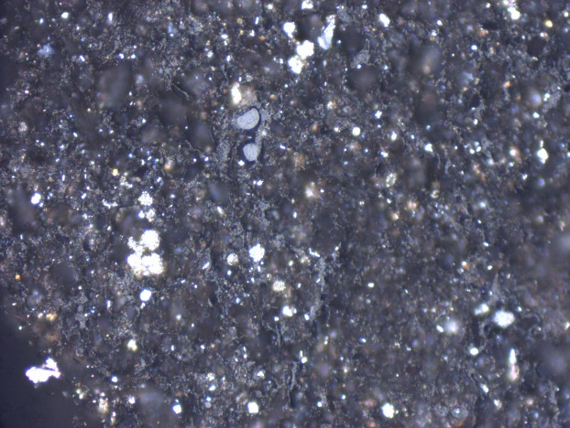

Slide 28
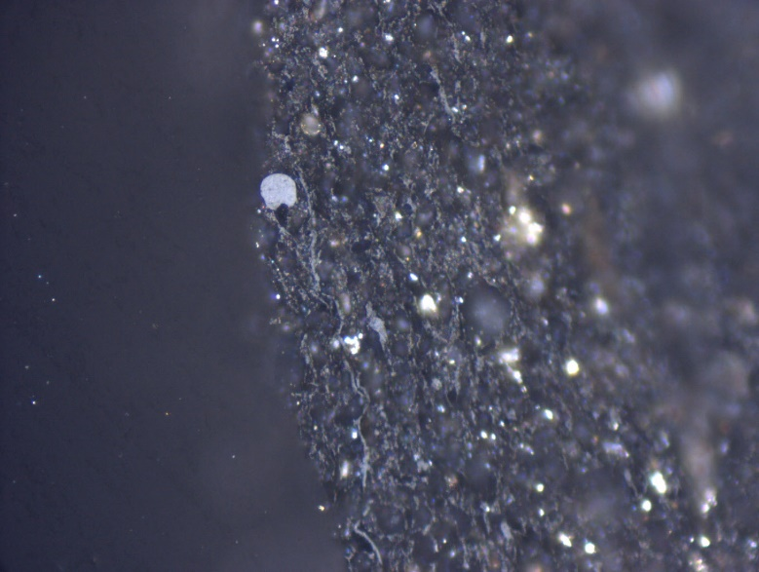

Slide 29
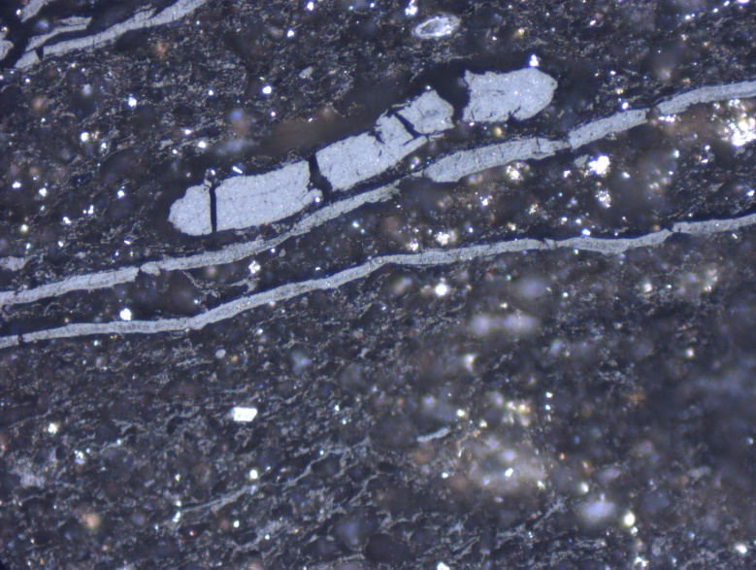
B
A

Slide 30
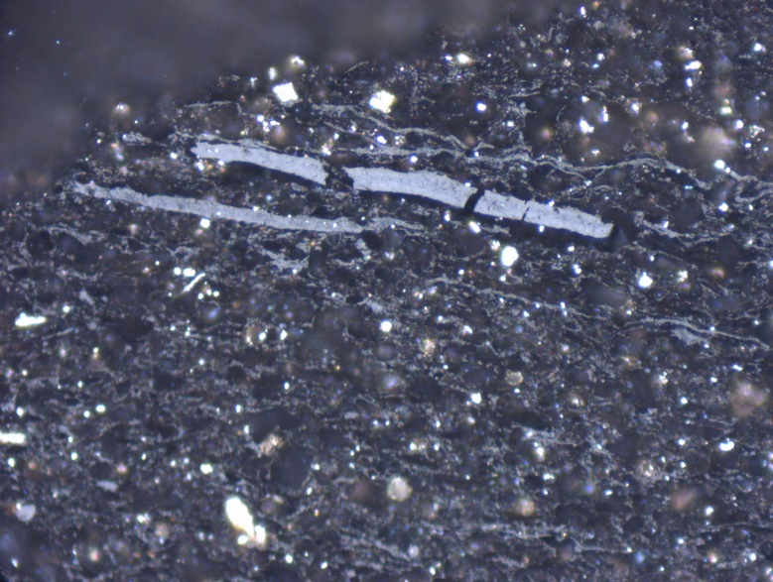

Slide 31
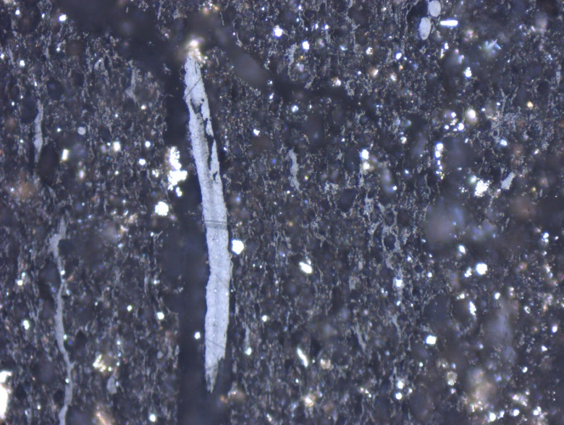

Slide 32
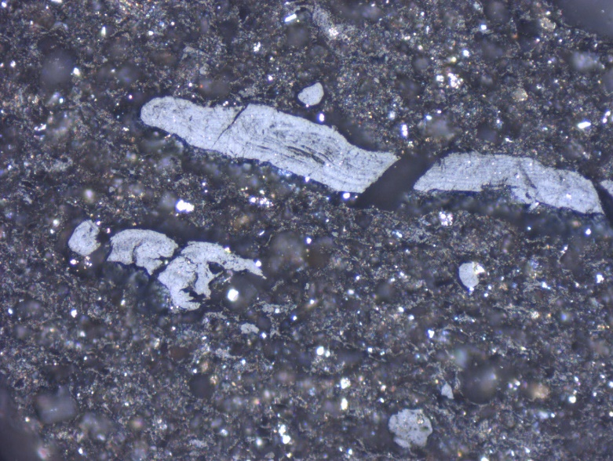
B
A

Slide 33
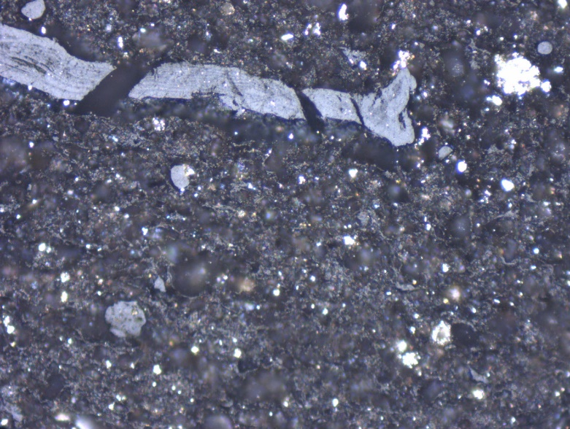
A
B

Slide 34
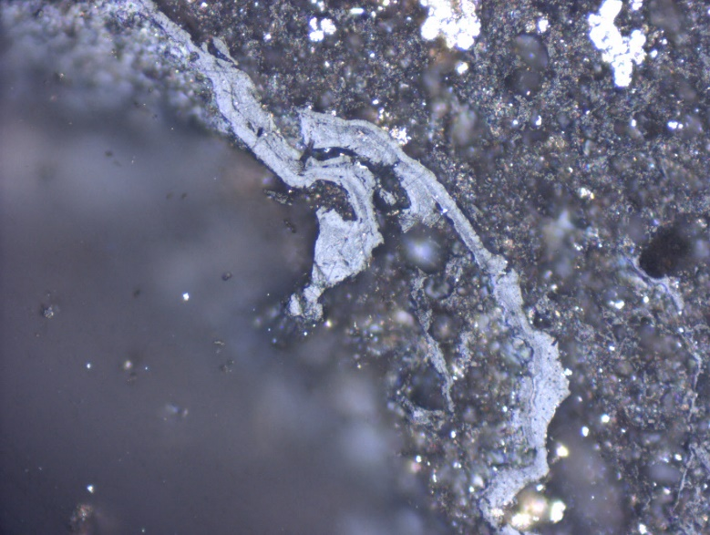
A
B

Slide 35
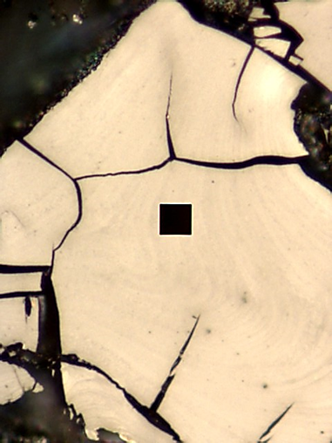
A
B

Slide 36
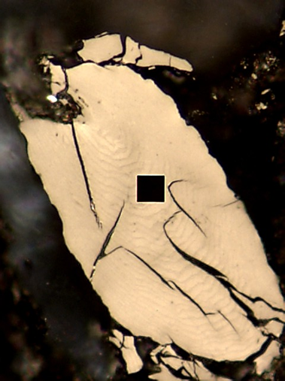
A
C
B

Slide 37
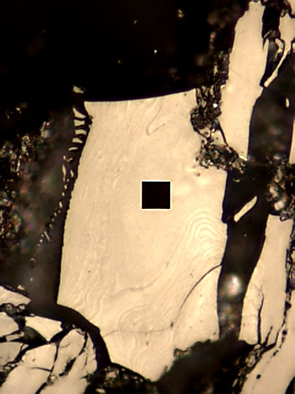
A
B
C

Slide 38
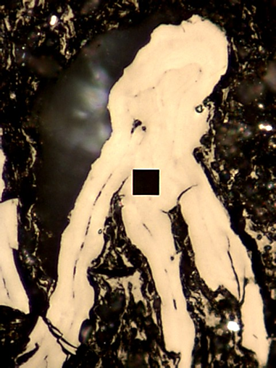
A
B

Slide 39
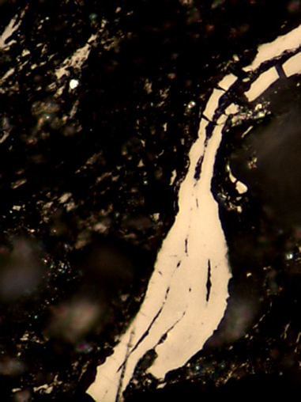

Slide 40
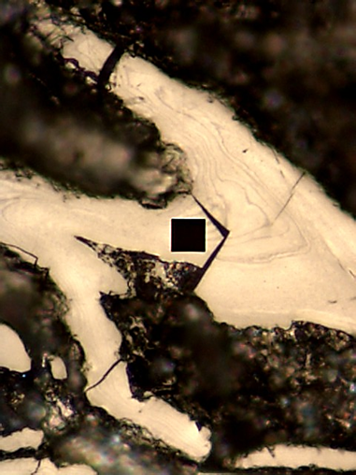
C
A
B

Slide 41
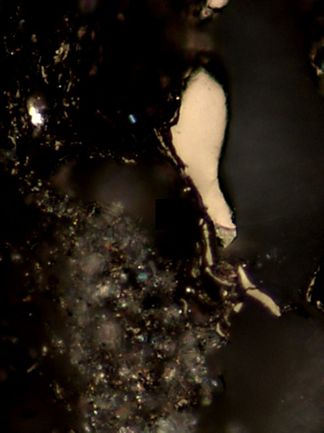

Slide 42
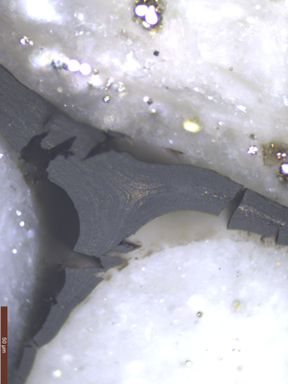
A
B

Slide 43
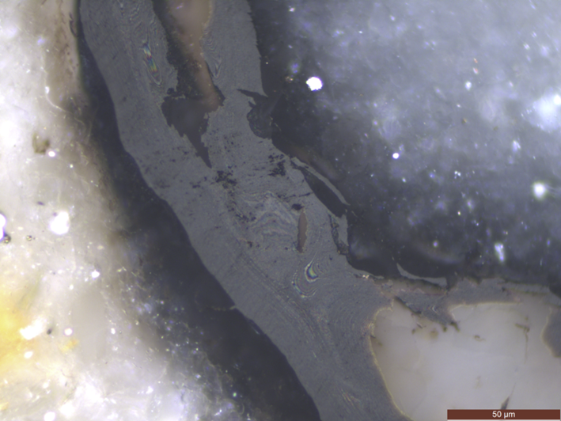
A
B

Slide 44
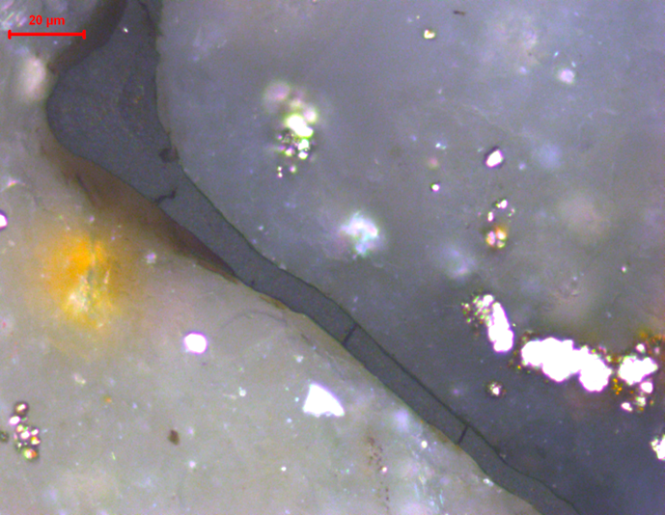
A
B

Slide 45
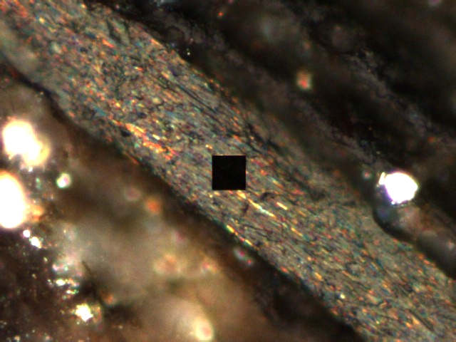
A
B

Slide 46
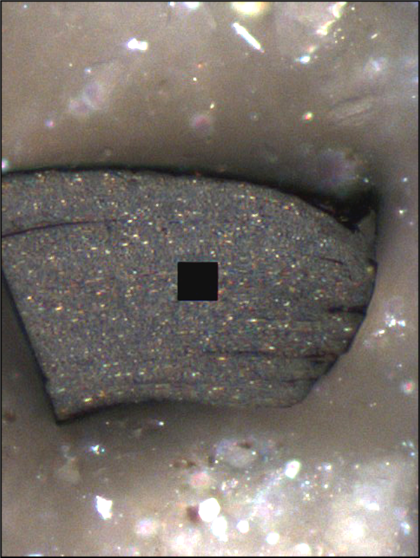
B
A

Slide 47
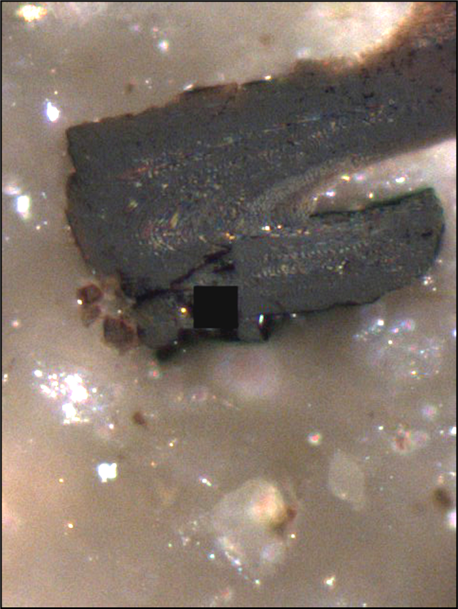
B
A

Slide 48
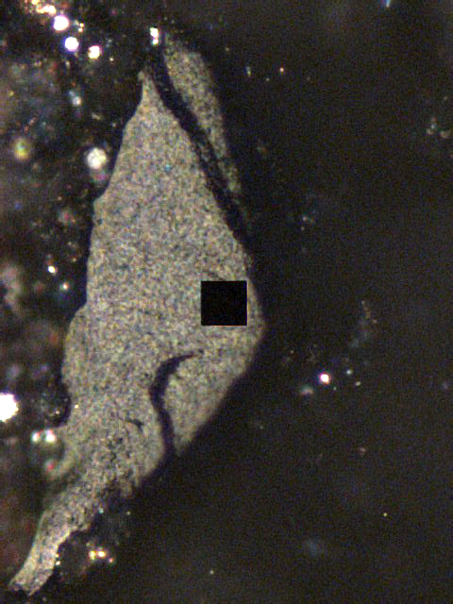

Slide 49
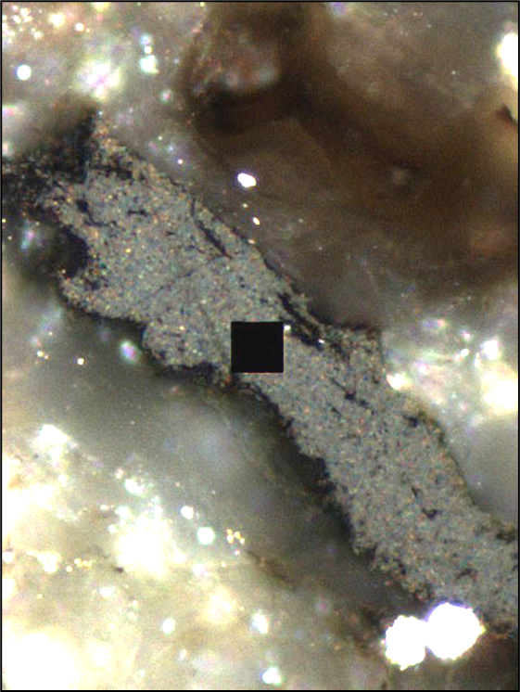
A
B

Slide 50
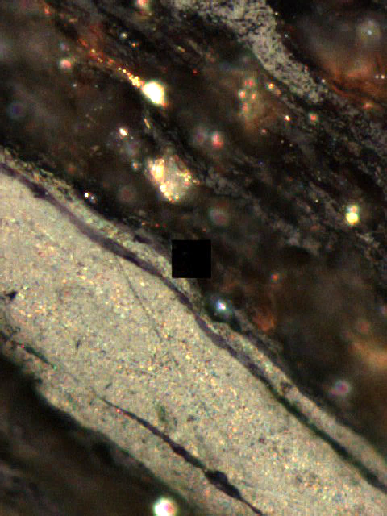
A
B

Slide 51
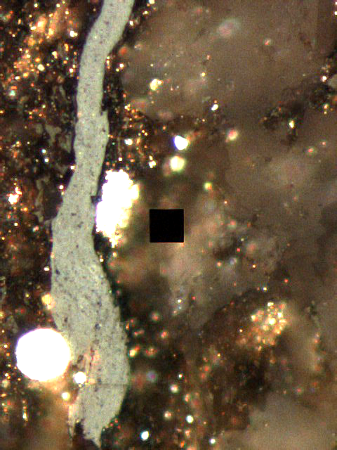
A
B

Slide 52

A
B

Slide 53

A
B

Slide 54


Slide 55

A
B
C

Slide 56

B
A
C

Slide 57

B
A

Slide 58

A
B

Slide 59

B
A

Slide 60

A
C
B

Slide 61

A
B

Slide 62


Slide 63

B
A
C

Slide 64

A
B

Slide 65


Slide 66


Slide 67


Slide 68


Slide 69


Slide 70


Slide 71


Slide 72


Slide 73


Slide 74

A
B

Slide 75

A
B

Slide 76

A
B

Slide 77


Slide 78


Slide 79

A
B

Slide 80

A
B

Slide 81


Slide 82


Slide 83


Slide 84


Slide 85


Slide 86


Slide 87

A
B

Slide 88


Slide 89


