Slide 1



Report on Self – heating of coal and coal wastes working group
ICCP COMMISSION III
2014 Activity
66th ICCP Meeting, Kalkota, September 20-27, 2014
Convenors:
Magdalena Misz-Kennan (US)
Deolinda Flores (UP)
Jolanta Kus (BGR)

Slide 2
The aim of the Self-heating Working Group:
to gather examples of various forms of transformation of organic matter in coal and coal wastes of various rank
to establish a classification of transformed organic particles (weathered and thermally altered) in coal wastes that will reflect the complex conditions in the waste dumps.

Slide 3
Past activity:
The SHWG was established during the 62nd ICCP Meeting in Oviedo (2008) and information about it was published in the ICCP News Letter No. 45, 2008.
Four Round Robin Exercises were carried out in 2009, 2010, 2012 and 2013.
Discussion on the established terminology took place during the 63rd ICCP Meeting in Porto in 2011.
Discussion on HOW to present the form that has to recognized took place during the 64th ICCP Meeting in Beijing in 2012 and by e-mails after the meeting. The discussion continued during the ICCP Meeting in 2013

Slide 4
Factors influencing the morphology of organic particles in coal wastes:
Internal factors: maceral composition, rank of organic matter
External factors: heating rate, end heating temperature and time, access of air and moisture, shape of the dump

Slide 5
Current problems:
how to present the form that has to be recognized (using a square marking a field within particle or cross hair or arrow or another way?),
should we modify the present classification?
quantitaive analysis of organic particles in coal wastes

Slide 6
How to present the forms???
An arrow for specific forms to be classified (e.g. devolatilization vacuoles, microfractures, cracks,...)
A square to the forms that need to be classified considering the whole particle (e.g. paler and darker in colour particle).

Slide 7
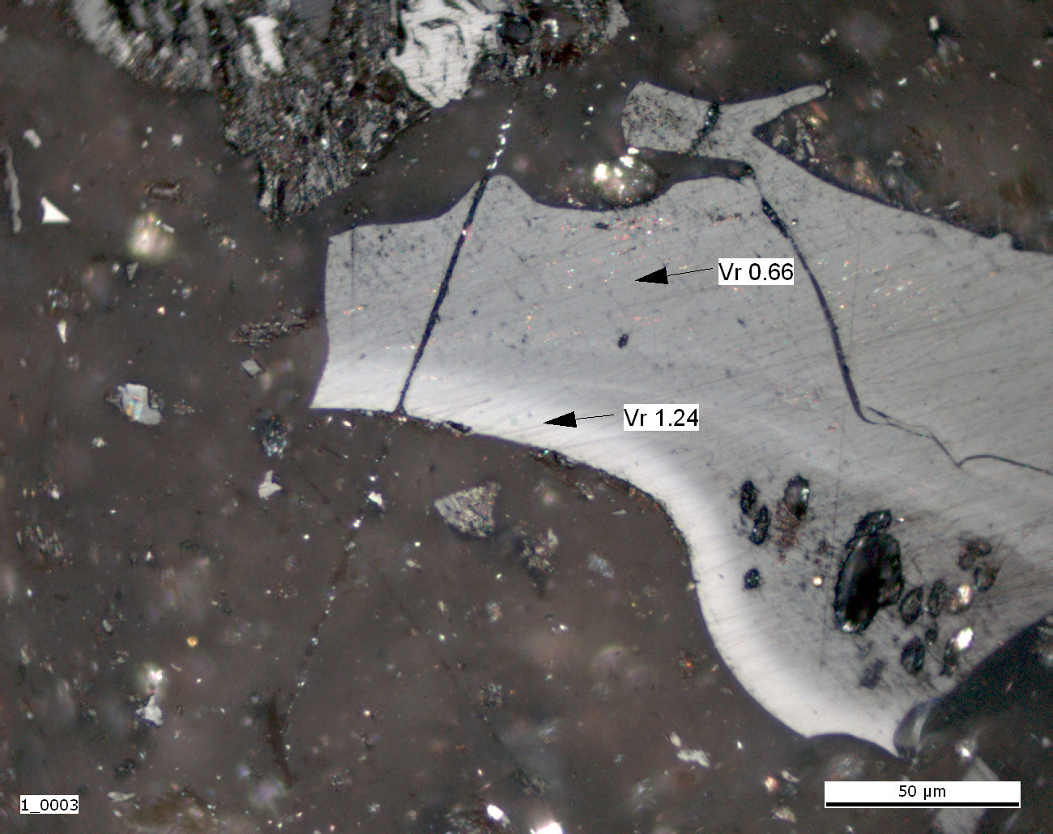

Slide 8
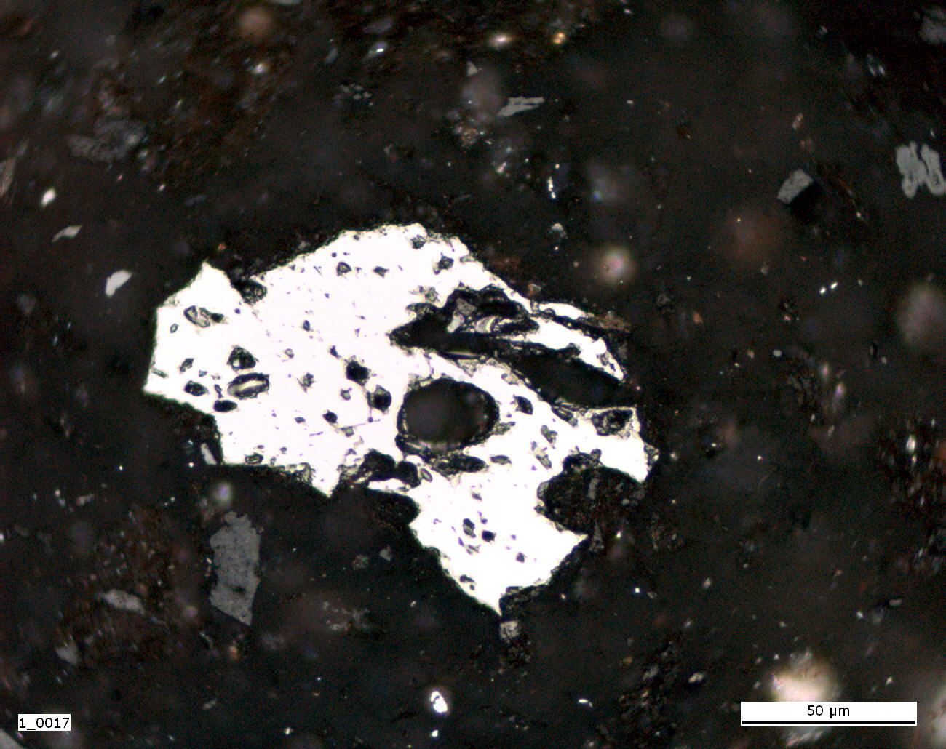

Slide 9
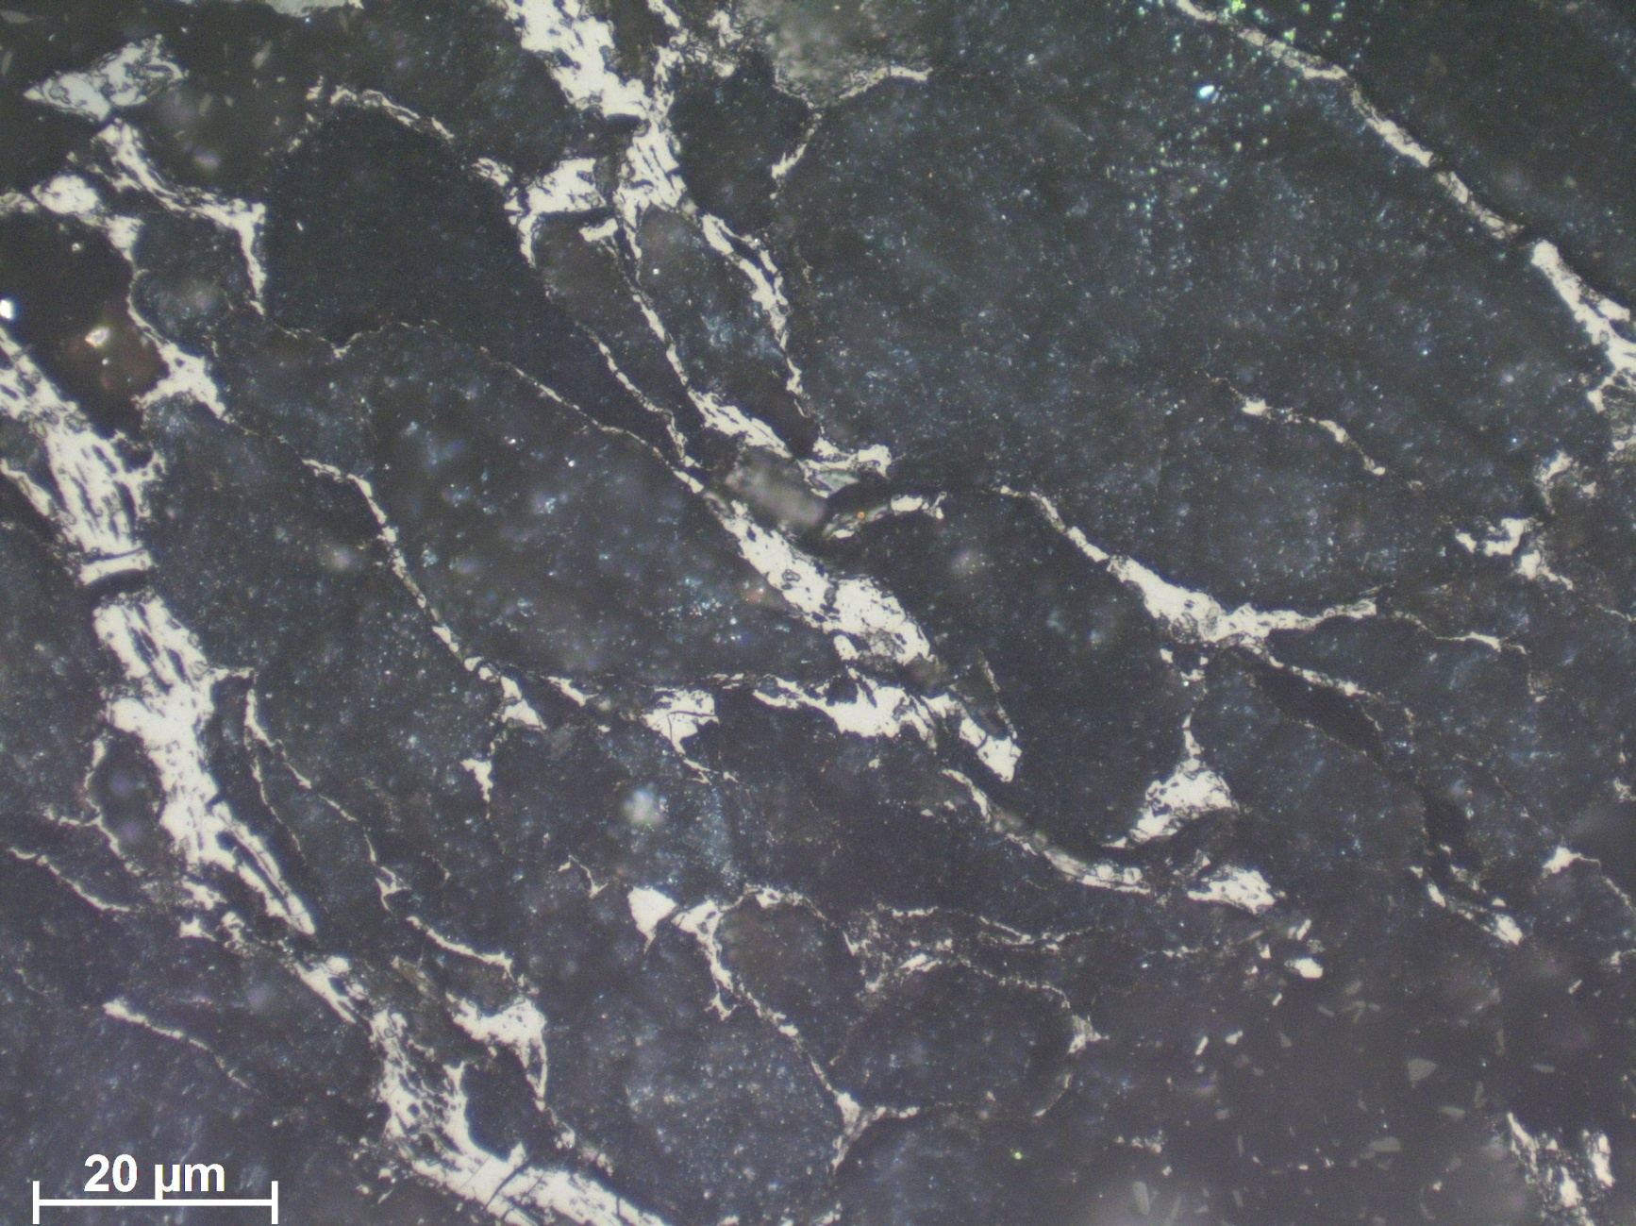

Slide 10
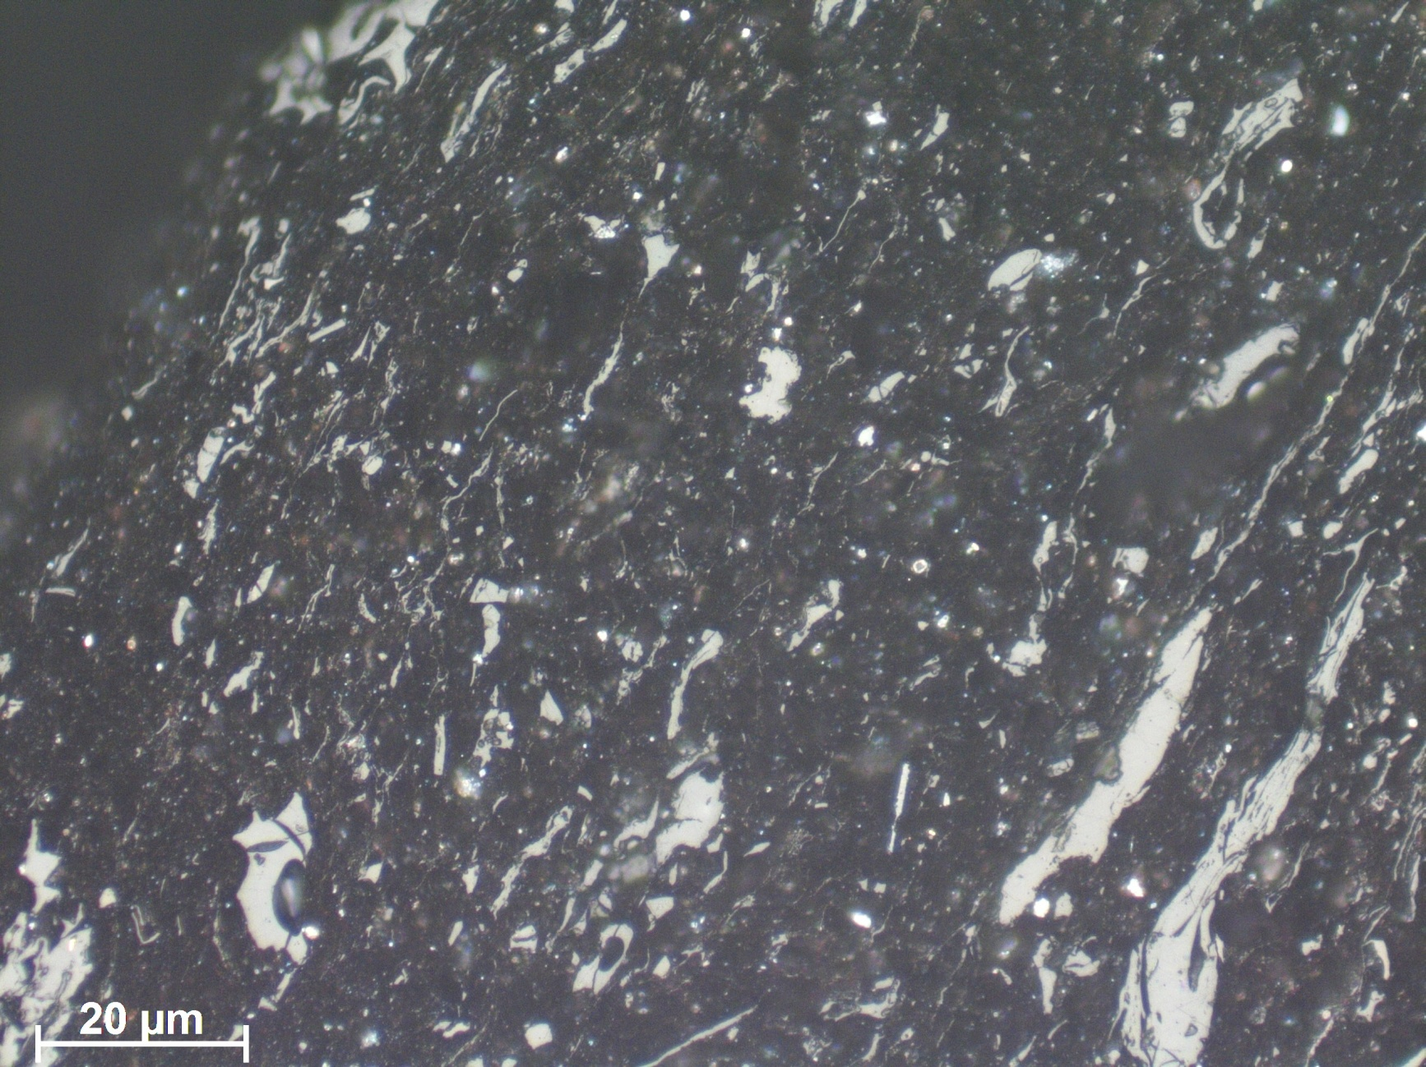

Slide 12
Table for identification of entire particle in a square
Photo No. | Unaltered particle | Altered particles |  |  |  |  | Newly formed particles
 |  | Appearance | Structure |  | Texture
 |  | Heat altered/higher reflectance | Massive | Devolatili-sation pores | Isotropic | Anisotropic | Pyrolytic carbon | Bitumens
1 |  | x |  | x | x
2 |  | x |  | x | x

Slide 13
Table for identification of a feature under an arrow in a square
Photo No. | Altered particles
 | Appearance
 | Fractures and fissures | Paler in colour oxidation rim | Darker in colour oxidation rim | Plasticised edge | Band | Devolatilisation pores
1 | x
2 |  |  |  |  |  | x

Slide 14
The 2011 classification of tranformed organic matter in coal wastes:
Unaltered particles
Altered particles
  Appearance: cracked and microfractured, oxidation rims (paler and darker in colour), plasticized edges, bands, paler in colour particle
  Structure: massive, devolatilization pores
  Texture: isotropic, anisotropic
Newly formed particles
  Pyrolytic carbon
  Bitumens

Slide 15
Classification of forms in self-heated coal wastes
The problem with the current classification particularly in the categories “Appearance” and “Structure” is that they are a bit descriptive and not prescriptive,(prescriptive as quantified, e.g. the char classification (e.g. Bailey et al 1990, in Fuel vol. 69).
Therefore, this descriptive mode is making the point under observation (cross hair or arrow) to be of importance.
If we have some categorization based on vol - % of the “Appearance” or “Structure” categories then we could be able to apply these % on the “particle” level.
e.g. a particle that has a 5% of an oxidation rim, but the cross hair is on the unaltered part, still will be classified as “altered particle with an oxidation rim”.

Slide 16
Classification of forms in self-heated coal wastes
For cracks and microfractures a “frequency criteria” could be established, e.g. number of cracks-fractures per dimension (and perhaps for this the use of a “square” would be more appropriate).
And definitely will be good to define “quantitatively” what “massive” and “devolatilization pores” denotes. (Perhaps introducing a similar categorization as per Bailey et al., 1990??).
Finally, I think that the classification should be open to the “right” to the “Maceral terminology” as well as to the “Char Terminology”.

Slide 17
The 2014 modified classification of organic matter in coal wastes:
Unaltered particles
Altered particles
  porous particles – particles with porosity >75%
  mixed porous particles - particles with porosity 25-50%
  mixed dense particles - particles with porosity 50-75%
  massive particles – particles with porosity <25%
  massive particles with cracks - particles with porosity <25% and containing irregular cracks within the particle or perpendicular to the edge of the particle
  massive particles with oxidation rims - particles with porosity <25% and paler or darker in colour oxidation rims
Newly formed particles: pyrolytic carbon, bitumens

Slide 18
Discussion
how to present the forms?
what about our classification?
can we now publish results? or we better modify classification, have one more Round Robin Exercise and.... publish?

Slide 19
Future activity:

