Slide 1



Report on Self – heating of coal and coal wastes working group
ICCP COMMISSION III
2015 Round Robin Exercise
67th ICCP Meeting, Potsdam, September 6-12, 2015
Convenors:
Magdalena Misz-Kennan (US)
Deolinda Flores (UP)
Jolanta Kus (BGR)

Slide 2
The aim of the Self-heating Working Group:
to gather examples of various forms of transformation of organic matter in coal and coal wastes of various rank
to establish a classification of transformed organic particles (weathered and thermally altered) in coal wastes that will reflect the complex conditions in the waste dumps.

Slide 3
Past activity:
The SHWG was established during the 62nd ICCP Meeting in Oviedo (2008) and information about it was published in the ICCP News Letter No. 45, 2008.
Four Round Robin Exercises were carried out in 2009, 2010, 2012, 2013, and 2014.
Discussion on the established terminology took place during the 63rd ICCP Meeting in Porto in 2011.
Discussion on HOW to present the form that has to recognized took place during the 64th ICCP Meeting in Beijing in 2012 and by e-mails after the meeting.

Slide 4
Current problems:
should we modify the present classification?
how to present the form that has to be recognized (using a square marking a field within particle or cross hair or arrow or another way?),
terminology?

Slide 5
Participants of 2015 Round Robin Exercise:
Kimon Christanis
Deolinda Flores
Manuela Marques
Georgeta Predeanu
Nandita Choudhury
Marta Malecha
Jen O’Keefe
Stavros Kalaitzidis
Ashok Singh
Sławomira Pusz
Dragana Životić
Nikki Wagner
Ivana Sýkorová
Joana Ribeiro
Walter Pickel
Johan Joubert
Sandra Rodrigues

Slide 6
2015 Round Robin Exercise:
30 photos were selected representing transformed organic matter in coal wastes undergone self-heating processes.
The rank of unaltered organic matter was 0.6% Rr.
Reflectance values of transformed organic matter were given in the photos as Rr or Rmax.
Participants were asked to distinguish the forms of transformed organic matter positioned under square.

Slide 7
Proposed new classification
Level 1: determines the nature of the particle. Here two categories are distinguished: organic, mineral
Level 2: determines the degree of alteration of organic particles. Organic particles were divided into three types: non-altered, altered, newly formed
Level 3: determines the structure of particles. That level applies only to altered particles that are divided into: porous, massive
Level 4: determines the optical properties of particles. Both massive and porous particles were divided into two categories depending if they are: fluorescent, non-fluorescent.
Level 5: determines the texture of the particles. In this level fluorescent particles are isotropic and non-fluorescent particles might be: isotropic, anisotropic

Slide 8
Level 1 |  | Level 2 |  |  | Level 3 |  | Level 4 |  | Level 5
Organic particle | Minerals | Non-altered | Altered | Newly formed | Massive | Porous | Fluorescent | Non-fluorescent | Isotropic | Anisotropic

Slide 9
Level 6: determines associations linked with the particle. Various categories can be distinguished among the isotropic and anisotropic particles:
  for non-altered particles: huminite, vitrinite, liptinite, inertinite
  for newly formed particles: bitumens, pyrolytic carbon, chars, graphite, coke
  for altered particles: fractures, fissures; paler in colour oxidation rims; darker in colour oxidation rims; fractures with paler in colour oxidation rims; fractures with darker in colour oxidation rims; plasticised edges; plasticised edges with paler in colour oxidation rims; plasticised edges with darker in colour oxidation rims; bands; devolatilisation pores; devolatilisation pores with paler in colour oxidation rims; devolatilisation pores with darker in colour oxidation rims; paler in colour particle

Slide 10
Non-altered |  |  |  | Newly formed particles
Huminite | Vitrinite | Liptinite | Inertinite | bitumens | pyrolytic carbon | chars | graphite | coke
Altered particles
fractures, fissures | paler in colour oxidation rims | darker in colour oxidation rims | fractures with paler in colour oxidation rims | fractures with darker in colour oxidation rims | plasticised edges | plasticised edges with paler in colour oxidation rims | plasticised edges with darker in colour oxidation rims | bands | devolatilisation pores | devolatilisation pores with paler in colour oxidation rims | devolatilisation pores with darker in colour oxidation rims | paler in colour particle

Slide 11
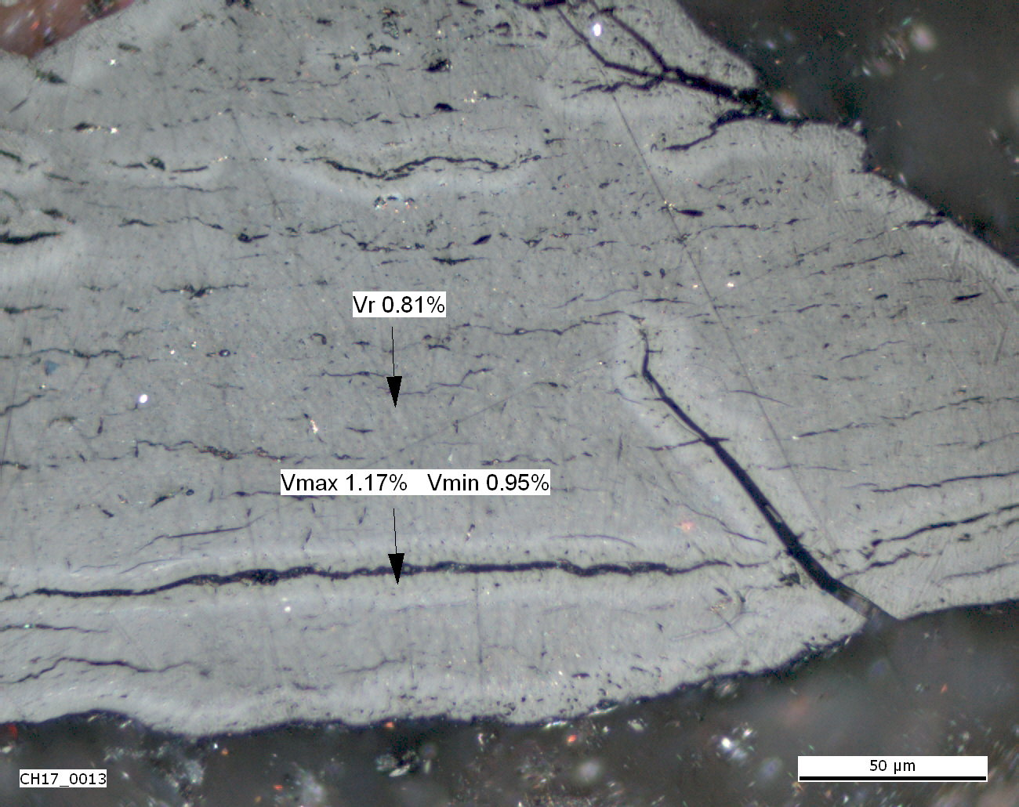
Level 1 |  | Level 2 |  |  | Level 3 |  | Level 4 |  | Level 5
Organic particle | Minerals | Non-altered | Altered | Newly formed | Massive | Porous | Fluorescent | Non-fluorescent | Isotropic | Anisotropic
Non-altered |  |  |  | Newly formed particles
Huminite | Vitrinite | Liptinite | Inertinite | bitumens | pyrolytic carbon | chars | graphite | coke
Altered particles
fractures, fissures | paler in colour oxidation rims | darker in colour oxidation rims | fractures with paler in colour oxidation rims | fractures with darker in colour oxidation rims | plasticised edges | plasticised edges with paler in colour oxidation rims | plasticised edges with darker in colour oxidation rims | bands | devolatilisation pores | devolatilisation pores with paler in colour oxidation rims | devolatilisation pores with darker in colour oxidation rims | paler in colour particle

Slide 12
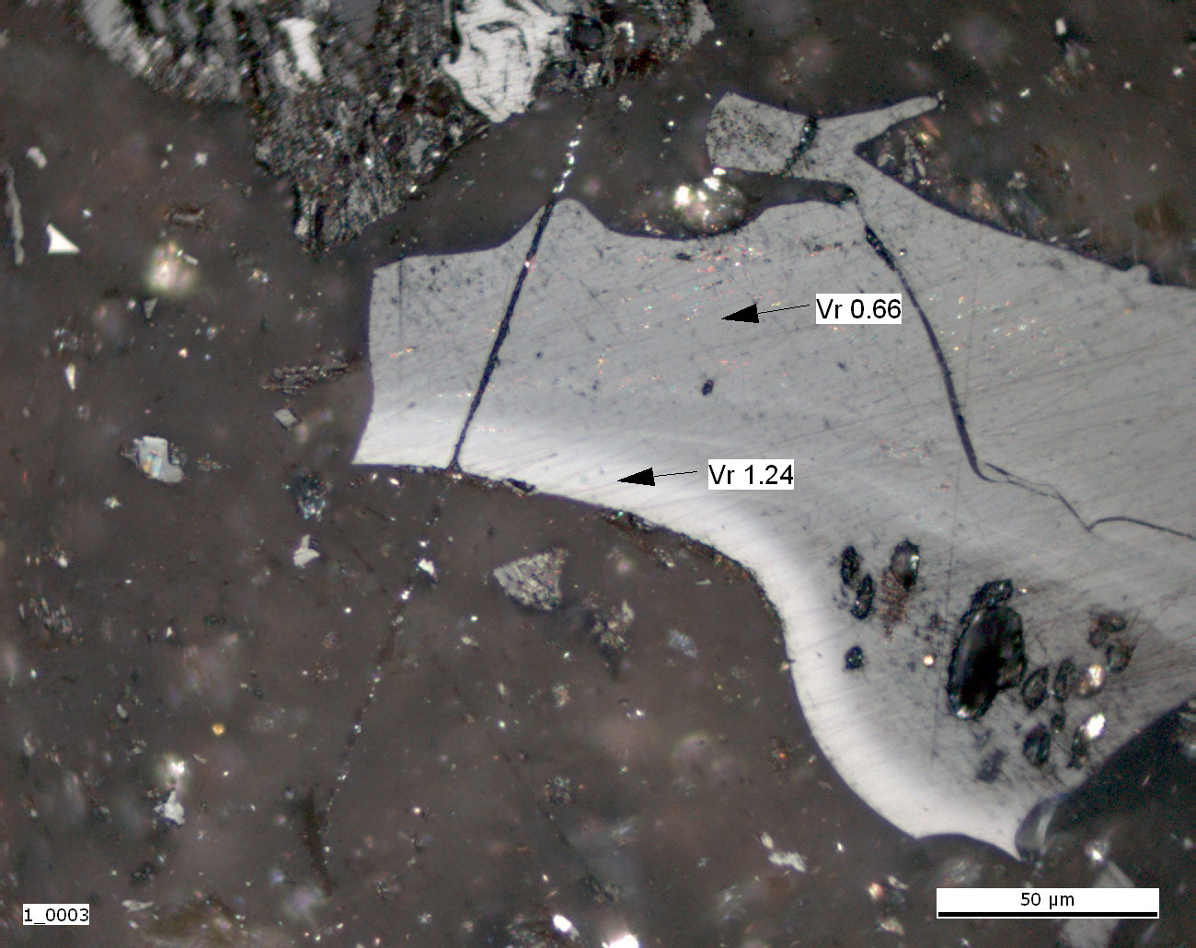
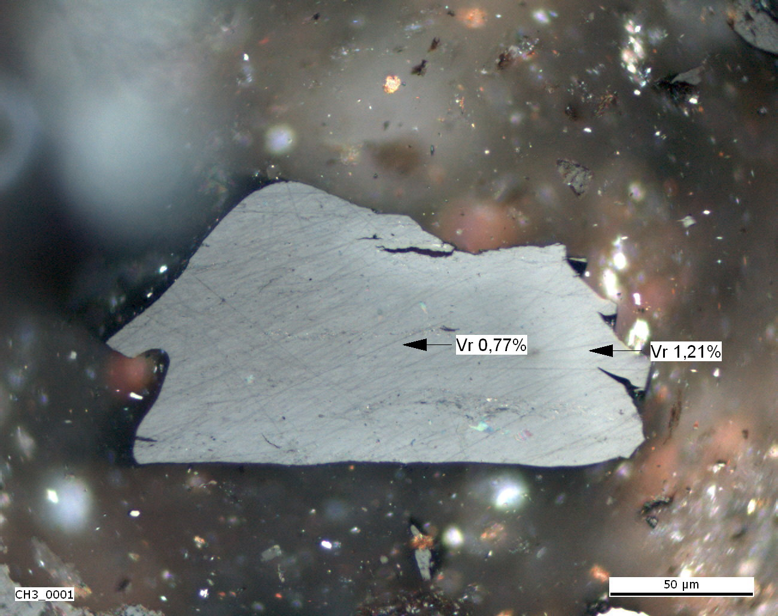
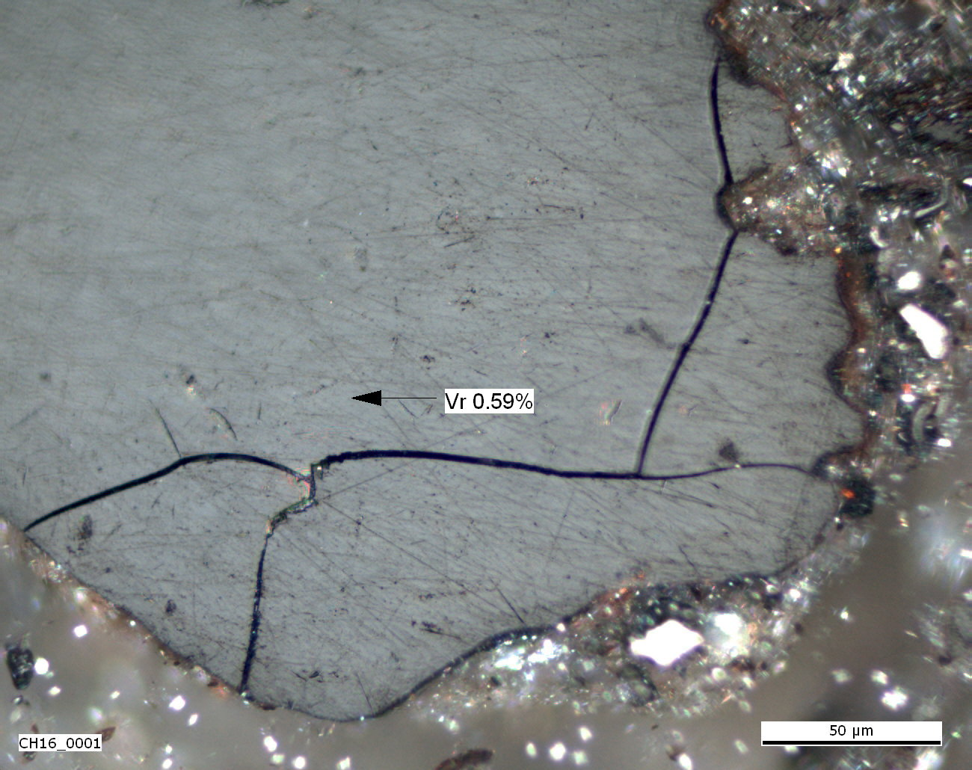
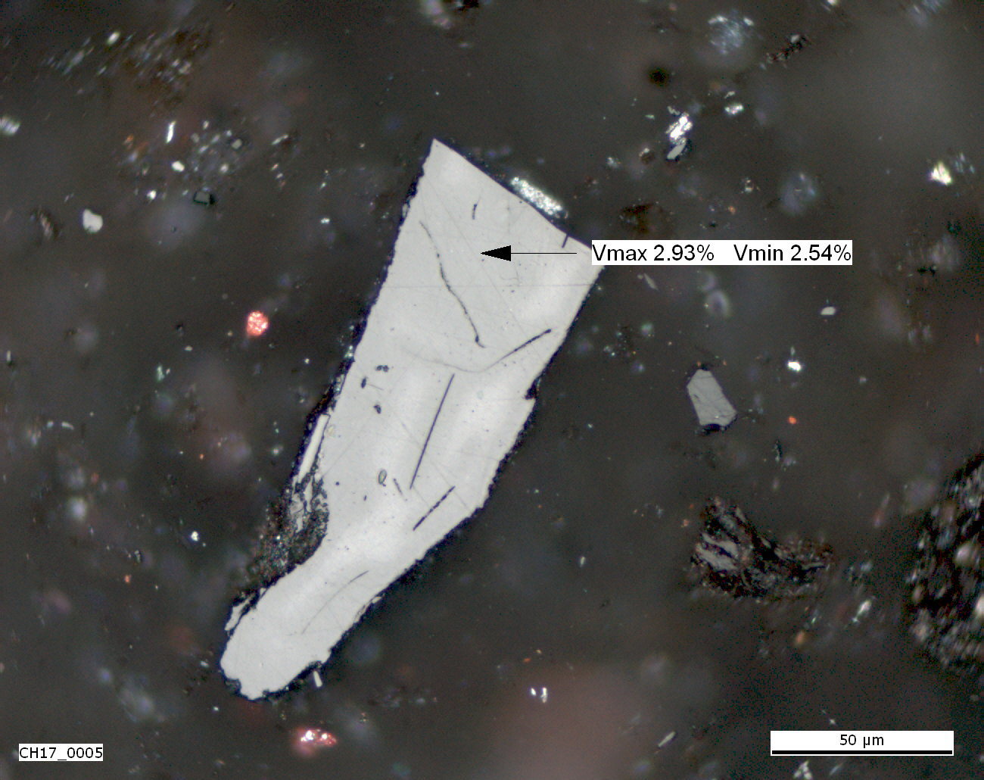
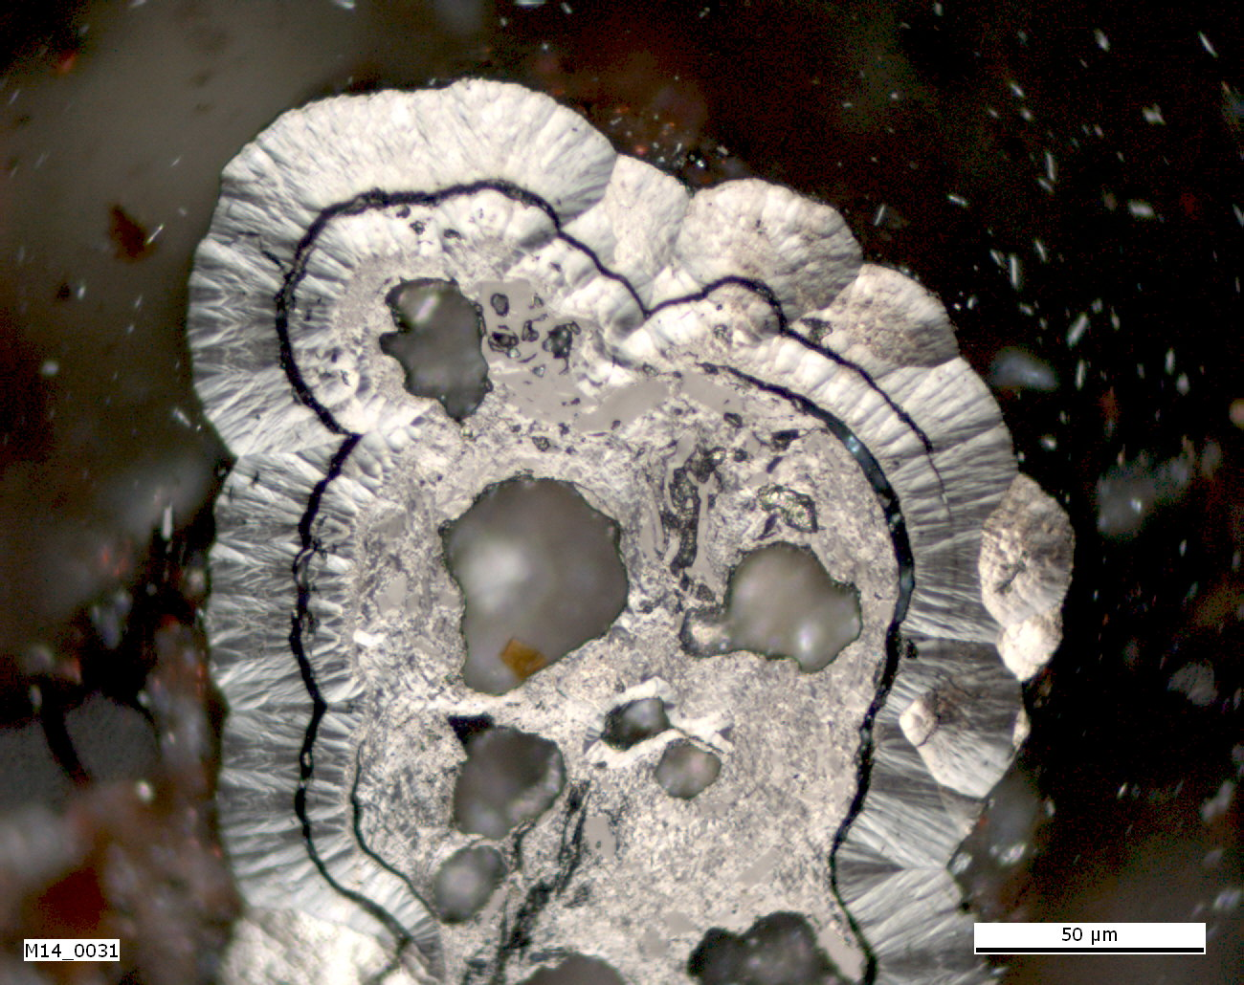
Particles with the highest level of agreement
Photo 2
Photo 9
Photo 10
Photo 12
Photo 16
Photo 19

Slide 13
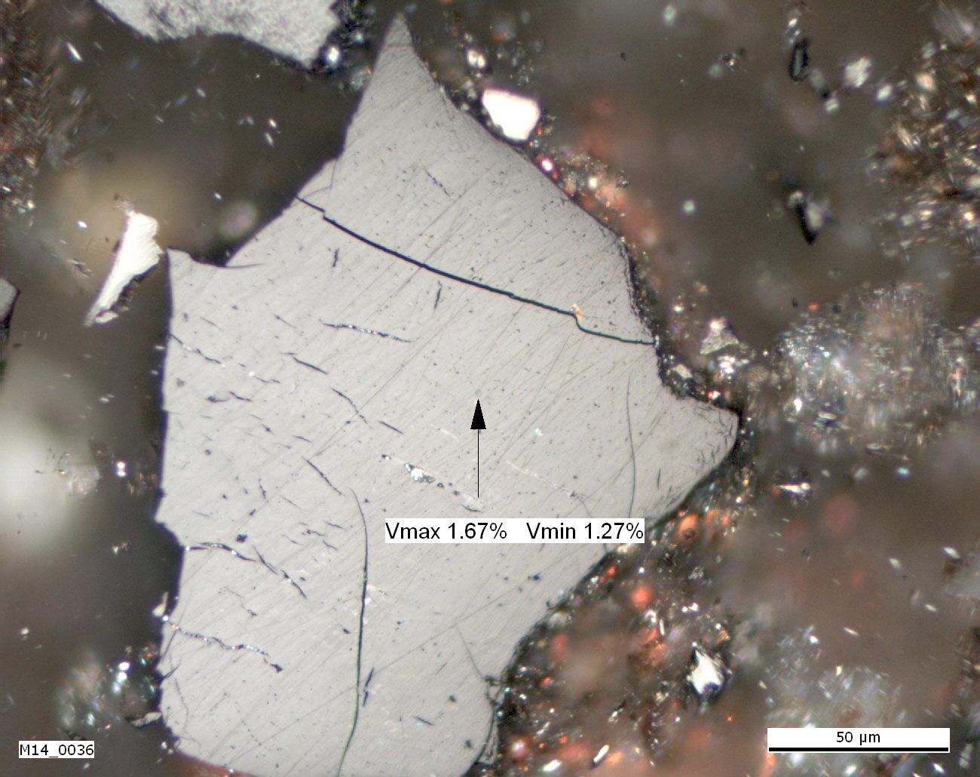
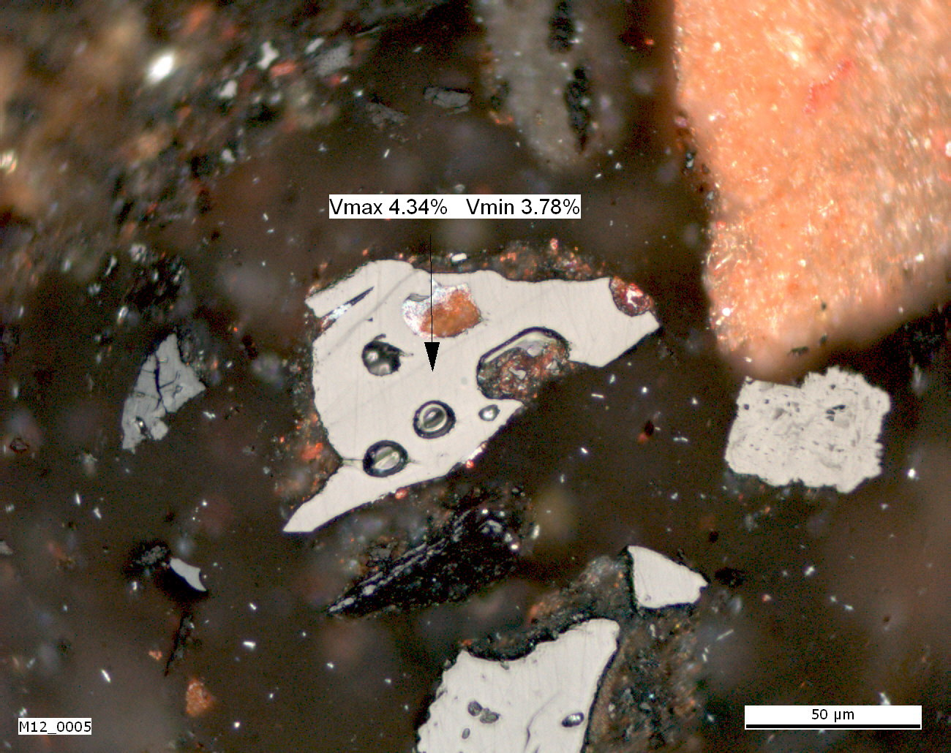
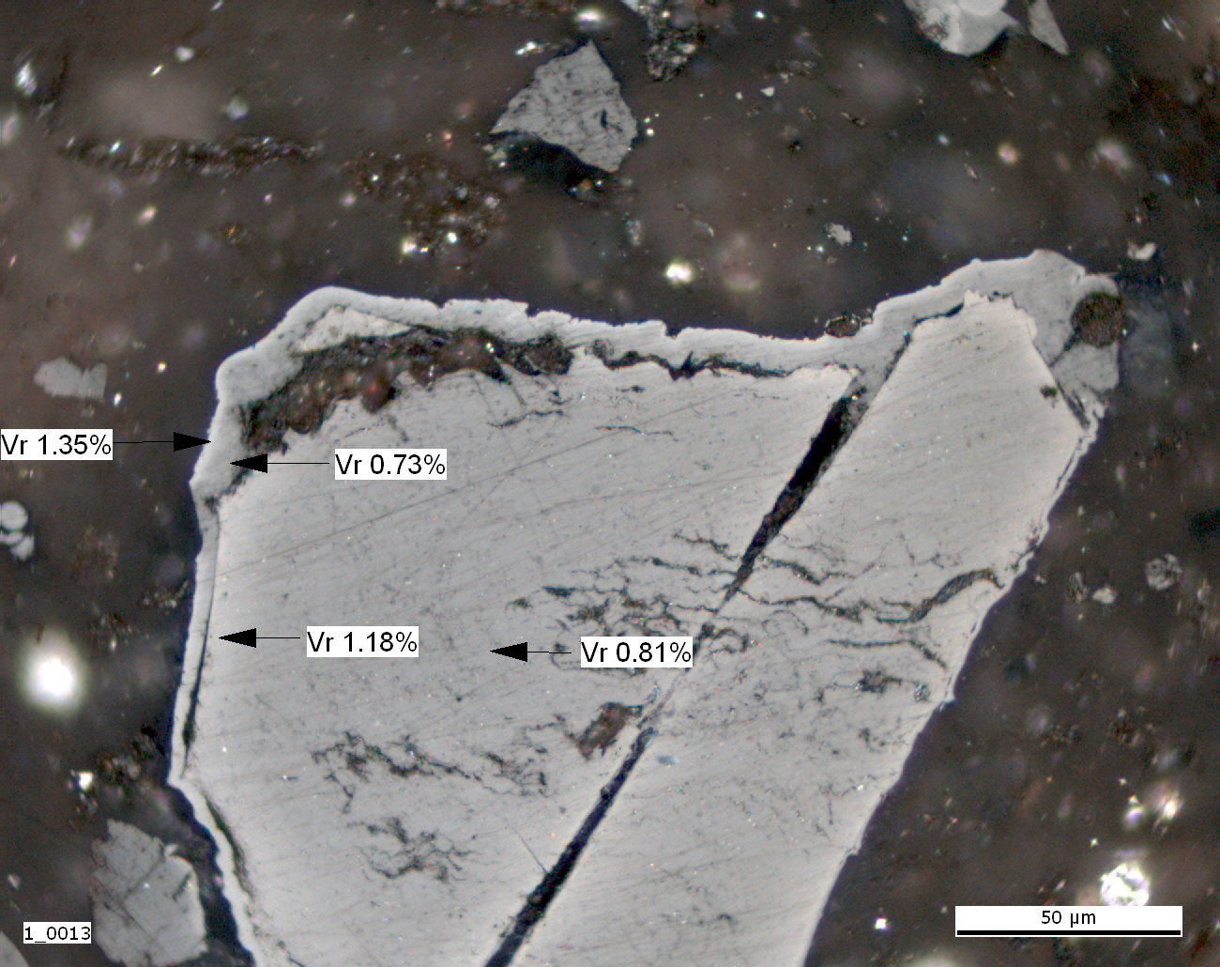
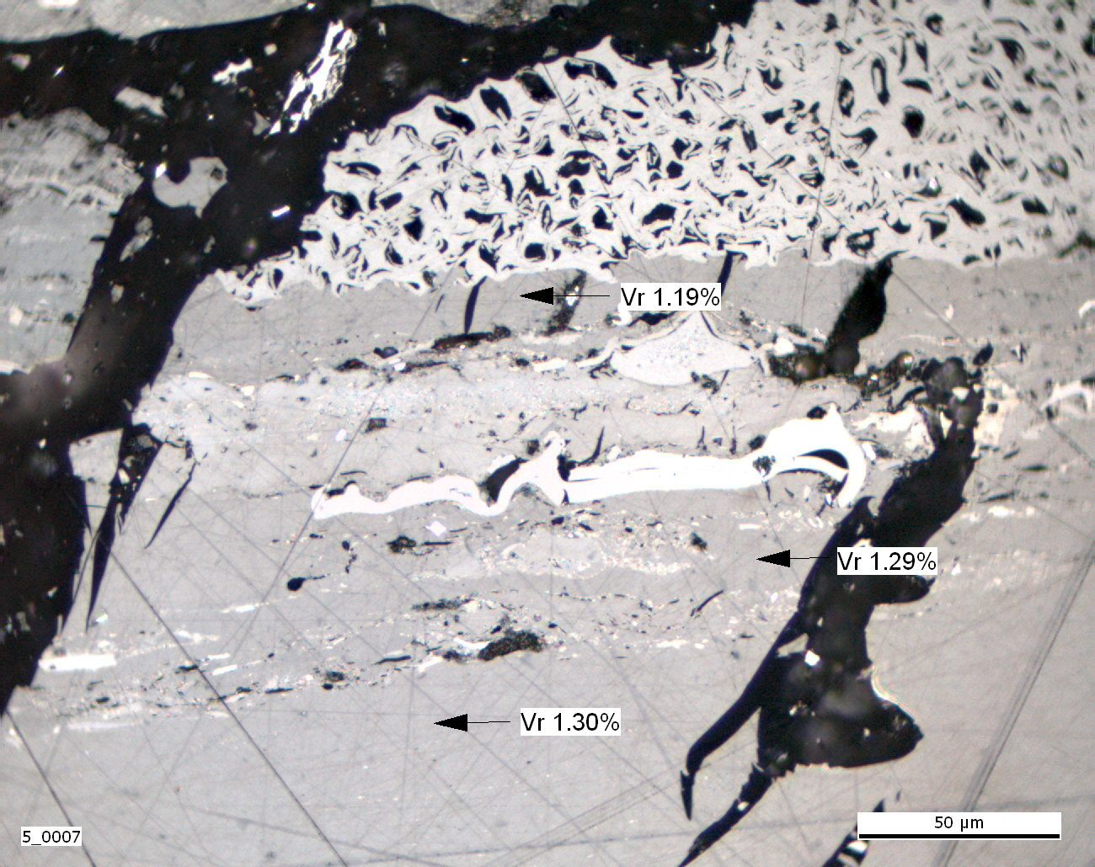
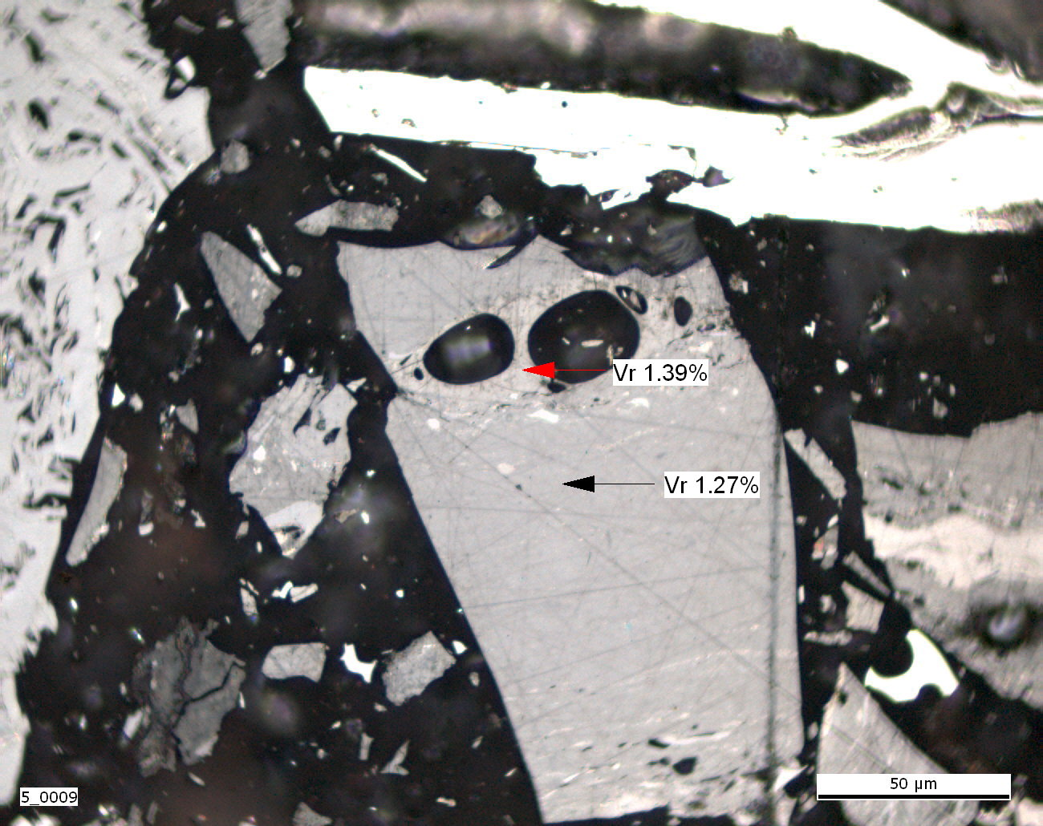
Particles with the highest level of agreement
Photo 20
Photo 21
Photo 22
Photo 27
Photo 28

Slide 14
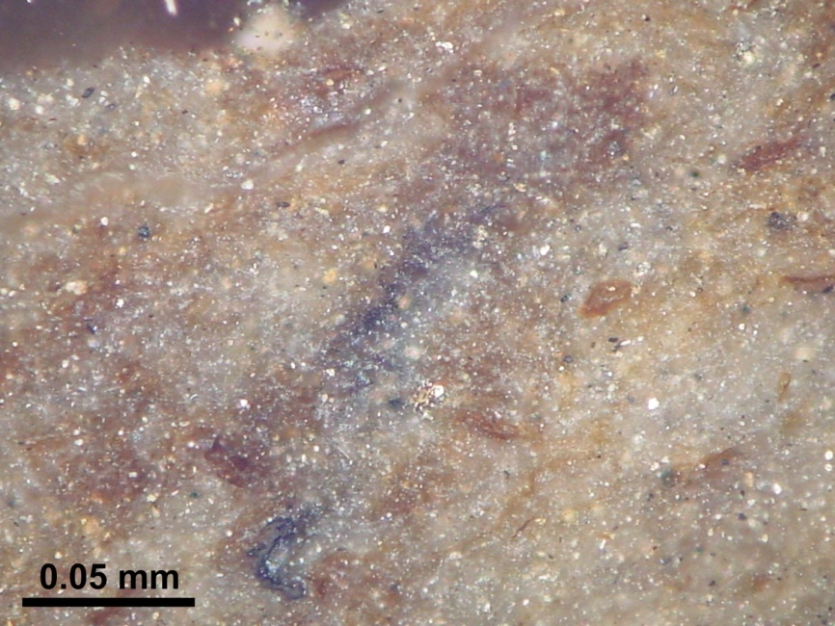
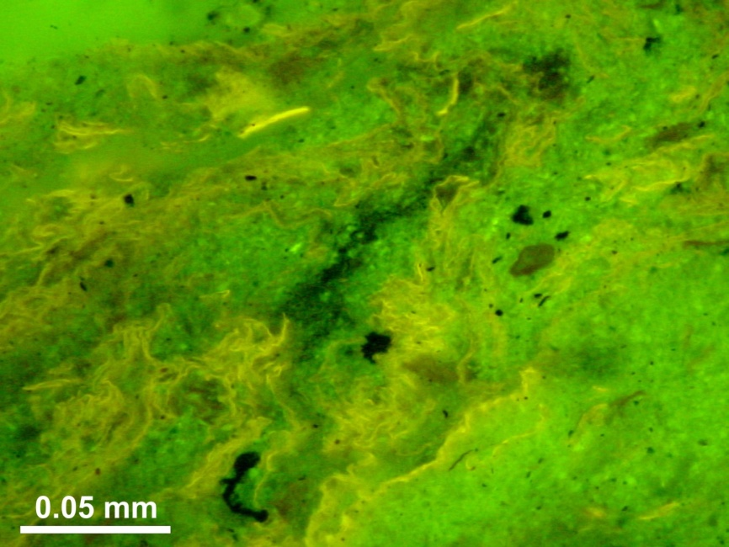
Particles with the highest level of agreement (Photo 30)

Slide 15
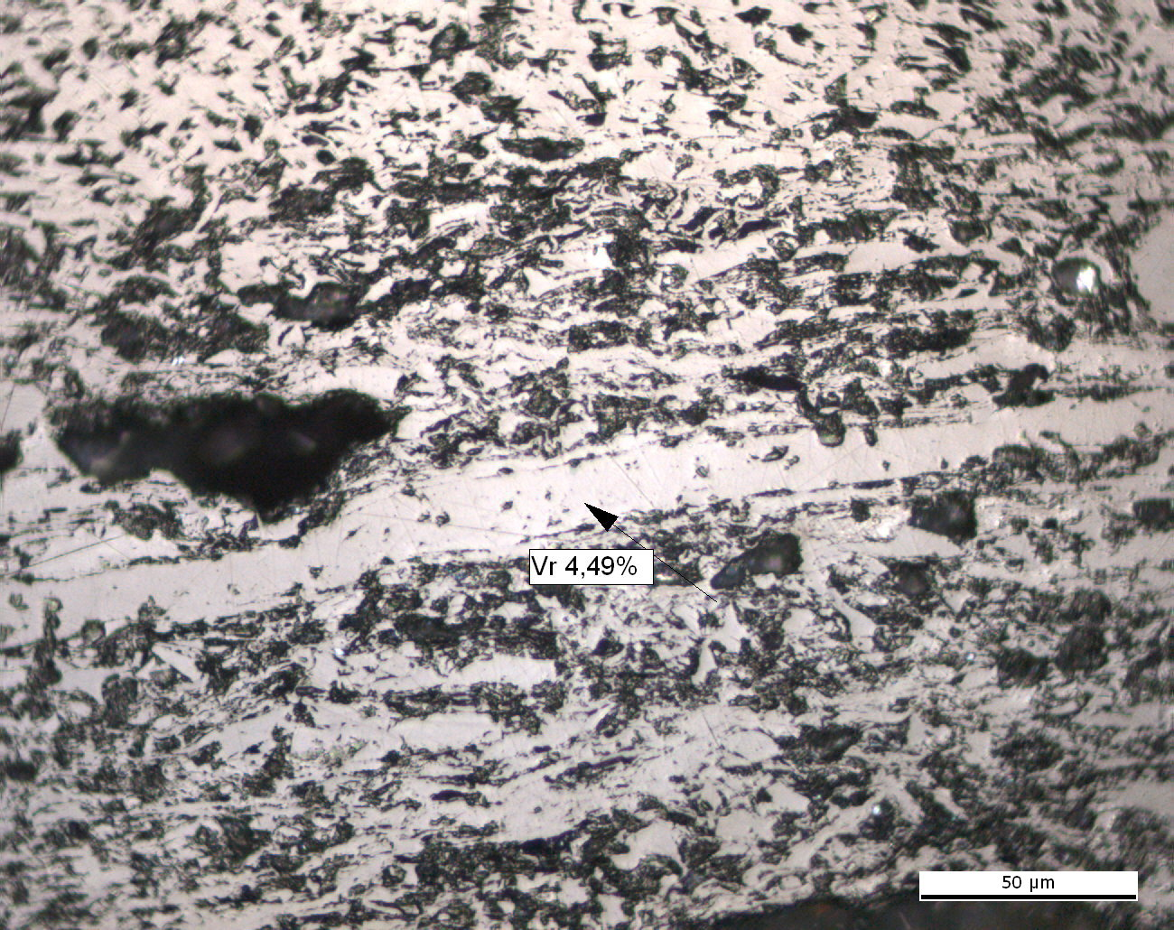
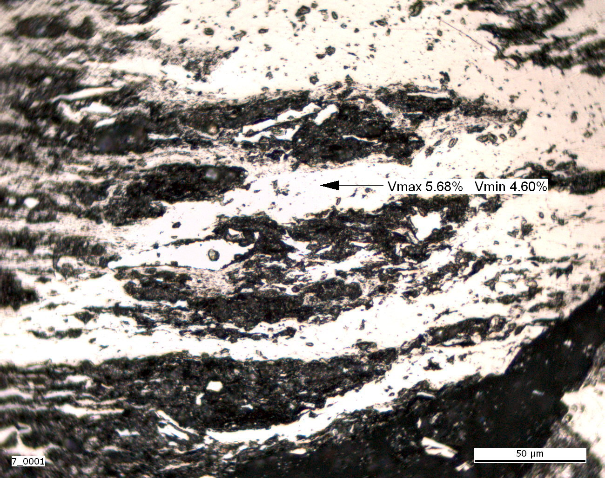
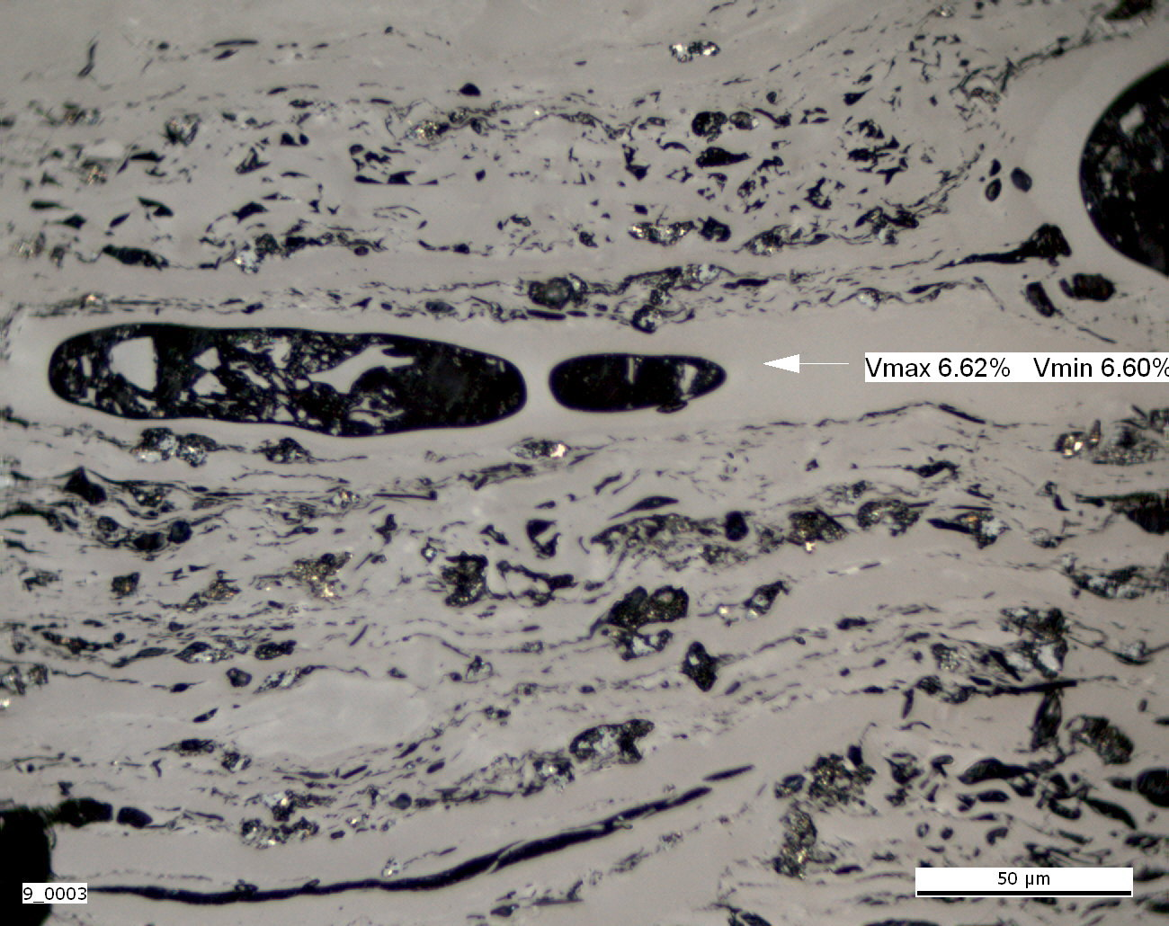
The most troublesome forms
Photo 1
Photo 3
Photo 5
Photo 6
Photo 7
Photo 8

Slide 16
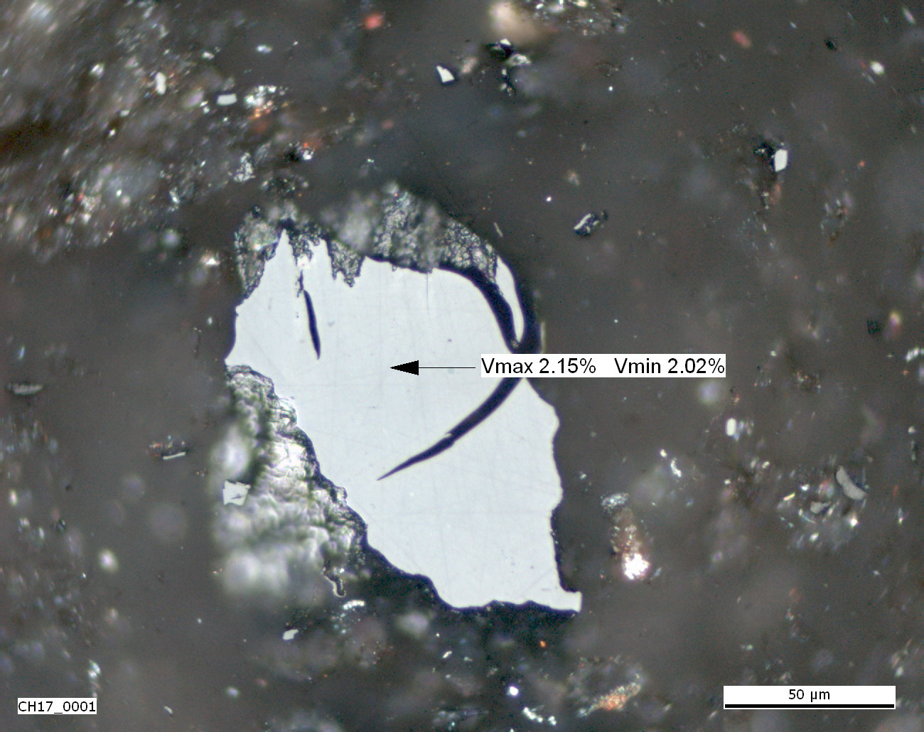
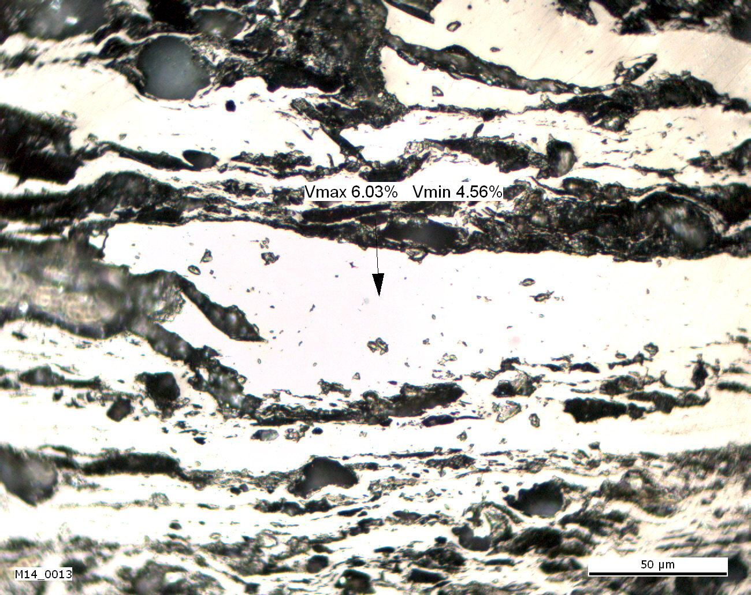
The most troublesome forms
Photo 11
Photo 14
Photo 15
Photo 17
Photo 18
Photo 23

Slide 17
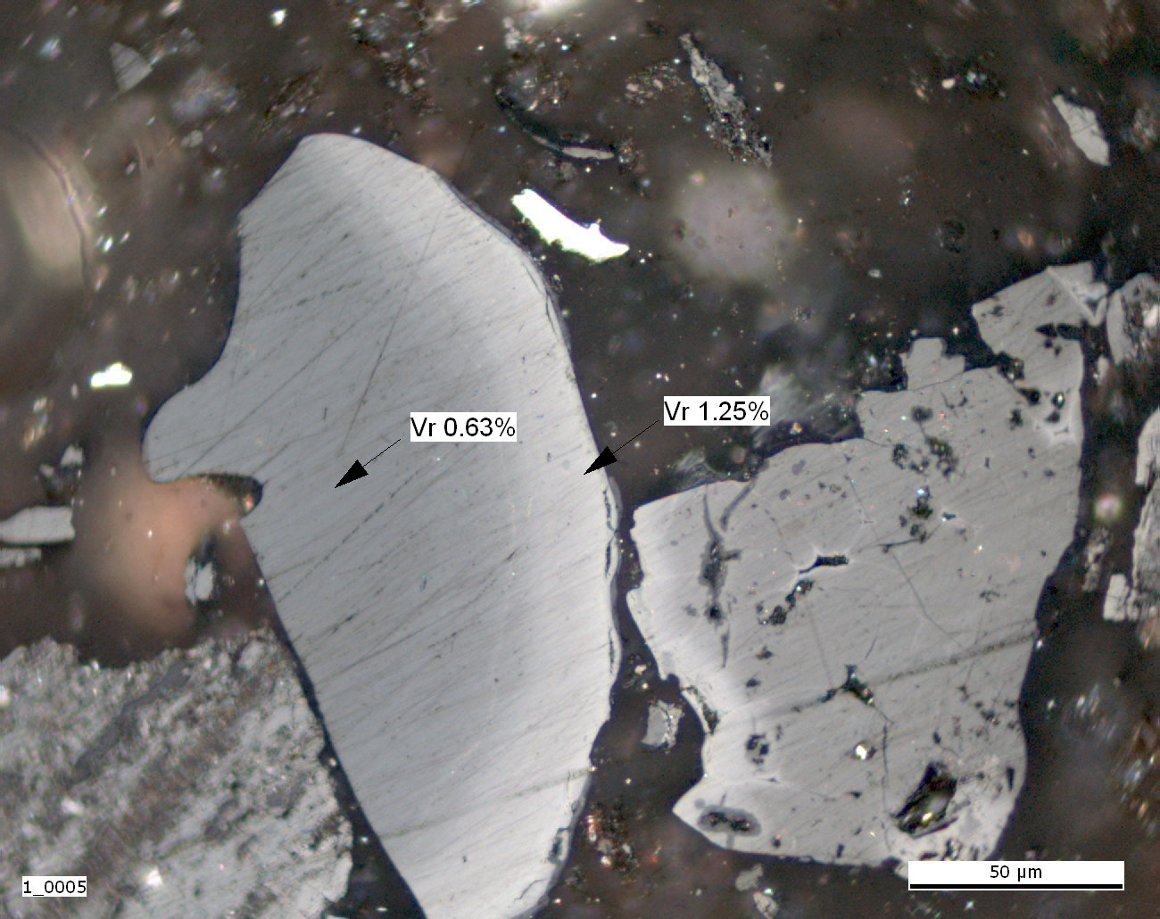
The most troublesome forms
Photo 24
Photo 25
Photo 26

Slide 18
Comments from participants
The classification should be shortened in final phase.
In level 6 more than one option should be given
To replace ‘porous’ with ‘non-massive’ in order to comprise fractures and dispersed material too.
To define exactly what we classify: if the particles used in the first column, LEVEL 1 and also in DESCRIPTION or structure of an organic or carbonaceous material on the defined area or at the point, which is determined in analysis.

Slide 19
Comments from participants
What is the boundary between the types of "altered organic matter" and "char / coke" (the newly formed organic matter) in the case of un-caking or weakly caking coals.
In the case of "altered particles? Organic-carbonaceous mass "I propose to distinguish:
i) weak alteration macerals (vitrinite, liptinite and inertinite) with altered optical properties and is preserved texture and morphology;
ii) strong alteration macerals with altered optical properties and to some extent still distinguishable morphology macerals and other structures after degassing with modified optical properties, improved reflectivity.

Slide 20
Comments from participants
The classification 3.Types altered organic (carbon material), I think it would be possible to change the types of "newly created particles - Organic-carbon materials," according to the proportion of products in the alteration:
  char char
  coke coke
  bitumens
  pyrolytic carbon
  graphite

Slide 21
Comments from participants
Bitumens in the proposed classification includes only hydrocarbons by yellow fluorescence (Alpern et al. 1992). When studying samples from self-heating processes in coal seams and in coal wastes in the Intrasudetic Basin, and in the Upper Silesian Basin, but also in lignite deposits I identified a massive formations of pitchy - tarry nature. (Microphotos i shall send it later). When classifying bitumen would be appropriate to include bitumen with increased reflectivity and no fluorescence according to the classification H.Jacob (1993) [H.Jacob: Nomenclature, Classification, Characterization and Genezis of Natural Solid Bitumen (Migrabitumen). In: J.Parnel, H. Kucha, P. Landais, 1993. Bitumens in Ore Deposits. Special Publication of No.9 the Society for Geology Applied to Mineral Geology, Springer - Verlag, Berlin, Heidelberg, ..., 11 to 27]

Slide 22
Comments from participants
Ranks among the forms of optical anisotropy also undulose extinction or surface anisotropy?
Rating plastic rims seems subjective, especially if the particles are not assessed as a whole

Slide 23
Level 0 | Level 1 | Level 2 | Level 3 | Level 4 | Level 5 | Level 6
 |  |  |  |  |  | Huminite
 | Organic particle | Non-altered | Massive | Fluorescent | Isotropic | Vitrinite
 |  |  | Porous | Non-fluorescent | Anisotropic | Liptinite
 |  |  |  |  |  | Inertinite
 |  |  |  |  |  | fractures, fissures
Organic particle |  |  |  |  |  | paler in colour oxidation rims
Mineral |  | Altered | Massive | Fluorescent | Isotropic | darker in colour oxidation rims
 |  |  | Porous | Non-fluorescent | Anisotropic | plasticised edges
 |  |  |  |  |  | bands
 |  |  |  |  |  | devolatilisation pores
 |  |  |  |  |  | paler in colour particle
 |  |  |  |  |  | bitumens
 |  |  |  |  |  | pyrolytic carbon
 |  | Newly formed | Massive | Fluorescent | Isotropic | chars
 |  |  | Porous | Non-fluorescent | Anisotropic | graphite
 |  |  |  |  |  | coke

Slide 24
Future activity
Another Round Robin Exercise?
Can we publish the classification?

