Slide 1



Report on Self – heating of coal and coal wastes working group
ICCP COMMISSION III
2016 Round Robin Exercise
68th ICCP Meeting, Houston, September 18-23, 2016
Convenors:
Magdalena Misz-Kennan (US)
Deolinda Flores (UP)
Jolanta Kus (BGR)

Slide 2
The aim of the Self-heating Working Group:
to gather examples of various forms of self-heating-related transformations of organic matter in coal and coal wastes of various ranks
to create a classification of these self-heating induced transformations in coal and coal wastes.

Slide 3
The objectives of the 2016 Round Robin Exercise:
test the newly established and modified classification of transformed organic matter in coal wastes on 30 particles in a ppt presentation.
compare the results with the results from the 2015 Round Robin Exercise.

Slide 4
Past activity:
The SHWG was established during the 62nd ICCP Meeting in Oviedo (2008) and information about it was published in the ICCP News Letter No. 45, 2008.
Six Round Robin Exercises were carried out in 2009, 2010, 2012, 2013, 2014, 2015 and 2016.
Discussion on the established terminology took place during the 63rd ICCP Meeting in Porto in 2011.
Discussion on HOW to present the form that has to recognized took place during the 64th ICCP Meeting in Beijing in 2012 and by e-mails after the meeting.

Slide 5
Participants of 2016 Round Robin Exercise:
Kimon Christanis
Deolinda Flores
Manuela Marques
Georgeta Predeanu
Stavros Kalaitzidis
Sławomira Pusz
Dragana Životić
Nikki Wagner
Ivana Sýkorová
Joana Ribeiro
Walter Pickel
Ali Ihsan Karayigit
Walter Pickel
Paolo Martizzi

Slide 6
2016 Round Robin Exercise:
30 photos were selected representing transformed organic matter in coal wastes undergone self-heating processes.
The rank of unaltered organic matter was 0.6% Rr.
Reflectance values of transformed organic matter were given in the photos as Rr or Rmax.
Participants were asked to distinguish the forms of transformed organic matter positioned under square.

Slide 7
Proposed new classification
Level 1: determines the nature of the particle. Here two categories are distinguished: organic, mineral
Level 2: determines the degree of alteration of organic particles. Organic particles were divided into three types: non-altered, altered, newly formed
Level 3: determines the structure of particles. That level applies only to altered particles that are divided into: porous, massive
Level 4: determines the optical properties of particles. Both massive and porous particles were divided into two categories depending if they are: fluorescent, non-fluorescent.
Level 5: determines the texture of the particles. In this level fluorescent particles are isotropic and non-fluorescent particles might be: isotropic, anisotropic

Slide 8
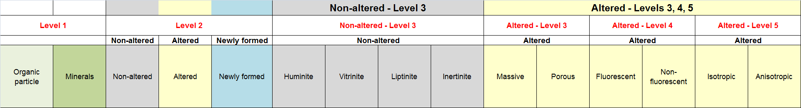

Slide 9
Level 6: determines associations linked with the particle. It applies ONLY to altered particles. Various categories can be distinguished among the isotropic and anisotropic particles:
  fractures, fissures
  paler in colour oxidation rims
  darker in colour oxidation rims
  plasticised edges
  bands
  devolatilisation pores
  paler in colour particle

Slide 10
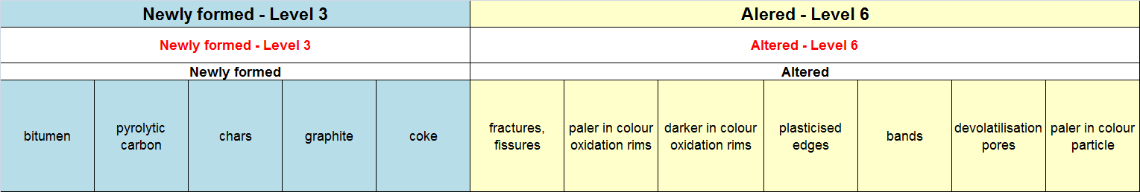

Slide 11
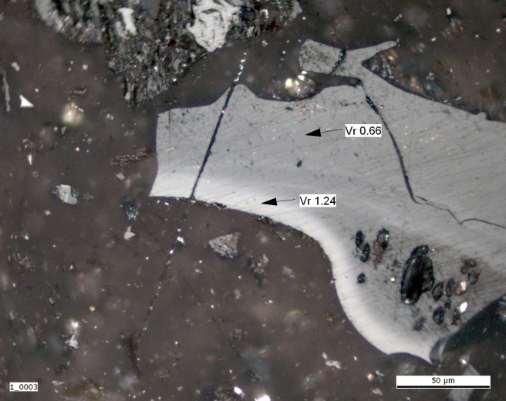
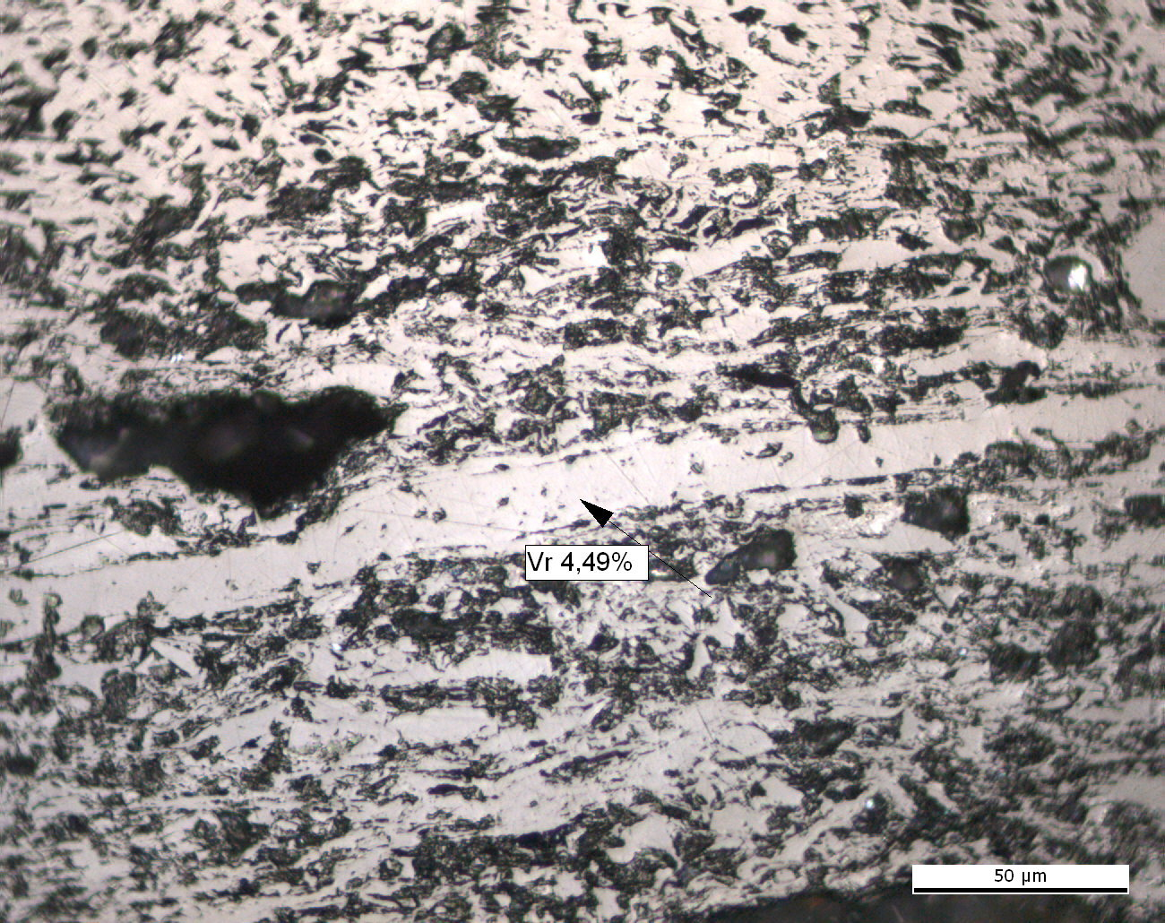
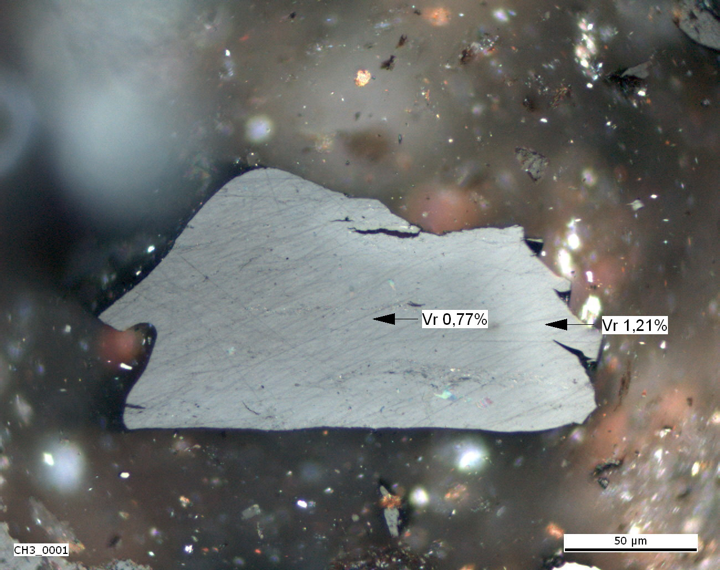
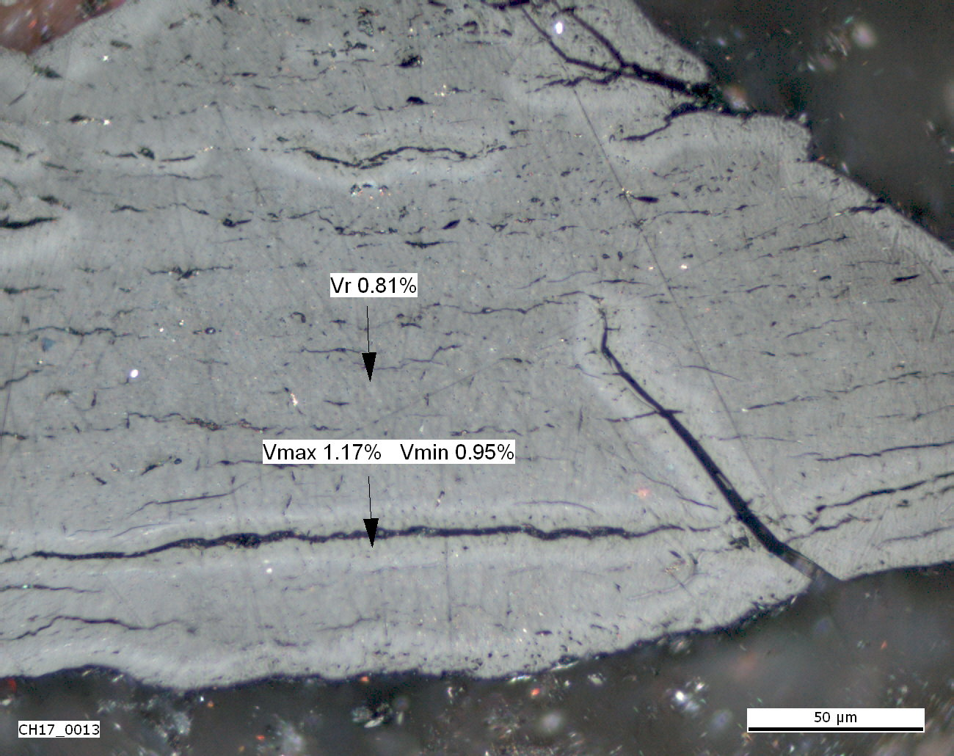
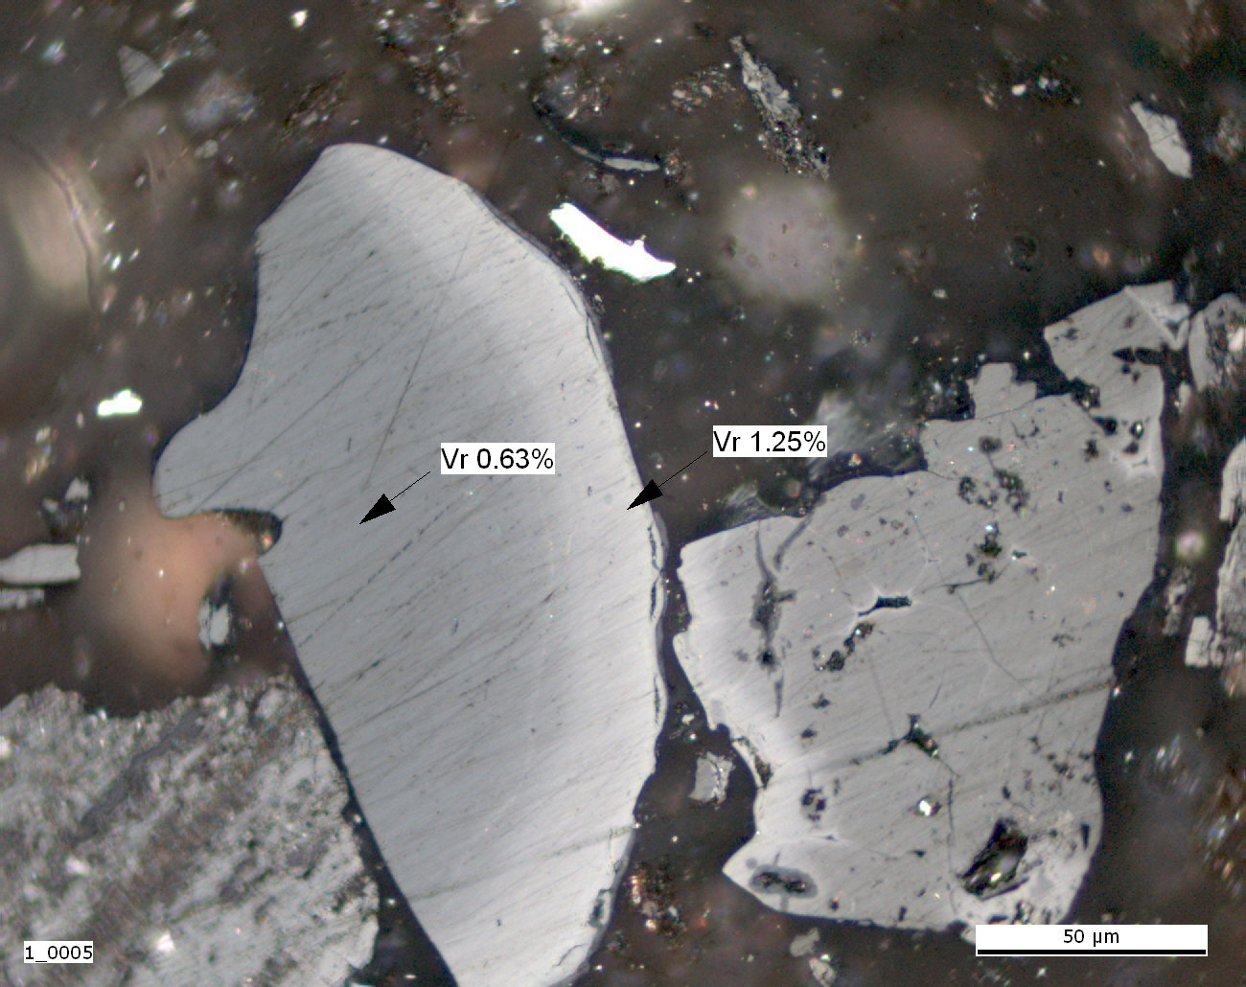
Particles with the highest level of agreement
Photo 2
Photo 3
Photo 6
Photo 11
Photo 25

Slide 12
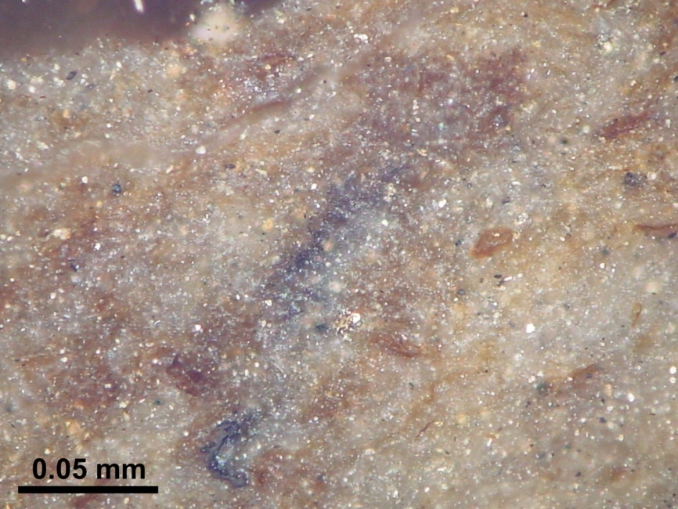
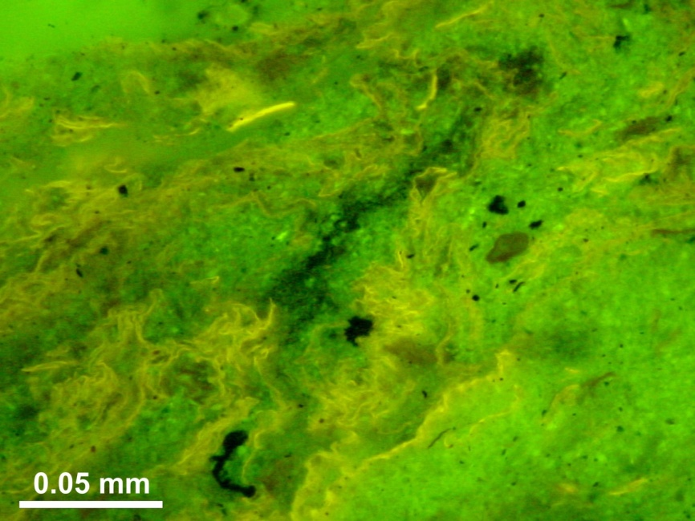
Particles with the highest level of agreement (Photo 30)

Slide 13
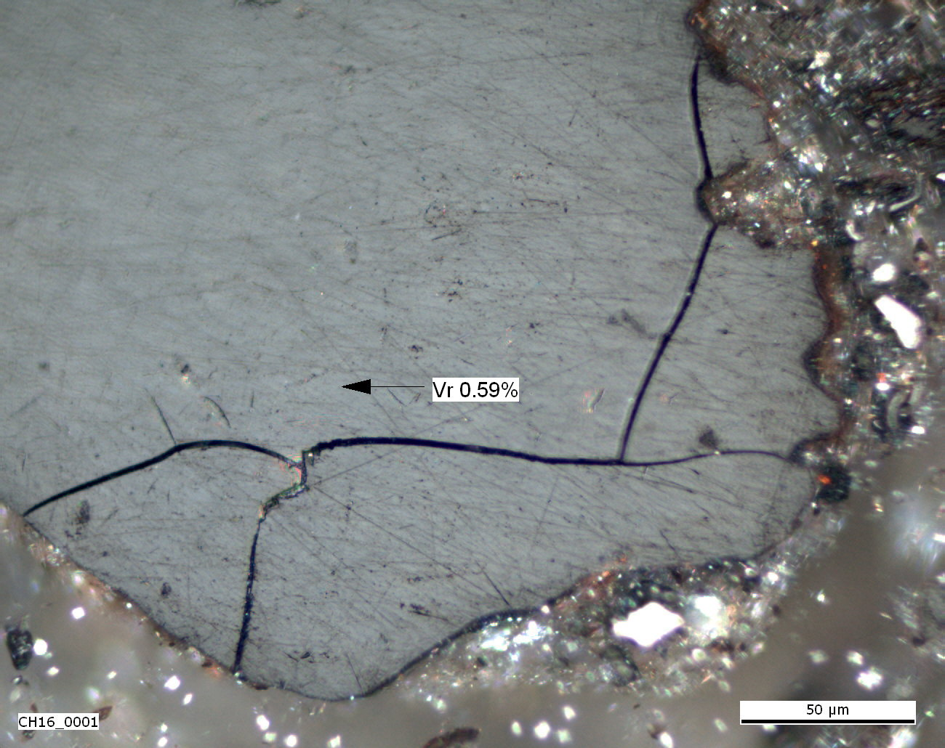
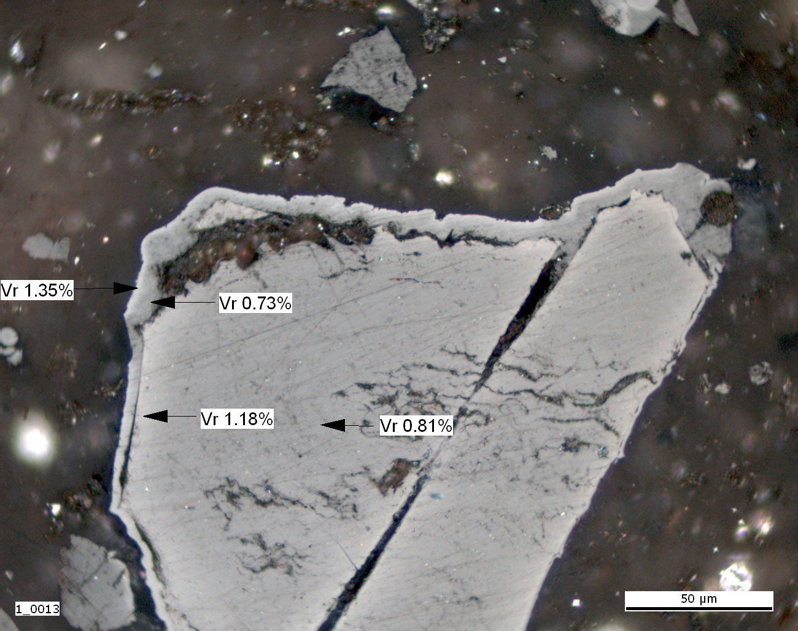
The most troublesome forms
Photo 10
Photo 12
Photo 23
Photo 26

Slide 14
Comments from participants
The classification scheme used this year was simpler than the previous one (2015). The proposed classification system is easier to understand and provides some leeway in assessing certain parameters.
Bands should fall under newley formed as it is not something normally present.
Devolatilisation pores are also newley formed rather than altered.

Slide 15
Comments from participants
Isotropic / anisotropic particles on the base of pictures. Should these terms be replaced by homogeneous / heterogeneous?
Maybe in future Round Robin Exercises to replace VR by R, as you label reflectances of vitrinite and non-vitrinite equally with VR = vitrinite reflectance.
semifusinite-fusinite and heat affected appears to be somewhat hard to distinguish as you basically would have to distinguish, when the heat effect (fire) happened - during self heating or coal deposition and I think, often you can't.

Slide 16
Comments from participants
I guess you want them all to be altered as the reflectance is higher than 'prescribed' in the guidelines - but they look like vitrinites t me, maybe from a contaminating coal. Wonder if highr reflectance alone is argument enough to assume them to be heat affected

Slide 17
Comments from participants
O R G A N I C P A R T I C LE |  |  |  |  |  |  |  |  |  |  |  |  |  |  |  |  |  |  |  | MINERALS
Non-altered |  |  |  | Altered |  |  |  |  |  |  |  |  |  |  | Newly formed
Huminite | Vitrinite | Liptinite | Inertinite | Fluorescent | Non-fluorescent | Isotropic | Anisotropic | fractures, fissures | paler in colour oxidation rims | darker in colour oxidation rims | plasticised edges | bands | devolatilisation pores | paler in colour particle | bitumen | pyrolytic carbon | chars | graphite | coke

Slide 18
Comments from participants
There was not enough variety in the images to be able to really test the classification scheme.
I would like to see new photos, namely of newly formed particles. In fact the photos correspond essentially to organic (massive and isotropic) altered particles which represent only part of the proposed classification.

Slide 19
Further comments
Altered – Porous particles showing porous structure associated with devolatilisation related to thermal processes. Porosity being an original feature of maceral, e.g. porosity of fusinite, is not included here.

Slide 20
Conclusions:
The results were very good and much better comparing to last year.
The proposed classification is ready to be published.

Slide 21
Future activity
Another Round Robin Exercise in 2017 testing the classification on greater variety of forms and more pictures.
Preparing an exercise on the base of self-heated coals.

Slide 22
Acknowledgements
To Jolanta Kus and Deolinda Flores for their help in preparation the Round Robin Exercises and reports
To all participants for their time and work in this working group as well as for their comments
To Deolinda, Nikki, Ivana, Jim for sending pictures of self-heated particles

