Slide 1
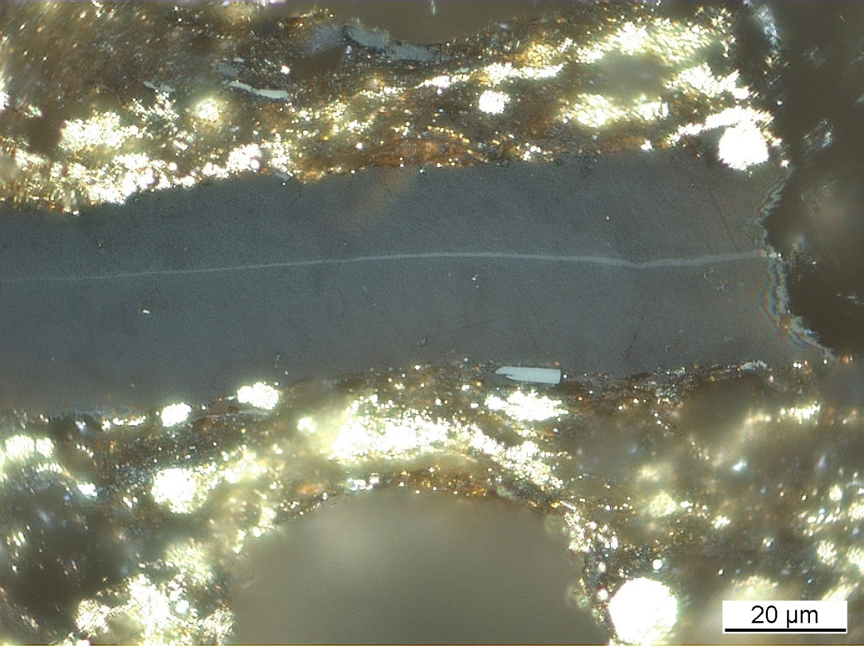
Identification of Dispersed organic Matter WG
Commission II
British Geological Survey, National Geological Repository
North Sea, UK, offshore well 16/17-14
Kimmeridge Clay Formation
Convenor: Dr. Jolanta Kus
ICCP Commission II
75th ICCP Meeting, Oviedo, Spain, 2024

Slide 2
Commission II: Identification of Dispersed Organic Matter WG
The aims of the IDOM WG are as follows:
1. to examine and asses a potential suitability of the ICCP-TSOP Classification System of DOM in identification of organic components in whole rock pellets,
2. to modify, if necessary the ICCP definitions of liptinite macerals (lamalginite, telalginite and bituminite (ICCP, 1993).
Meeting of ICCP IDOM WG 19.09.2023 – Joint 74th ICCP and 39th TSOP Meeting, Patras, 2023
Notes:
Fibered light sources of a given specification depending on the bulb type, wavelength, output mode and measurement type (Absorbance, Fluorescence, Reflectance, Transmission or Calibration and with options for UV, Visible
Tungsten HalogenHL-2000 – red
Deuterium Tungsten HalogenDH-2000-BAL – blue

Slide 3
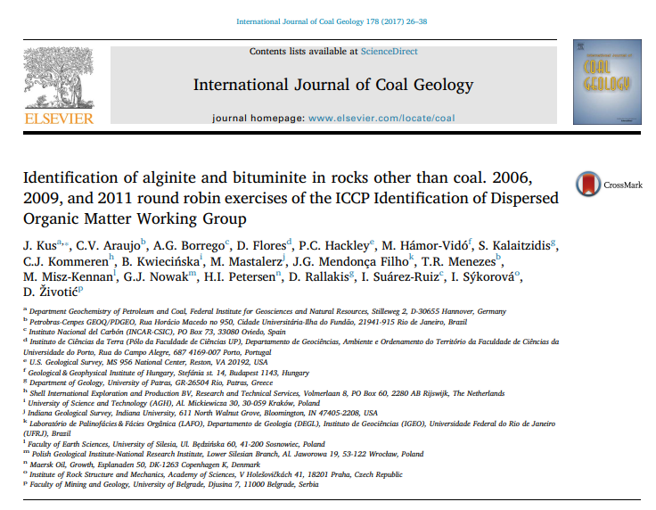
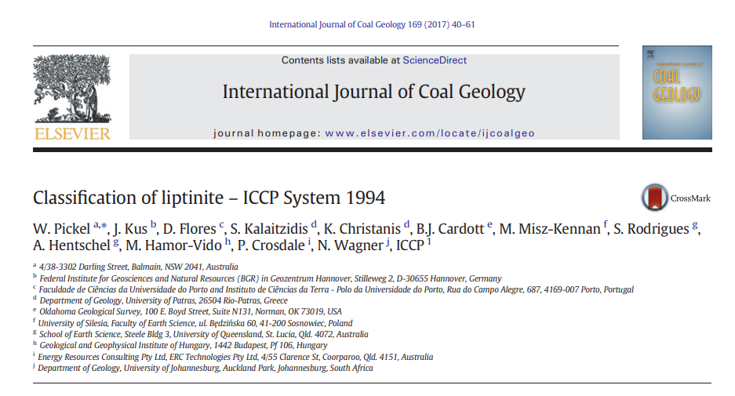
Commission II: Identification of Dispersed Organic Matter WG
Achievements of the IDOM WG are as follows:
1. Running round robin exercises in 2006, 2009, 2011, 2016, 2018, 2020, and 2022.
2. Publication of results from the 2006, 2009, and 2011 round robin exercises in 2017 in: Kus et al. (2017).
3. Contribution of results of the IDOM round robin exercises to the Classification of liptinite – ICCP System 1994 in Pickel et al. (2017).
4. Preparation of Case study of maturity series with Posidonia Shale from Hills area in Lower Saxoany Basin, Germany in 2013 and 2014.
Meeting of ICCP IDOM WG 19.09.2023 – Joint 74th ICCP and 39th TSOP Meeting, Patras, 2023
Notes:
Fibered light sources of a given specification depending on the bulb type, wavelength, output mode and measurement type (Absorbance, Fluorescence, Reflectance, Transmission or Calibration and with options for UV, Visible
Tungsten HalogenHL-2000 – red
Deuterium Tungsten HalogenDH-2000-BAL – blue

Slide 4
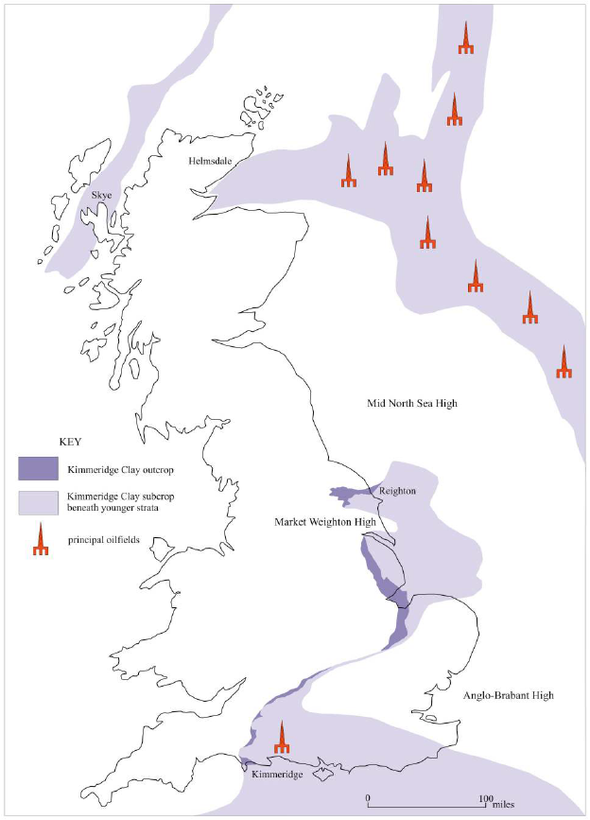
Commission II: Identification of Dispersed Organic Matter WG
Summary of the 2016, 2018, 2020 Round Robin Exercises:
2016 Kimmeridge Bay: (N=21)
1. No preparation difficulties with possible effects on analyses in VRr (%):
GM – 0.476%
GSD – 0.1021
2. If excluding the signed multiple of standard deviation (SMSD)> 1.0 sensu Hackley et al. (2020):
GM – 0.499% (0.34 – 0.58%)
GSD – 0,0927
2020
North Sea
2018
Filey Bay
Gallois, R. W. 2004. Open University Geological Journal, Vol. 25, Part 2.
2016
Kimmeridge Bay
Meeting of ICCP IDOM WG 19.09.2023 – Joint 74th ICCP and 39th TSOP Meeting, Patras, 2023
Notes:
Fibered light sources of a given specification depending on the bulb type, wavelength, output mode and measurement type (Absorbance, Fluorescence, Reflectance, Transmission or Calibration and with options for UV, Visible
Tungsten HalogenHL-2000 – red
Deuterium Tungsten HalogenDH-2000-BAL – blue

Slide 5
Commission II: Identification of Dispersed Organic Matter WG
Summary of the 2016, 2018, 2020 Round Robin Exercises:
2018 Filey Bay: (N=20)
1. Sever preparation difficulties with possible effects on analyses in VRr (%):
GM – 0.466%
GSD – 0.1099
2. If excluding the signed multiple of standard deviation (SMSD)> 1.0 sensu Hackley et al. (2020):
GM – 0.453%
GSD – 0.1081
2020
North Sea
2018
Filey Bay
Gallois, R. W. 2004. Open University Geological Journal, Vol. 25, Part 2.
2016
Kimmeridge Bay
Meeting of ICCP IDOM WG 19.09.2023 – Joint 74th ICCP and 39th TSOP Meeting, Patras, 2023
Notes:
Fibered light sources of a given specification depending on the bulb type, wavelength, output mode and measurement type (Absorbance, Fluorescence, Reflectance, Transmission or Calibration and with options for UV, Visible
Tungsten HalogenHL-2000 – red
Deuterium Tungsten HalogenDH-2000-BAL – blue

Slide 6
Commission II: Identification of Dispersed Organic Matter WG
Summary of the 2016, 2018, 2020 Round Robin Exercises:
2020 North Sea: (N=19; 18 plus 1 add. Participant)
1. Severe preparation difficulties with possible explanation for analyses in VRr (%):
GM – 0.708%
GSD – 0,0951
2. If excluding the signed multiple of standard deviation (SMSD)> 1.0 sensu Hackley et al. (2020):
GM – 0.711%
GSD – 0.042
2020 & 2023
North Sea
2018
Filey Bay
Gallois, R. W. 2004. Open University Geological Journal, Vol. 25, Part 2.
2016
Kimmeridge Bay
Meeting of ICCP IDOM WG 19.09.2023 – Joint 74th ICCP and 39th TSOP Meeting, Patras, 2023
Notes:
Fibered light sources of a given specification depending on the bulb type, wavelength, output mode and measurement type (Absorbance, Fluorescence, Reflectance, Transmission or Calibration and with options for UV, Visible
Tungsten HalogenHL-2000 – red
Deuterium Tungsten HalogenDH-2000-BAL – blue

Slide 7
Commission II: Identification of Dispersed Organic Matter WG
Preparation of draft manuscript in 2024 on the
2016, 2018, and 2020 round robin exercises (conventional water-baesd preparation method)
1. Clarification of the term “unstructured” in terms of lacking a definite shape or form as opposed to lacking internal structure.
2. The bituminite definition requires clarification of its established description in terms of morphological characteristics and should be accompanied with suitable photomicrograph examples. Usage of the term “typically” should be avoided.
3. A note on how to differentiate bituminite from other alginite macerals or mineral-bituminous groundmass is necessary.
Provide a description of bituminite in accordance to the supplied bituminite description sheet (2016, 2018, 2020).
Form, Size, Appearance, Impurities,
Internal structure, Optical properties,
Association with:
Bituminit I, II, III of Teichmüller and
Ottenjann (1977),
Bituminit I, II of Mackenzie-Basin (Creaney, 1980),
Amorphinite A, B, and C (van Gijzel, 1980),
Sapropelinites I, II of Mukhopadhyay et al. (1985 a,b).
Meeting of ICCP IDOM WG 19.09.2023 – Joint 74th ICCP and 39th TSOP Meeting, Patras, 2023
Notes:
Fibered light sources of a given specification depending on the bulb type, wavelength, output mode and measurement type (Absorbance, Fluorescence, Reflectance, Transmission or Calibration and with options for UV, Visible
Tungsten HalogenHL-2000 – red
Deuterium Tungsten HalogenDH-2000-BAL – blue

Slide 8
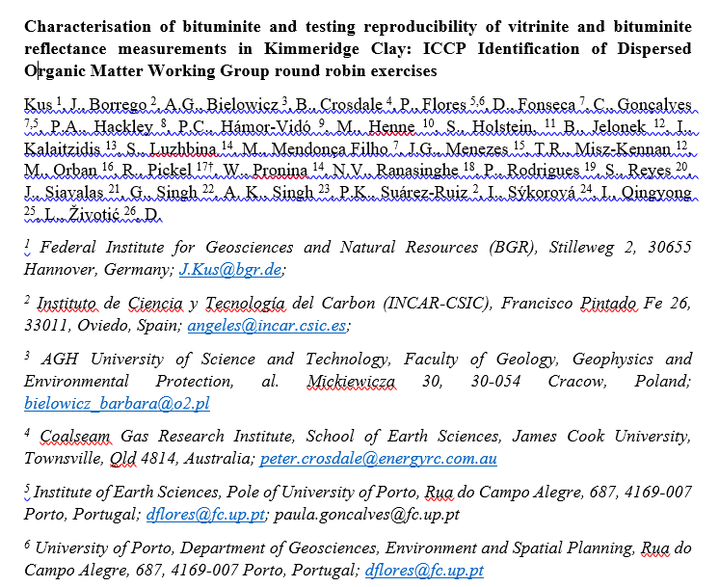
Commission II: Identification of Dispersed Organic Matter WG
Preparation of draft manuscript in 2024 on the
2016, 2018, and 2020 round robin exercises (conventional water-baesd preparation method)
Characterisation of bituminite and testing reproducibility of vitrinite and bituminite reflectance measurements in Kimmeridge Clay: ICCP Identification of Dispersed Organic Matter Working Group round robin exercises
Meeting of ICCP IDOM WG 19.09.2023 – Joint 74th ICCP and 39th TSOP Meeting, Patras, 2023
Notes:
Fibered light sources of a given specification depending on the bulb type, wavelength, output mode and measurement type (Absorbance, Fluorescence, Reflectance, Transmission or Calibration and with options for UV, Visible
Tungsten HalogenHL-2000 – red
Deuterium Tungsten HalogenDH-2000-BAL – blue

Slide 9
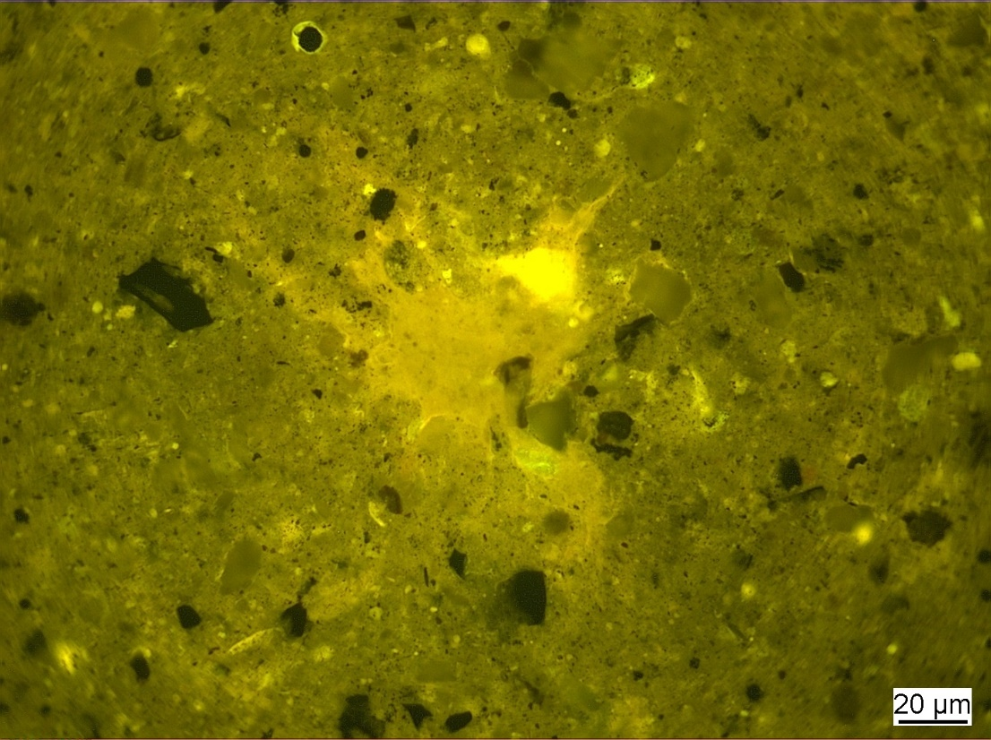
Thank you very much for your attention!
Meeting of ICCP IDOM WG 19.09.2023 – Joint 74th ICCP and 39th TSOP Meeting, Patras, 2023

Slide 10
Impressum
Herausgeber:
Bundesanstalt für Geowissenschaften und Rohstoffe
Stilleweg 2
30655 Hannover
Contact:
Dr. Jolanta Kus
Jolanta.Kus@bgr.de
Joint 74th ICCP and 39th TSOP Meeting, Patras, Greece, 2023
ICCP Commission II
Dispersed organic matter in sedimentary rocks WG
Stand: August 2023
Meeting of ICCP IDOM WG 19.09.2023 – Joint 74th ICCP and 39th TSOP Meeting, Patras, 2023

