Slide 1
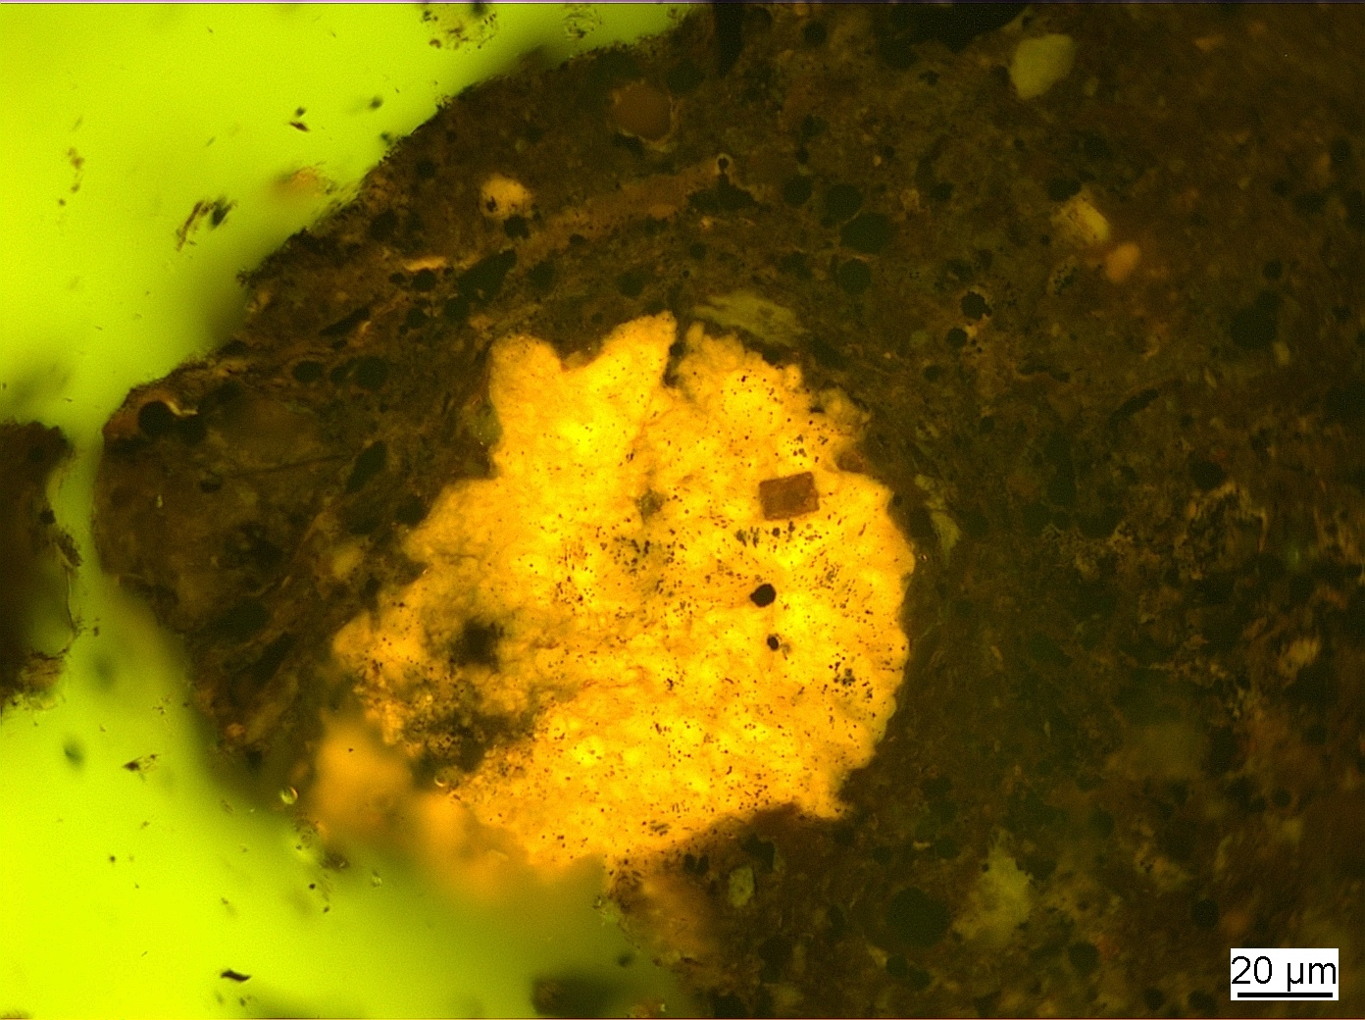
Identification of Dispersed Organic Matter WG
Commission II
British Geological Survey, National Geological Repository
North Sea, UK, offshore well 16/17-14
Kimmeridge Clay Formation
Convenor: Dr. Jolanta Kus
ICCP Commission II
76th ICCP Meeting, Beijing, China, 2025

Slide 2
Commission II: Identification of Dispersed Organic Matter WG
The aims of the IDOM WG are as follows:
1. to examine and asses a potential suitability of the ICCP-TSOP Classification System of DOM in identification of organic components in whole rock pellets,
2. to modify, if necessary the ICCP definitions of liptinite macerals (lamalginite, telalginite and bituminite (ICCP, 1993).
Meeting of ICCP Commission II – 76th ICCP Meeting, Beijing, China, 2025
Notes:
Fibered light sources of a given specification depending on the bulb type, wavelength, output mode and measurement type (Absorbance, Fluorescence, Reflectance, Transmission or Calibration and with options for UV, Visible
Tungsten HalogenHL-2000 – red
Deuterium Tungsten HalogenDH-2000-BAL – blue

Slide 3
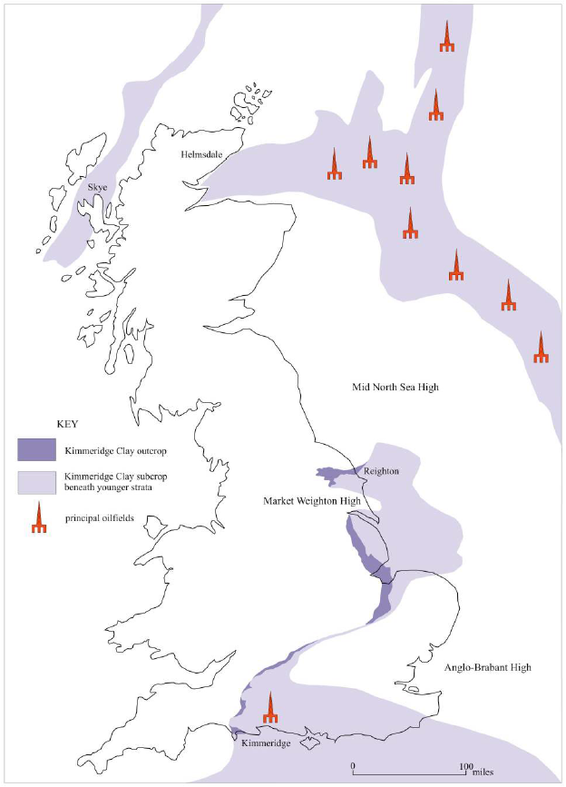
Commission II: Identification of Dispersed Organic Matter WG
Summary of the 2016, 2018, 2020 Round Robin Exercises:
2016 Kimmeridge Bay: (N=21)
1. No preparation difficulties with possible effects on analyses in VRr (%):
GM – 0.476%
GSD – 0.1021
2. If excluding the signed multiple of standard deviation (SMSD)> 1.0 sensu Hackley et al. (2020):
GM – 0.499% (0.34 – 0.58%)
GSD – 0,0927
2020
North Sea
2018
Filey Bay
Gallois, R. W. 2004. Open University Geological Journal, Vol. 25, Part 2.
2016
Kimmeridge Bay
Meeting of ICCP Commission II – 76th ICCP Meeting, Beijing, China, 2025
Notes:
Fibered light sources of a given specification depending on the bulb type, wavelength, output mode and measurement type (Absorbance, Fluorescence, Reflectance, Transmission or Calibration and with options for UV, Visible
Tungsten HalogenHL-2000 – red
Deuterium Tungsten HalogenDH-2000-BAL – blue

Slide 4
Commission II: Identification of Dispersed Organic Matter WG
Summary of the 2016, 2018, 2020 Round Robin Exercises:
2018 Filey Bay: (N=20)
1. Sever preparation difficulties with possible effects on analyses in VRr (%):
GM – 0.466%
GSD – 0.1099
2. If excluding the signed multiple of standard deviation (SMSD)> 1.0 sensu Hackley et al. (2020):
GM – 0.453%
GSD – 0.1081
2020
North Sea
2018
Filey Bay
Gallois, R. W. 2004. Open University Geological Journal, Vol. 25, Part 2.
2016
Kimmeridge Bay
Meeting of ICCP Commission II – 76th ICCP Meeting, Beijing, China, 2025
Notes:
Fibered light sources of a given specification depending on the bulb type, wavelength, output mode and measurement type (Absorbance, Fluorescence, Reflectance, Transmission or Calibration and with options for UV, Visible
Tungsten HalogenHL-2000 – red
Deuterium Tungsten HalogenDH-2000-BAL – blue

Slide 5
Commission II: Identification of Dispersed Organic Matter WG
Summary of the 2016, 2018, 2020 Round Robin Exercises:
2020 North Sea: (N=19; 18 plus 1 add. Participant)
1. Severe preparation difficulties with possible explanation for analyses in VRr (%):
GM – 0.708%
GSD – 0,0951
2. If excluding the signed multiple of standard deviation (SMSD)> 1.0 sensu Hackley et al. (2020):
GM – 0.711%
GSD – 0.042
2020 & 2023
North Sea
2018
Filey Bay
Gallois, R. W. 2004. Open University Geological Journal, Vol. 25, Part 2.
2016
Kimmeridge Bay
Meeting of ICCP Commission II – 76th ICCP Meeting, Beijing, China, 2025
Notes:
Fibered light sources of a given specification depending on the bulb type, wavelength, output mode and measurement type (Absorbance, Fluorescence, Reflectance, Transmission or Calibration and with options for UV, Visible
Tungsten HalogenHL-2000 – red
Deuterium Tungsten HalogenDH-2000-BAL – blue

Slide 6
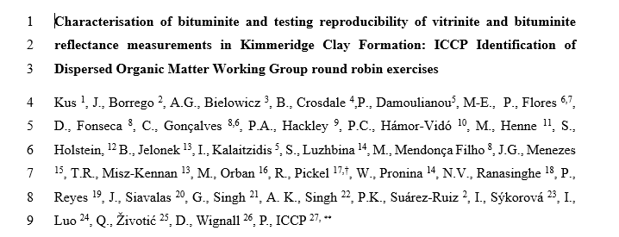
Commission II: Identification of Dispersed Organic Matter WG
Preparation of draft manuscript in mid 2024-2025 on the 2016, 2018, and 2020 round robin exercises (conventional water-baesd preparation method)
Review of the manuscript at USGS started in July 2025
Review of the manuscript at ICCP began in September 2025
Meeting of ICCP Commission II – 76th ICCP Meeting, Beijing, China, 2025
Notes:
Fibered light sources of a given specification depending on the bulb type, wavelength, output mode and measurement type (Absorbance, Fluorescence, Reflectance, Transmission or Calibration and with options for UV, Visible
Tungsten HalogenHL-2000 – red
Deuterium Tungsten HalogenDH-2000-BAL – blue

Slide 7
Commission II: Identification of Dispersed Organic Matter WG
Preparation of draft manuscript in mid 2024-2025 on the 2016, 2018, and 2020 round robin exercises (conventional water-baesd preparation method)
Main outcomes:
Bituminite morphological characteristics including form, appearance, impurities, and gradational character should be considered for renovation of the bituminite definition.
We recommend not to advance with association to formerly defined bituminite types (e.g., bituminite I sensu Teichmüller and Ottenjann, 1977).
Mean random BitR_{o} %, including outlying values, varied from 0.19 to 0.35 % and was reported here for the first time, with GSD from 0.04 to 0.17.
Mean VR_{o} values including outliers in the three REE ranged from 0.47 to 0.71 %, confirming the immature to thermally mature nature of the KCF samples used.
Precision of VR_{o} values (no outlying values excluded) evaluated via the averaged unsigned multiple of the standard deviation rule (< 1.5) showed moderate to high precision comparable to historical values from similar RRE.
An average reproducibility limit (RL) of 0.29 % (no outlying values excluded) showed an improvement in reproducibility relative to similar historical REE (0.35 %)
Meeting of ICCP Commission II – 76th ICCP Meeting, Beijing, China, 2025
Notes:
Fibered light sources of a given specification depending on the bulb type, wavelength, output mode and measurement type (Absorbance, Fluorescence, Reflectance, Transmission or Calibration and with options for UV, Visible
Tungsten HalogenHL-2000 – red
Deuterium Tungsten HalogenDH-2000-BAL – blue

Slide 8
Thank you very much for your attention!
2020 ROUND ROBIN EXERCISE
Core plug of the 16/17-14 well in the Viking Graben, North Sea, UK.
3-channel false colour confocal laser scanning microscope (CLSM) image of bituminite and lamalginite (in pale and dark red) and framboidal pyrite (in green).
Meeting of ICCP Commission II – 76th ICCP Meeting, Beijing, China, 2025

Slide 9
Impressum
Herausgeber:
Bundesanstalt für Geowissenschaften und Rohstoffe
Stilleweg 2
30655 Hannover
Contact:
Dr. Jolanta Kus
Jolanta.Kus@bgr.de
76th ICCP Meeting, Beijing, China, 2025
ICCP Commission II
Identification of dispersed Organic Matter WG
Stand: September 2025
Meeting of ICCP Commission II – 76th ICCP Meeting, Beijing, China, 2025

