Slide 1

Proposal for a Working group (Commission I)
Radiolytical alteration of the organic matter in coal
and rocks enriched in radioactive minerals
Tatiana Larikova, Ivana Sýkorová, Martina Havelcová
Jolanta Kus, Stavros Kalaitzidis

Slide 2

Introduction
Association of uranium with the organic matter have been studied for more than ninety years, e.g.:
  in bitumens (Ellsworth, 1928a, b; Parnell, 1993; England et al., 2001),
  bituminous coal (Kříbek et al., 2017; Sýkorová et al., 2016; Eskenazy and Velichkov, 2012),
  lignite (Havelcová et al. 2014; Rallakis et al., 2019),
  shales (Lecomte et al., 2017; Liu et al., 2020).
Uranium minerals usually occur as inclusions of nanometer to micrometer size, often homogeneously dispersed in the organic matrix.
Uranium derived from hydrothermal fluids concentrates in urano-organic complexes by adsorption, or by reduction of uranyl complexes; later, U may precipitate in a form of uraninite and other minerals.
Long-lasting association of U with bitumen or coal macerals leads to damage of the organic matter. The main alteration processes of organic matter due to the presence of U comprise oxidation, biodegradation, radiolysis, and thermal degradation. During radiolysis α and β particles, and γ rays are emitted from mineral grains containing U and Th and their daughter products.

Slide 3
Petrographic evidences of radiolytical alteration
Reflectance values in bitumen or coal increase and fluorescence intensity decreases with increase in U concentration (Breger, 1974; Parnell, 1993; Smieja-Król et al., 2009);
Bright aureoles (circles and ellipses under microscope) - halos appearing in macerals around uranium minerals;
Bright areas, or irregular zones, and zones forming around veins in organic matter (Jedwab, 1966; Gentry et al., 1976, Leventhal et al., 1986; Sýkorová et al., 2016; Machovič et al., 2021; Havelcová et al., 2022).
Structural breakdown and chemical alteration of organic matter.

Slide 4
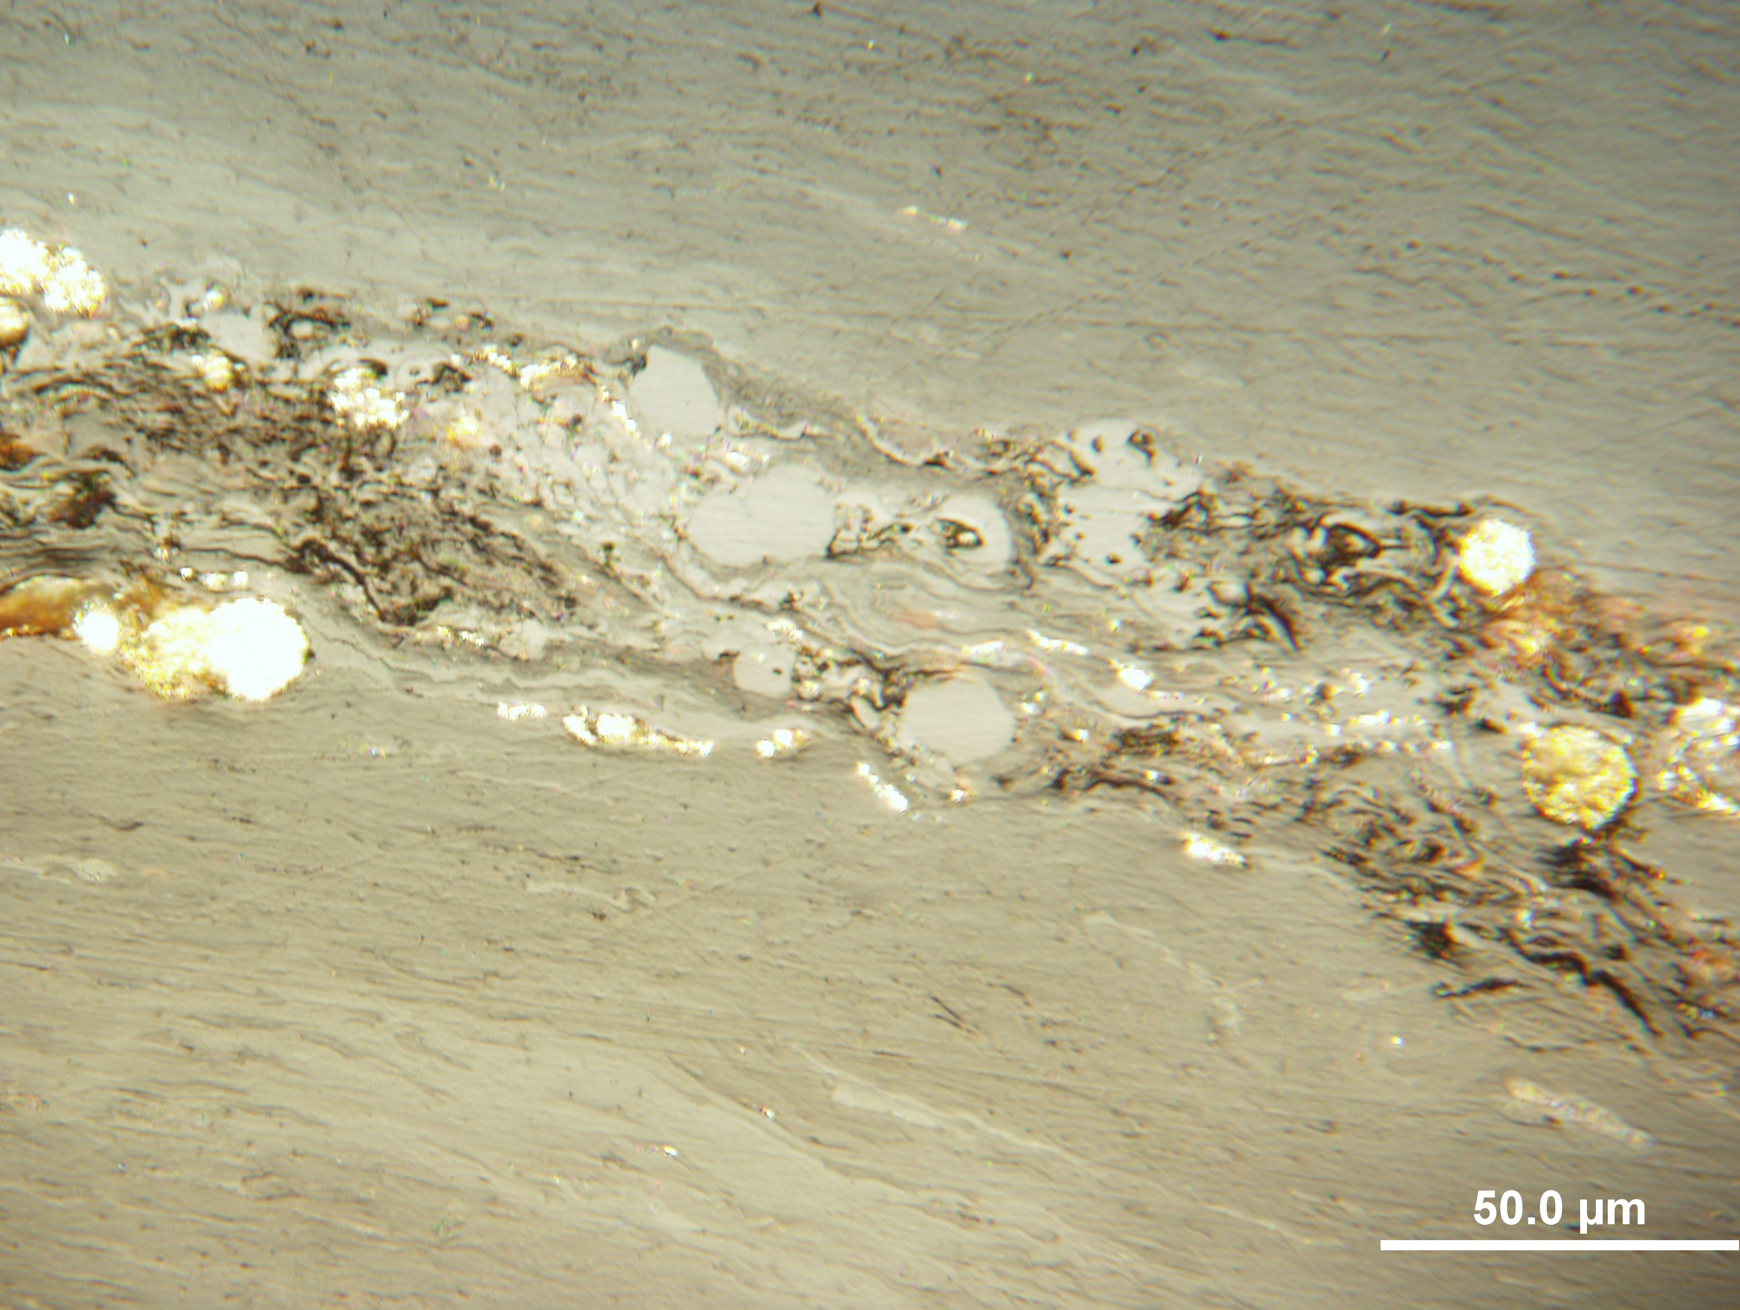
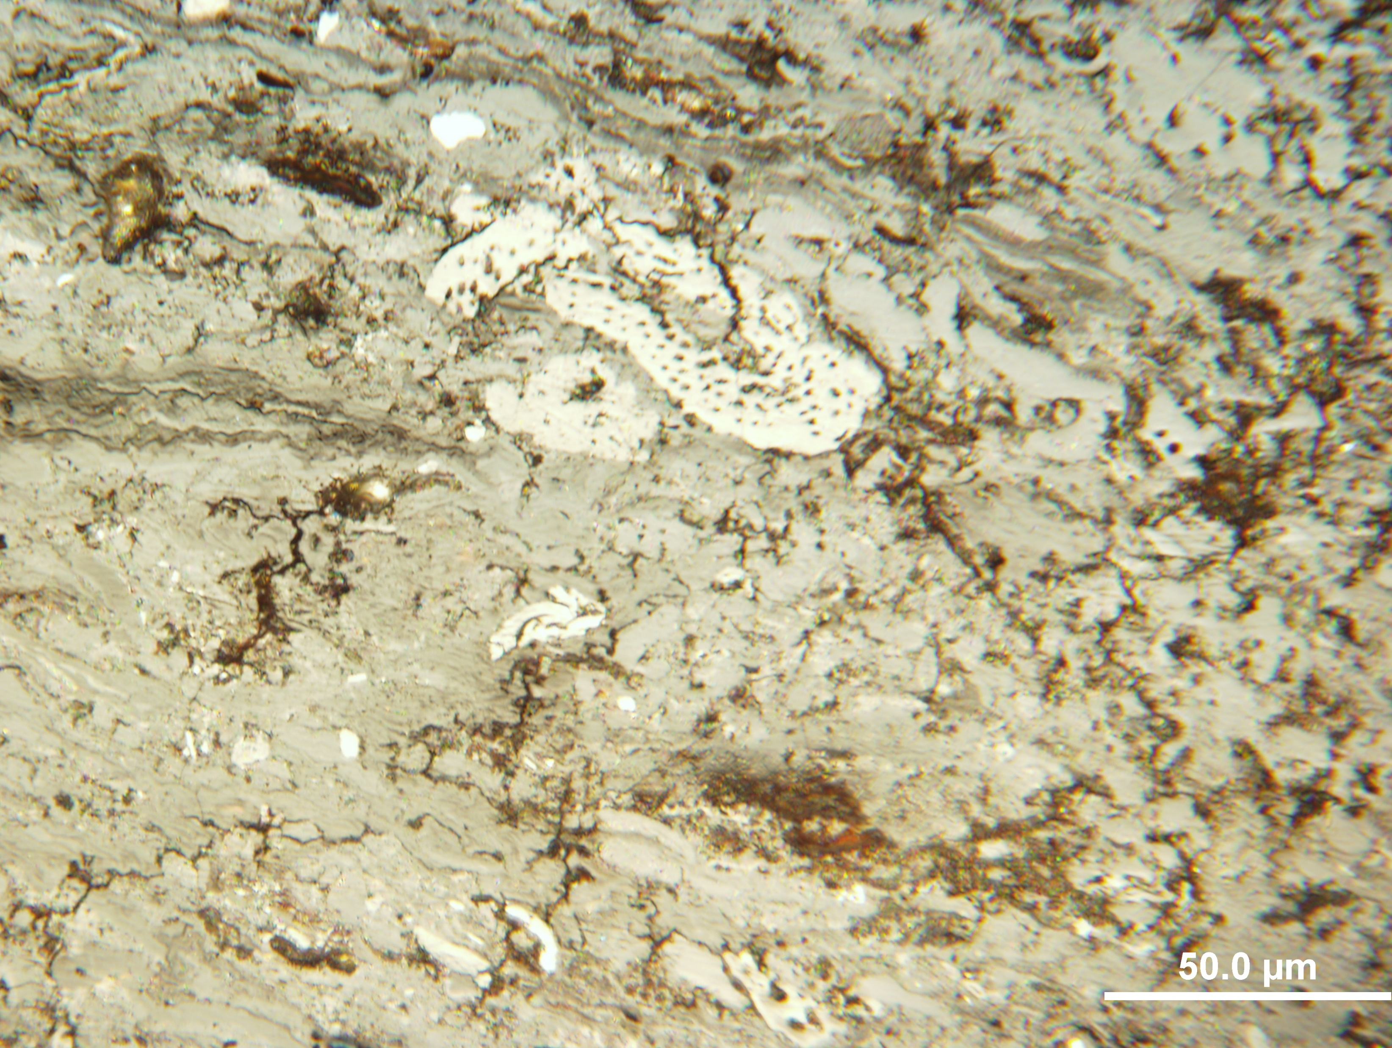
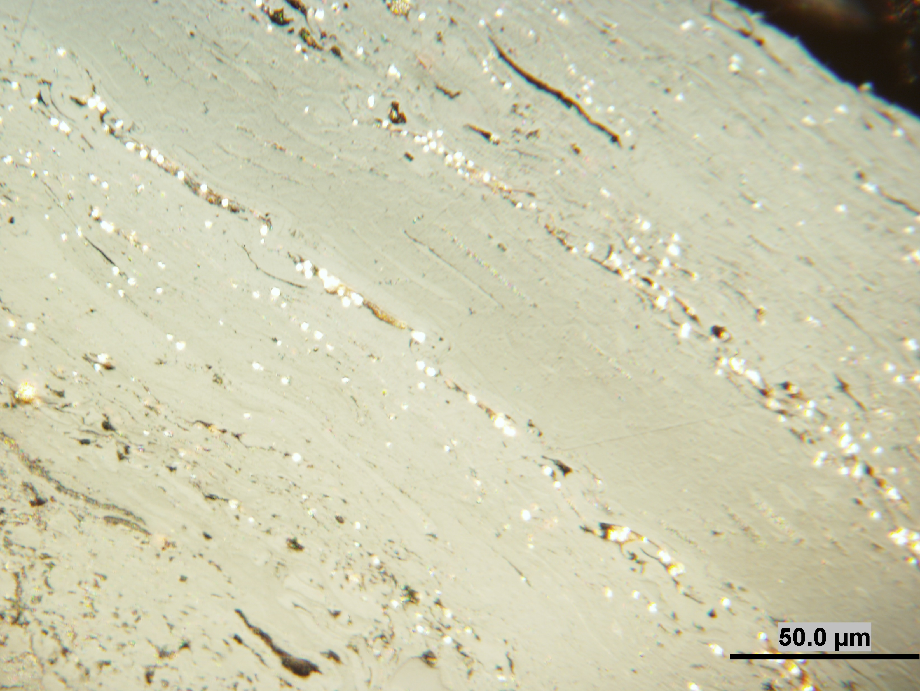
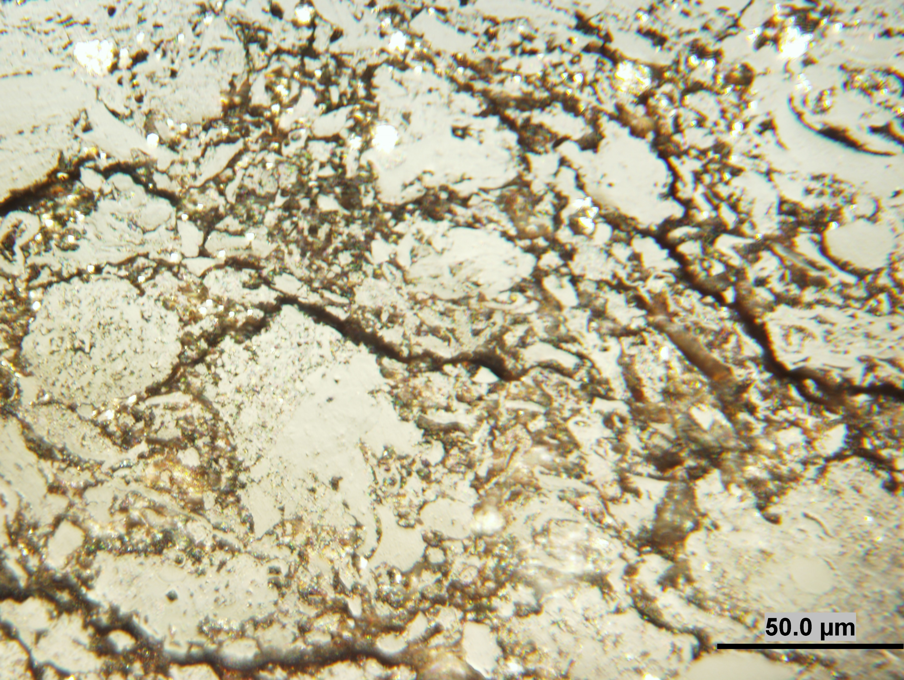
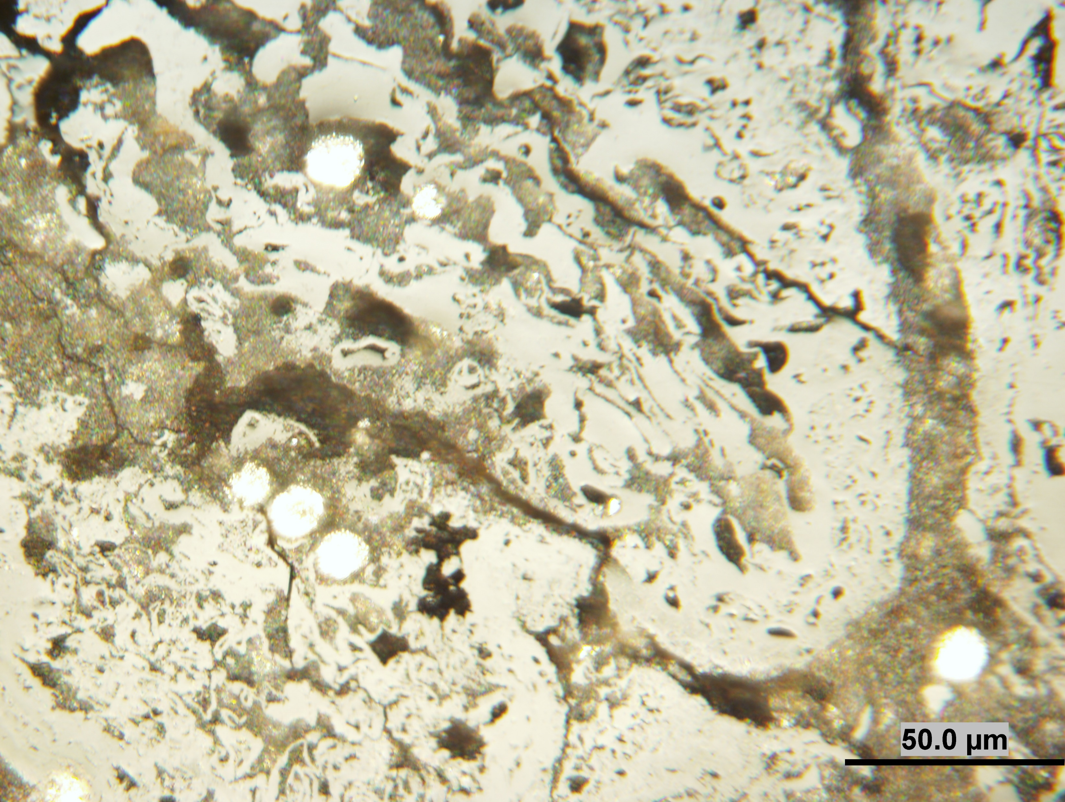
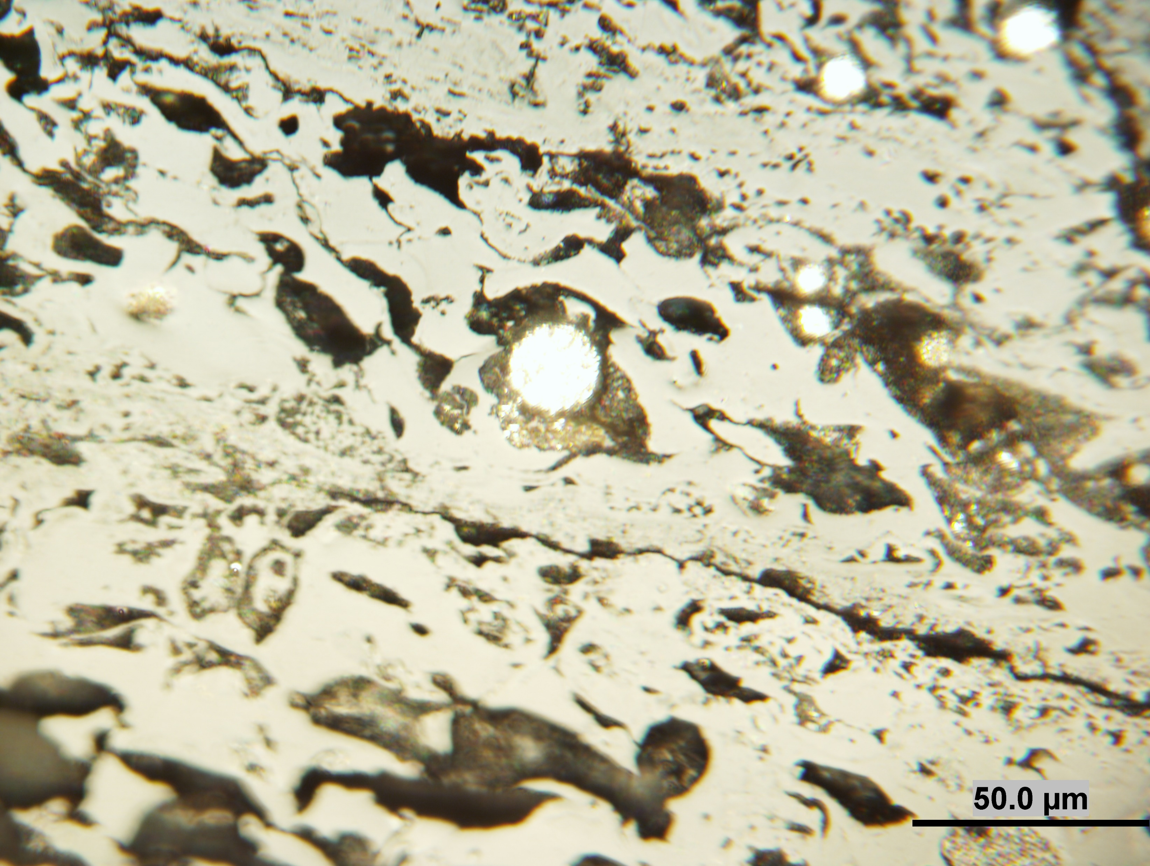
Uraniferous lignite
Radiolytic alteration of organic matter was studied on lignite from two Tertiary Czech basins with uranium contents from 500 ppm up to 28 000 ppm and 61 000 ppm.
A
U up to 500 ppm
B.
Band of mixture of huminite, liptinite and inertinite macerals with pyrite in original coal with low U content. Reflectance ranged from 0.30% to 0.40%, huminite content vary between 70 and 90 vol.%; liptinite and inertinite macerals and minerals did not exceed 20 vol.%.
B. Densinite with inclusions of liptinite macerals, funginite, inertodetrinite and clay minerals in lignite with U content up to 500 ppm. No apparent changes due to radiolytical alteration were observed in huminite and liptinite.
U < 61000 ppm
C.
U < 28000 ppm
D.
F.
G.
Light zones in ulminite (C) around cracks, rare halos and semicokes. Altered huminite was reclassified within the inertinite macerals: semifusinite, fusinite and macrinite. Reflectance of altered liptinite increased up to 0.30% and fluorescence colour changed from yellow to reddish brown.
Porous semicoke formed by partial degassing of huminite and liptinite macerals and clay minerals, and decomposition of pyrite and other ore minerals, including uraniferous minerals (D – G). Average reflectance of altered ulminite increases up to 0.50%, and actual reflectance of altered huminite exceeding 0.60% - 0.85% measured in semicoke (Havelcová et al. 2014).

Slide 5
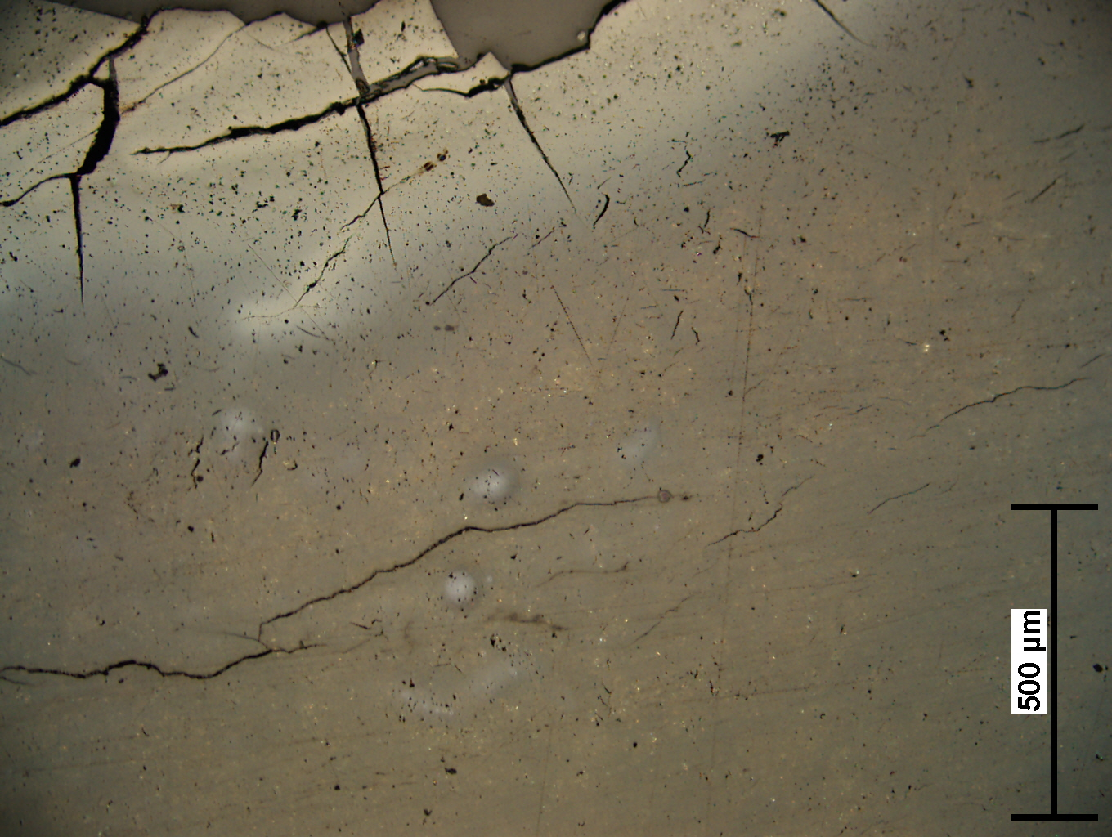
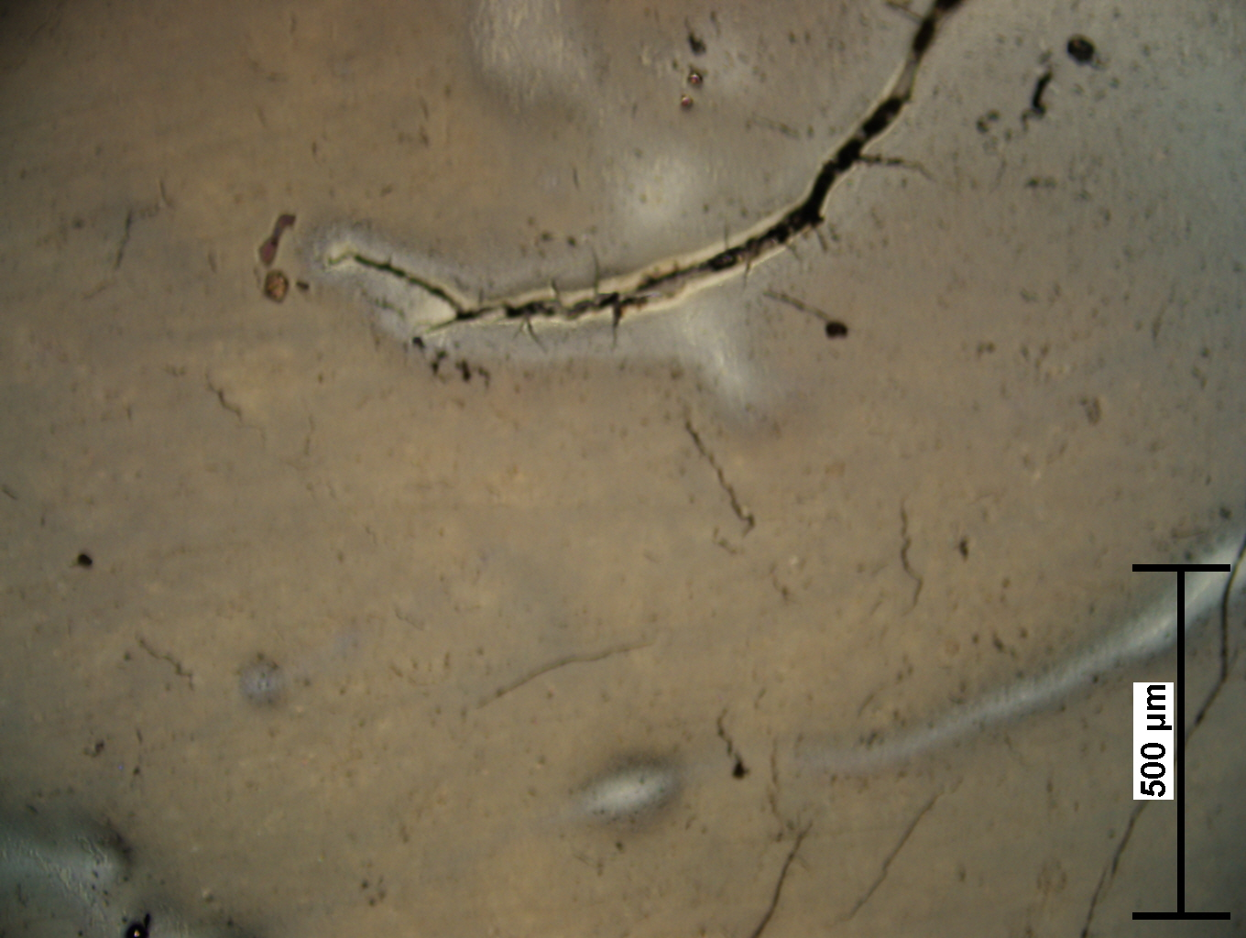
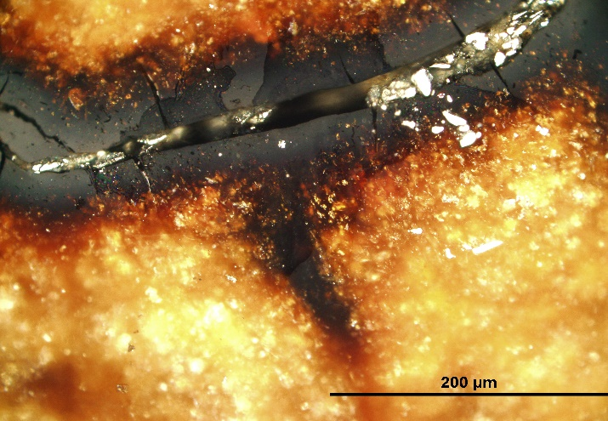
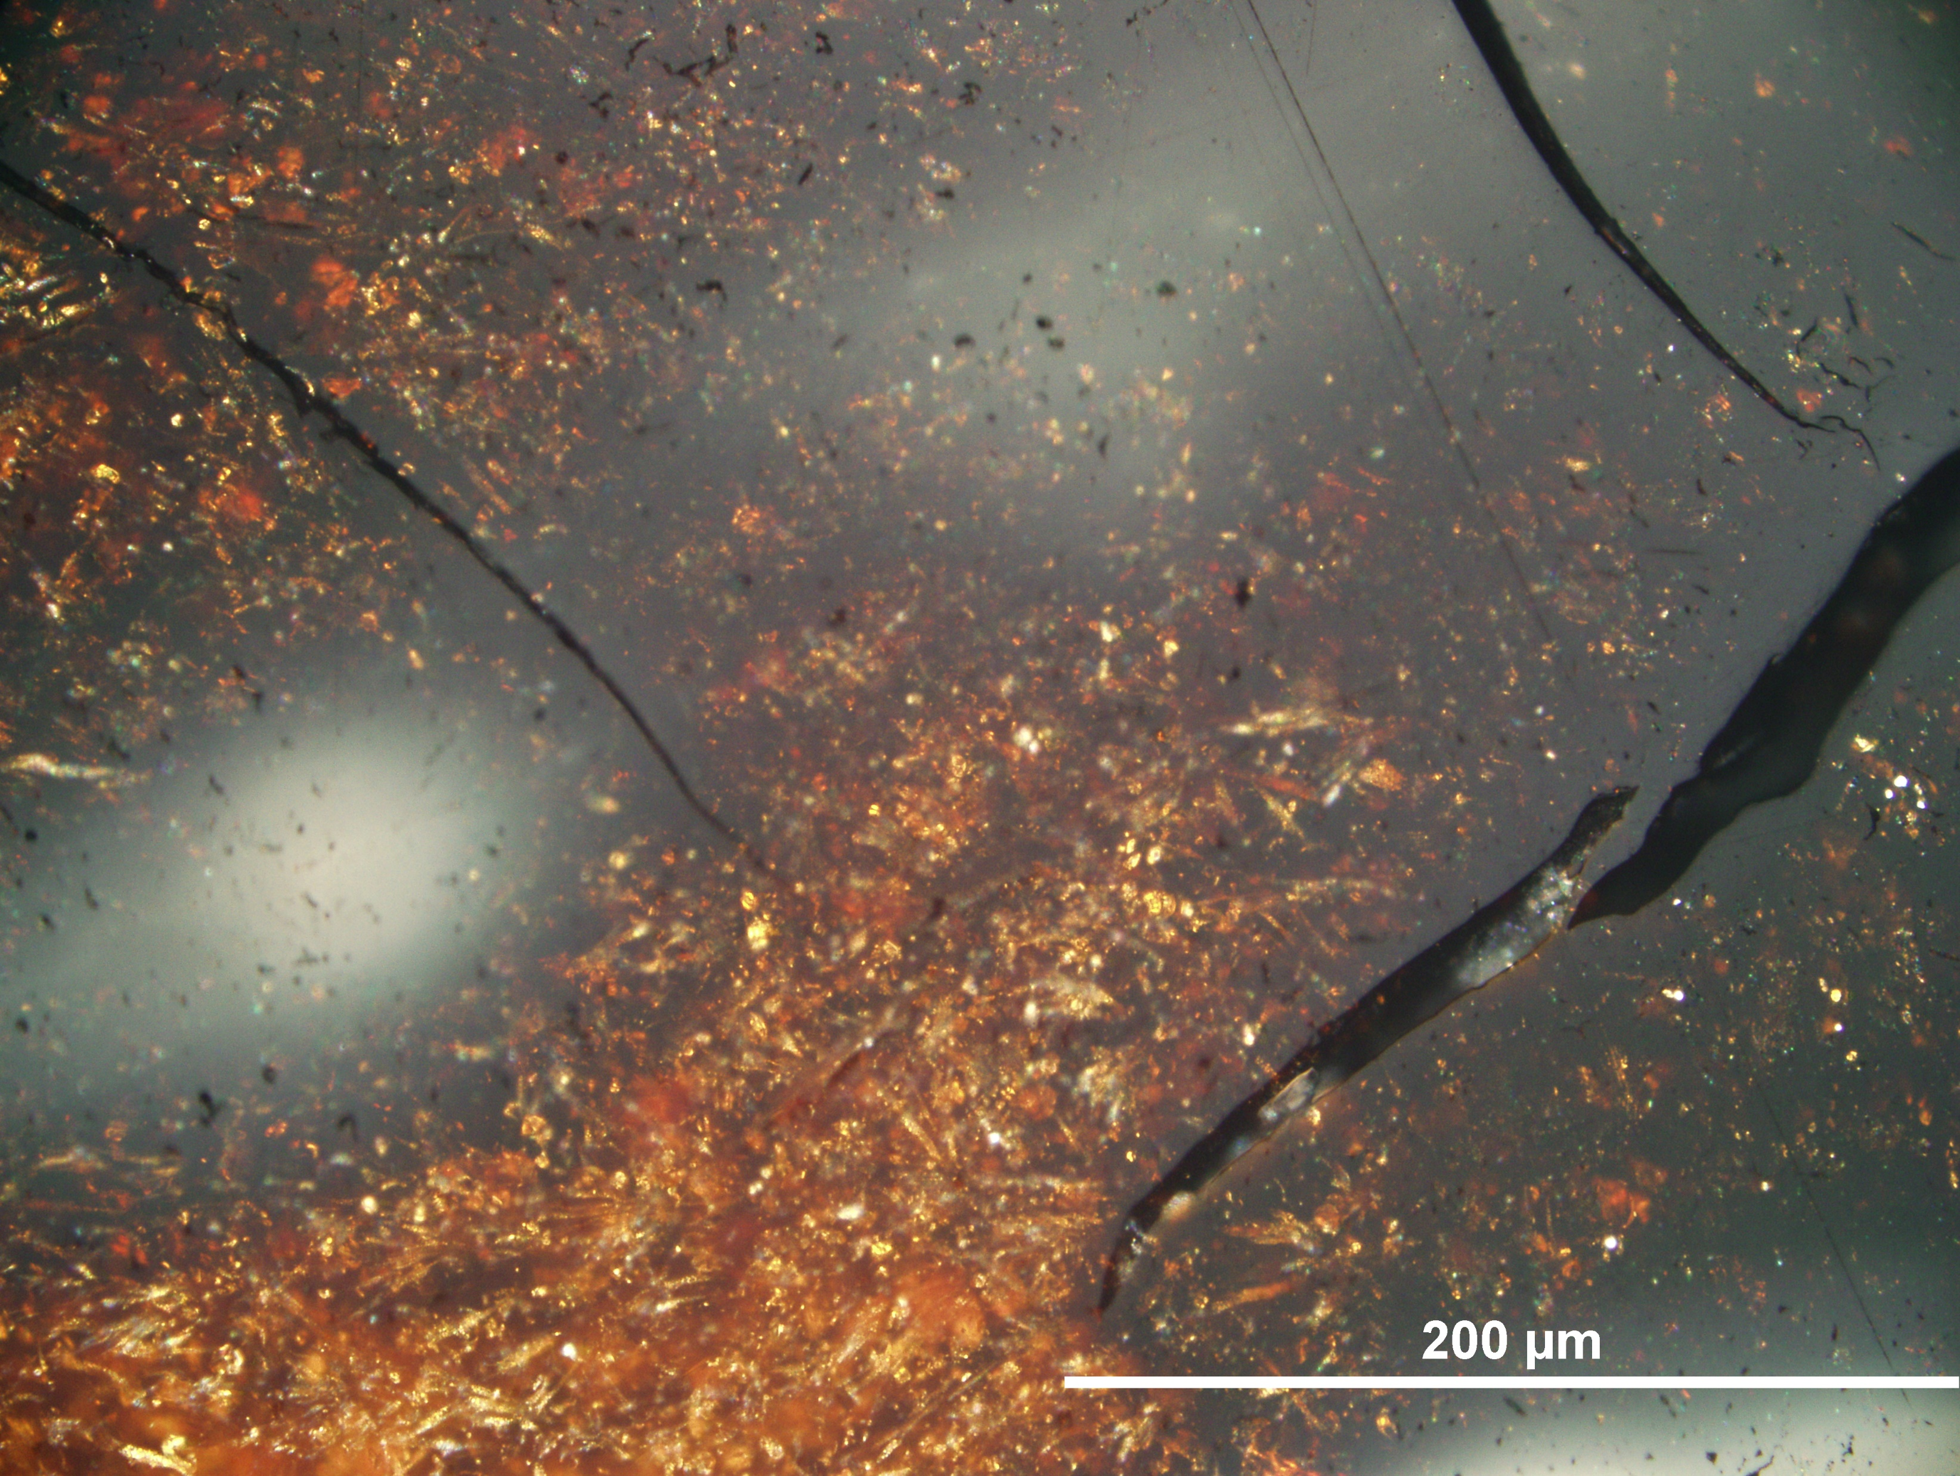
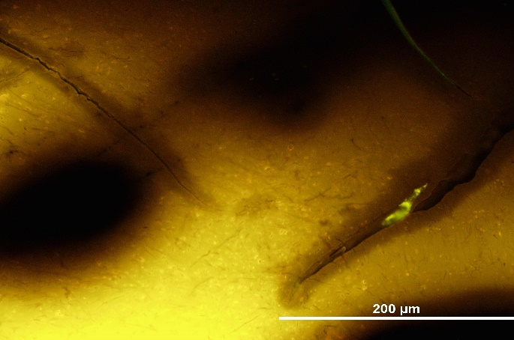
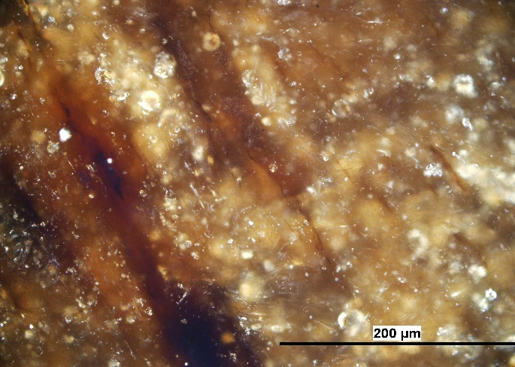
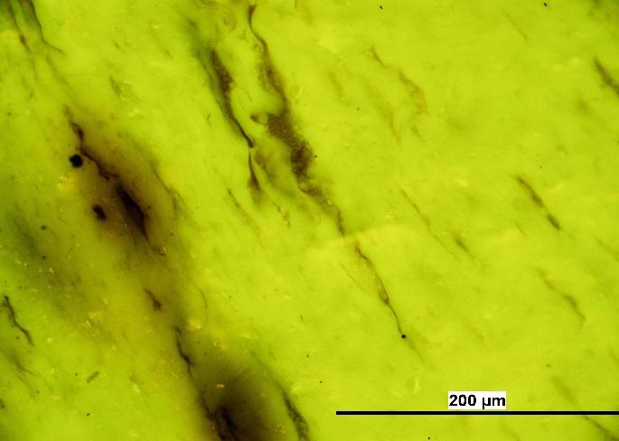
Uraniferous fossil resin (duxite)
U content up to 1.5wt%.
There are light altered zones around radioactive minerals in resinite (R = 0.10%) with small fragments of textinite and ulminite (Rr = 0.24%).
A, B, C Around cracks filled with sub-microscopic uranium minerals, and also around dispersed U minerals, resinite in light zones and halos has reflectance 0.17-37%.
A.
B.
C.
D, E, F, E In the fluorescence mode, resinite had a bright yellow colour that with increasing of radiolytic alteration, changed to dull brown or black in halos (Havelcová et al., 2016)
D.
E.
F.
G.

Slide 6
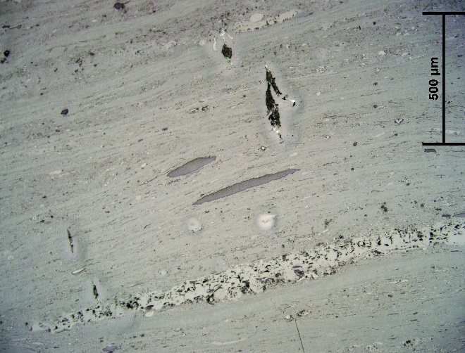
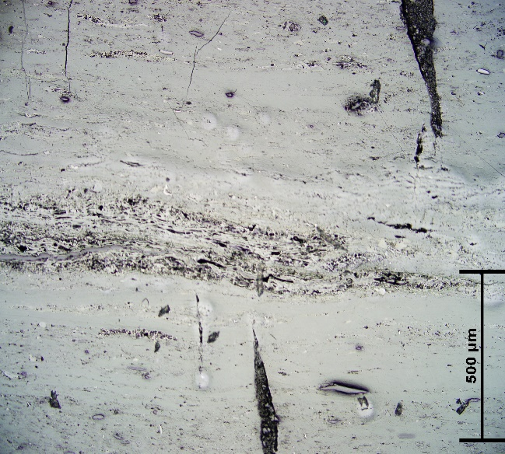
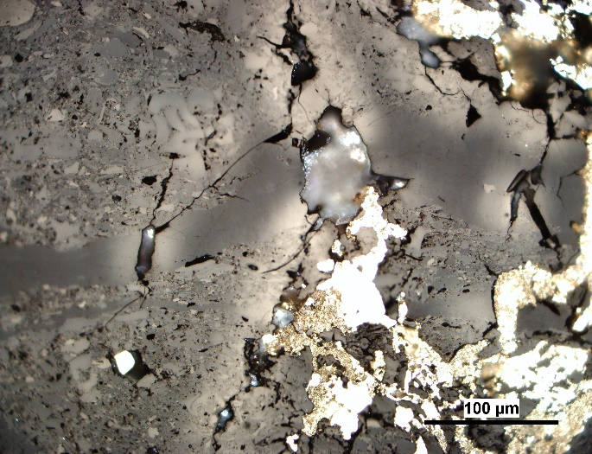
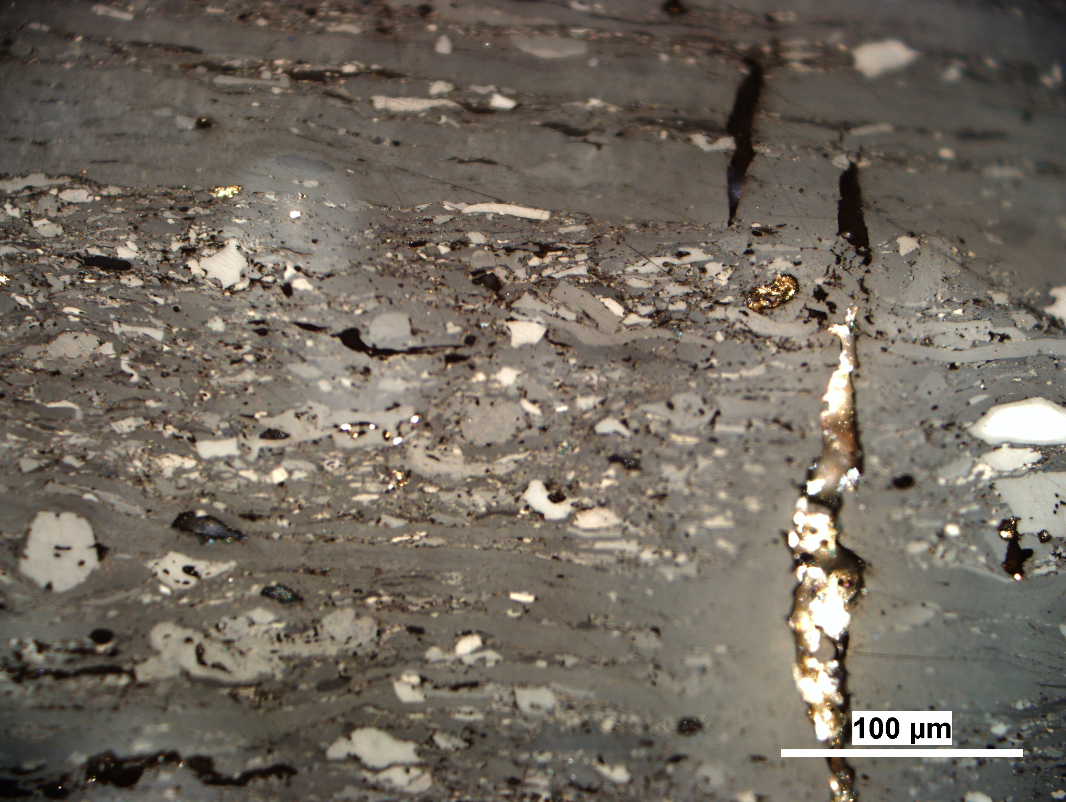
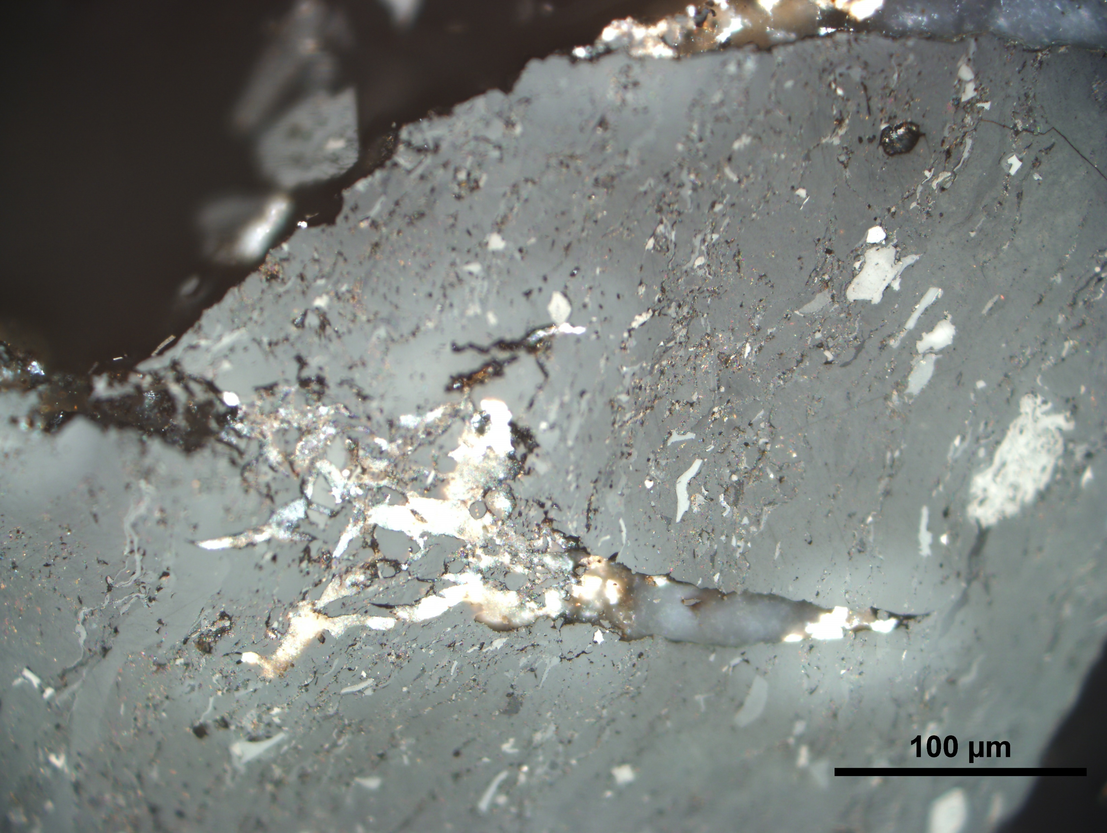
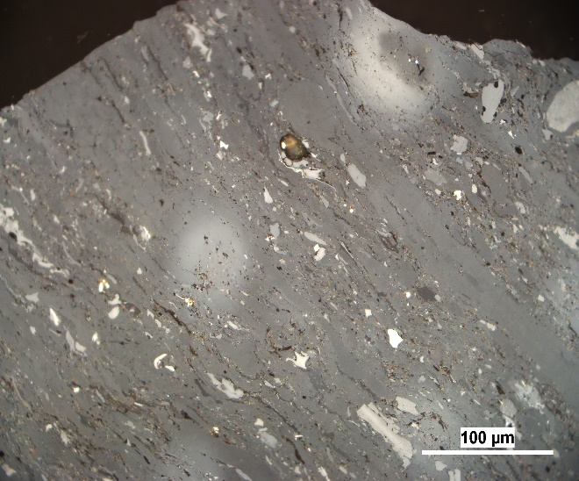
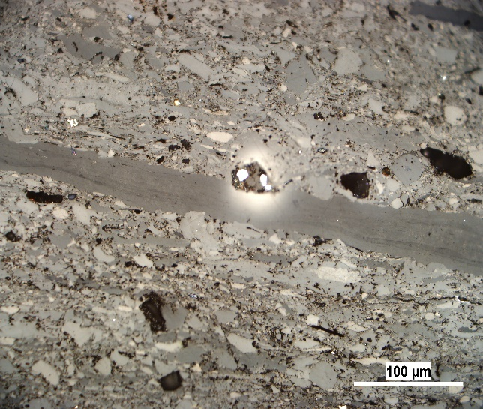
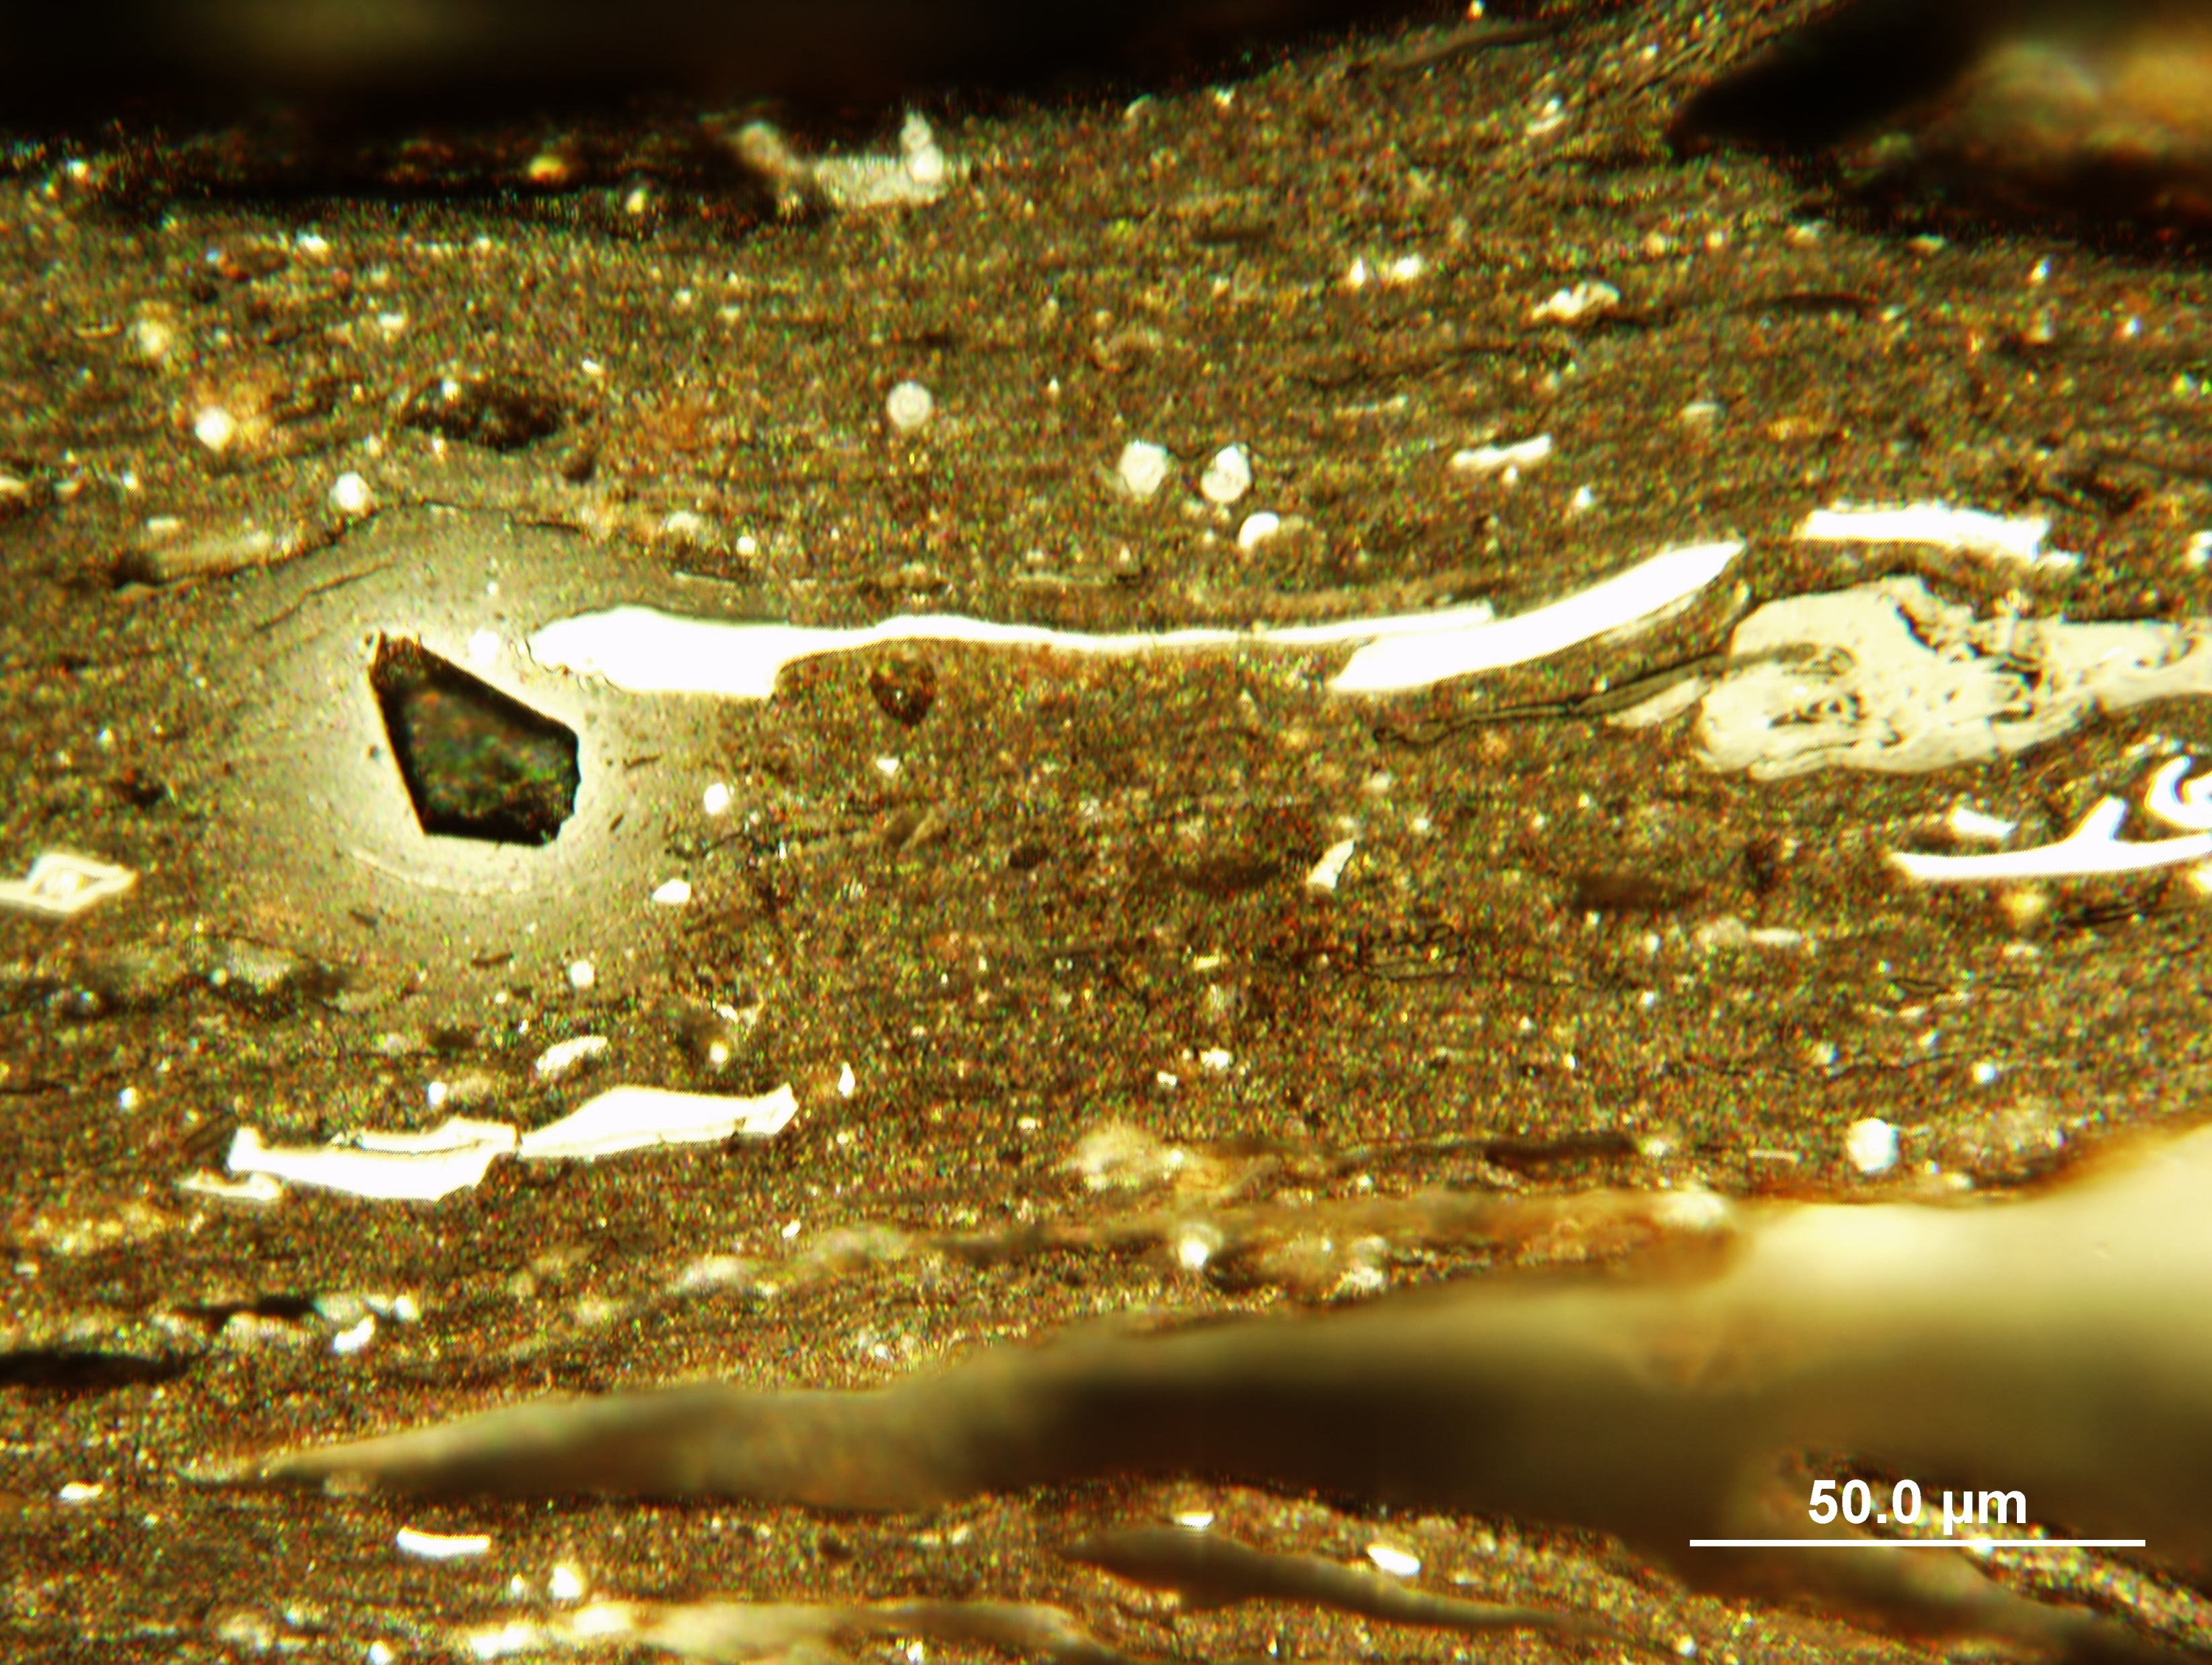
Uraniferous bituminous coal
Bituminous coal (A – H, reflectance of vitrinite Rr = 0.72 – 0.86%) and sapropel (I) from the coal waste dump at Rybníček coal and U deposit in the Intrasudetic Basin with U content between 42 ppm and 1287 ppm.
(A., B. – dry lens):
(D., F., G., H. – imersion lens )
A.
B.
C.
D.
Two basic forms of radiolytical alteration have been observed in coal with U contents above 551 ppm:
Various bright zones around cracks and veins (C., D., E.) and halos occur around dispersed grains of uraninite and coffinite.
The mean reflectance values of light zones in vitrinite around cracks and veins, and in halos, increase up to 0.94% and 1.75%.
E.
F.
G.
I.

Slide 7
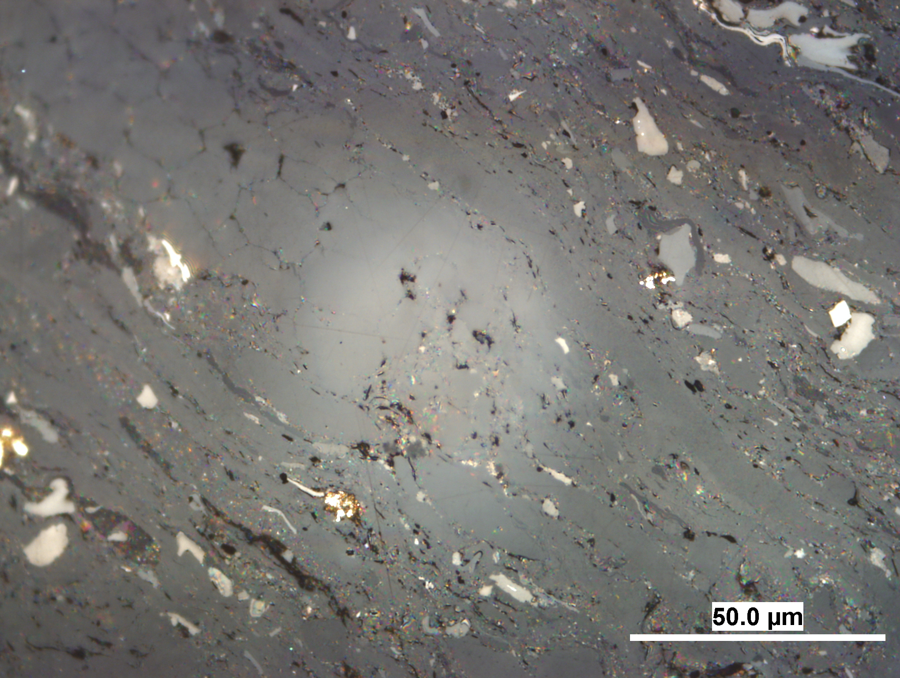
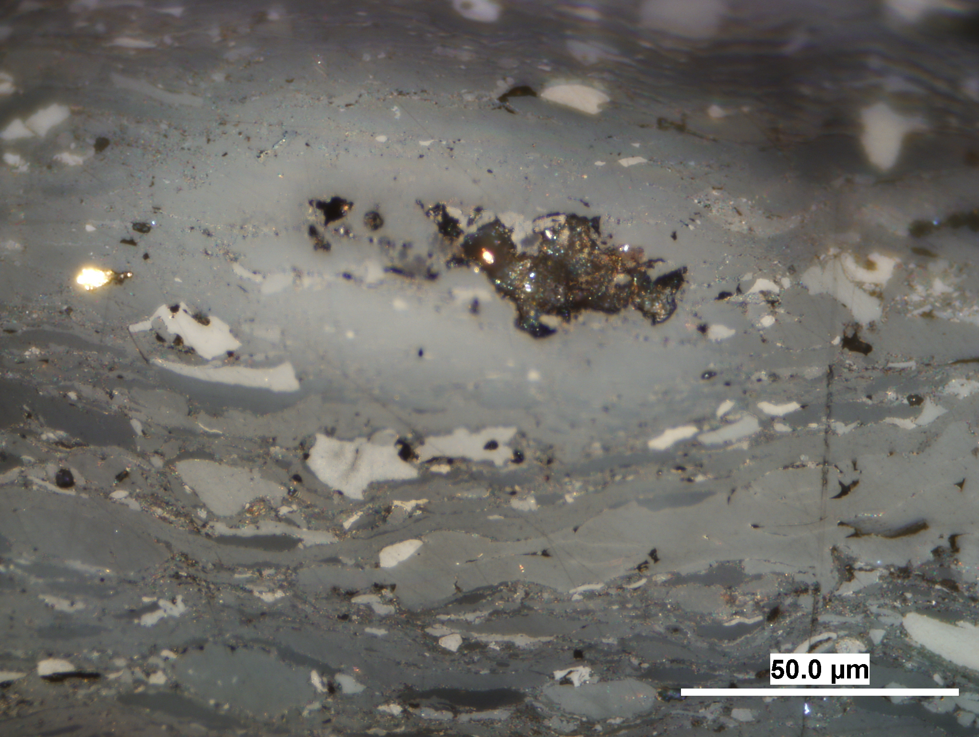
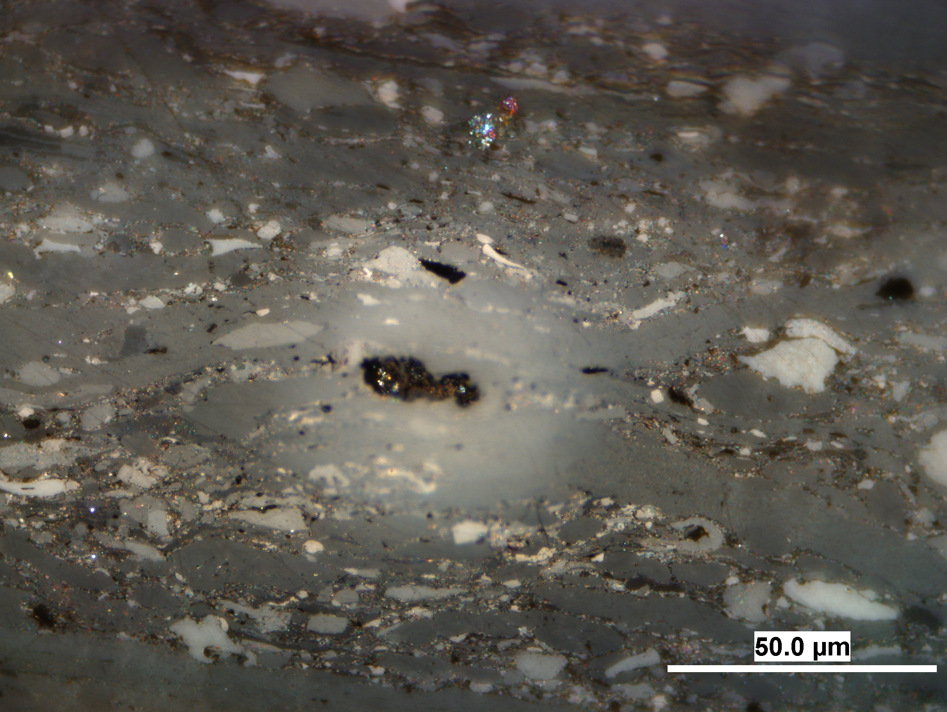
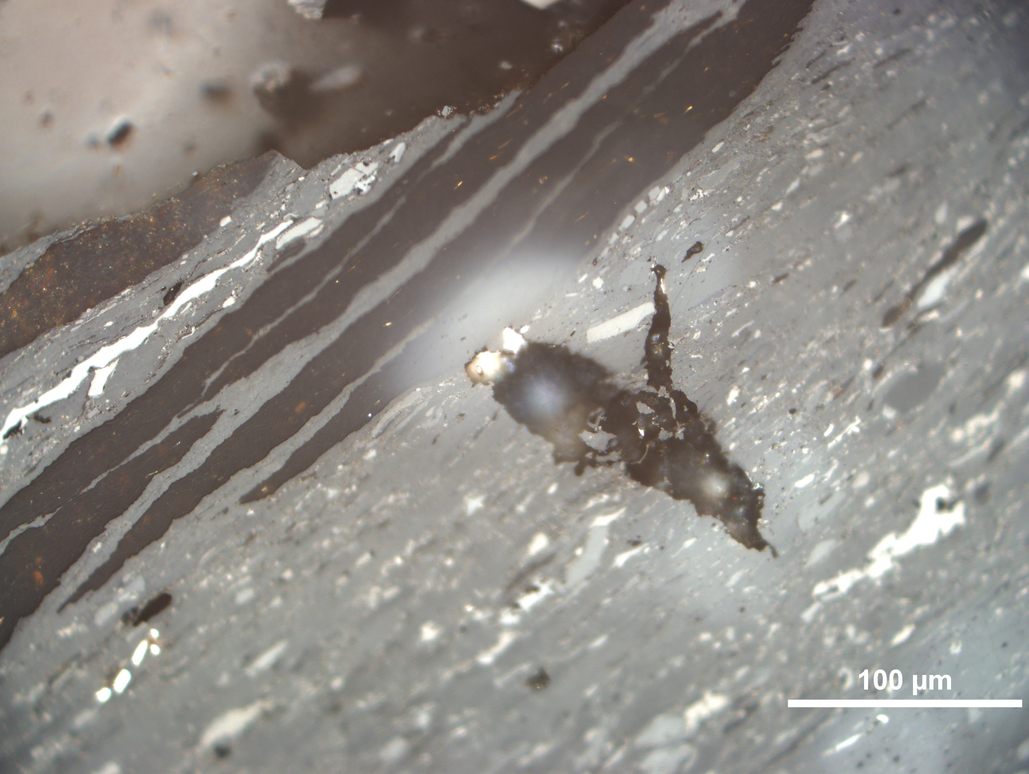
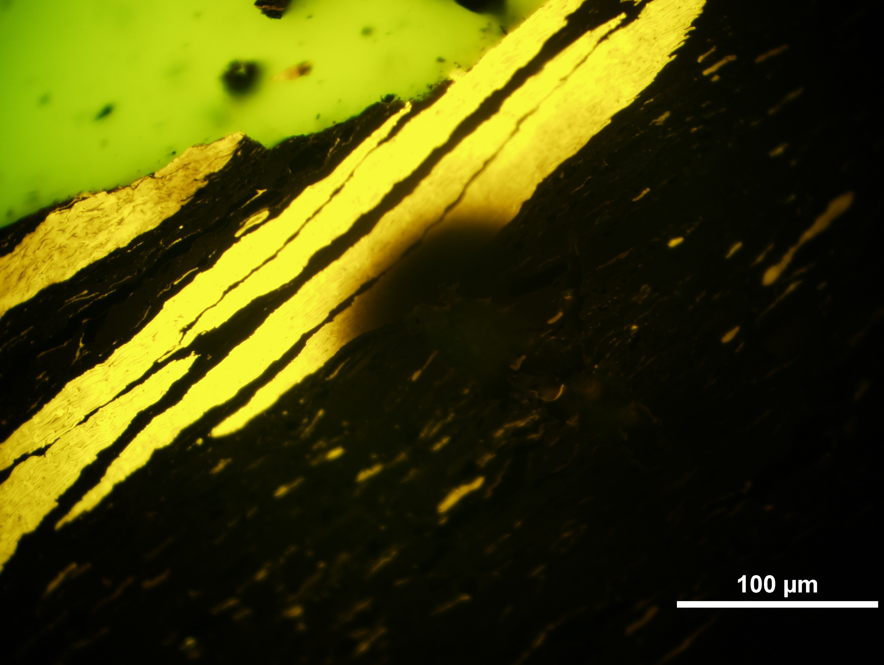
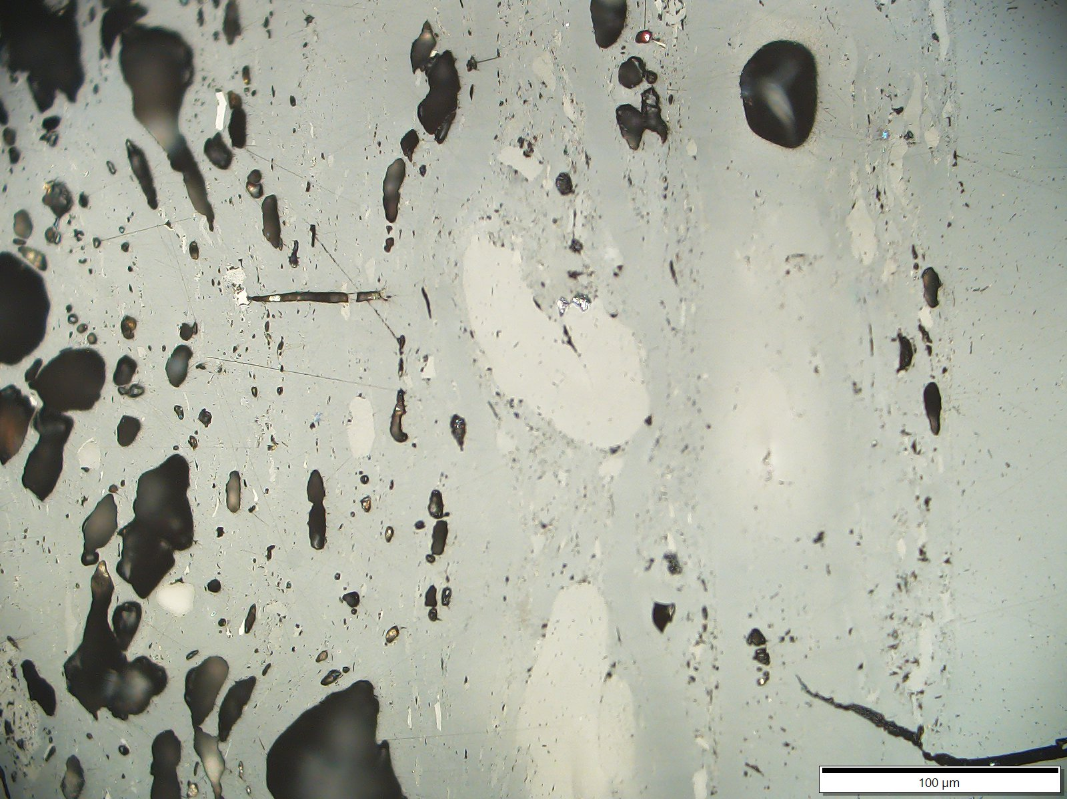
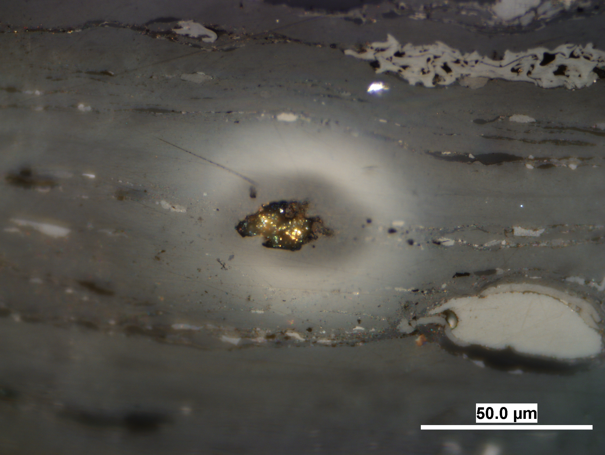
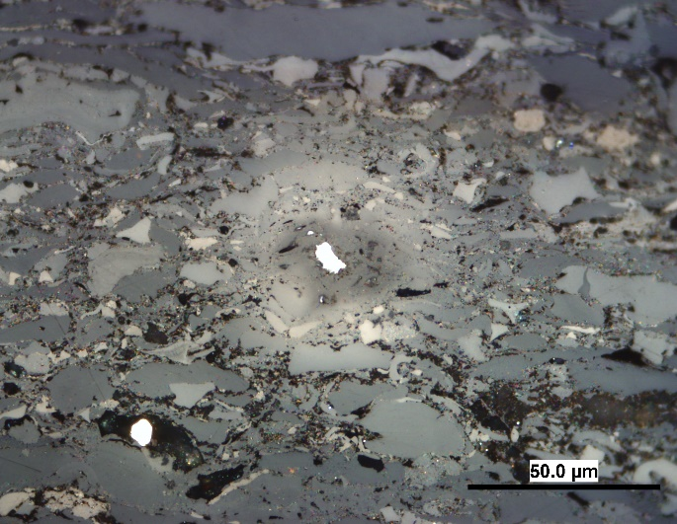
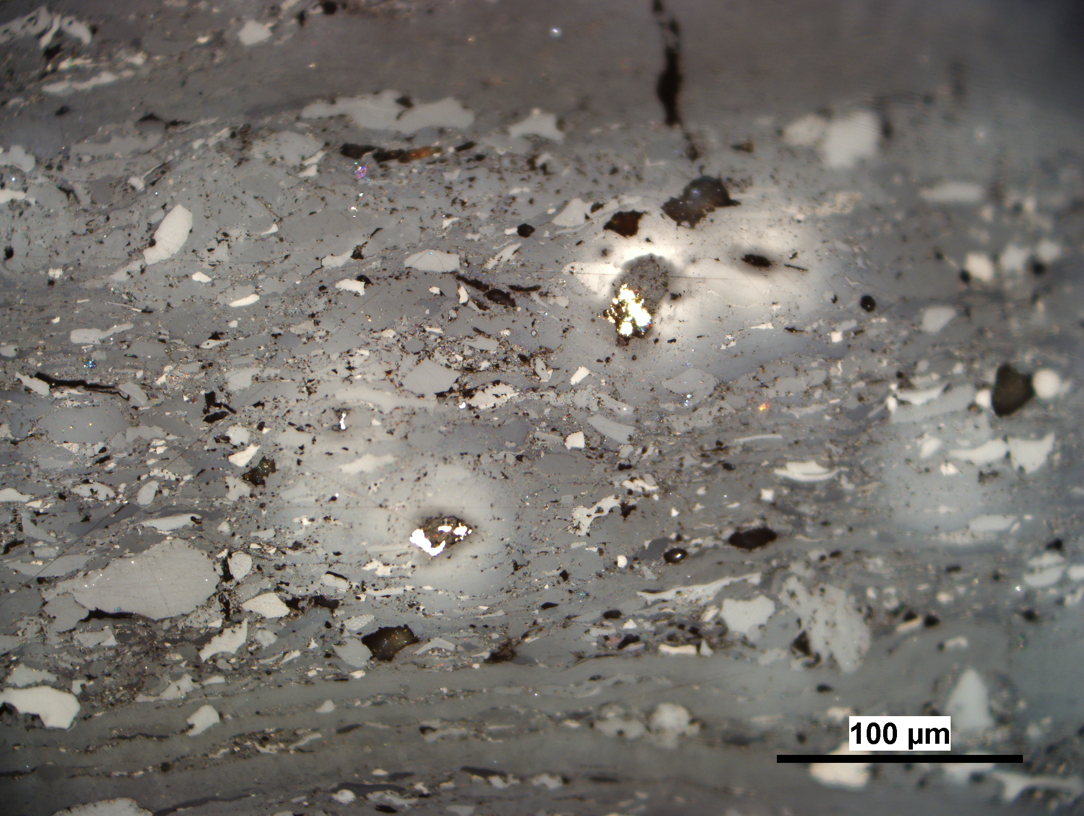
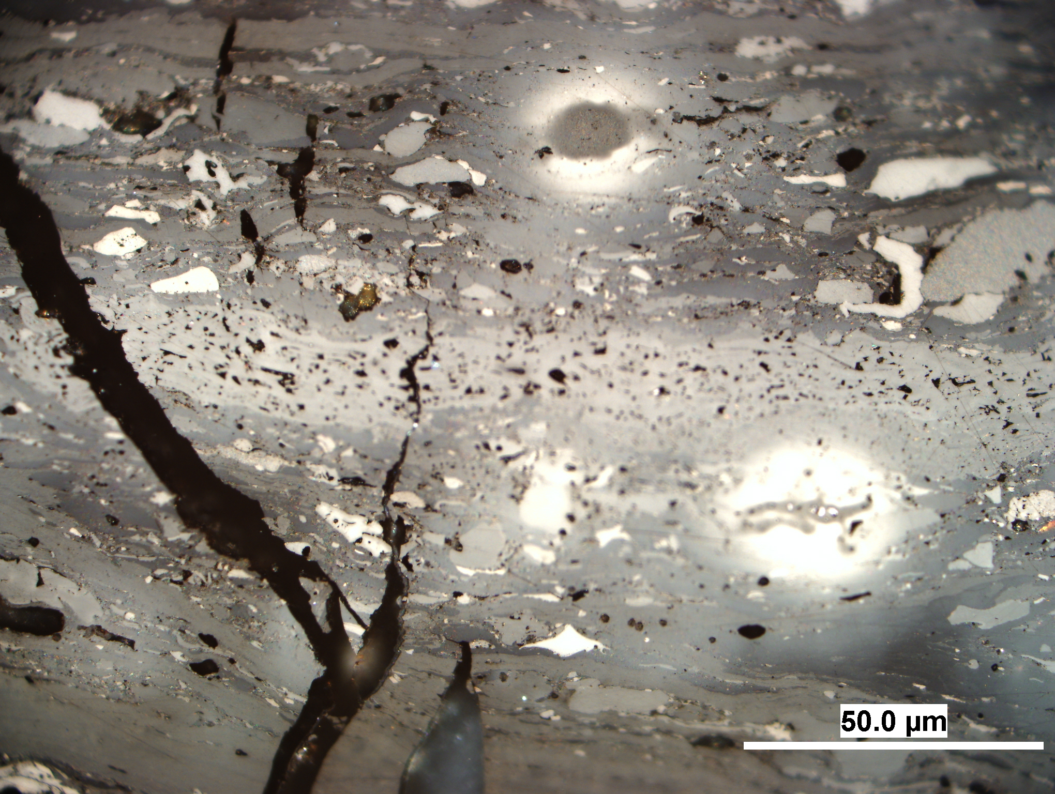
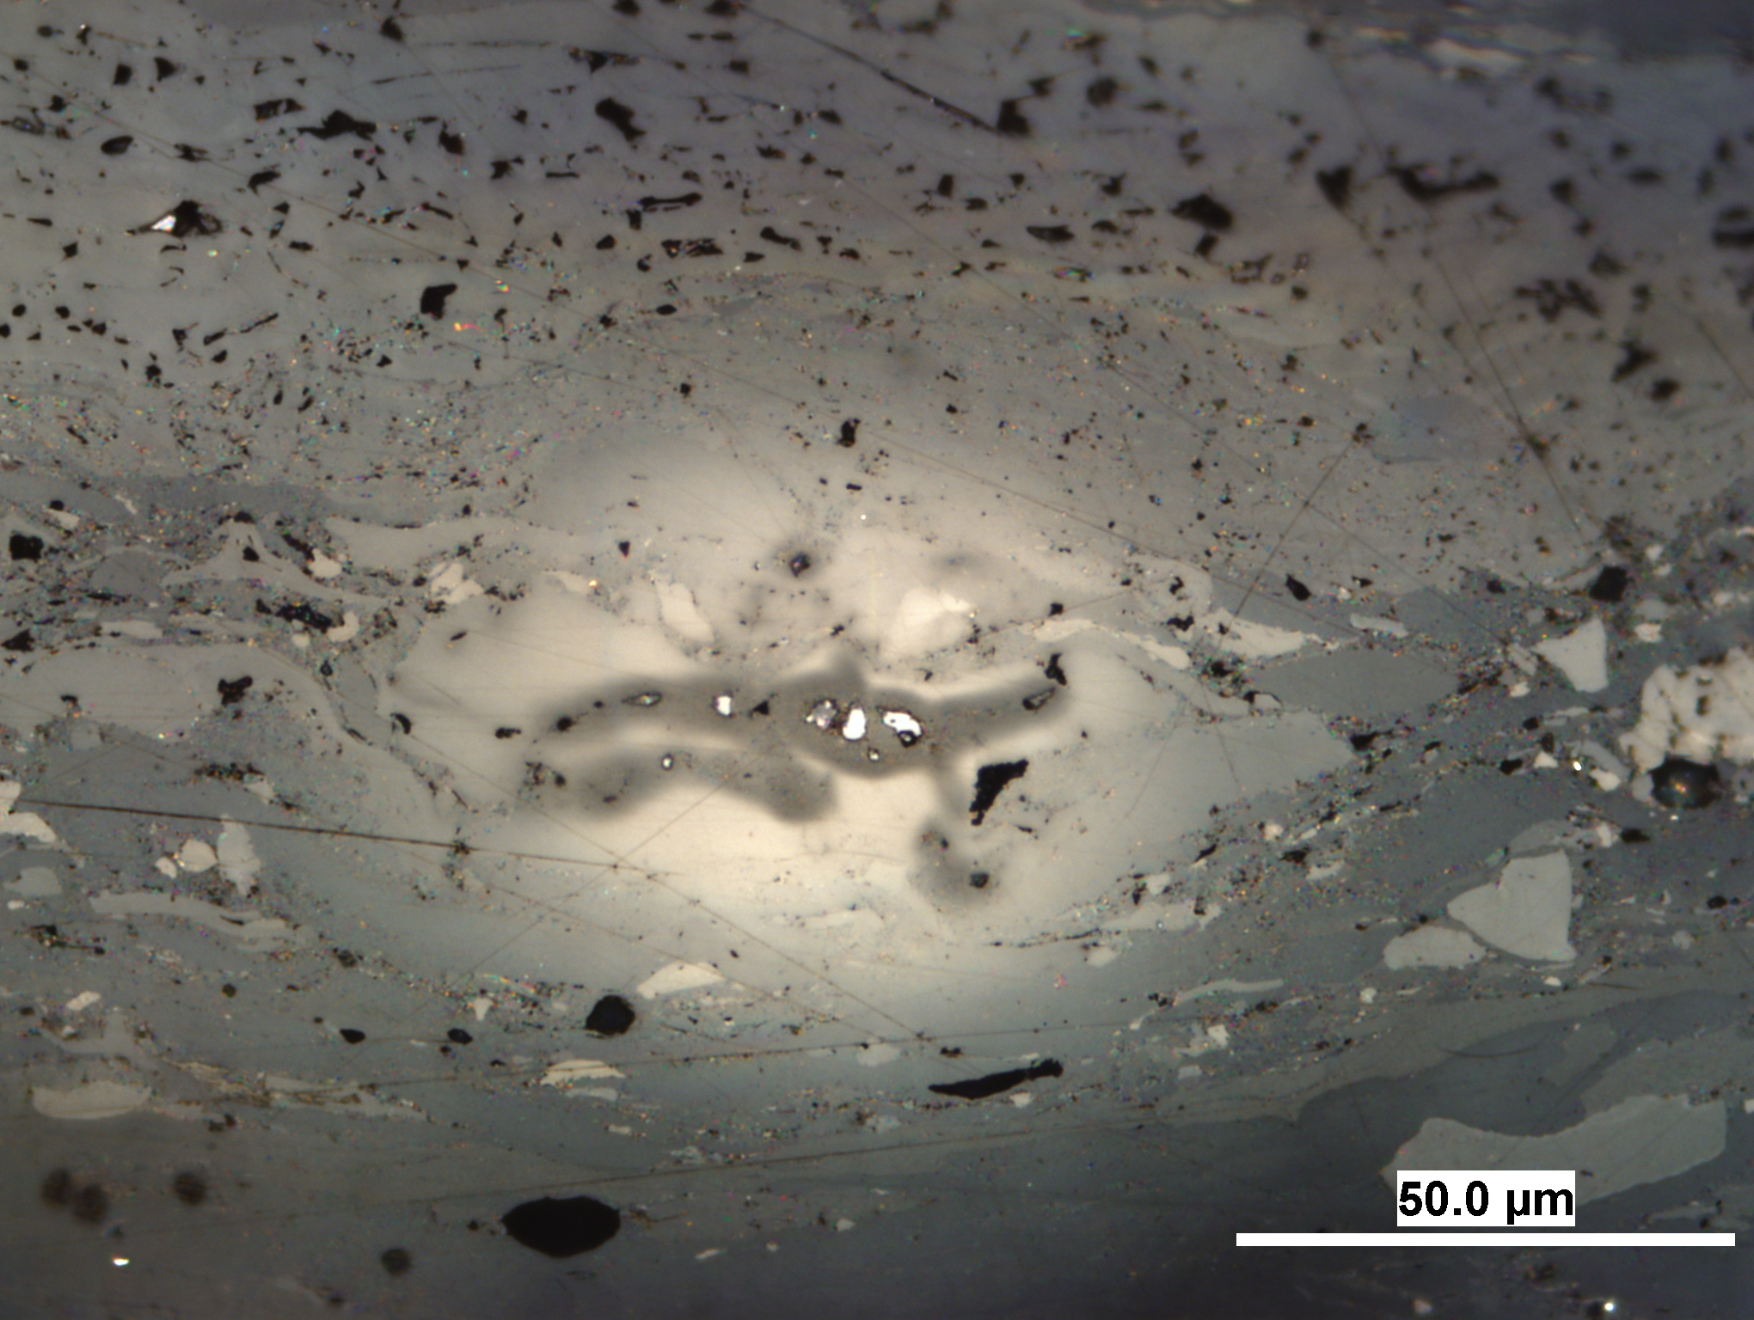
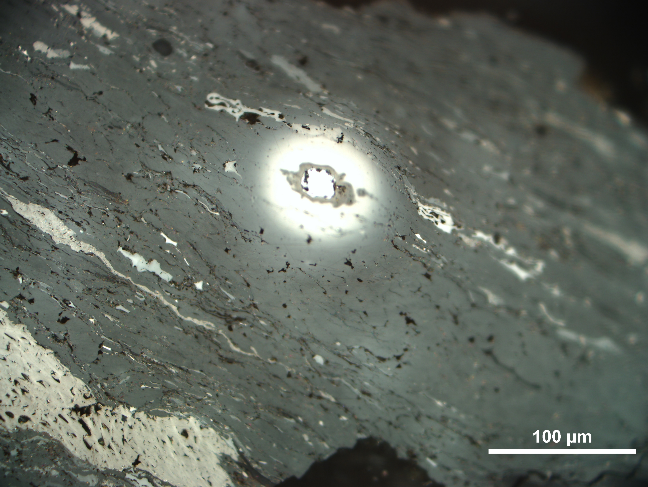
Uraniferous coal: halo variability
In studied coals, the halo volume did not reach 15 vol.%. The structure of the halos is complex both optically and chemically (Sýkorová et al., 2016; Machovič et al., 2021). Two types of halos were distinguished by reflectance and morphology:
1. halos with minimal relief and reflectance values increasing from 0.70% on the edge of the halo to 1.62% at the contact with U minerals. This type is dominant.
J.
K.
L.
M.
N.
U.
2. halos characterized by strong relief and a strong increase in reflectance value from 0.70% in a dark rim around U mineral, to R more than 3% in the lightest parts of halo (O – T).
The residues of these halos can be observed in sample heated only up to 500ºC U
Reflectance of liptinite macerals increased from 0.30% to 0.90%, and fluorescence colour has changed from yellow to orange and black (Sýkorová et al., 2016).
halo
O.
P.
Q.
R.
S.
T.

Slide 8
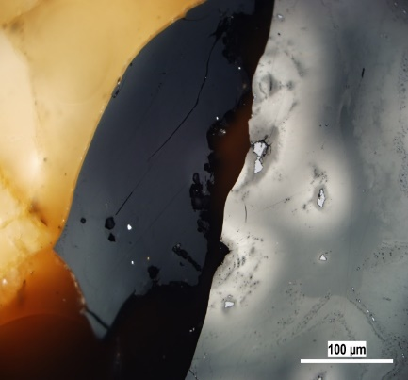
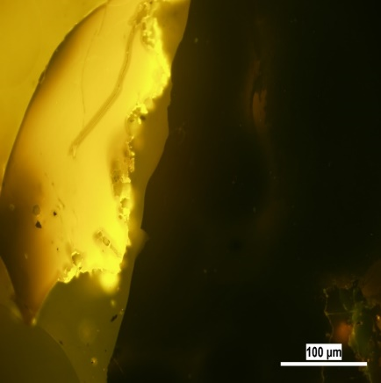
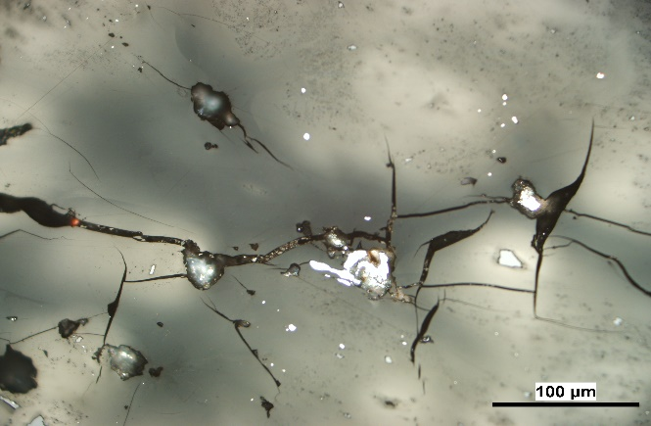
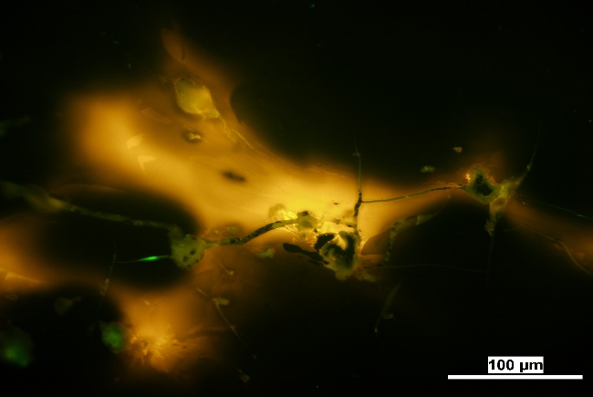
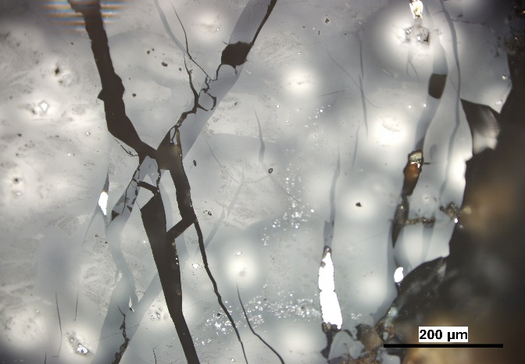
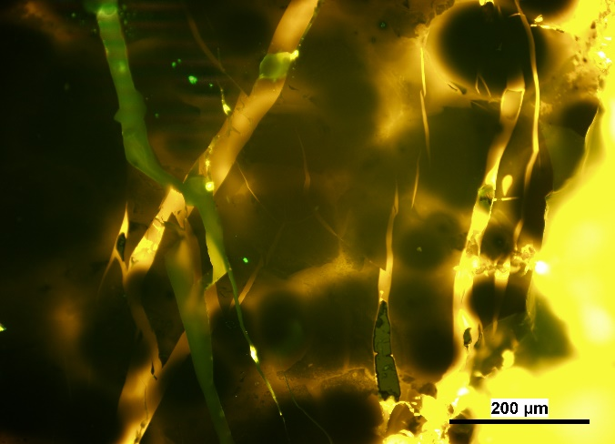
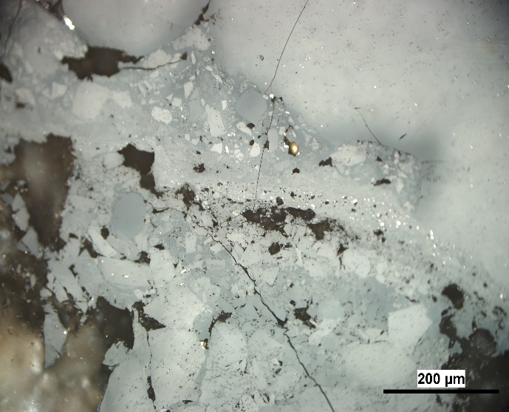
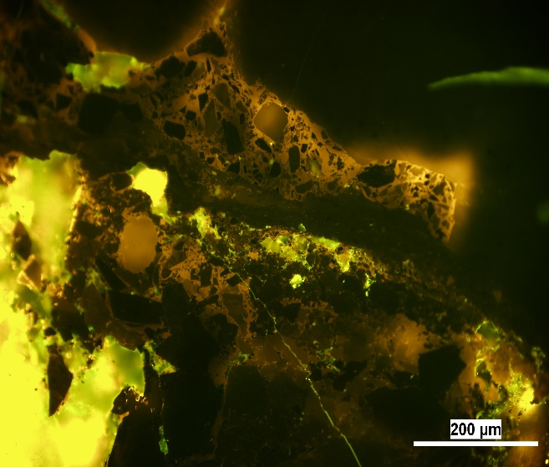
Uraniferous bitumen: variable alteration in reflected and blue light
U concentrations in the uraniferous Permo-Carboniferous sediments (Vrchlabí, Czech Rep.) ranged from 25,455 to 47,965 ppm. More than 70 vol.% of the bitumen were radiolytically altered.
Petrographical components of UB were distinguished according to Reflectance values – intensity of radioactive alteration:
a) Unaltered bitumen (B): dark mineral-free solid amorphous bitumen with a yellow to orange fluorescence colour, mean reflectance 0.54% to 0.69% RB;
b) Altered bitumen (AB): mineral free to weakly mineralised AB
* weakly altered bitumen (WAB) – darker to grey shades, with mean maximum reflectance Rmax = 1.05 – 1.49%;
* strongly altered bitumen (SAB) – lighter, with shades of grey to white color, without fluorescence color, with Rmax = 2.97 – 3.31%;
Unaltered amorphous bitumen and weakly to strongly altered and scarcely mineralized bitumen including halo in quartz vein.
Transformation of amorphous weakly altered bitumen to strongly radiolytically altered bitumen with dispersed grains of uranium minerals, and quartz.
Unaltered/weakly altered bitumen with a group of halos.
Amorphous and detrital weakly/strongly altered bitumen with residues of unaltered bitumen.

Slide 9
Uraniferous bitumen (UB)
Petrographical components of UB distinguished according to morphology of bitumen and their mineralisation:
Amorphous bitumen (ABAm) – structureless matter, weakly to strongly altered, rarely mineralized;
Halo zones (ABHalo) – circular, oval or irregular light and dark zones around uraninite grains. The halo zones differ in size (mostly over 30 µm) and brightness. Reflectance values vary within a halo, which may be related to the character of the radiation energy transfer, size and shape of inclusions, and density of the organic matter changing with the degree of structural reorganisation by the radiolytic alterations (Machovič et al., 2021).
Irregular light zones (ABIZ) - Aggregates of irregular and asymmetrically embossed and highly reflective structures around uraninite grains (often decayed), prevailed in bitumens with high U concentrations and with denser U mass (Havelcová et al., 2022).
Rarely mineralized altered bitumen (AB>Min) – altered bitumen with dispersed mineral inclusions.
Intensively mineralized altered bitumen (AB>Min) – compact areas of fine-grained minerals in altered bitumen.
Mineral matter bitumen.
Mineral matter is represented by a mixture of individual grains of radioactive minerals (uraninite etc.), quartz, pyrite, Fe and Ti oxides, and other accessory minerals; and also by quartz and carbonates filling cracks and veins. (Havelcová et al.,2022).
Example from the black coal.
High reflectance halo with marked vitrinite reflectance values, which increase from the dark edge to the contact with a U phase. (Sykorova et al. 2016)

Slide 10
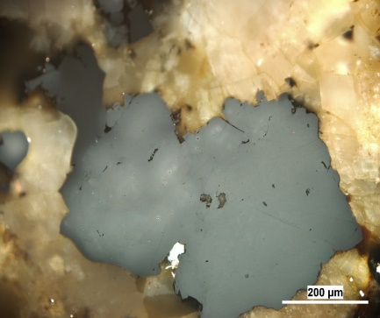
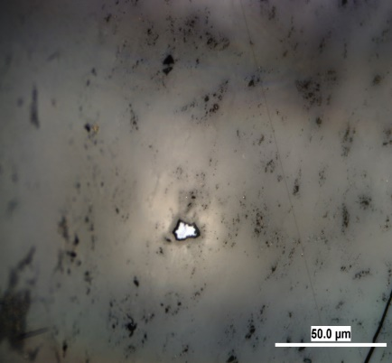
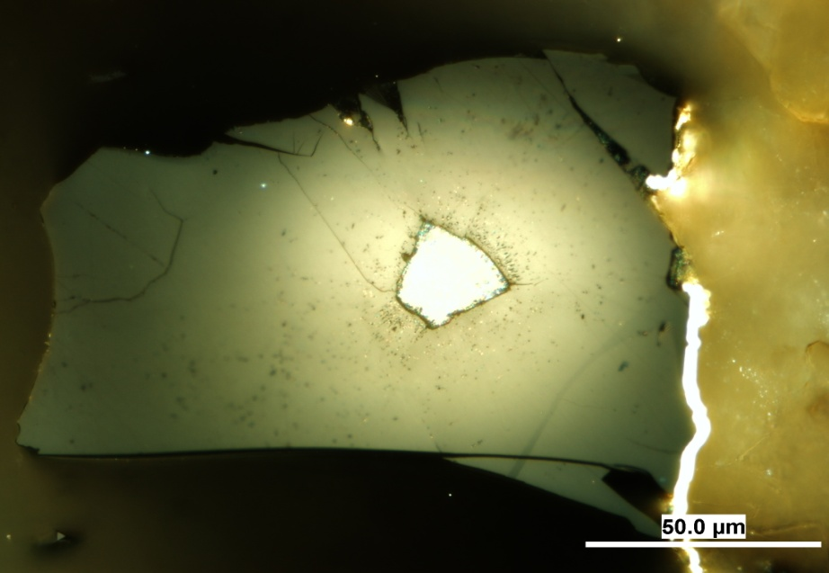
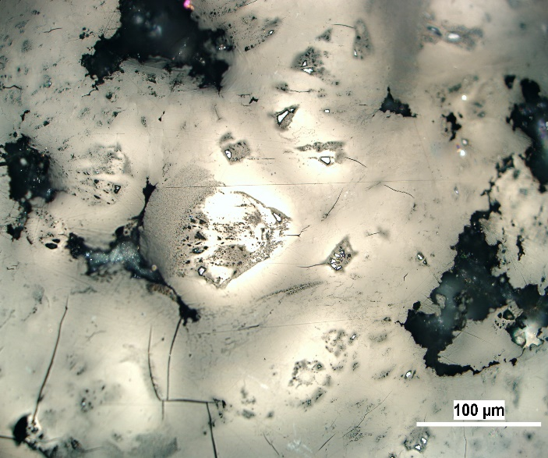
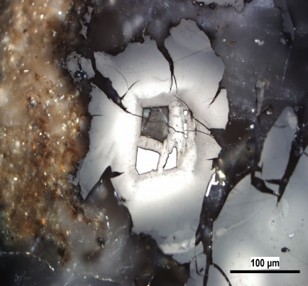
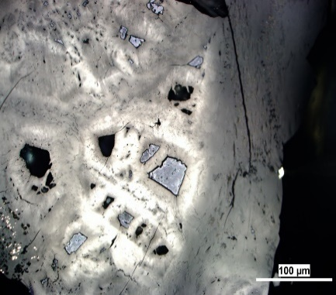
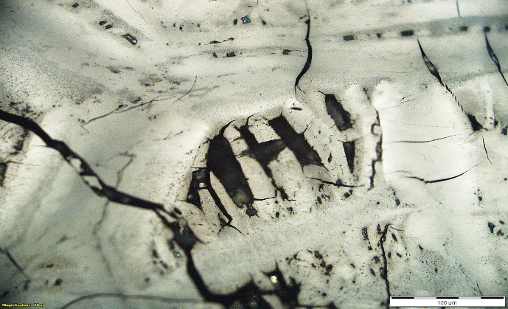
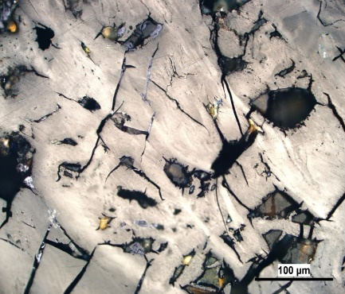
Uraniferous bitumen – halo and irregular zones
Cluster of weakly altered bitumen with group of less reflective halos in carbonate vein.
Altered bitumen with dispersed minerals and irregular dark and light halo zones around radioactive mineral.
Large grain of radioactive mineral with a simple high reflective halo in weakly altered bitumen
Light and dark irregular zones around separate grains of radioactive minerals in variously altered bitumen.
Highly relief variously altered bitumen with fissures around a group of distinct radioactive minerals in quartz and clay minerals
An interesting textures formed by zones of darker and light bitumen around grains of radioactive mineral and voids of various sizes.
Weathered and variably altered bitumen with cracks, U mineral grains and voids left by them.

Slide 11
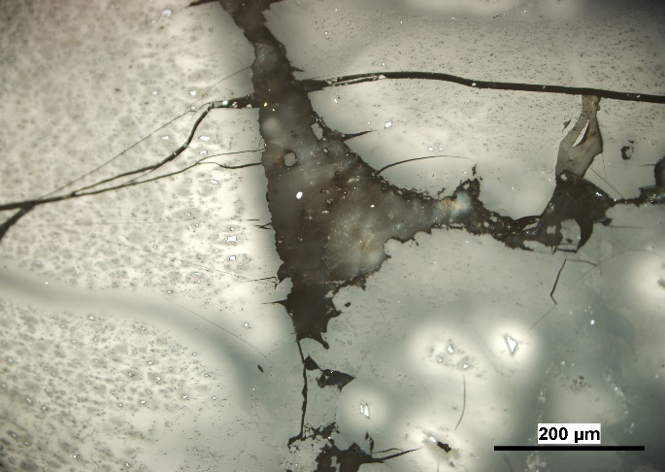







Uraniferous bitumen – irregular morphology and mineralization
Variably altered bitumen with fine-grained radioactive and other minerals.
Transformations of an amorphous unaltered to altered bitumen along bands of altered bitumen with dispersed radioactive minerals and quartz.
Irregular light veins of strongly altered bitumen in densely mineralized quartz aggregates
Strongly altered light amorphous bitumen with dark areas of fine-grained quartz with radioactive minerals.
Altered bitumen with dispersed U and other minerals around grains of Fe oxides in a crack.
Complex textures with light zones around radioactive minerals alined with layers of altered amorphous bitumen which alternates with interesting zones of densely mineralized bitumen with quartz and uraninite microparticles surrounded by small bright and dark halos.
.
Complex nodular texture of strongly altered bitumen with dark and light zones around radioactive minerals near weakly altered amorphous bitumen with mineral inclusions.

Slide 12

Conclusions
Studying of the morphology, structures and properties of the uraniferous organic matter in sedimentary rocks is a very important topic, mainly in geological, nuclear and environmental research fields, that are focused on radioactive materials and wastes.
The aims of this WG are:
Petrological identification and definition of microscopical textures of radiolytic alteration of organic matter (bitumens, coal macerals, dispersed organic matter) with potential suitability for the ICCP Classification.
To determine the range of (critical) uranium concentrations at which the degradation processes of organic matter begin to appear, resulting in increasing light reflectance and formation of zones around radioactive minerals.
To determine the basic types of the bright areas around radioactive minerals: halos, bright zones around cracks and veins, and the others. On this base, the system of distinct optical structures will be developed.
It may be important to make another WG for the Commission II, studying reflectance measurements, and determination of the chemical parameters and structures of radiolytically altered organic matter, e.g. by Raman and Micro-FTIR spectrometry etc.
Structural breakdown and chemical alteration of organic matter
Raman microspectroscopy mapping of an area around coffinite (A),
profile of the FWHM D values across the halo (B)

Slide 13
REFERENCES
Breger, I.A., 1974. The role of organic matter in the accumulation of uranium: the organic geochemistry of the coal-uranium association. International Atomic Energy Agency (IAEA): IAEA.
Ellsworth, H., 1928a. Thucholite, a remarkable primary carbon mineral from the vicinity of Parry Sound, Ontario. Am. Mineral. 13, 419-441.
Ellsworth, H., 1928b. Thucholite and uraninite from Wallingford Mine, near Buckingham, Quebec. Am. Mineral. 13, 442-448.
Eskenazy, G.M., Velichkov, D., 2012. Radium in Bulgarian coals. Int. J. Coal Geol. 94, 296-301.
England, G.L., Rasmussen, B., Krapež, B., Groves, D.J., 2021. The origin of uraninite, bitumen nodules, and carbo seams in Witwatersrand gold-uranium-pyrite oree deposits based on a permo-Triassic analogue. Econ. Geol., 96, 1907-1920.
Gentry, R.V., 1976. Radiohalos in coalified wood. New evidence relating to the time uranium introduction and coalification. Science, 194, 315-318.
Havelcová, M., Machovič, V., Mizera, J., Sýkorová, I., Borecká, L., Kopecký, L., 2014. A multi-instrumental geochemical study of anomalous uranium enrichment in coal. J. Env. Rad. 137, 52-63.
Havelcová, M., Machovič, V., Mizera,J., Sýkorová, I., René, M., Borecká, L., Lapčák, L., Bičáková, O., Janeček, O., Dvořák, Z., 2016. Structural changes in amber due to uranium mineralization. J. Environ. Radioactiv. 158–159, 89–101.
Havelcová, M., Sýkorová, I., René, M., Mizera, J., Coubal, M., Machovič, V., Strunga, V., Goliáš, V., 2022. Geology and petrography of uraniferous bitumens in Permo-Carboniferous sediments (Vrchlabí, Czech Republic). Minerals, 12, 544, 1-19.
Jedwab, J. 1966. Significance and use of optimal phenomenon in uraniferous caustobioliths. In: Coal Science, Advances in Chemistry; American Chemical Society, Washington, DC.119-132.
Kříbek, B., Sýkorová, I., Veselovský, F., Laufek, F., Malec, J., Knésl, I., Majer, V., 2017. Trace element geochemistry of self-burning and weathering of a mineralized coal waste dump: The Novátor mine, Czech Republic. Int. J. Coal Geol., 173, 158-175.
Lecomte, A., Cathelineau, M., Michels, R., Peiffert, C., Brouand, M., 2017. Uranium mineralization in the Alum Shale Formation (Sweden): Evolution of U-rich marine black shale from sedimentation to metamorphism. Ore Geol. Rev., 88, 71-98.
Leventhal, J.S., Daws, T.A., Frye, J.S., 1986. Organic geochemical analysis of sedimentary organic matter associated with uranium. Appl. Geochem., 1, 241-247.
Liu, B., Mastalerz, M., Schieber, J., Teng, J., 2020. Association of uranium with macerals in marine black shales: Insights from the Upper devonian New Albany Shale, Illinois Basin. Int. Coal Geol., 217, 103351.
Machovič V., Havelcová M., Sýkorová I., Borecká L., Lapčák L., Mizera J., Kříbek B., Krist P., 2021. Raman mapping of coal halos induced by uranium mineral radiation. Spectrochimica Acta Part A: Molecular and Biomolecular Spectroscopy 246, 2021; 118996.
Parnell, J., 1993. Chemical age dating of hydrocarbon migration using uraniferous bitumens, Czech-Polish Border Region. In J. Parnell et al. (eds). Bitumens in Ore Deposits. Springer-Verlag Berlin - Heidelberg, 510-517.
Rallakis, D., Michels, R., Brouand, M., Parize, O., Cathelineau, M., 2019. The role of organic matter on uranium precipitation in Zoovch Ovoo, Mongolia. Minerals, 9, 310.
Smieja-Król, B., Duber, S., Rouzaud, J.-N., 2009. Multiscale organisation of organic matter associated with gold and uranium minerals in the Witwatersrand basin, South Afrika. Int. J. Coal Geol. 78, 77-88.
Sýkorová, I., Kříbek, B., Havelcová, M., Machovič, V., Špaldoňová, A., Lapčák, L., Knésl, I., Blažek, J., 2016. Radiation- and self-ignition induced alterations of Permian uraniferous coal from the abandoned Novátor mine waste dump (Czech Republic). Int. J. Coal Geol. 168, 162–178.
Taylor, G.H., Teichmüller, M., Davis, A., Diessel, C.F.K., Littke, R., Robert, P., 1998. Organic Petrology. Gebrüder Borntraeger, Berlin-Stuttgart.

